Slide 1
BOSTON COLLEGE WORLD-WIDE WEBINARS
Understanding Medicare for Health Care
in Retirement September 21, 2017
Sean Cavanaugh ’91, P’19

Slide 2
Important things to keep in mind
• Not a deposit • Not FDIC or NCUSIF insured • Not guaranteed by the institution • Not insured by any federal government agency • May lose value
This material is not a recommendation to buy, sell, hold or roll over any asset, adopt an investment strategy, retain a specific investment manager or use a particular account type. It does not take into account the specific investment objectives, tax and financial condition, or particular needs of any specific person. Investors should work with their financial professional to discuss their specific situation.
This material should be regarded as educational information on health care and is not intended to provide specific advice. If you have questions regarding your particular situation, you should contact your legal or tax advisors.
This information is general in nature and is not intended to be tax, legal, accounting or other professional advice. The information provided is based on current laws, which are subject to change at any time, and has not been endorsed by any government agency.
Nationwide Investment Services Corporation (NISC), member FINRA. Nationwide Retirement Institute is a division of NISC.
Nationwide, the Nationwide N and Eagle, Nationwide is on your side and Nationwide Retirement Institute are service marks of Nationwide Mutual Insurance Company. © 2017 Nationwide
NFM-9512AO.22 (03/17)
Notes:
[READ SLIDE]

Slide 3
Agenda
The retirement income challenge
Understanding the health care opportunity
Creating a plan to address health care costs
Notes:
Transitioning back to Health Care, specifically, we’ll cover: the retirement income challenge, the health care opportunity and understanding health care. We’ll also discuss how Nationwide can help you create plans to address your clients’ health care costs.

Slide 4
Challenge
— The retirement income —
Notes:
[READ SLIDE]

Slide 5
Retirement decision points
The retirement income challenge
Retirees need to make a series of important decisions between ages 55 and 70½
Earliest age to begin Social Security benefits (at reduced amount)
Full Social Security
benefit
eligibility
Maximum Social Security benefit eligibility
Age
62
Age
66–67
Age
70
Age
55
Age
59½*
Age
65
Age
70½
If retired and have a 401(k), may withdraw without IRA penalty
Can withdraw tax-deferred assets without IRA penalty *Age 50 for Public Safety Workers
Must take RMDs (Required Minimum Distribution) from IRAs
Medicare eligibility
Source: The Retirement Income Reference Book, 2015, LIMRA.
Notes:
Retirees must plan for many decisions, most of them guided by law, between the ages of 55 and 70½. These decisions may largely influence retirement success as well as long-term financial adequacy – how and when you withdraw, and how to get the most from retirement benefits like Social Security and Medicare.
This means that everyone needs to be educated before and after retirement to make decisions at these key ages.

Slide 6
The retirement income challenge
Consumer estimate of annual health care costs in retirement
$26K+: | 5%
$16K - $25K: | 5%
$11K - $15K: | 3%
$6K - $10K: | 11%
$1K - $5K: | 16%
Not sure/can’t estimate: | 60%
𝟕6%
have underestimated, or don’t know their medical costs
Source: Nationwide/Harris Poll "Health Care and Long-Term Care Study." Consumer study of 801 adults 50 and older, 2016.
Notes:
According to a new study by Nationwide titled “Health care costs in retirement”, nearly three-quarters of consumers underestimate, or have no idea about health care costs.
The majority of adults can’t estimate their health care costs in retirement (60%) or their LTC costs (70%) for themselves.
However, among those who provided an estimate, the annual costs for health care in retirement are expected to be approximately $11,680 for themselves and their spouse combined; the estimate is considerably higher for LTC costs at $81,050.

Slide 7
Opportunity
— Understanding the health care —
Notes:
[READ SLIDE]

Slide 8
The health care opportunity
Health care is an important concern.
67%
affluent say one of their top fears in retirement is their health care costs being out of control¹
2nd largest
expense in retirement – second only to housing when it comes to the major expenses in retirement²
5.8%
projected annual growth in health care spending through 2022³
¹ Nationwide/Harris Poll "Health Care and Long-Term Care Study." Consumer study of 801 adults 50 and older, 2016.
² U.S. Bureau of Labor Statistics. Consumer Expenditures in 2014.
³ National Health Expenditure Projections, 2012–22: Slow Growth Until Coverage Expands and Economy Improves. Health Affairs. September 2013.
Notes:
Various surveys and health care cost estimates, as well as other outside health care studies, help explain why health care is such an important concern.

Slide 9
The health care opportunity
Consumers want help.
60%
adults can’t estimate their health care costs in retirement
72%
wish they understood Medicare coverage better
Source: Nationwide/Harris Poll "Health Care and Long-Term Care Study." Consumer study of 801 adults 50 and older, 2016.
Notes:
The good news is that consumers want help, presenting a large opportunity for knowledgeable advisors.

Slide 10
Health care
― Understanding ―
Notes:
[READ SLIDE]

Slide 11
Understanding health care
Health care expenses
Out-of-pocket health care estimates for a 65-year-old couple can reach $259,000−$395,000 over 20 years in retirement.
Source: Savings Needed for Medigap Premiums, Medicare Part B Premiums, Medicare Part D Premiums and Out-of-Pocket Drug Expenses for Retirement at Age 65 in 2015. Assuming a 90% chance of having enough savings. "Amount of Savings Needed for Health Expenses for People Eligible for Medicare: Unlike the Last Few Years, the News Is Not Good," by Paul Fronstin, Dallas Salisbury, and Jack VanDerhei, EBRI. October 2015.
Notes:
To do this, let’s break down health care expenses for the average retired couple.
Nearly half of their expenses are Medicare cost-sharing provisions such as copays and deductibles. It’s important to note that Premiums for Medicare Parts B and D as well as out of pocket expenses make up over half their expenses.
It’s been estimated that a couple retiring now will need between $259,000 and $392,000 to cover their out of pocket health care expenses.
It’s important to note that the pie chart does not include other health-related expenses, such as over-the-counter medications, most dental services and long-term care.

Slide 12
Understanding health care
Health care expenses
23%
Out-of-pocket prescription drug expenses
45%
Medicare cost-sharing provisions
32%
Premiums for Medicare, Part B & D
Source: Medicare.gov, 2017.
Notes:
To do this, let’s break down health care expenses for the average retired couple.
Nearly half of their expenses are Medicare cost-sharing provisions such as copays and deductibles. It’s important to note that Premiums for Medicare Parts B and D as well as out of pocket expenses make up over half their expenses.
It’s been estimated that a couple retiring now will need between $259,000 and $395,000 to cover their out of pocket health care expenses.
It’s important to note that the pie chart does not include other health-related expenses, such as over-the-counter medications, most dental services and long-term care.

Slide 13
Understanding health care
Health care expenses
Medicare covers only about 62% of expenses associated with health care services
Source: "How Much Does Medicare Cover?" EBRI Fast Facts. #251. Oct. 17, 2013.
Notes:
Americans, on the whole, are not prepared for the reality of health care costs in retirement. In addition, Americans don’t really understand how Medicare works. For example, 47% of people surveyed think that Medicare helps pay for long-term care, and it does not. In fact, according to The Employee Benefit Research Institute, Medicare covers 62% of expenses associated with health care services. Individuals are in large part responsible for covering the other 38%.
The Medicare website states, "It is important … to understand that Medicare does not cover everything, and it does not pay the total cost for most services or supplies that are covered.“
The website has a Medicare Coverage Database where you can search for Medicare Coverage information by state and coverage topic. Entering information into the Medicare Coverage Database will most likely reinforce the idea that “Medicare does not cover everything.” For example, I entered a few coverage topics in Massachusetts and received the following information:
Medicare does not cover an eye exam.
Generally Medicare does not cover eyeglasses or contact lenses.
Medicare does not cover routine hearing exams or hearing aids.- Medicare does not cover routine dental care or most dental procedures such as cleanings, fillings, tooth extractions or dentures. Medicare does not pay for dental plates or other dental devices.

Slide 14
Understanding health care
Health care expenses
57% don't know if long-term care is covered or not
16% believe Medicare covers all or part of long-term care costs
Source: Nationwide/Harris Poll "Health Care and Long-Term Care Study." Consumer study of 801 adults 50 and older, 2016.
Notes:
Americans, on the whole, are not prepared for the reality of health care costs in retirement. In addition, Americans don’t really understand how Medicare works. For example, 47% of people surveyed think that Medicare helps pay for long-term care, and it does not. In fact, according to The Employee Benefit Research Institute, Medicare covers 62% of expenses associated with health care services. Individuals are in large part responsible for covering the other 38%.
The Medicare website states, "It is important … to understand that Medicare does not cover everything, and it does not pay the total cost for most services or supplies that are covered.“
The website has a Medicare Coverage Database where you can search for Medicare Coverage information by state and coverage topic. Entering information into the Medicare Coverage Database will most likely reinforce the idea that “Medicare does not cover everything.” For example, I entered a few coverage topics in Massachusetts and received the following information:
Medicare does not cover an eye exam.
Generally Medicare does not cover eyeglasses or contact lenses.
Medicare does not cover routine hearing exams or hearing aids.- Medicare does not cover routine dental care or most dental procedures such as cleanings, fillings, tooth extractions or dentures. Medicare does not pay for dental plates or other dental devices.

Slide 15
Understanding health care
Applying for Medicare
Enrollment is automatic if you are getting Social Security or Railroad Retirement benefits prior to Medicare eligibility
All others must apply with Social Security (or Railroad Retirement) during their seven-month Initial Enrollment Period (IEP)
Three months before 65th birthday
Month of 65th birthday
Three months after 65th birthday
The sooner, the better.
Notes:
Social Security tells people it is best to apply for Medicare three months before age 65. Clients don’t have to be retired to get Medicare. The retirement age for full Social Security benefits is slowly going up to age 67, but clients can still get full Medicare benefits at age 65. Clients can’t get Medicare benefits before age 65 unless they have a disability or End Stage Renal Disease. If they are already receiving Social Security benefits (for example, getting early retirement), they will be automatically enrolled in Medicare without having to apply again. They will get a Medicare card and other information about three months before age 65 or before their 25th month of disability benefits.

Slide 16
Understanding health care
Option 1
Original Medicare Part A and Part B +
Secondary insurance GHI, MedSup +
Rx coverage Part D or GHI
Option 2
Medicare Advantage (Part C) 1. Hospitalization 2. Medical 3. Rx (MA-PD)
or
Notes:
Let’s talk more about Medicare to get a better understanding of what we’re dealing with.
[OPTIONAL]
Medicare is a federal health insurance program administered by the Centers for Medicare and Medicaid Services (CMS) for people 65 and older, any age and disabled, or those diagnosed with End Stage Renal Disease (ESRD).

Slide 17
Understanding health care
Option 1 – Medicare Part A: Hospital Insurance
Patient costs for an in-hospital stay, 2017
Days 1−60 | $1,316 deductible
Days 61−90 | $329 per day copay
Days 91−150 | $658 per day copay
Days 150+ | All costs
Inpatient hospitalization
Skilled nursing facilities
Home health care
Hospice
Source: Medicare.gov, 2017.
Notes:
Let’s just look at an overview of what Medicare Part A doesn’t cover. Notice the high out-of-pocket cost for an extended hospital stay.

Slide 18
Understanding health care
Option 1 – Medicare Part B: Medical Insurance
Individual pays, 2017
Monthly premium (based on MAGI)
$183 deductible
20% coinsurance on doctors’ services and outpatient care
Doctors/providers
Preventive benefits
Durable medical equipment
Outpatient services
Source: Medicare.gov, 2017
Notes:
Let’s look at an overview of what Medicare Part B doesn’t cover. Please also note that a client’s income in retirement determines the monthly premium for Medicare Part B – the higher the adjusted gross income, the higher the premium.
Changes to original Medicare under the Affordable Care Act, in effect since 2011:
No out-of-pocket costs for most preventive services
Part B Deductible and Coinsurance will be waived
Annual Wellness Visit
Comprehensive health risk assessment
Personalized Prevention Plan
Health advice and referral to education and preventive counseling
Part B income thresholds are frozen at 2010 levels through 2019

Slide 19
Understanding health care
Option 1 – Medicare Part B: Monthly Premiums
If Your Yearly Income in 2015 was:
You pay (2017)
Filed individual tax return | Filed joint tax return
$85,000 or less | $170,000 or less | $109.00*
$85,001−$107,000 | $170,001 - $214,000 | $187.50
$107,001−$160,000 | $214,001 - $320,000 | $267.90
$160,001−$214,000 | $320,001 - $428,000 | $348.30
above $214,000 | above $428,000 | $428.60
*If protected by the hold-harmless provision; otherwise, it’s $134.
Source: Medicare.gov, 2017.
Notes:
Let’s look at an overview of what Medicare Part B doesn’t cover. Please also note that a client’s income in retirement determines the monthly premium for Medicare Part B – the higher the adjusted gross income, the higher the premium. It covers expenses for doctors, equipment and some preventive services.
Premiums are paid monthly, starting at just over $100 and scale up based on your modified adjusted gross income. (Your adjusted gross income plus your tax exempt interest income). Please note that a client's income in retirement determines the monthly premium for Medicare Part B -- the higher the adjusted gross income, the higher the premium.
$85,000 or less $170,000 or less $109* or $141
*If protected by the hold-harmless provision; otherwise, it’s $134.

Slide 20
Understanding health care
Option 1 – Medicare Part D: Prescription Drug Coverage
Available two ways:
Stand-alone Prescription Drug Plans (PDPs)
Through Medicare Advantage Plans (MAPDs)
ALL people with Medicare can get Part D
Open Enrollment October 15 to December 7, 2017:
Other enrollment times based on circumstance
Coverage begins January 1, 2018
FOR BROKER/DEALER USE ONLY—NOT FOR USE WITH THE PUBLIC
Notes:
All people with Medicare have the option to join a plan that covers prescription drugs.
Anyone who has Medicare Part A (Hospital Insurance), or Medicare Part B (Medical Insurance), or both Part A and Part B is eligible to join a Medicare prescription drug plan and must enroll in a plan to get Medicare prescription drug coverage. However, those who live outside the US or who are incarcerated may not enroll and are not eligible for coverage.
Costs will vary depending on the plan; at a minimum, plans must provide a standard level of coverage as shown here. Plans may offer more coverage and additional drugs for a higher monthly premium.

Slide 21
Understanding health care
Option 1 – Medicare Part D: Prescription Drug Coverage (2017)
You pay
95% Medicare benefit
(catastrophic coverage)
Beneficiary pays 5% (min. co–pay)
$3.30 generic or $8.25 brand
Medicare pays
$4,950 out-of-pocket reached
$7,425 in total drug costs
100%
No Medicare coverage
in donut hole
100%
No Medicare coverage
in donut hole
The donut hole is large and expensive
Beneficiary pays 100%
40% of the cost for brand name medications
51% of the cost of generic medications
$3,700 in total drug costs
75%
Medicare benefit
(initial coverage)
Beneficiary pays 25% or flat co-pay amounts based on formulary
$400 Deductible
Beneficiary pays 100% or $400
Source: Medicare.gov, 2017.
Notes:
This slide provides an overview of what Medicare Part D covers and what it doesn’t.
Some recent changes to Medicare Part D include:
• Annual Deductible: $0 – $400
• Co-pays: 25% or flat co-pay amounts based on formulary
• Coverage Gap (donut hole): $3,700 - $7,425 in total drug costs
• Coverage Gap the insured pays: 40% of the cost on brand name medications and 51% of the cost on generic medications during coverage gap
• Catastrophic Coverage is reached after $4,950 is spent out of pocket: approximately 5% co-pay after coverage gap
The “donut hole” discounts will increase each year until the gap is closed in 2020. After that, retirees will be responsible for 25% of all prescription drug costs after the deductible until they reach the level of catastrophic coverage.

Slide 22
Understanding health care
Option 1 – Medigap: Medicare supplemental insurance
Pay only after Original Medicare (Parts A & B)
Flexibility to see any doctor who accepts Medicare
Open Enrollment − Six months beginning with Part B effective date at age 65 or older
Notes:
This slide provides an overview of Medigap coverage. [Read bullets.]
Additional talking points:
10 standard plans offering different levels of coverage (A–L). The number of standard plans was reduced from 12 standard plans to 10 standard plans in 2010.
Different premiums for same coverage, depending upon insurance company
No coverage for prescription drugs, dental, hearing or vision

Slide 23
Understanding health care
Cost of Medicare Premiums
 | Monthly | Annual
Medicare Part A | $0 | $0
Medicare Part B | $109.00* | $1,308.00¹
Medicare Part D | $42.17 | $506.04²
Medigap Plan F | 173.00 | $2,076.00³
Total per person | $324.17 | $3,890.04
Total per couple | $648.34 | $7,780.08
*If protected by the hold-harmless provision; otherwise, it’s $121.80.
This grid shows you the actual cost of premiums based on investor’s annual income below $170,000 married filed jointly. This is for illustrative purposes only.
¹ Medicare.gov, 2017.
² Kaiser Family Foundation. “Medicare Part D: A First Look at Plan Offerings in 2017.” 2016.
³ Medicare.gov., 2016. Median cost for Medigap Supplement Plan F in Columbus, Ohio. Ranges from $124-$222.
Notes:
For this discussion let’s look at a couple who is married, filing jointly with an MAGI below $170,000. Both husband and wife are healthy and will not have any additional health care expenses besides required premiums.
Medicare Part B premiums are based on your MAGI. This grid shows you the actual cost of premiums based on investor’s annual income below $170,000 married filed jointly is $109 per month.
Medicare Part D premiums are on average about $500 per year (varies by state) and are subject to the plan a person selects. The plan would be selected based on the prescription drugs being taken.
Medigap insurance can vary by carrier. The median premium in Ohio for 2016 is $173.00 per person per month for an annual cost of about $2,076. This would cover plan C, which is considered to be a benchmark plan.
Medigap plan F is the most popular and covers all the same categories as C, with the additional coverage for Medicare Part B excess charges Medigap policies range between $116 and $247 in the state of Ohio, as an example.

Slide 24
Understanding health care
Leverage these health care planning resources
Medicare www.Medicare.gov 1-800-MEDICARE www.MyMedicare.govA
Eldercare.org
State Health Insurance Programs (SHIP)
Benefitscheckup.org
Social Security Administration www.SocialSecurity.gov 1-800-772-1213
Notes:
Here are a few resources for furthering your health care planning knowledge. Please note that SHIP programs and contact information vary by state.

Slide 25
Creating a plan
— to address health care costs —
Notes:
[READ SLIDE]

Slide 26
Americans underestimate retirement health care costs
The majority of pre-retirees have underestimated the cost of health care in retirement
Create a plan to eliminate the guesswork with a personalized Health Care Cost Assessment from Nationwide
Notes:
[READ SLIDE]

Slide 27
Start with a Health Care Cost Assessment
Determine individual health care costs
The Nationwide Personalized Health Care Cost Assessment
Powered by calculations from one of the world’s leading actuarial firms
Provides a personalized estimate of possible annual health care expenses
Includes estimates for Medicare, out-of-pocket and long-term care expenses
Notes:
We know that a couple both age 65 today living to average life expectancy could need as much as $220,000 to cover premiums for health insurance coverage and out-of-pocket expenses during retirement. A couple who lives to age 95 could need as a much as $550,000. This example is for an average couple. This is an important number; but a realistic number for your clients, based on their personal health history, will be much more valuable.
Fortunately, we can help with a tool called the Nationwide P Health Care Cost Assessment. This tool was developed by a team of professionals, including leading physicians and experienced actuaries, using proprietary health risk analysis and up-to-date actuarial cost data. These experts analyze personal health and lifestyle information, healthcare costs, actuarial data and medical coverage. The result is a meaningful, personalized cost estimate that will help your clients plan for future health care expense, including Medicare, out-of-pocket and long-term care costs.
With the Nationwide Personalized Health Care Cost Assessment, we can assess a client’s health status and how it may affect their future medical costs. Then we can estimate their years in retirement and health care costs during those years. We can also assess alternative scenarios. For example, what is the financial impact if they retire one year earlier or one year later than they currently plan?

Slide 28
Health Care and LTC Cost Assessment
Notes:
The personalized health care cost assessment allows you to easily and quickly provide your clients with possible annual health care cost estimates based on their individual profiles.
The Assessment starts with a 3-part questionnaire on the client’s health history, lifestyle and history of medical conditions. It also allows them to choose a metro region for retirement, which will more accurately calculate the cost of long-term care in that area.
Completing this assessment is a critical first step for planning. The report will tell clients about their health profile, health risks, estimated life expectancy based on those risks and hypothetical estimates for health care costs in retirement. Costs are broken out into Medicare, out-of-pocket and long-term care expense categories so clients can take an even more detailed look into what their costs will be.
The report will help you determine what clients need to invest today to fund their health care costs during retirement. We will utilize tools that allow for “what-if” scenarios. For example, how will a change in their year of retirement affect their out-of-pocket health care costs?
You can talk with your clients about the most appropriate way to save so that they don’t have to worry about having the funds needed to cover one of the most important expenses they will have during retirement.

Slide 29
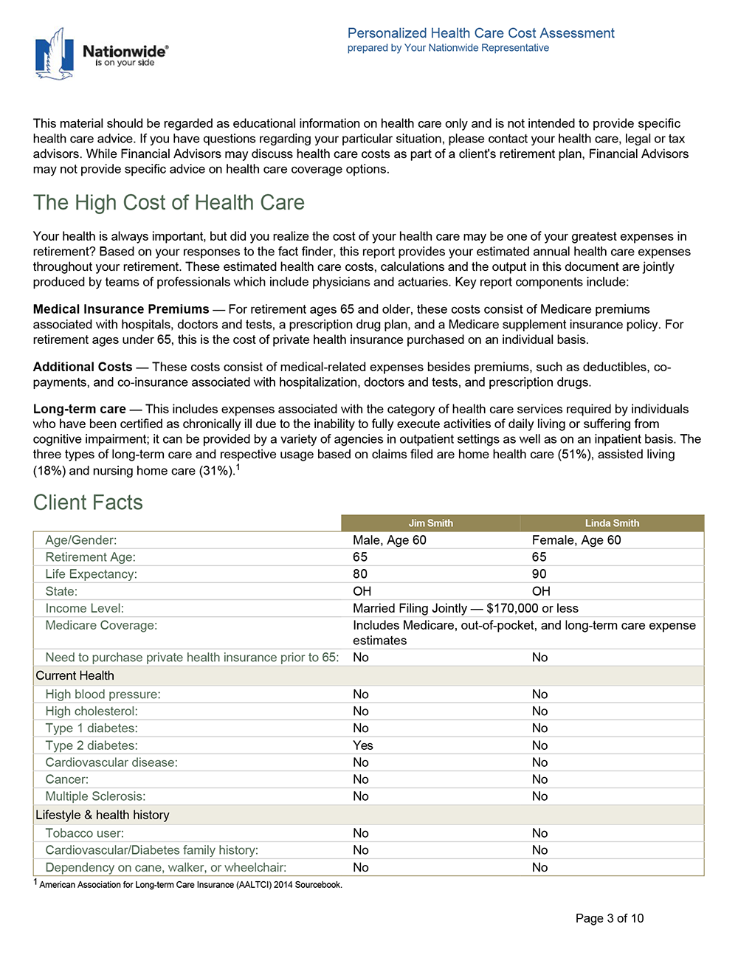
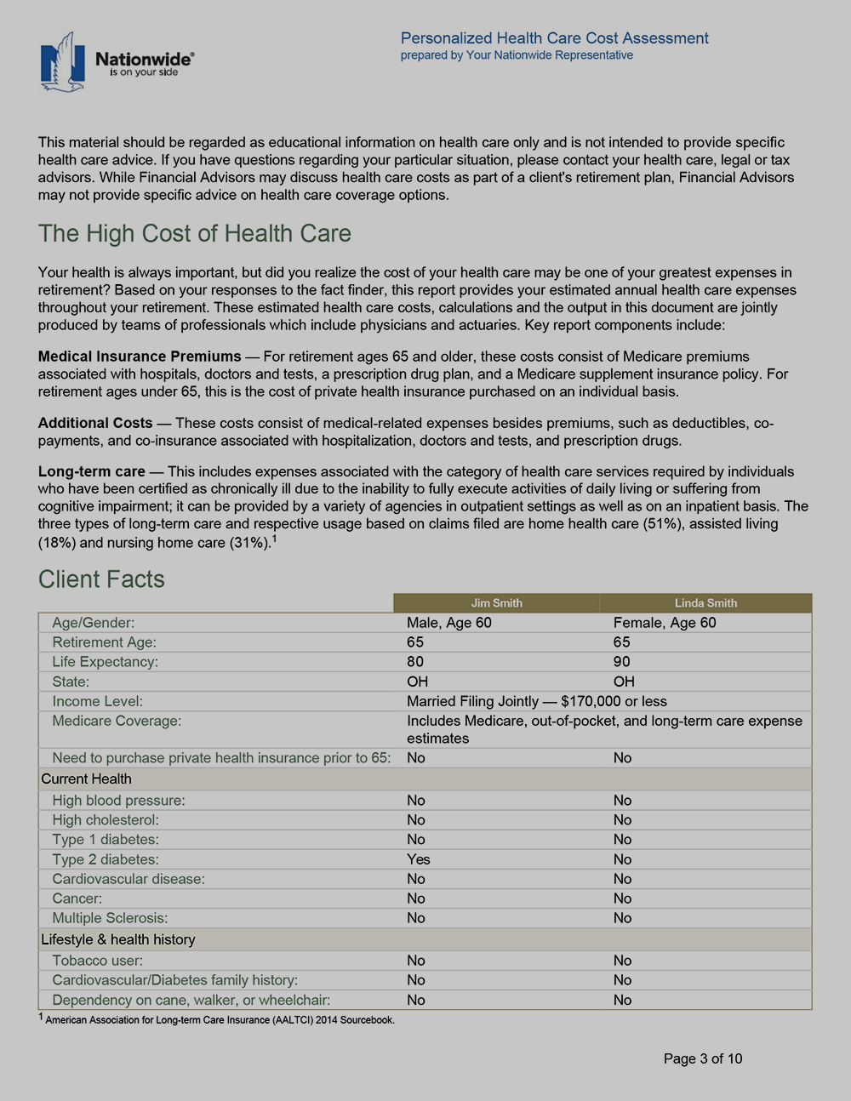
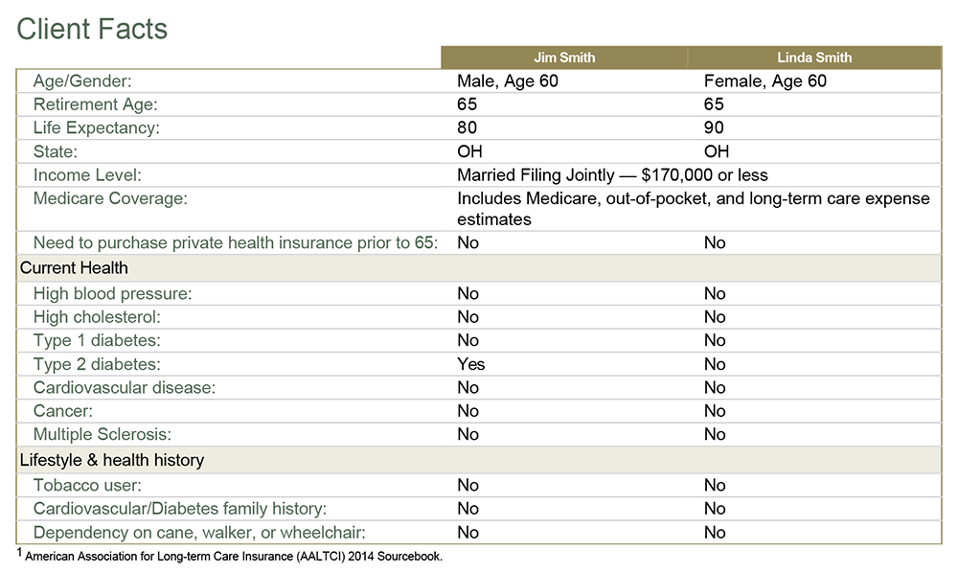
Health Care and LTC Cost Assessment
Health Care and LTC Cost Assessment

Slide 30
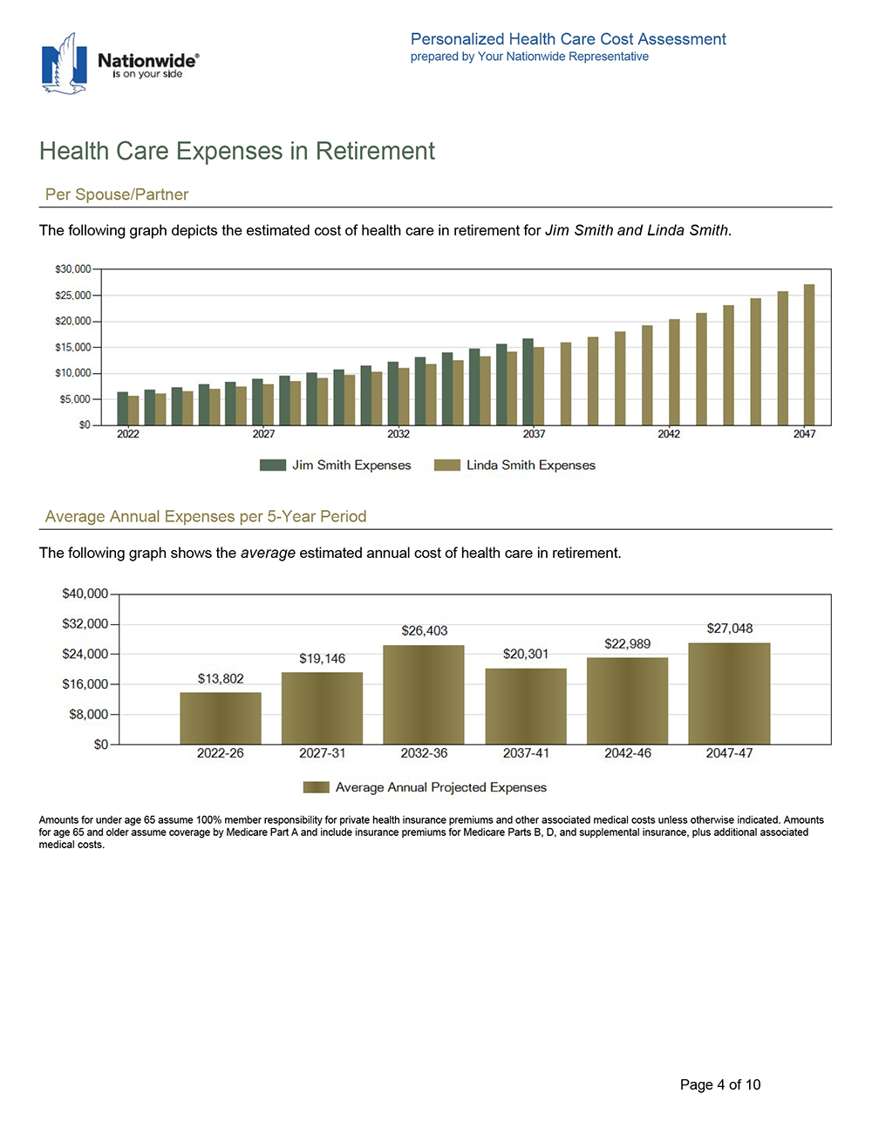
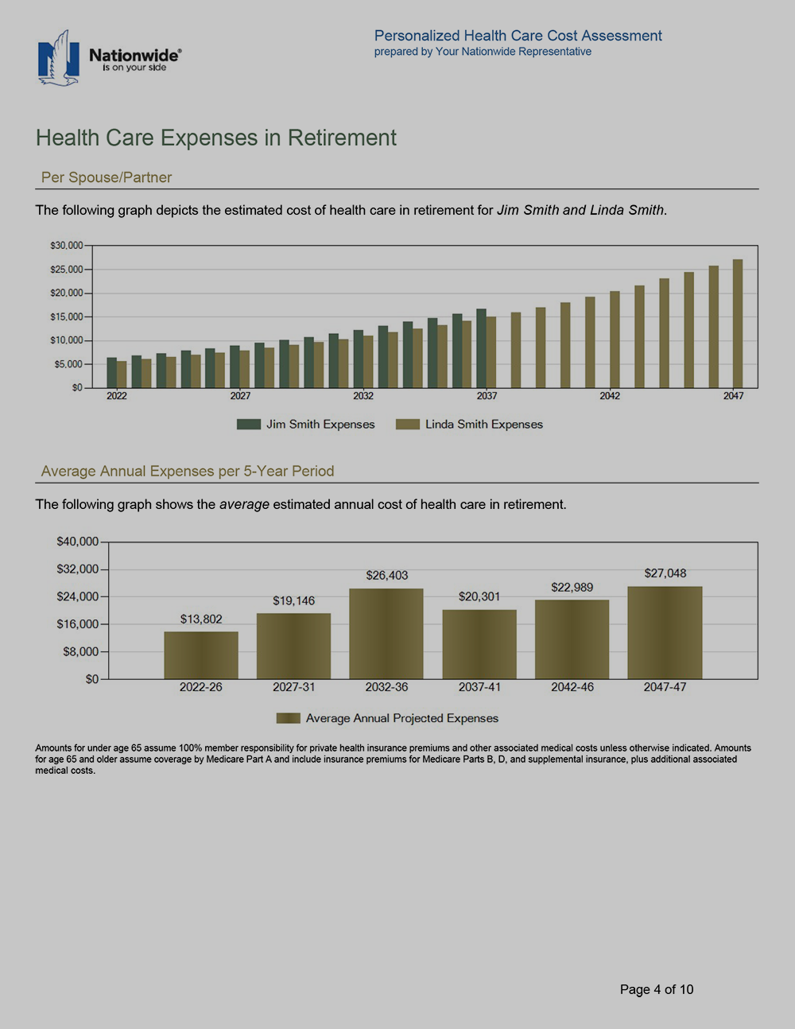
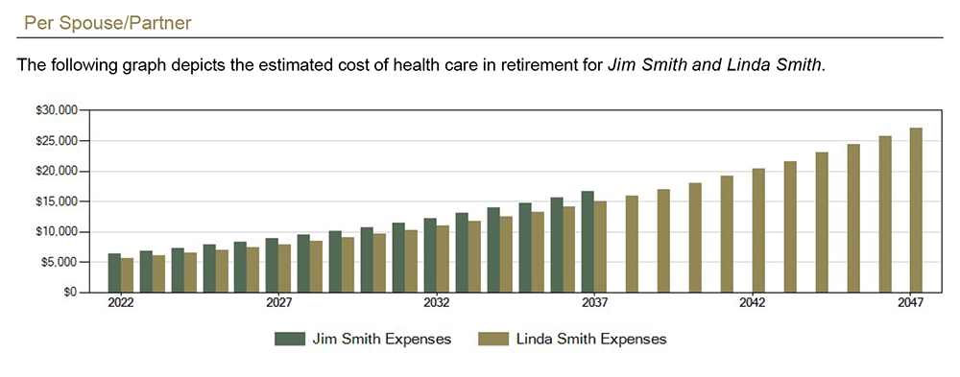
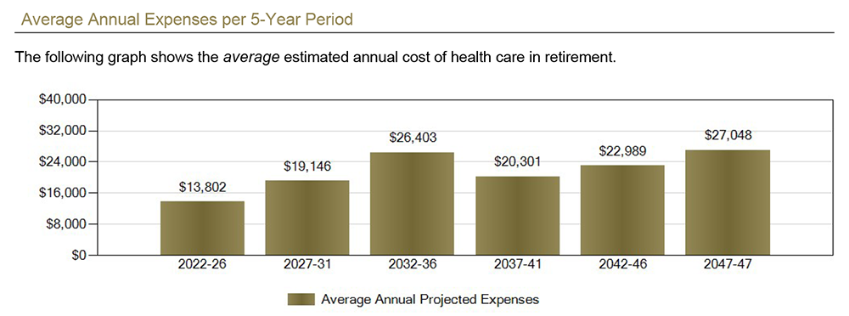
Health Care and LTC Cost Assessment

Slide 31
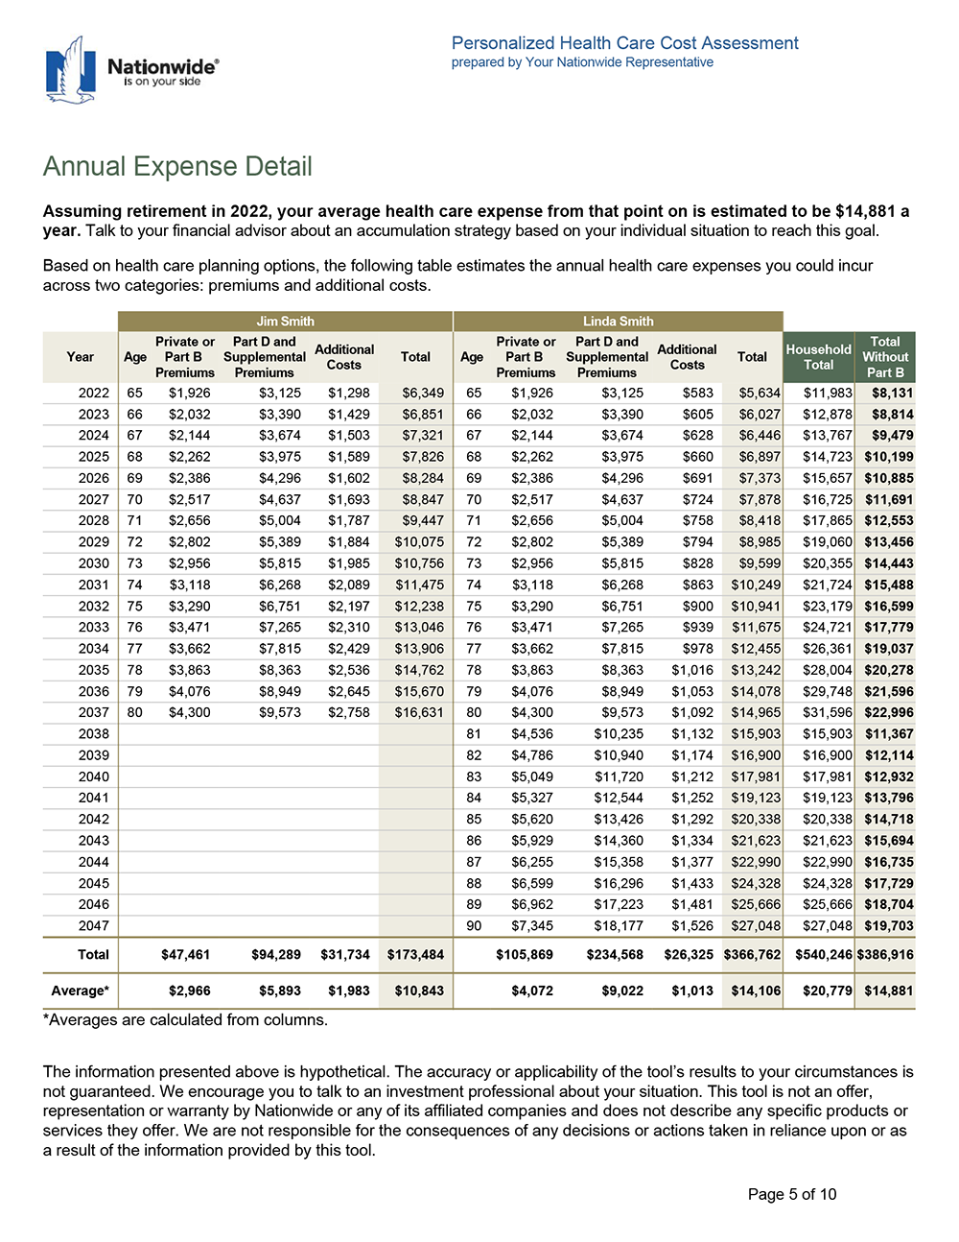
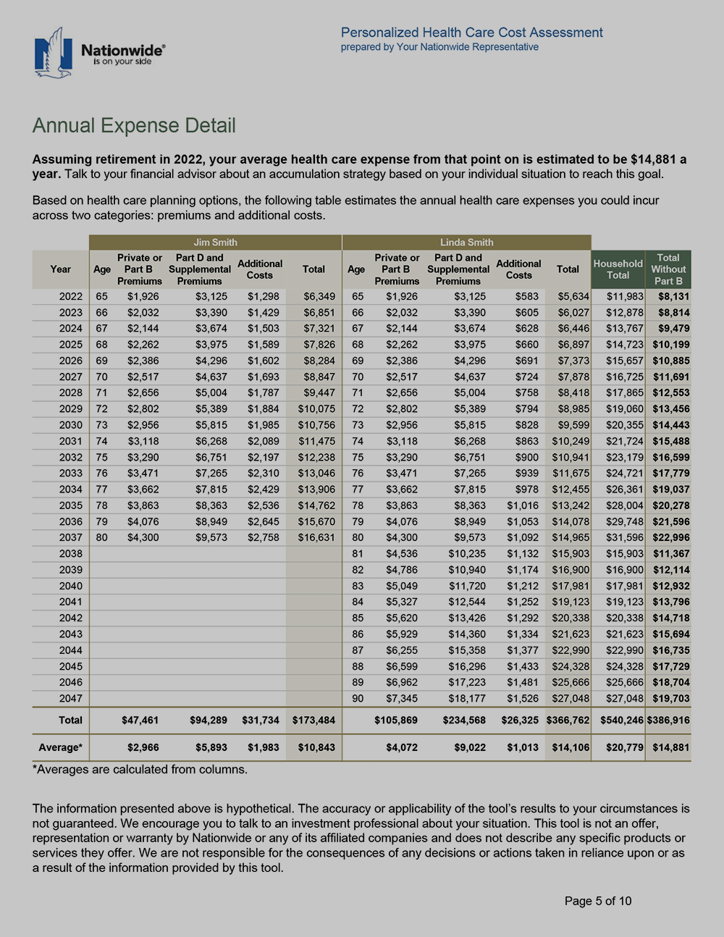
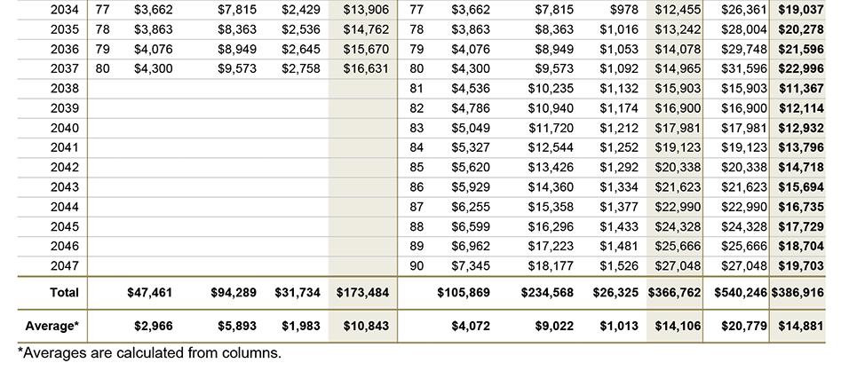
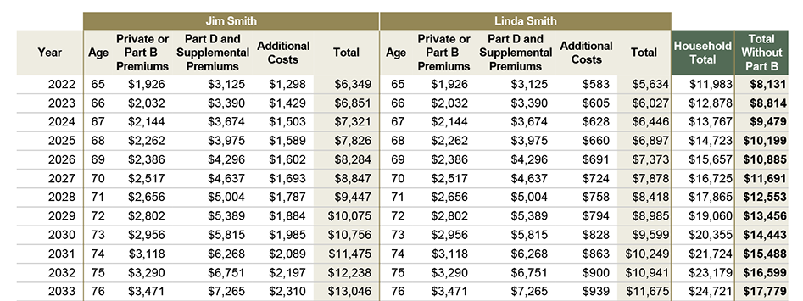
Health Care and LTC Cost Assessment

Slide 32
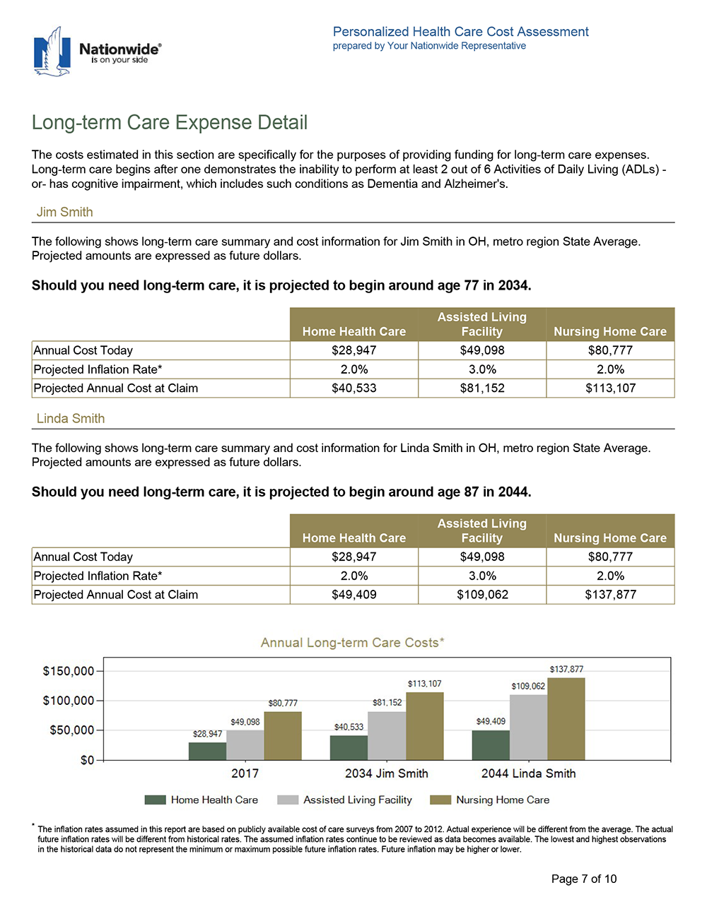
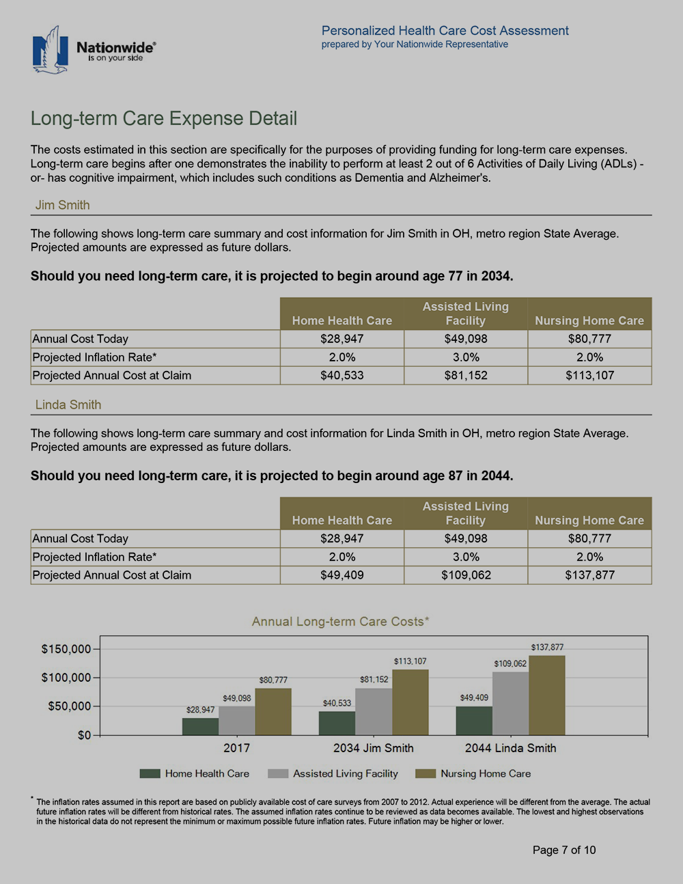
Health Care and LTC Cost Assessment

Slide 33
Summary
The retirement income challenge
Understanding the health care opportunity
Creating a plan to address health care costs
Notes:
Now that we have covered these topics in detail, let’s summarize our discussion:
- Leverage the growing anxiety and attention directed at health care today.
- Follow the three-step strategy for making the most of today’s health care opportunity.
- Differentiate yourself in the eyes of your clients.

Slide 34
Q&A and Contact
Sean Cavanaugh ’91, P’19
CERTIFIED FINANCIAL PLANNER™
Branch Manager
3111 Camino Del Rio North, Suite 920
San Diego, CA 92108
T 877.462.2011
F 619.462.2015
sean.cavanaugh@raymondjames.com
www.raymondjames.com/cavanaughgroup
Certified Financial Planner Board of Standards Inc. owns the certification marks CFP®, CERTIFIED FINANCIAL PLANNER™, and CFP® in the U.S.

