Slide 1

BOSTON COLLEGE WORLD-WIDE WEBINARS
Top 3 College Savings Strategies
January 19, 2017
Christopher Viggiano ’99

Slide 2

Investing in a
child’s future
Three ways to pursue your
education planning goals
Boston College Alumni Webinar
January 19th 2017
Presented by: Christopher Viggiano, CFA
Notes:
Welcome and thank you for attending today’s Boston College Alumni Webinar. I’m here to talk about some ways to fund your children’s or grandchildren’s education expenses.
Let me start by introducing myself, [again] my name is Chris Viggiano, Class of ’99, BS, Biochemistry . On the personal-side, I reside in NYC with my wife and two daughters, ages 9 & 4, so I’m hopeful to be a parent of the classes of ’30 & ’35. On the professional-side, I am a CFA charterholder with prior experience as a quantitative analyst and portfolio manager. I’m currently a financial advisor with Merrill Lynch Wealth Management, serving a diverse client-base across the country who all share a similar interest in increasing efficiencies across their entire financial situation, including current income generation, retirement planning and trust and estate guidance.
OK, let’s get started.

Slide 3
Neither Merrill Lynch nor any of its affiliates or financial advisors provide legal, tax or accounting advice. You should consult your legal and/or tax advisors before making any financial decisions.
Merrill Lynch Wealth Management makes available products and services offered by Merrill Lynch, Pierce, Fenner & Smith Incorporated, a registered broker-dealer and
Member SIPC, and other subsidiaries of Bank of America Corporation (“BofA Corp.”).
Banking products are provided by Bank of America, N.A., and affiliated banks, Members FDIC and wholly owned subsidiaries of BofA Corp.
Investment products:
Are Not FDIC Insured | Are Not Bank Guaranteed | May Lose Value
Merrill Lynch and the Bull Symbol are registered trademarks of Bank of America Corporation.
NextGen, NextGen College Investing Plan and The College Investing Plan for the Next Generation are registered trademarks of the Finance Authority of Maine.
© 2017 Bank of America Corporation. All rights reserved. Ι ARV89HQL Ι 306000PM-0416

Slide 4

What are your life priorities?
Notes:
Let’s start our discussion by taking a 30,000 foot perspective and ask you to consider, what are your life priorities? I’ve been asking my clients what they think about when it comes to what's really important to them.
The things that came up over and over again are here—your health, home, family, finances, work, leisure and giving.
Today we want to focus on your family.

Slide 5


Help fund my children’s or grandchildren’s education
Notes:
While the prospect of having enough money to pay for college may seem daunting, integrating education planning into your overall financial strategy makes sense. For both parents and grandparents who want to fund their children’s or grandchildren’s education, the key to developing an education funding strategy is to understand the options available. You will find a number of tax-advantaged education planning vehicles available that offer benefits beyond paying tuition and other school-related expenses.
For parents, you can help emphasize the value of education by helping fund your children’s college expenses. And making education planning part of your overall financial strategy can offer a number of tax benefits, including the removal of significant assets from your estate. Developing a strategy early could help defray expenses when your child is ready to attend college.
For grandparents, an education funding strategy can help instill the value of education in your grandchildren. It also can remove significant assets from your estate, and may reduce federal estate taxes, while allowing you to retain control of those assets.
Before making any decisions, however, please consult your tax advisor.

Slide 6
A college degree leads to higher income
Usual annual earnings of wage and salary workers, fourth quarter 2015
Source: Bureau of Labor Statistics, bls.gov; Table 5. Quartiles and selected deciles of usual weekly earnings of
full-time wage and salary workers by selected characteristics, 4th quarter 2015 averages, not seasonally adjusted. Weekly amounts multiplied by 52 to get annual totals shown on chart.
Notes:
Today, we need to think about college as an investment for a lifetime. Over a lifetime, the gap in earning potential between someone with a high school diploma and someone with a college degree could be staggering. While the cost of college may be imposing to many families, the cost of not going to college is likely to be much greater.

Slide 7
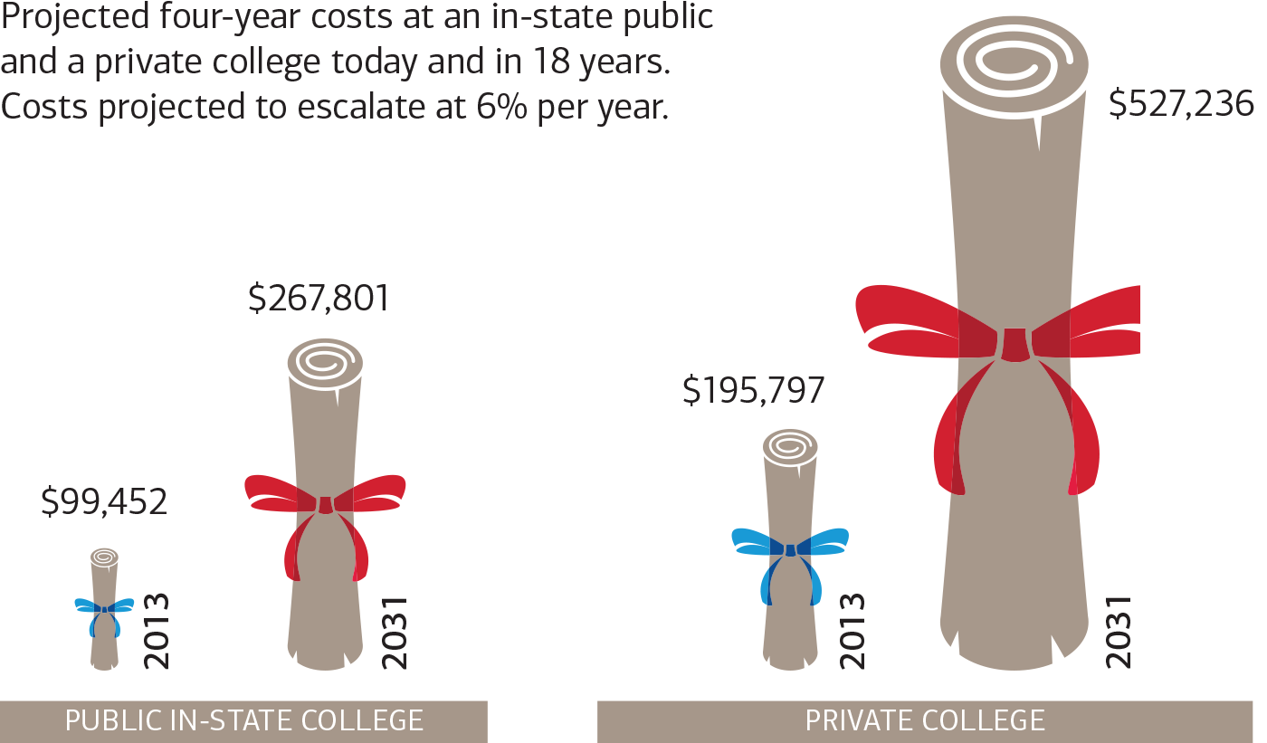
Which grows faster? Your children or college costs?
Four-year cost of college is going up
2016
2034
2016
2034
Source: www.collegeboard.org. College Cost Calculator as of March 2016.
Notes:
Here’s a question for you: Which grows faster? Your children or college costs?
Everyone knows that sending your children to a private high school, college or graduate school is expensive. But take a look at how quickly the cost of a college education is rising.
The four-year cost of attending college in 2016 was $99,452 for a four-year (in-state) public institution and $195,797 for a four-year private institution. By the time a child born in 2016 enters college in 18 years, or 2034, those numbers are projected to increase significantly—to $267,801 for a public college and $527,236 for a private college.

Slide 8
Today’s discussion
  Sources of financing
  Tax-advantaged education funding vehicles
  Each vehicle’s affect on financial aid calculations
  A potential estate planning strategy
  Resources
Notes:
Our discussion today will focus on education planning, including:
Your funding options – in other words, grants & scholarships, borrowing and using your savings
The benefits and considerations of different tax-advantaged education planning vehicles
How each vehicle affects financial aid calculations
A potential estate planning strategy utilizing Section 529 plans
Some recommended pieces of literature to continue your understanding of our discussion today
My goal is to encourage you to begin thinking strategically about planning for your children’s and grandchildren’s education. After our discussion, I would be happy to answer any questions you may have at a high-level, or continue the discussion on a more personalized and private setting.
OK, let’s get started.

Slide 9


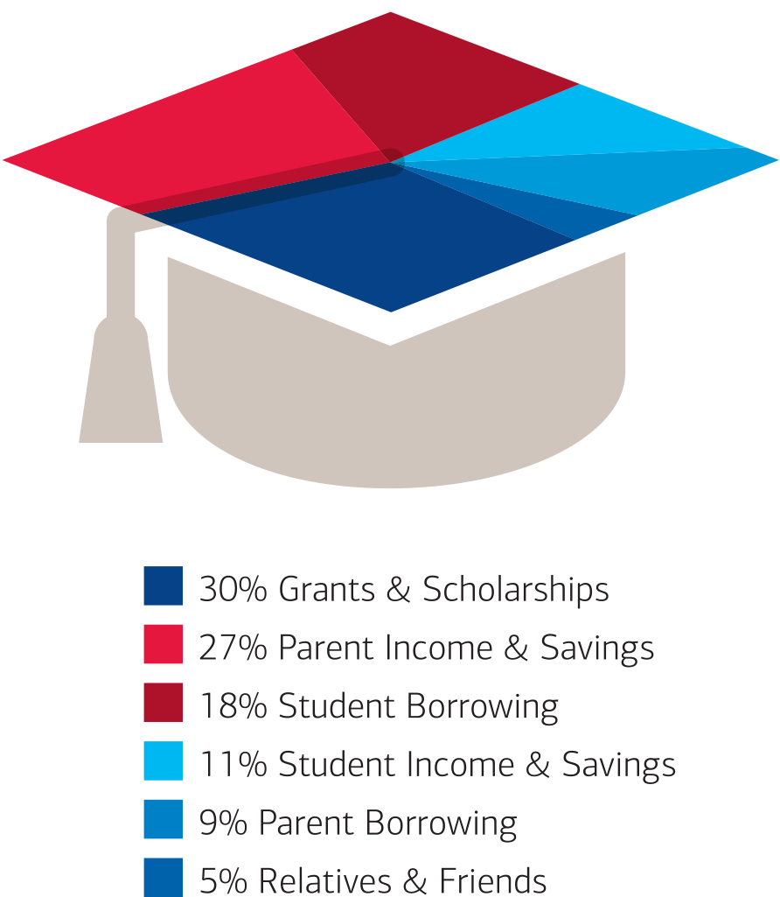
How the average family pays for college
Average percentage of total cost of attendance paid by source
32% Parent Income & Savings
30% Grants & Scholarships
16% Student Borrowing
11% Student Income & Savings
6% Parent Borrowing
5% Relatives & Friends
Source: Ipsos Public Affairs/Sallie Mae’s How America Pays for College 2015 study: How the Typical Family Pays for College, 2014-15.
Notes:
Sallie Mae's "How America Pays for College 2015" study conducted by Ipsos Public Affairs confirmed that students deeply value higher education, with 97% percent agreeing that college is an investment in the future.
The study also found that American families are making the investment in higher education the smart way—by pursuing grants and scholarships (30 percent) more frequently than borrowing (16 percent student borrowing, 6 percent parent borrowing). Based on a nationally representative survey of college-going students and parents of undergraduates, the study found that 32 percent of college expenses were funded by parent income and savings.

Slide 10

Grants and scholarships
Typically Do Not Require Repayment
Grants: often need-based
Scholarships: usually merit-based
May qualify even if the child doesn’t qualify for financial aid
Financial support based on academic achievement
or other criteria, including financial need
Criteria set by federal or state government, or the educational institution
Proceeds used to offset cost of education
Notes:
Grants and scholarships can be a large part of helping to offset the costs of education.
We all hope that our children and grandchildren will have a large part of their college expenses covered by various grants and scholarships. In 2013, these programs paid for 30% of the college costs for the average family, so they can represent a large portion of overall costs.
However, it’s difficult to plan for grants and scholarships, so it remains important to take control of our savings when funding education. We cannot assume that our children and grandchildren will receive these benefits, and we should remain involved in building an education fund for them, knowing the overall value of an education.

Slide 11



Borrowing and saving
  Loans
Tax-advantaged investment options
Notes:
Let's look at two of these funding options, borrowing money with a loan and using a tax-advantaged investment option.
We'll start by looking at loans. Parents and their children traditionally have used loans, in part or in full, to pay for college. But as you'll see on the next slide, this option has a few drawbacks.

Slide 12
Consider borrowing
  Loans
Benefits
Considerations
  Accessible
  Useful if children are older and you haven’t saved
  Potentially lower rates
  May be risky for your long-term financial goals
  Child starts post-college life with debt
  Parents may delay retirement to help pay back the loan
Notes:
Loans for college and graduate school are nothing new.
If your children are older and you haven’t saved for college yet, loans may be an option. Loans based on financial need offer some benefits, including generally relatively lower interest rates and a delayed repayment feature. Loans not based on financial need may not have the same benefits, but they are still an accessible option.
Despite the popularity of loans, many parents want to avoid them. Why? Because they saddle your children with significant debt, potentially delaying their ability to save for their own financial needs, such as a house, retirement or their own children’s education. Parents also may end up delaying retirement savings to help pay back the loan.

Slide 13



Consider tax-advantaged investment options
Section
529 plan
Coverdell Education
Savings Account
Uniform Gifts to Minors Act/Uniform Transfers to Minors Act Account
Please remember there's always the potential of losing money when you invest in securities.
Before you invest in a Section 529 plan, request the plan’s official statement from your financial advisor and read it carefully. The official statement contains more complete information, including investment objectives, charges, expenses and risks of investing in the plan, which you should carefully consider before investing. You should also consider whether your home state or your designated beneficiary’s home state offers any state tax or other benefits that are available only for investments in such state’s 529 plan. Section 529 plans are not guaranteed by any state or federal agency.
Notes:
Now let’s talk about tax-advantaged education savings options. The three options we’ll discuss today are Section 529 college savings plans, Coverdell Education Savings Accounts (ESAs) and UGMA/UTMA custodial accounts.

Slide 14
What do you want to fund?
Section
529 plan
Coverdell Education
Savings Account
Uniform Gifts to Minors Act/Uniform Transfers to Minors Act Account
  Tuition & fees, room & board, books, required supplies and equipment, computers or peripheral equipment, computer software or Internet access and related services, and certain services for special needs beneficiaries.¹
  Qualified elementary, secondary and/or higher education expenses²
  Any purpose to benefit the designated beneficiary
¹ The beneficiary must be attending an accredited institution at least half time for room and board to be considered an eligible expense.
² To be eligible for the favorable tax treatment afforded to the earnings portion of any withdrawal from Section 529 accounts, withdrawals must be used for “qualified higher education expenses,” as defined in the Internal Revenue Code. For withdrawals from Coverdell ESAs, expenses must be “qualified higher education expenses” or “qualified elementary and secondary education expenses,” as defined in the Internal Revenue Code.
Notes:
While each of these accounts offers certain tax advantages, there are significant differences, including what the accounts can be used to fund.
A Section 529 plan can fund tuition and fees, room and board, books, required supplies and equipment, computers or peripheral equipment, computer software or Internet access and related services, as well as certain services for special needs beneficiaries.
A Coverdell Education Savings Account (ESA) can fund qualified elementary, secondary and/or higher education expenses.
And a Uniform Gifts to Minors Act/Uniform Transfers to Minors Act Account (UGMA/UTMA) can be used for any purpose to benefit the designated beneficiary.
Depending on your situation, you may want to create a strategy that combines these vehicles. For example, a Coverdell ESA and a Section 529 plan can work together to help fund private high school and college expenses. Let’s take a look at how each of these tax-advantaged plans works.

Slide 15
A tax-advantaged investment option
A Section 529 plan provides a tax-advantaged way to invest for future qualified higher education expenses.¹
  Potential benefits
  Withdrawals, including any earnings generated, are federal (and possibly state) income tax-free¹
Account owner retains control and can change beneficiary at any time²
  Assets are not part of account owner’s taxable estate³
  Five-year front-loading of contributions (up to $140,000 per couple or $70,000 per individual)
  No age or income limitations on contributions or withdrawals
¹ To be eligible for the favorable tax treatment afforded to the earnings portion of withdrawals from Section 529 accounts, withdrawals must be for “qualified higher education expenses,” as defined in the Internal Revenue Code.
² You are generally permitted to change the beneficiary to another qualified member of the family, as defined under the Internal Revenue Code, without triggering income tax and 10% additional federal tax. However, a change of beneficiary will potentially be subject to federal gift tax if the new beneficiary is in a younger generation than the generation of the beneficiary being replaced or is not a member of the family of the prior beneficiary. In addition, if the new beneficiary is in a generation two or more generations younger than the generation of the prior beneficiary, the transfer may be subject to the generation-skipping transfer tax.
³ Contributions are generally considered completed gifts for federal gift tax purposes and, therefore, are potentially subject to federal gift tax.
Notes:
A lot has been said about Section 529 college savings plans in the last few years. They’re becoming a widely used education funding plan by parents and grandparents because of their tax advantages and flexibility and because they allow the account owner to retain ownership of the assets until they are withdrawn.
A Section 529 plan gives you the flexibility to use the assets at accredited post-secondary schools nationwide, including graduate schools and accredited trade schools. Institutions must be eligible to participate in federal student financial aid programs. Some foreign institutions are also eligible.
When you contribute to a Section 529 plan, withdrawals, including any earnings generated, will be federal (and possibly state) income tax free, as long as the funds are used for qualified higher education expenses at post-secondary and graduate institutions. To be eligible for the favorable tax treatment afforded to the earnings portion of any withdrawals from Section 529 accounts, withdrawals must be for “qualified higher education expenses,” as defined in the Internal Revenue Code.
The account owner retains control and can change the beneficiary to another qualified member of the family, as defined under the Internal Revenue Code, at any time and as often as you want without adverse income tax consequences.
Section 529 plan’s assets generally are not part of the account owner’s taxable estate.
Additionally, you can contribute five years worth of gifts in the first year. This would enable parents and grandparents to make a special federal gift-tax election of up to $140,000 per couple or $70,000 per individual for each beneficiary in one year. However, this front-loading provision prevents additional tax-free gifts to the recipients during the five-year period, without using the donor’s lifetime unified credit. If you were to die before the end of the five-year period, a prorated portion of the contribution may be included in your taxable estate for estate planning purposes. This will be discussed in more detail later in the presentation.
And there are no age or income limitations on contributions or withdrawals.

Slide 16
A tax-advantaged investment option
A Section 529 plan provides a tax-advantaged way to invest for future qualified higher education expenses.
  Considerations
  Earnings withdrawn and not used for qualified higher education expenses are subject to taxes
  Investment options
  vary by plan
  Can only be
  funded with cash
  Certain state tax benefits may only be available for contributions made to your particular home state Section 529 plan
Notes:
Section 529 plans have certain limitations, though in many cases their benefits outweigh those limitations.
If you decide to use any withdrawals for a nonqualified expense—in other words, if you use it for anything other than qualified higher education expenses—the earnings portion of the withdrawal is subject to federal income tax and possibly a 10% additional federal tax, as well as state and local income taxes. However, this additional tax may not apply if the student receives a scholarship, dies or becomes disabled.
Additionally, available investment options are determined by the (terms of the) Section 529 plan. Also, these plans can be funded only with cash (including a check) but not securities or third-party assets.
Section 529 plans are offered by individual states. As a result, the features and benefits of each state’s program differ significantly, so you should compare program features before you decide where to invest. For example, certain state tax benefits may only be available for contributions made to your particular home state Section 529 plan. Several states offer a state income tax deduction or other benefits for residents who contribute to the Section 529 plan in the state they reside or pay taxes. You should review the potential benefits and consequences, if any, of your home state’s Section 529 plan before you decide to invest in it.

Slide 17
A tax-advantaged investment option
A Coverdell Education Savings Account (ESA) is a
tax-advantaged trust or custodial account that can help fund qualified elementary, secondary and/or higher education expenses.¹
  Potential benefits
  Withdrawals, including any earnings generated, are federal
  (and possibly state)
  income-tax-free¹
Account owner retains
control and can change
beneficiary at any time²
  There are no restrictions other than those imposed by the institution where the account
  is held
¹ To be eligible for the favorable tax treatment afforded to the earnings portion of any withdrawal, withdrawals from Coverdell ESAs, must be used for “qualified higher education expenses” or “qualified elementary and secondary education expenses,” as defined in the Internal Revenue Code.
² You generally are permitted to change the beneficiary to another member of the family (as defined in the Internal Revenue Code) without triggering income tax and a 10% additional federal tax, provided the new beneficiary is under age 30 or is a special needs beneficiary.
Notes:
A Coverdell Education Savings Account (ESA) is a tax-advantaged trust or custodial account that can help families save and invest for qualified education expenses from kindergarten through graduate school.
Contributions are made with after-tax dollars, and withdrawals, including any earnings, will not be subject to federal (and possibly state) income tax if they are used to pay for qualified higher education expenses. Funds can be use for tuition & fees, room & board, books, required supplies and equipment, computers or peripheral equipment, computer software or Internet access and related services, and certain services for special needs beneficiaries.
Qualified elementary and secondary expenses include academic tutoring, uniforms, transportation, supplementary items (including extended-day programs), computer technology equipment, and special needs services for special needs beneficiaries.
Like a Section 529 plan, an ESA account owner retains control and can change the beneficiary at any time.
There are no restrictions on investment options other than those imposed by the institution where the account is held.

Slide 18
A tax-advantaged investment option
A Coverdell Education Savings Account (ESA) is a
tax-advantaged trust or custodial account that can help fund qualified elementary, secondary and/or higher education expenses.
  Considerations
  Earnings withdrawn and not used for qualified elementary or secondary education expenses are subject to taxes
  Contributions limited to
  $2,000 per year
  per beneficiary
  Ability to
  contribute subject to income limitations¹
  Can fund
  account only until beneficiary’s 18th birthday, except in the case of a special needs beneficiary
  Withdrawals generally are required to be made by age 30, except in the case of a special needs beneficiary
¹ The eligibility limit for contributions depends on the individual’s tax return filing status and modified adjusted gross income (“MAGI”). There is an income limit phase out for single taxpayers with MAGI between $95,000 and $110,000 and for joint taxpayers with MAGI between $190,000 and $220,000. If your MAGI is $110,000 (single) or $220,000 (joint) or more, you cannot contribute to an ESA.
Notes:
However there are some things to consider.
If you decide to use withdrawals for a nonqualified expense—in other words, if you use it for anything other than qualified education expenses—the earnings portion of that withdrawal is subject to income tax and possibly a 10% additional federal tax.
There are contribution limits—$2,000 per year per beneficiary. Total contributions for the same beneficiary cannot exceed the $2,000 limit.
If you wish to contribute the maximum permitted, the annual modified adjusted gross income limit is $190,000 for a joint taxpayer and $95,000 for a single taxpayer. The ability to contribute phases out up to an annual income of $220,000 and $110,000 for a joint and single taxpayer, respectively.
You can only fund the account until the beneficiary’s 18th birthday, except in the case of a special needs beneficiary.
And, withdrawals generally are required to be made within 30 days of reaching 30, except in the case of a special needs beneficiary.
While the $2,000 annual contribution limit may not cover tuition at a private college, the ability to use these assets for qualified elementary and secondary (kindergarten through high school) makes Coverdell ESAs appealing to certain parents. Used in conjunction with a Section 529 plan, Coverdell ESAs can be a tax-smart way to invest for a wide range of education expenses.

Slide 19
A tax-advantaged investment option
A Uniform Gifts to Minors Act (UGMA) ¹ or Uniform Transfers to Minors Act (UTMA)¹ account lets donors set aside money for children until they have reached a set age of maturity²
  Potential benefits
  Fund with
  cash or securities
  First $1,050 of
  earnings each year is
  federal (and possibly state) income tax-free
  No restrictions on
  investment options other
  than those imposed by the relevant state UGMA/UTMA laws
¹ UGMA/UTMAs were developed to help create uniform laws governing the gifting or transfer of assets to children. While the rules governing the accounts are similar from state to state, there are differences, such as the age a minor can assume control of the account. Be sure to understand the rules in your state before setting up an account.
² Upon reaching age of maturity under the state UGMA/UTMA law—usually 18 , 19 or 21, depending on the state—the child (minor) gains control of assets and may use them as he or she sees fit.
Notes:
The UGMA/UTMA acts (Uniform Gifts to Minors Act and Uniform Transfer to Minors Act) were developed to help create uniform laws governing the gifting or transfer of assets to children. While the rules governing the accounts are similar from state to state, there are differences, such as the age a minor can assume control of the account. Be sure to understand the rules in your state before setting up an account.
One of the major benefits of these accounts is that you can fund them with either cash or securities. So if you have highly appreciated stock, you can use it to fund an UGMA/UTMA account.
Also, the first $1,050 of earnings each year is federally and possibly state income tax free.
Additionally, UGMA/UTMA accounts do not have contribution limits, although contributions qualify for the annual federal gift tax exclusion. So annual gifts to a child should not exceed $14,000 per person or $28,000 per couple to avoid a federal gift tax. Remember, these are annual amounts. You could make larger gifts that would use up part of your lifetime exclusion.

Slide 20
A tax-advantaged investment option
A Uniform Gifts to Minors Act (UGMA) ¹ or Uniform Transfers to Minors Act (UTMA)¹ account lets donors set aside money for children until they have reached a set age of maturity²
  Considerations
  Limited tax advantages
  on annual earnings
  above $1,050³
  Beneficiary gains control of the assets at
  age of majority
  Cannot change the beneficiary
  May be considered part of the custodian's federal estate for federal estate tax purposes
¹ UGMA/UTMAs were developed to help create uniform laws governing the gifting or transfer of assets to children. While the rules governing the accounts are similar from state to state, there are differences, such as the age a minor can assume control of the account. Be sure to understand the rules in your state before setting up an account.
² Upon reaching age of maturity under the state UGMA/UTMA law—usually 18 , 19 or 21, depending on the state—the child (minor) gains control of assets and may use them as he or she sees fit.
³ Annual unearned income between $1,050 and $2,100 is generally taxed at the child's tax rate, and unearned income over $2,100 generally is taxed at the parent's tax rate if the child is under age 18, or the child is age 18 and does not have earned income that is more than half of his or her financial support, or is a full time student that is at least age 19 and under 24 who does not have earned income that is more than half of his or her financial support if at least one parent is living at the end of the tax year and the child is not filing a joint return for the tax year.
Notes:
UGMA/UTMA accounts have certain limitations, as you see on this slide. Before opening one, you should carefully consider your child’s needs, maturity and attitude toward education. Why is this a concern?
While these accounts offer tax advantages, they are limited. Annual earnings above $1,050 generally are taxed at the child’s tax rate. Income above $2,100 generally is taxed at the parents’ presumably higher tax rate.
Once your child reaches the statutory vesting age, the custodian loses control of the assets entirely as they must be transferred to the child. The child then can use them for any purpose, not necessarily for college expenses.
When you set up an UGMA/UTMA custodial account, the assets are considered an irrevocable gift to the child. You cannot change the beneficiary, so those assets essentially belong to your child.
Additionally, if you are both the donor and the custodian of the account and you die before the child reaches the statutory vesting age, these assets are still includable in your estate for federal estate tax purposes.

Slide 21


How to evaluate Section 529 college savings plans
  How does this plan compare with
  other plans?
  Does my home state plan offer state
  tax advantages?
  If I contribute to my current home state plan, are there any consequences if I move to another state or withdraw assets for a nonqualified purpose?
  What is the range of investment
  options that are available?
  Who are the program and
  investment managers?
  What are the fees and investment performance for the program?
Notes:
Let’s go back to Section 529 plans and take a closer look at that option.
Section 529 plans are offered by individual states. As a result, the features and benefits of each state’s program can differ significantly, so you should compare program features before you decide where to invest. This slide suggests some questions you should ask when comparing 529 plans from different states.
[REVIEW SLIDE]
Several states offer a state income tax deduction or other benefits to individuals who contribute to the Section 529 plan administered by the state in which they reside or pay taxes. In addition, there may be other consequences if you subsequently move out of state and are no longer eligible for deductions or if you take nonqualified withdrawals from your Section 529 plan account. You should review the features and benefits of your state’s Section 529 plan before you decide to contribute to a plan.

Slide 22
Impact on federal financial aid
Section
529 plan
Coverdell Education
Savings Account
Uniform Gifts to Minors Act/Uniform Transfers to Minors Act Account
Generally treated as an asset of the parent, which
is weighted at 5.6% toward the expected family
contribution (EFC) formula. Qualified withdrawals are
not considered to be income to the parents or student in the EFC formula
Generally treated as an asset of the parent, which
is weighted at 5.6% toward the EFC formula. Qualified withdrawals are not considered to be income to the parents or student in the EFC formula
Treated as an asset of the beneficiary, which is weighted at 20% toward the expected family contribution formula
Notes:
When we look at the financial aid implications on the three different vehicles, both the Section 529 and Coverdell Education Savings Account count 5.6% to the Expected Family Contribution for federal aid calculations, whereas, the UGMA/UTMA accounts count 20% towards the EFC calculation. Noteworthy, other family members’ (grandparents, for example) ownership of Section 529 accounts do not count towards the EFC, however, when the beneficiary student receives the funds, it will count towards income calculations in the EFC, so careful consideration should be given to the sequence of access to funds.

Slide 23
Special gifting rules for Section 529 plans – a potential estate planning strategy
Gifting rule for Section 529 plans (front-loading)
  Individuals can contribute up to $70,000 per designated beneficiary ($140,000 per married couple) in a single year and elect to prorate it over five years.
  Contributions are considered completed gifts¹ to the designated beneficiary and are removed from the donor’s taxable estate for federal estate tax purposes.
  If the donor dies within the five-year period, a prorated portion of the gift is included in
  the donor’s taxable estate.²
      Earnings are not included in the taxable estate for federal estate tax purposes.
 |  | Year 1 | Year 2 | Year 3 | Year 4 | Year 5
Individual | › | $14,000 | $14,000 | $14,000 | $14,000 | $14,000 | = | $70,000 removed from donor’s estate in five years
Couple | › | $28,000 | $28,000 | $28,000 | $28,000 | $28,000 | = | $140,000 removed from donors’ estate in five years
¹ Since such contributions are considered completed gifts for federal gift tax purposes, they may be subject to federal gift tax.
² If the donor dies before the five-year prorating period has expired, the contribution allocated to the remaining years in the five-year period moves back into his/her taxable estate. For example, if a grandfather contributes $70,000 to a Section 529 account for his granddaughter, makes the election and dies four years later, then $14,000 (only the fifth-year gift) would be included in his gross estate for federal estate tax purposes. Also, any and all appreciation on the entire original gift (i.e., $70,000) is not considered part of his taxable estate.
Notes:
With a Section 529 plan, you can invest for the education of designated beneficiaries (your children or grandchildren) and at the same time remove assets from your taxable estate for federal estate tax purposes.
This rule allows eligible individuals to contribute up to $70,000 and eligible married couples filing jointly to contribute up to $140,000 per beneficiary in a single year without incurring a federal gift tax or having the gift applied to your lifetime exemption, assuming no other gifts are made to the same beneficiary in the subsequent five-year period. You can average the gift over the next five years on your federal gift tax return, however if you were to die before the end of the five-year period, a prorated portion of the contribution may be included in your taxable estate for federal estate tax purposes. Remember, generally there are no federal gift tax implications for a qualifying change of beneficiary of the same generation.
In this example, an individual contributed $14,000 a year for five years and a married couple filing jointly contributed $28,000 a year for five years to a Section 529 account. At the beginning of the fifth year, the individual effectively had removed $70,000 from his taxable estate while the couple had removed $140,000 from their taxable estate.

Slide 24
Maximize the five-year gifting strategy
Scenario: Fully fund five Section 529 plan accounts
Grandparents with multiple grandchildren and an estate planning need
Grandparents
Child 1
Child 2
Child 3
Grandchild 1
$140,000
Grandchild 2
$140,000
Grandchild 3
$140,000
Grandchild 4
$140,000
Grandchild 5
$140,000
Total Investment = $700,000
If the contributor dies within the five-year period, a prorated portion of the gift is included in the donor’s estate for federal estate tax purposes.
Notes:
If you are a grandparent saving for a grandchild’s education, Section 529 plans can be an excellent way to pass the value of education to your loved ones while removing assets from your estate for estate-tax purposes.
In this example, grandparents established Section 529 accounts for each of their five grandchildren and fully funded each account for a total investment of $700,000.
Another strategy you may want to consider is to use assets held in a trust to fund a Section 529 plan account. This allows you the opportunity of tax-free growth while the trust retains control. You also have the ability to allocate assets to specific beneficiaries and reduce or eliminate annual tax-filing costs associated with the trust. Because you have the option of choosing different types of trusts—irrevocable and revocable—you should discuss your situation with your estate attorney and your tax advisor to help you determine which type may be right for you.

Slide 25

Goals-based approach
Analyze your life & priorities
Set your financial strategy
Stay on track
Notes:
So, I’ve provided you with a lot of information on education funding and I’m sure you are wondering “how do I take all of this and apply it to my situation?”
You may consider the strategic and guided approach above to investing for college, but be advised to pursue such goals within the context of retirement planning, life and legacy goals. Asset placement based on your tax situation is also key.
Above all, develop an implementation strategy that you feel comfortable with, and continue to review progress toward your education funding goals and revise your strategy as needed to help keep you on track.

Slide 26
Resources
  Savings information on the web:
  https://www.sec.gov/investor/pubs/intro529.htm
  http://www.finra.org/investors/saving-college
  https://www.irs.gov/pub/irs-pdf/p970.pdf
  Books:
  The Best Way to Save for College: A Complete Guide to 529 Plans 2015-2016 11th Edition
  The College Savings Factor: Cutting Through the Confusion of College Savings
  Financial aid:
  https://fafsa.ed.gov/
  https://studentaid.ed.gov/sa/
  https://studentloans.gov/myDirectLoan/index.action
  http://www.bc.edu/offices/stserv/financial/finaid.html
*Additionally, a college savings vehicle comparison factsheet will be made available after the webinar

Slide 27

Q & A
Christopher Viggiano, CFA
Financial Advisor
Merrill Lynch
212-236-5690 christopher.viggiano@ml.com
Notes:
I hope today’s presentation gave you some insights into the need to think strategically when you plan for your children’s and/or grandchildren’s education. I would be happy to answer any questions at this point or speak individually about your education funding options at a later time.
Thank you for taking time out of your busy schedules to join me today.

