Slide 1
Using Emotional Intelligence to Improve My Effectiveness
BOSTON COLLEGE WORLD-WIDE WEBINARS
Bob O’Neil
Leadership and Career Management Coach

Slide 2
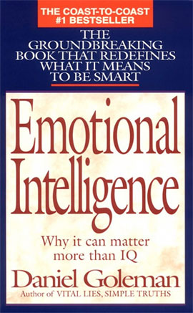
Background
Peter Salovey and John Mayer coined the term 'Emotional Intelligence' in 1990
Popularized by Daniel Goleman in his book, “Emotional Intelligence”
Do traditional tests of intelligence tell us about what it takes to be successful in life?
Conclusion: Emotional Intelligence more important I.Q.

Slide 3
Agenda for today

Slide 4
Agenda for today
High level overview of the basic principles of Emotional Intelligence

Slide 5
Agenda for today
High level overview of the basic principles of Emotional Intelligence
Deeper dive into some of the critical elements of Emotional Intelligence

Slide 6
Agenda for today
High level overview of the basic principles of Emotional Intelligence
Deeper dive into some of the critical elements of Emotional Intelligence
Explore ways to utilize the concepts of Emotional Intelligence to become more effective

Slide 7
Agenda for today
High level overview of the basic principles of Emotional Intelligence
Deeper dive into some of the critical elements of Emotional Intelligence
Explore ways to utilize the concepts of Emotional Intelligence to become more effective
Apply what we discuss (take notes on strengths, weaknesses, what actions might you take?)

Slide 8
What is Emotional Intelligence?

Slide 9
What is Emotional Intelligence?
The capacity for recognizing our own feelings and those of others, for motivating ourselves, and for managing our emotions well in ourselves and our relationships

Slide 10
Emotional Intelligence
Self-Awareness
Self-Regulation
Motivation
Empathy
Social
Skills

Slide 11
Emotional Intelligence Self Management
Self-Awareness
Self-Regulation
Motivation
Empathy
Social
Skills

Slide 12
Emotional Intelligence Relationship Management
Self-Awareness
Self-Regulation
Motivation
Empathy
Social
Skills

Slide 13
Emotional Intelligence Self Management
Self Awareness
Self Regulation
Motivation

Slide 14
Emotional Intelligence Self Management
Self Awareness
Understand your strengths and weaknesses
Recognize and understand your moods
Self Regulation
Motivation

Slide 15
Emotional Intelligence Self Management
Self Awareness
Understand your strengths and weaknesses
Recognize and understand your moods
Self Regulation
Ability to control feelings, moods, actions
Ability to suspend judgment, think before acting.
Motivation

Slide 16
Emotional Intelligence Self Management
Self Awareness
Understand your strengths and weaknesses
Recognize and understand your moods
Self Regulation
Ability to control feelings, moods, actions
Ability to suspend judgment, think before acting
Motivation
Passion for work that goes beyond money
Desire to achieve for the sake of the achievement

Slide 17
Emotional Intelligence Relationship Management
Empathy
Social Skills

Slide 18
Emotional Intelligence Relationship Management
Empathy
Skill at sensing the emotions of others
Take a genuine interest in the concerns of others
Social Skills

Slide 19
Emotional Intelligence Relationship Management
Empathy
Skill at sensing the emotions of others
Take a genuine interest in the concerns of others
Social Skills
Proficiency in managing relationships
Ability to find common ground; build rapport

Slide 20
Emotional Intelligence
Self-Awareness
Self-Regulation
Motivation
Empathy
Social
Skills

Slide 21
Concepts to be discussed.
“Strength gone too far”
“Derailers”
“Blind spots”
“Self-talk”

Slide 22
Self-Awareness
Definition
Recognize and understand moods, emotions and drives, as well as their effect on others

Slide 23
Self-Awareness
Definition
Recognize and understand moods, emotions and drives, as well as their effect on others
Hallmark
Project self-confidence
Realistic self-assessment
Constantly seek feedback
Honest and candid

Slide 24
Self-Regulation
Definition
Ability to control disruptive impulses and moods – suspend judgment and think before acting.

Slide 25
Self-Regulation
Definition
Ability to control disruptive impulses and moods – suspend judgment and think before acting.
Hallmark
Integrity
Trustworthy and fair
Comfort with ambiguity
Open to and seek change

Slide 26
Motivation
Definition
A passion to work for reasons that go beyond money; high energy and persistence

Slide 27
Motivation
Definition
A passion to work for reasons that go beyond money; high energy and persistence
Hallmark
Strong drive to achieve
Restless with status quo
High expectations
Track results and keep score

Slide 28
Empathy
Definition
The ability to understand the emotional make-up of a person and treat them accordingly

Slide 29
Empathy
Definition
The ability to understand the emotional make-up of a person and treat them accordingly
Hallmark
Expertise in team building
Ability to retain talent
Cultural sensitivity
Service to customers
Coaching and mentoring

Slide 30
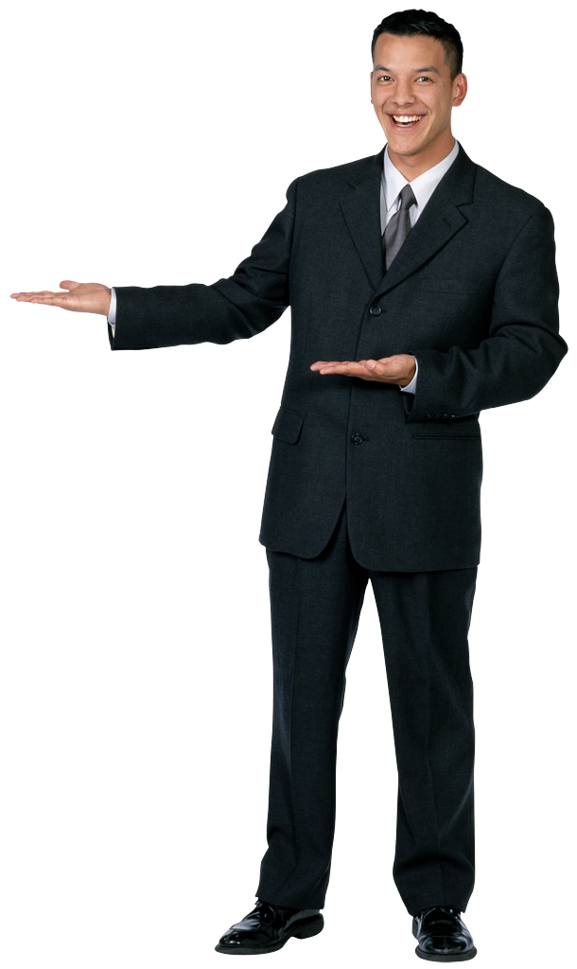
Social Skills
Definition
Proficiency in managing relationships and building networks; ability to find common ground and build rapport

Slide 31
Social Skills
Definition
Proficiency in managing relationships and building networks; ability to find common ground and build rapport
Hallmark
Effective in leading change
Persuasive
Building and leading teams
Build bonds broadly

Slide 32
Review and Summary
Better understanding of the basic principles of Emotional Intelligence
Have a deeper appreciation of your Emotional Intelligence strengths and how to apply them
Have a clearer idea about how to better manage your Emotional Intelligence weaknesses
Understand the challenges of your “strengths gone too far,” “derailers” and “blind spots.”

Slide 33
For more information on Emotional Intelligence
Classic books to read by Daniel Goleman:
Emotional Intelligence: Why It Can Matter More Than IQ
Working with Emotional Intelligence
Harvard Business Review Articles to read:
What Makes a Leader? By Daniel Goleman
Primal Leadership: Realizing the Power of Emotional Intelligence by Daniel Goleman, Richard Boyatzis and Annie McKee
Follow Daniel Goleman on LinkedIn:
Follow Daniel Goleman on LinkedIn (‪Brainpower: Mindsight and Emotional Intelligence in Leadership‬)
Workshops on Emotional Intelligence
American Management Association: Developing Emotional Intelligence
American Management Association: Leading with Emotional Intelligence

Slide 34
Q & A
Submit questions to Bob in the “Questions” section of your webinar dashboard.

Slide 35
Contact Information
Bob O’Neil
Leadership and Career Management Coach
boboneil0831@gmail.com
(508) 376-5563
https://www.linkedin.com/in/boboneil1952
Special favor (within a few weeks):
Please send me a brief email about how you have been able to use what we discussed today

