Slide 1
BOSTON COLLEGE
P-card Holder Training
Cecilia McClay Procurement Services
www.bc.edu/pcard

Slide 2
Class Purpose
To instruct you on the University requirements for holding a p-card and the responsibilities that come with it.
Reasons why you have a p-card
P-card Program: Benefits to the University
P-card Policy
Access Online Features
Receipt Retention and Reconciliation
Fraud and Internet Security

Slide 3


What is a P-card and why do you have one?
A p-card is a procurement tool that provides an extremely effective and efficient method of purchasing goods and services for less than 5000.00
The p-card is a VISA card, similar to a debit card.
You are a trusted and responsible Boston College employee.
You have been designated by the department manager to procure goods and services for your department

Slide 4
Background and Benefits to BC
P-card Program began in 1998
FY15 yielded 27.5 million with over 90,000 transactions
Goods and Services can be quickly obtained
The work related to procuring is greatly reduced
Reduces the number of requisitions, PO’s, invoices and checks
Enables Procurement to focus on strategic sourcing and other value-added activities.

Slide 5

Your Responsibilities as a Cardholder:
Purchase goods for the department.
Pull your p-card statement on a monthly basis from US Bank’s Access Online
Match statements to receipts
Maintain the documentation for Internal Audit.
Monitor your p-card activity on a regular basis.
Inform the P-2 or your supervisor of any missing receipts and document it.
Turn your card in on the last day of employment

Slide 6

Purchasing Goods and Services
The Advantages of Using Contracted Suppliers
You should be using BC’s contracted suppliers whenever possible.
They do not charge tax since they already have the ST5 and ST2 certificates.
They have passed the University’s vetting and have proper insurances, sustainability requirements , safe-driving records, etc.
The suppliers have won competitive, fair bids and were chosen according to best value and pricing.

Slide 7
Purchasing Goods and Services
Popular Contracted Suppliers (for orders under $5000.00)
Promotional Items: Caliber Logo
Bottled Water: Belmont Springs
Business Cards: Eagle Print Services
Coffee and Coffee Supplies: WB Mason
Computers: Dell and Apple
Copier Maintenance Agreements: Ricoh
Document Shredding: Shred-It
Office Products: WB Mason
Express Mail: Fed Ex, Ground: UPS, Bulk: JLS
Flowers: Boston City
Furniture: Creative Office Pavilion (formally Office Environments)

Slide 8




What is allowed on P-card?
Before you buy goods for your department you must know what is allowed and what is not allowed on p-card. Basically, any goods or services for your department under $5000.00 except the following:
Travel and entertainment related expenses (airlines, hotels, duck-tours, cruises, car rentals, parking fees, restaurants, theaters, museums, BC Club, taxis, subways, gas, etc.)
Alcohol
Animals
Firearms and ammunition
Cell phones

Slide 9



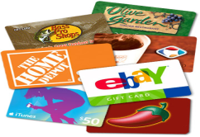


Not allowed on p-card
Prescription drugs
Radioactive and hazardous materials
Consulting and other Professional Services
Any payments to individuals
Gift cards and Certificates for Employees or Gift cards over 75.00 for non-employees
Personal purchases
Construction and renovation
Purchases over $5000.00

Slide 10
What receipts is the cardholder required to save?
  All receipts from non-contracted vendors no matter what the dollar amount
  *All receipts from contracted, level 3 suppliers over $1000.00
  All receipts for meetings and meals, including any BC Dining facility, along with a list of attendees and business purpose. If there are more than 25 people, then a group may be listed. ie: snacks for new employee orientation, total attendees: 21

Slide 11
*Receipts for Level 3 Suppliers
Receipts for purchases under $1000.00 do not need to be held for Contracted Level 3 Suppliers. Level 3 Suppliers provide line item data which can be viewed in PeopleSoft Financials. This rule does not apply to grants. (all receipts for grants must be saved.)
AirGas/Linde Gas | Science Cylinders
Allied Waste | Rubbish Removal
Anixter | Network Needs
Apple Computer (APL On-Line ONLY) | Macintosh Computers and Peripherals- NOT FROM ANY APPLE STORE
Auto Zone | Facilities Vehicle Needs
CDW | Computer Peripherals
Dell Computer | Dell Computers
Federal Express | Express Mail Provider
Fisher Scientific | Primary Lab Supply Provider
Henry Schein | Medical Supplies
Pitney Bowes | Postal Meter, Postage-On-Line
VWR | Secondary Lab Supplies
WB Mason | Office Supplies

Slide 12
How long are receipts held?
University Sponsored, Fund Code 100, 920 (student agencies) 220 (gift accounts) and 820 (capital projects) 3 fiscal years
Grants: Fund Code 500 and 120: life of the grant plus a minimum of three years after the submission of the final expenditure report for restricted, funding agencies, contract or grant funds ledger accounts

Slide 13
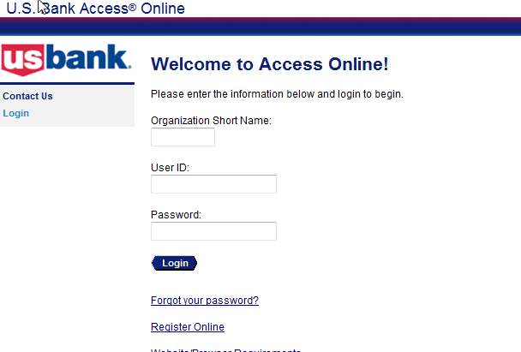
Reconciliation and Access-on-line
Every cardholder and Administrator MUST have access to US Bank’s Access-on-line. https://access.usbank.com

Slide 14
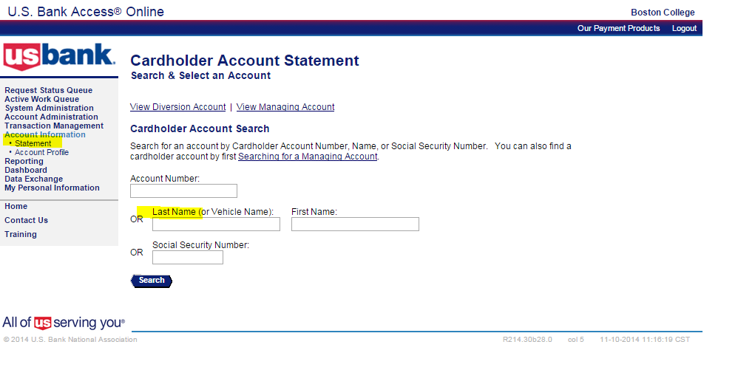
THE CARDHOLDER: Pulling a statement from US Bank
account information>statement>select billing cycle
US Bank provides 24 months of statements. Usually, a statement covers transaction beginning the 26th of the month and ending the 25th of the following month.

Slide 15
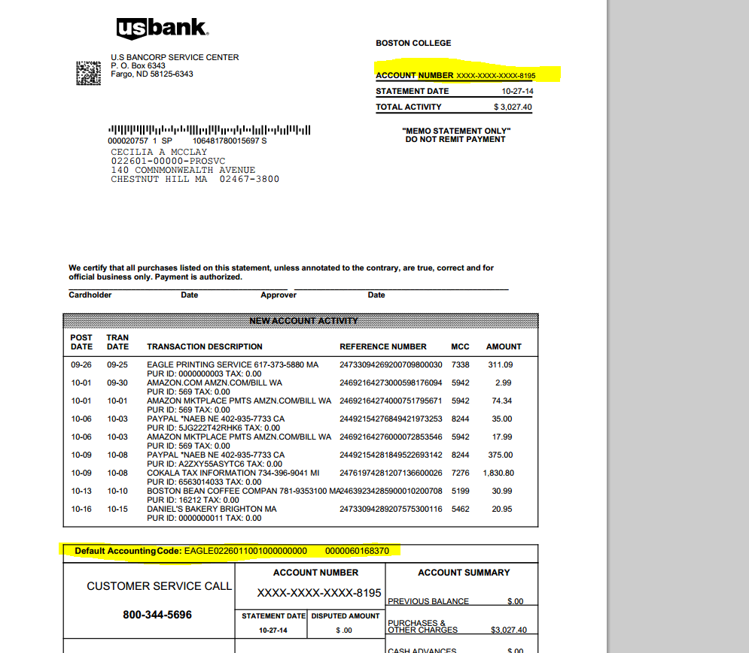
Cardholder: US Bank Statements

Slide 16

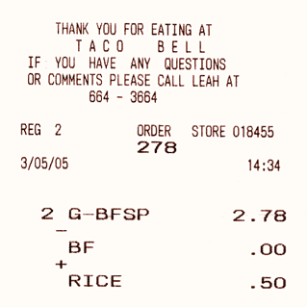
Reconciled P-cards
New P-card statements are issued around the 26th of every month.
Gather receipts for the month and attach them to the statement.
Best practice: Scan receipts or take a picture with your smart phone so you will never lose a receipt.
Receipts and statements should be stored electronically (behind a secured server)
Missing Receipts: Have your supervisor verify the purchase and sign your statement.

Slide 17

Separation of Duties Alert !
If the cardholder is responsible for the PeopleSoft reconciliation then another person in the department, preferably a supervisor must review the cardholder’s purchases and sign the reconciliation.

Slide 18
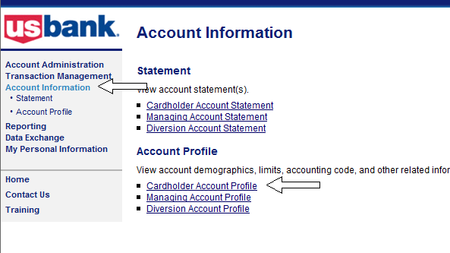
Checking real-time balances
Access-on-line: account information>cardholder account profile>cardholder’s name or credit card number>view a managing account>authorization limits

Slide 19
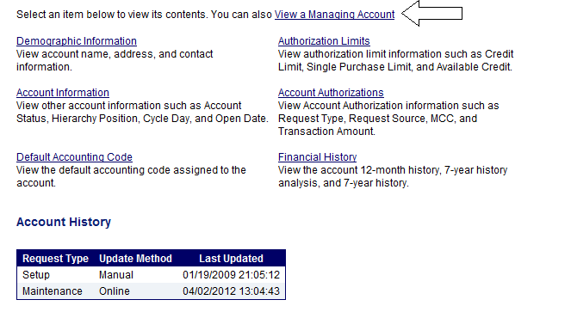
Checking real-time balances

Slide 20
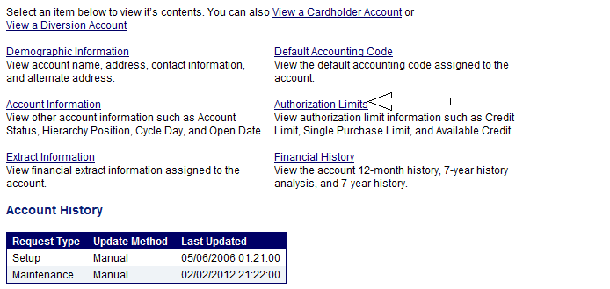
Checking real-time balances

Slide 21
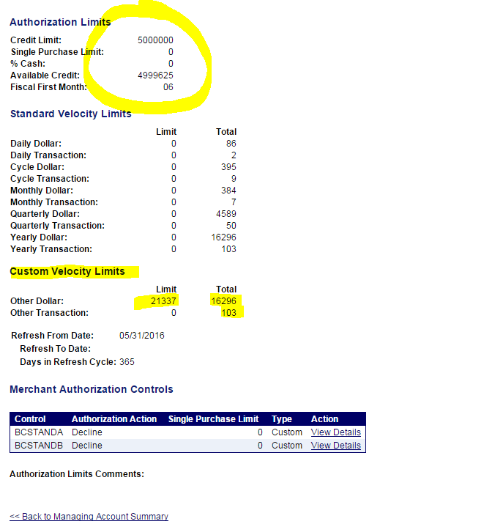
Checking real-time balances
This is the University monthly credit limit
Budgeted amount
Spent Amount
Pending transaction

Slide 22
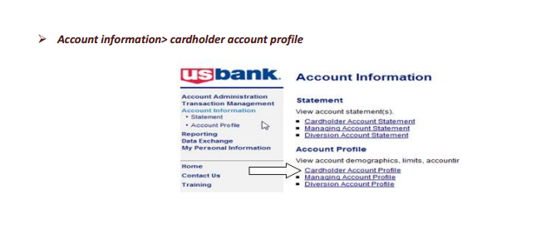
Looking at pending transactions and declines
Pending transactions are real-time. In this field approvals and declines can be seen. The Departmental P-Card Administrator can trouble-shoot p-card declines. Pending transactions will stay under “account authorizations” for up to 5 days. When the vendor is paid, the transaction will move to the cardholder’s transactions list in Access-on-line

Slide 23
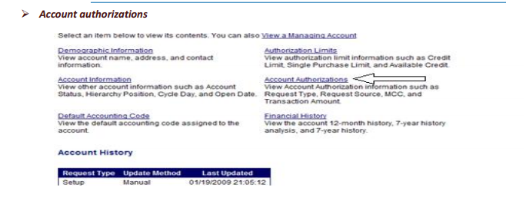
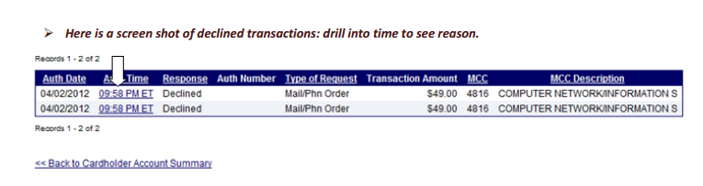
Looking at pending transactions and declines

Slide 24
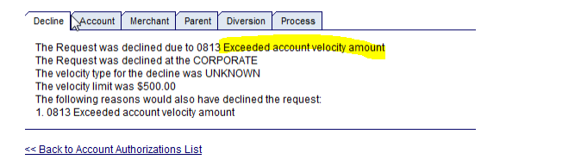
Looking at pending transactions and declines
Drill into the time to find the reason for the decline. This example shows the VELOCITY LIMIT is 500.00 and the account exceeded the velocity amount. The velocity amount is the budgeted amount of the p-card account in PeopleSoft. A budget transfer must be made into the p-card account (usually 68370). Keep in mind, the 19 budget transfer, if done by 2 pm will generate an e-mail to the bank and be available by noon on the NEXT business day. BUDGET TRANSFERS ARE NOT REAL-TIME FOR P-CARD.

Slide 25
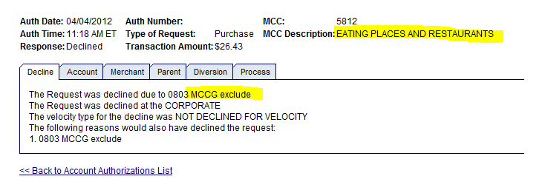
Looking at pending transactions and declines
MCC EXCLUDE or THE PURCHASE IS NOT ALLOWED

Slide 26
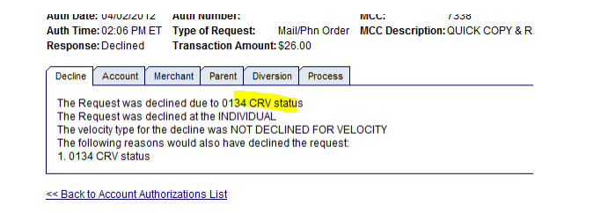
Looking at pending transactions and declines
CRV Status: The card has not been activated

Slide 27
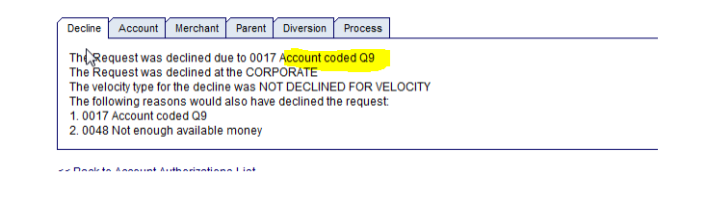
Looking at pending transactions and declines
Q-9: The grant has ended or the card is on a temporary
hold

Slide 28
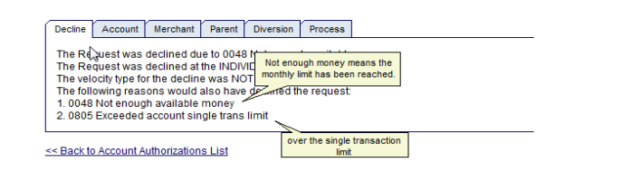
Looking at pending transactions and declines
Individual level: The Cardholder has exceed either the monthly limit or single transaction limit

Slide 29
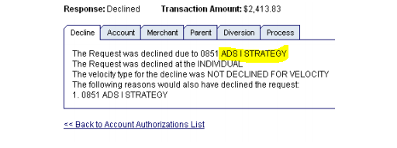
Looking at pending transactions and declines
Fraud Alert! Contact US Bank directly at
1-800-344-5696 If you get one of the following declines:
ADS 1 Strategy
ADS 11
ADS Filter
Caution account
Credit Rating

Slide 30
Common p-card hiccups
Out of funds: US Bank decline will say , EXCEED VELOCITY LIMIT
Solution: a budget transfer must be done into the p-card account. If it is done before 3 pm, the monies will be available by noon on the next business day.
2) PAYPAL: PayPal is a more secure option when checking out (if given the option). If a business is established, then PayPal will be coded as that business (ie: Eagle Print). However, if a business is not incorporated, then the p-card will decline. The MCC Code will be “professional services”. If you have no other option, please contact pcard@bc.edu to have the restriction temporarily lifted.
3) Address Verification: In this day and age of constant internet fraud, many business are verifying all of the information associated with the p-card. Please know the demographic information associated with the p-card before placing an order. Most cards are listed the BC Standard address but this info can be checked under “demographic information” in Access-on-line.
4) Card Activation: BC does not use social security #’s. Cards need to be activated by 4 numbers provided in the same envelope as the p-card.

Slide 31
Common p-card hiccups
5) Fraud alerts: any decline reason listed below has a fraud alert and the cardholder needs to contact US Bank directly to verify charges
ADS 1 Strategy
ADS 11
ADS Filter
Caution account
Credit Rating
6) International Purchases: Since all cards have been converted to the V-Chip, 90% of foreign purchases decline due to “fraud alert”.
Please contact US Bank before the purchase is made to verify the charge.

Slide 32
Common Internal Audit Violations and Red Flags
Split Transactions: FY15 yielded almost $100,000 in split transactions.
Shared P-cards: All buyers in a department should have their own p-cards
P-cards not deactivated after an employee leaves the department
Sales Tax Paid: FY15: 757 transactions equaling $34,000.
Gift Card Buying: Must not purchase for an employee. Must have proper documentation such as person’s name and business purpose. All gift card purchases are audited annually by Internal Audit.
Dining Receipts: Must have business purpose and attendees: the small dollar ones are the biggest red-flag
No Reconciliation of P-card

Slide 33


DATA SECURITY

Slide 34
DATA SECURITY
Maintain the confidentiality of P-card information stored on your computer by using only a secured server to store this sensitive information.
Never store credit card information on your desktop.
NEVER put credit card numbers in e-mail.
Empty recycling bin after deleting sensitive information.
Order online through secure websites: https://

Slide 35
Credit Card Fraud
Number-Running Criminals: Organized crime, much of it based in Eastern Europe and Russia have developed software that captures good credit card info. They find “unsecure cardable websites” that will continuously let them run numbers until a good one is captured. Since June 1, 2015, 217 active BC P-cards were captured by these criminals.
Every p-card beginning with 4246-0441 was compromised

Slide 36
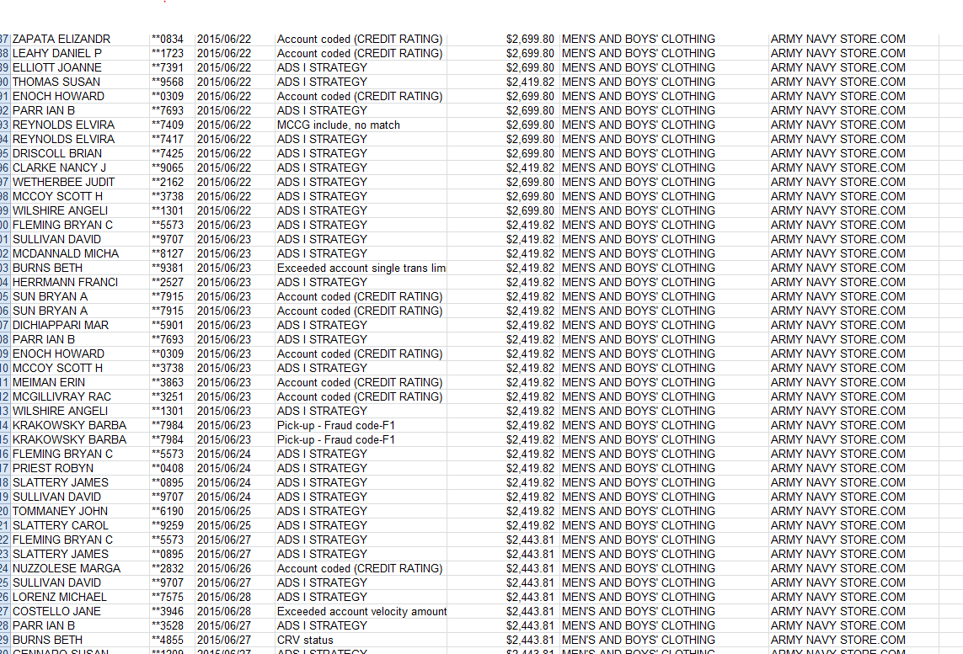
Examples of number runs

Slide 37
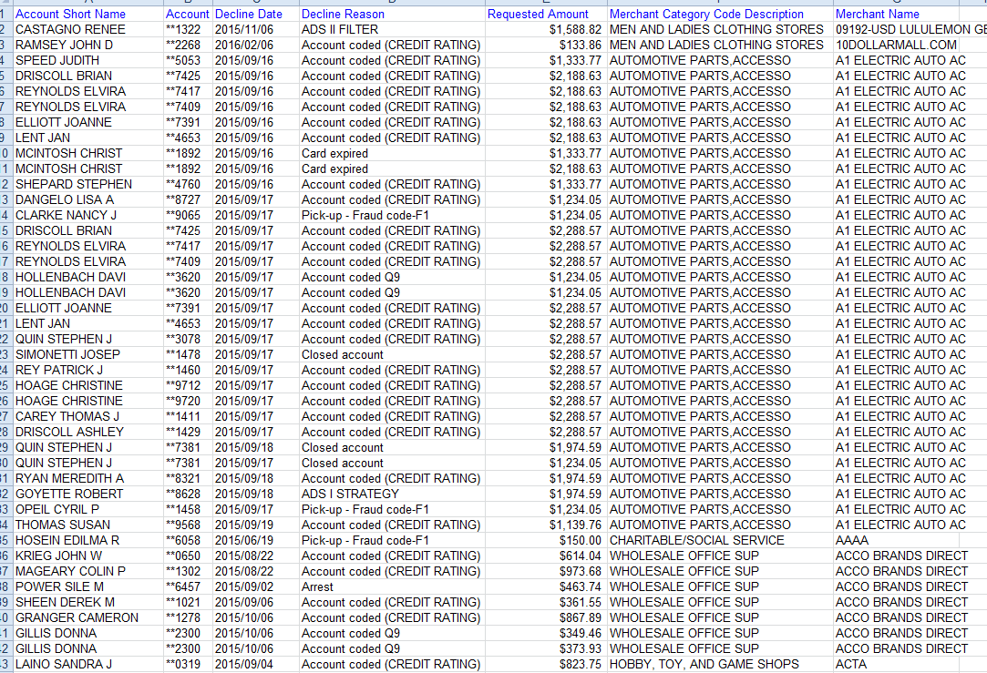
Examples of number runs

Slide 38
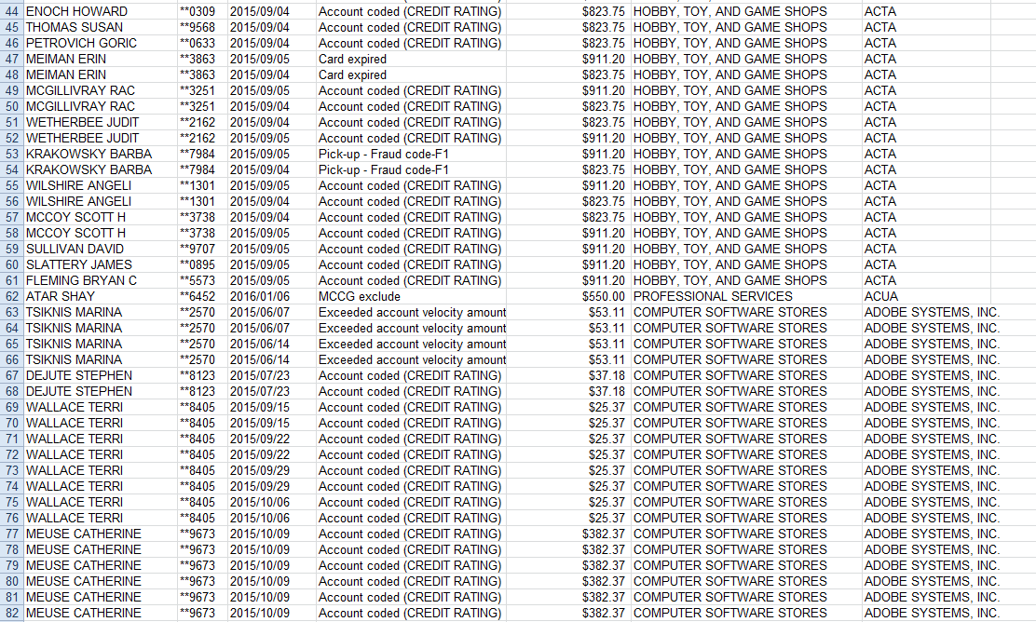
Examples of number runs

Slide 39

Business Ethics Hotline
Anonymously report ethical concerns
www.bc.ethicspoint.com
1-855-327-4477

Slide 40
Tools Provided:
Complete P-card Labs for Cardholders and Departmental P-card Administrator:
www.bc.edu/pcard

