Slide 2
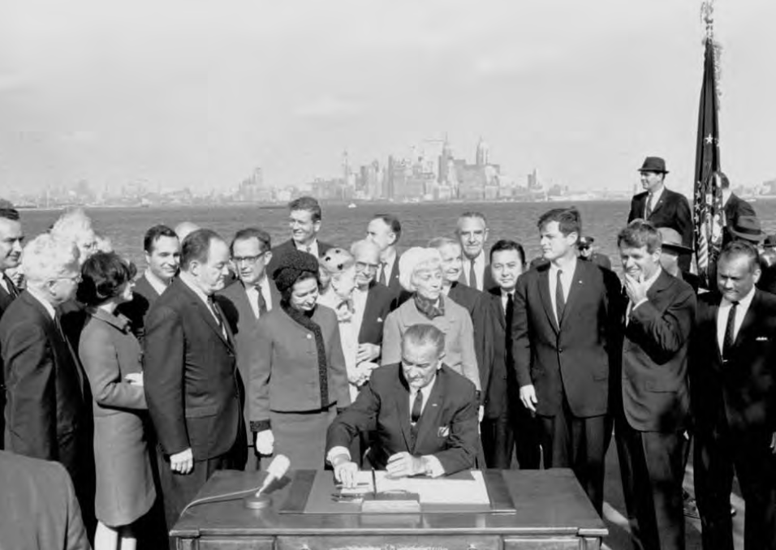
Notes:
LBJ signs Hart-Cellar Act, Oct 3, 1965 at base of the Statue of Liberty.

Slide 7
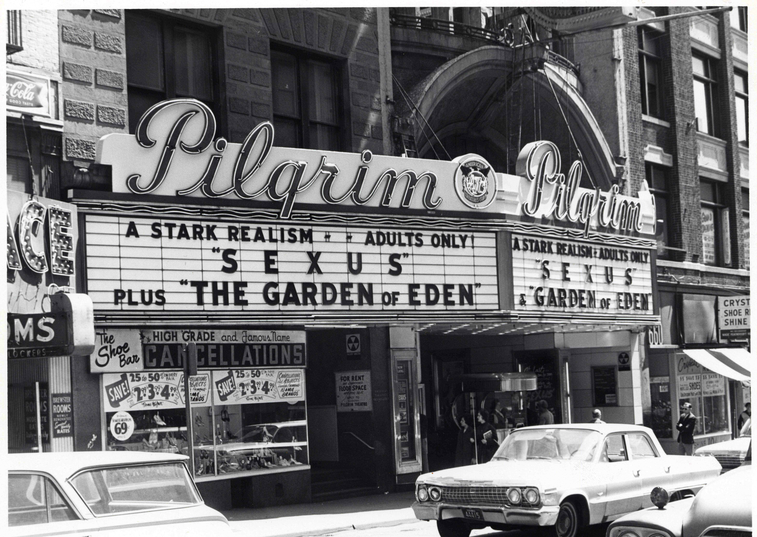
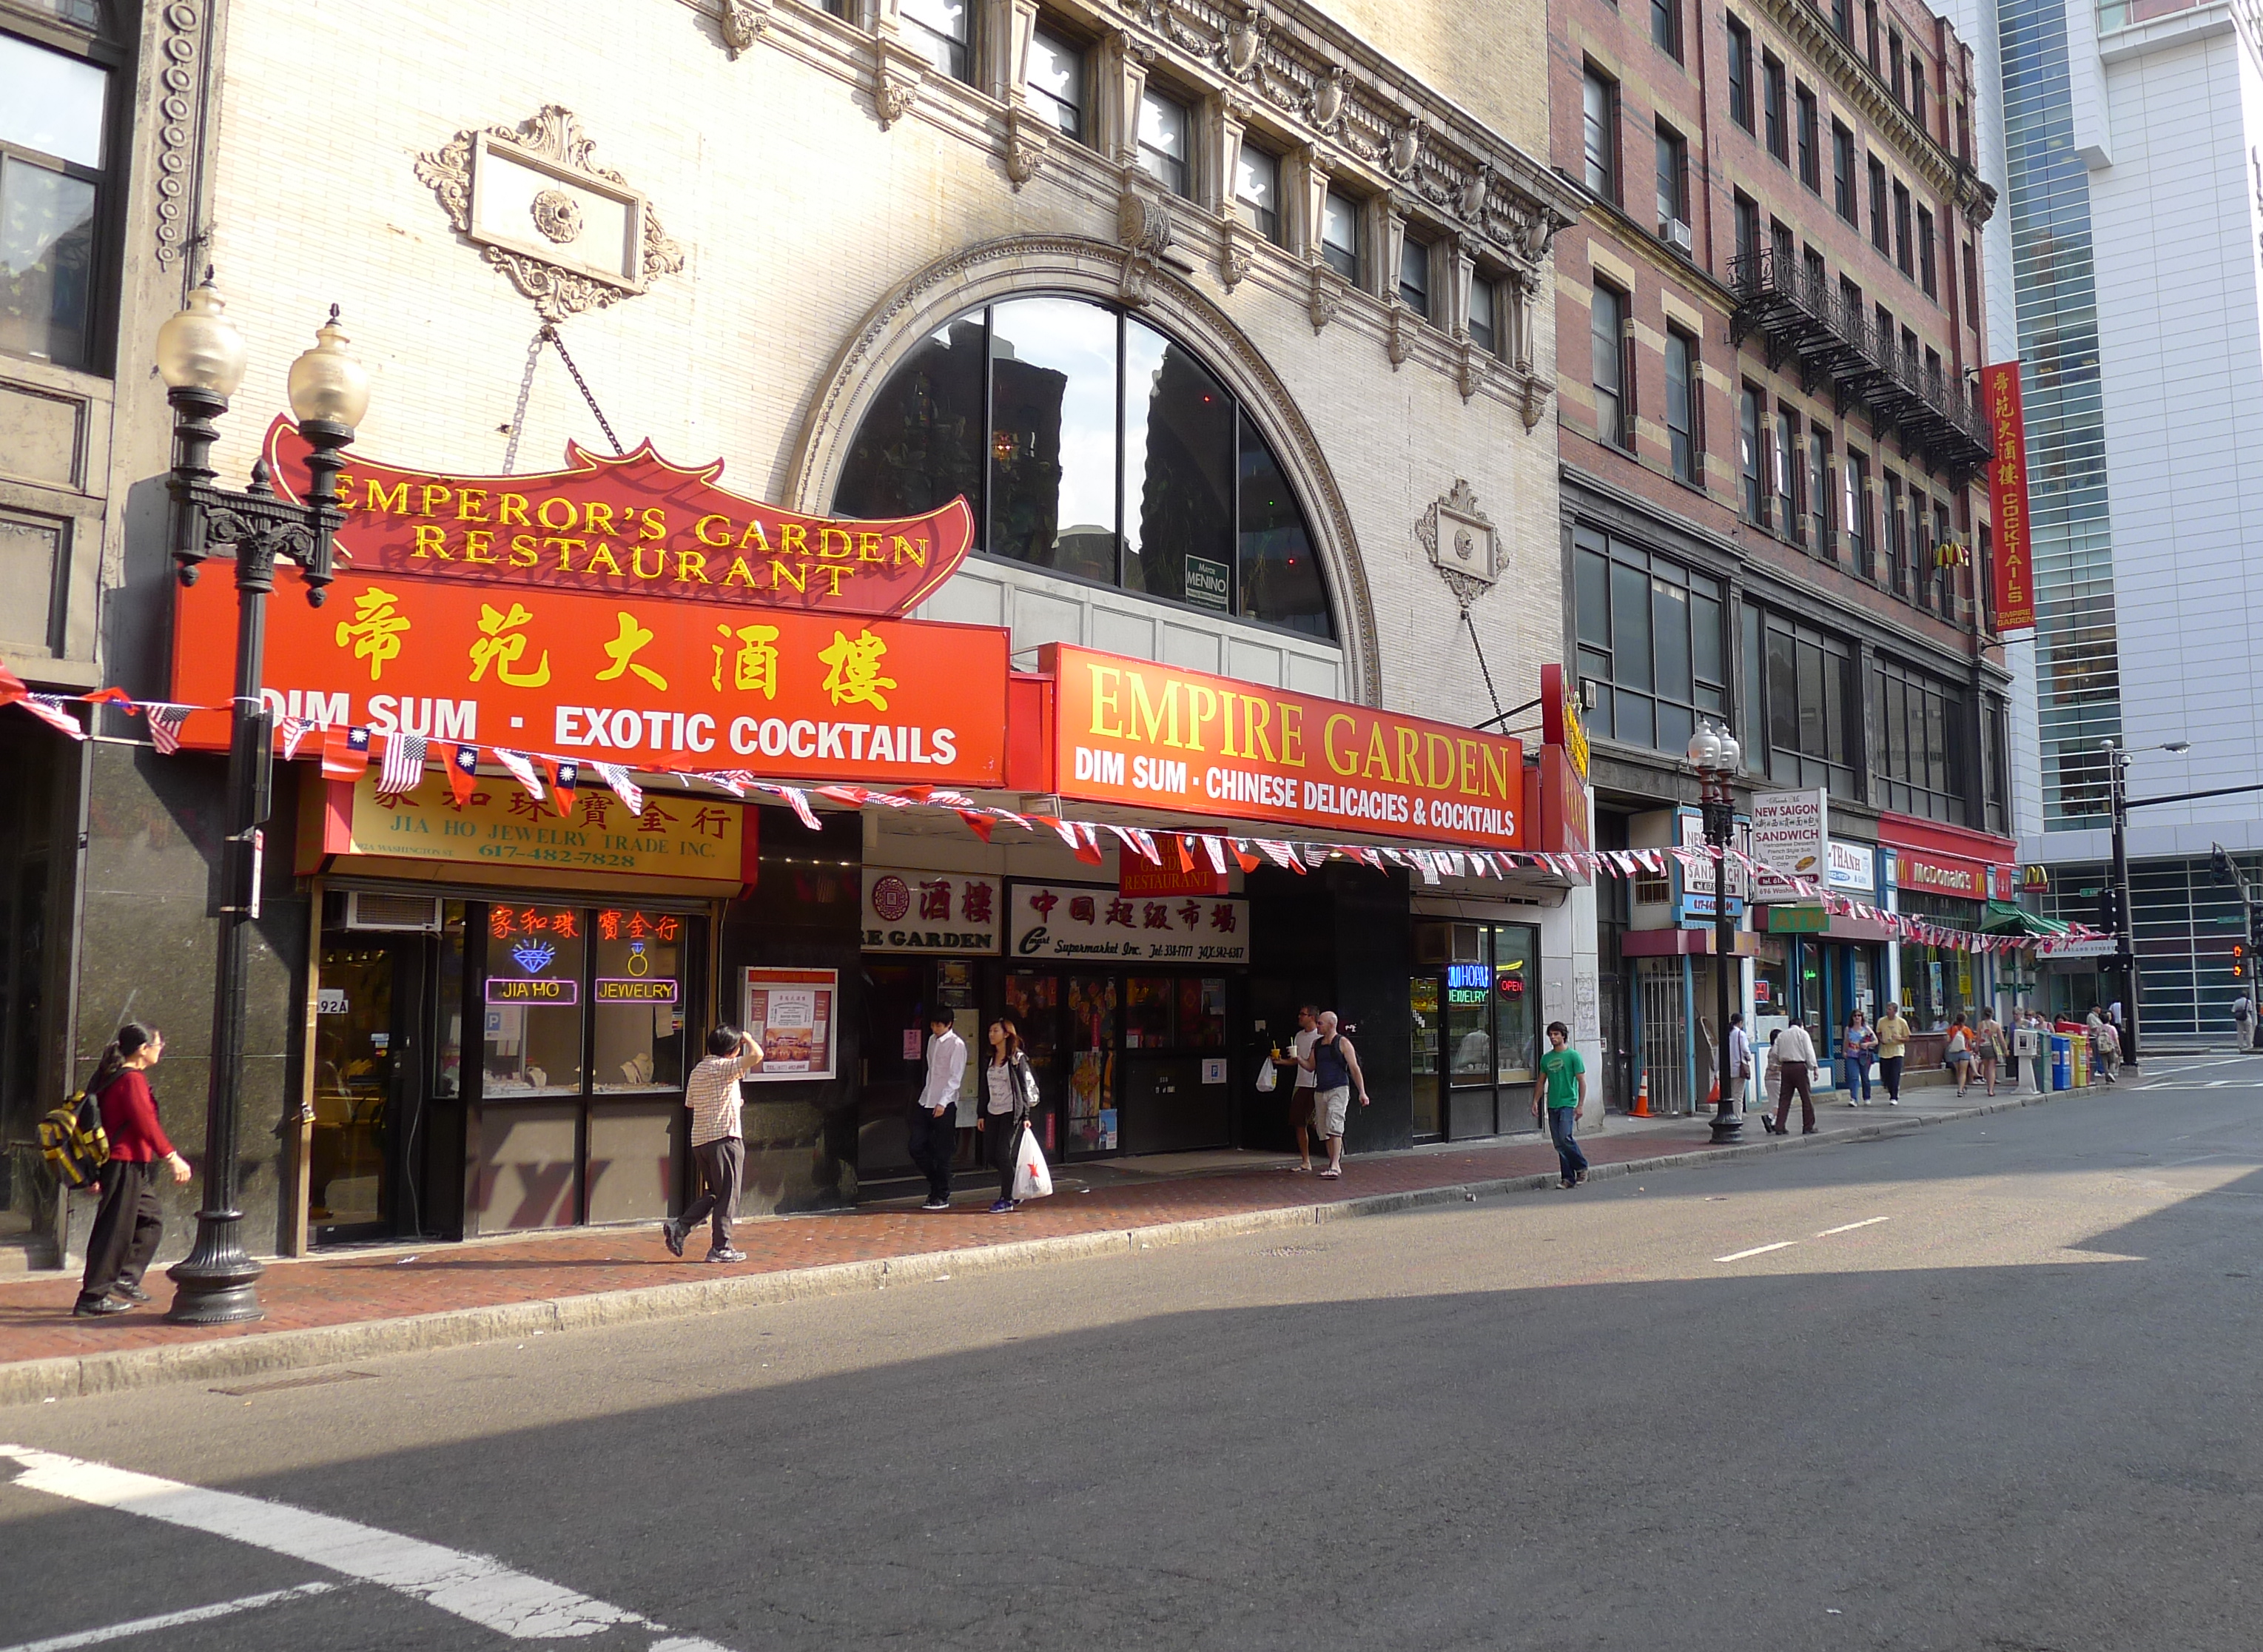
Washington Street, Chinatown
1967 and 2010

Slide 8
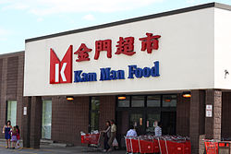
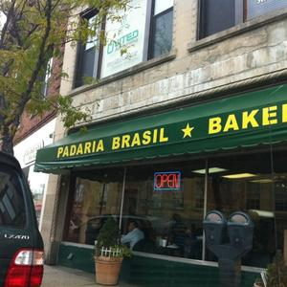
Quincy Point
Downtown Framingham

Slide 9
Thank you for coming!
Global Boston digital history project: globalboston.bc.edu
Questions? Contact me at: marilynn.johnson@bc.edu

Slide 12
Top 10 Groups in Metro Boston, 2010

Slide 13
One-Step Up Suburbs

Slide 14
Korean Church of Boston (1953)

Slide 15
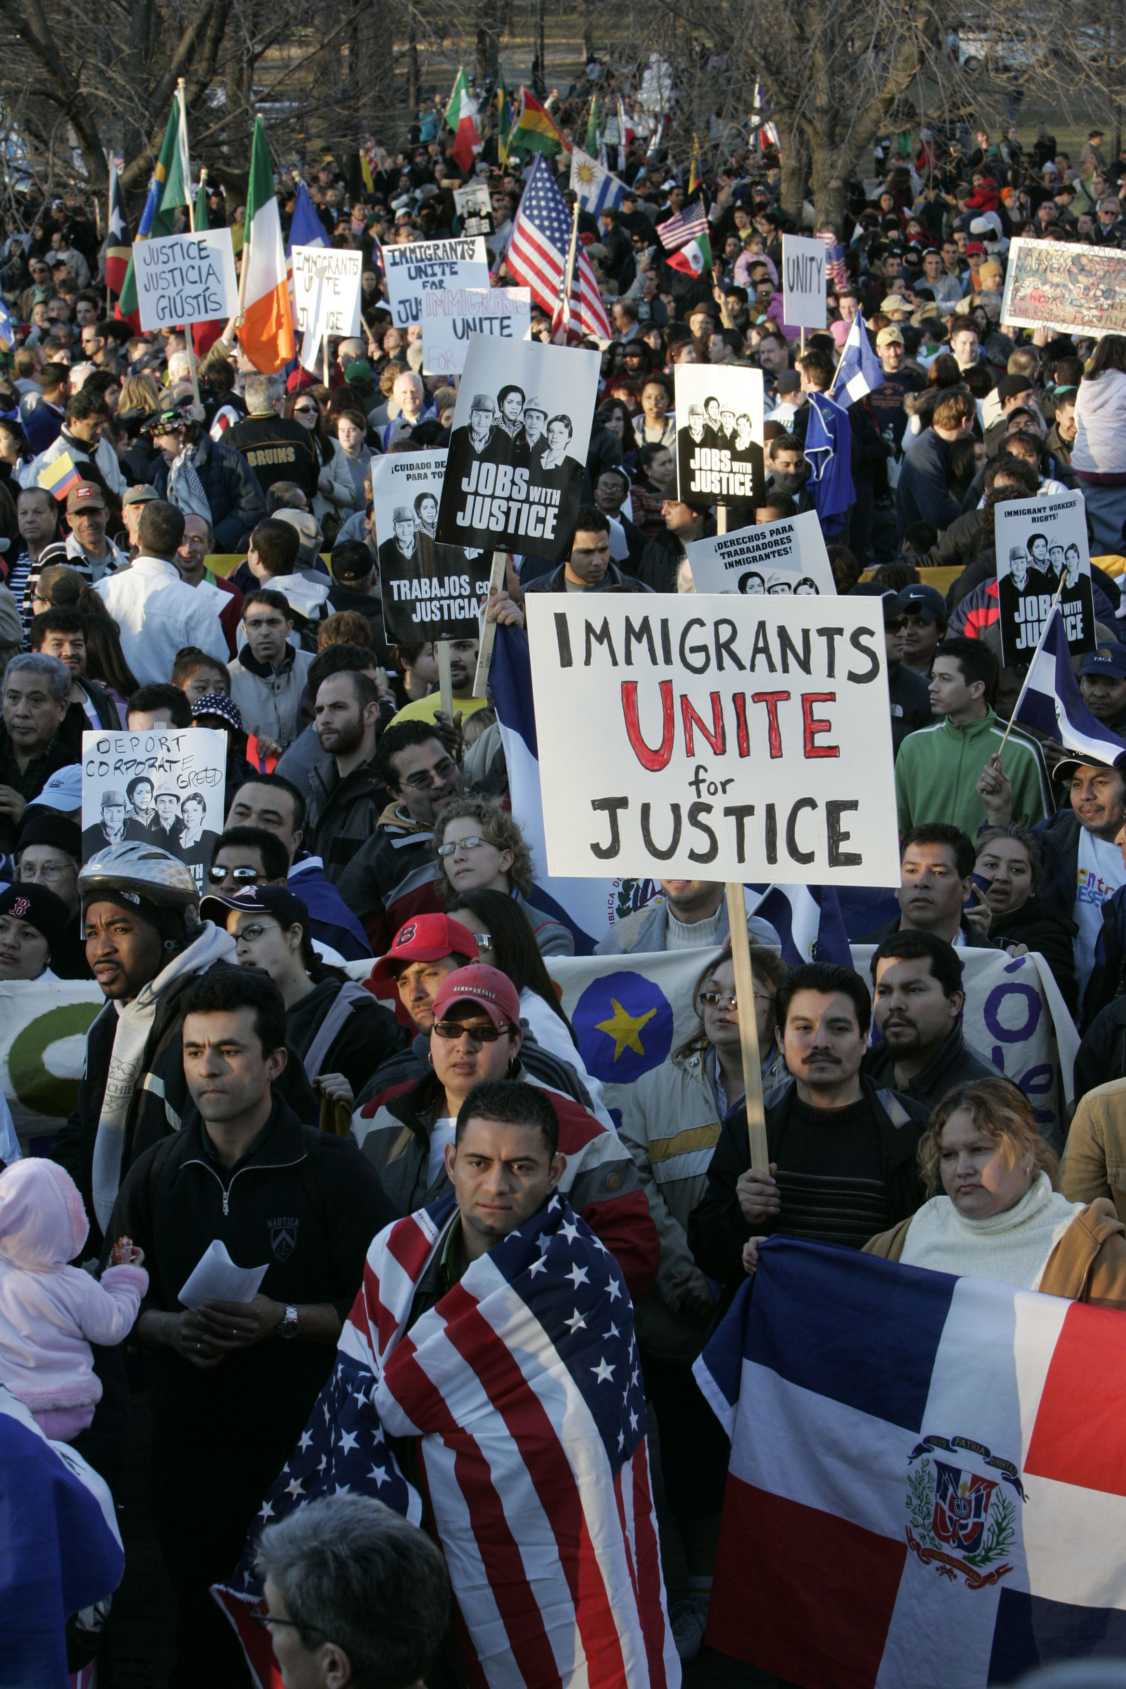

Slide 16
Thank you for coming!
For more information, see: thenewbostonians.com
The New Bostonians on Facebook
Questions? Contact me at: marilynn.johnson@bc.edu

Slide 18
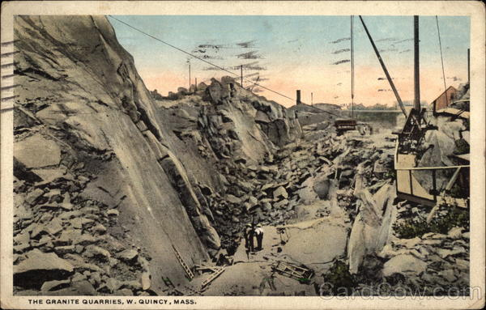
Quincy

Slide 19
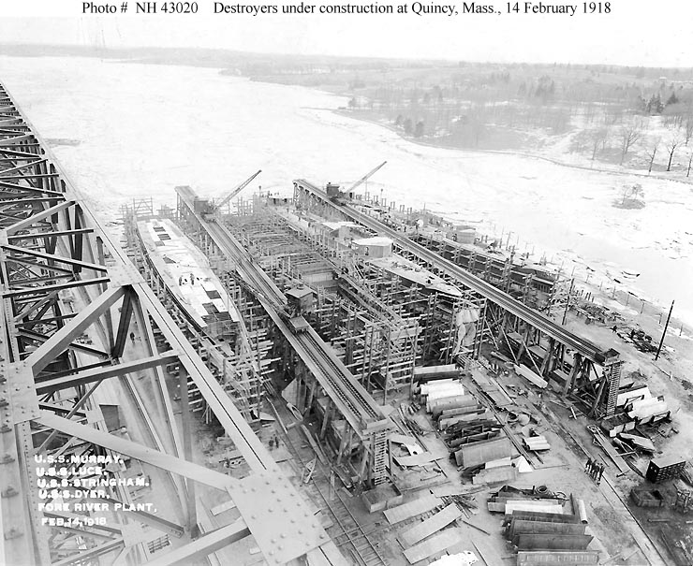

Slide 20
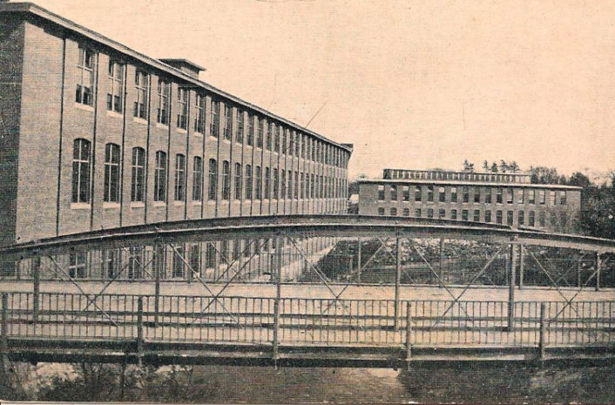
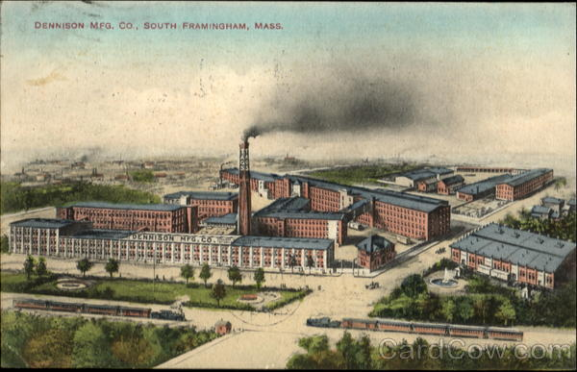
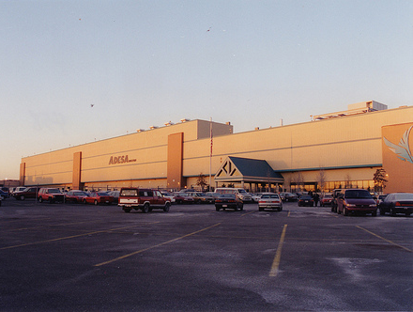
Framingham
1850s-1950s

Slide 21
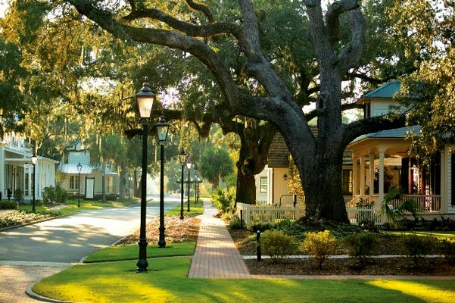
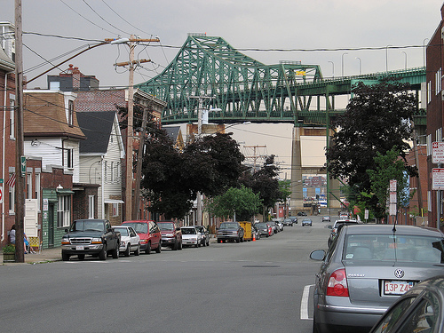
Polarities of Settlement
Affluent Suburbs—Rt. 128 and beyond
Mill towns & industrial cities
Notes:
Immigrant destinations: Chelsea (45% foreign born) and Lexington (23%)

Slide 22
Malden

Slide 23
Malden Today

Slide 24
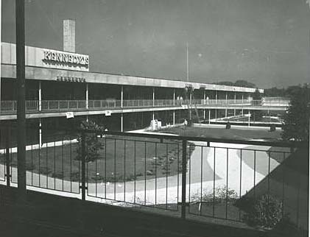
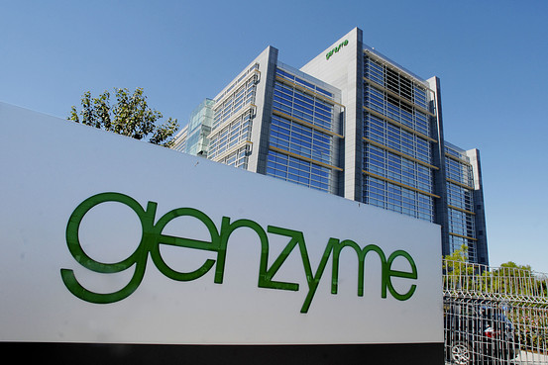
Framingham
1950s-present

Slide 25
Countries of Origin of Foreign Born
City of Boston, 2007
From: BRA & Mayor’s Office of New Bostonians

