Slide 1
Gentrification & Religion
Upscaling and Parish Diversity in Boston’s Charlestown Neighborhood

Slide 2
Gentrification & Religion
Research Questions:
What are the effects of gentrification on a religious congregation with diverse membership?
How have institutional decisions (merger and the cessation of a Spanish-language Mass) changed the experience of worship for congregants?

Slide 3
The Groups
Townies
  Longtime residents
  Irish
  Strict boundaries for membership – e.g. must be born in the Town
Latinos
  Mostly Caribbean
  Tend to be lower-income (from former St. Catherine church)
  Some blurring of lines (Newcomer/Latinos)
Newcomers
  Affluent
  Tend to be younger professionals, but also some “empty-nesters”

Slide 4
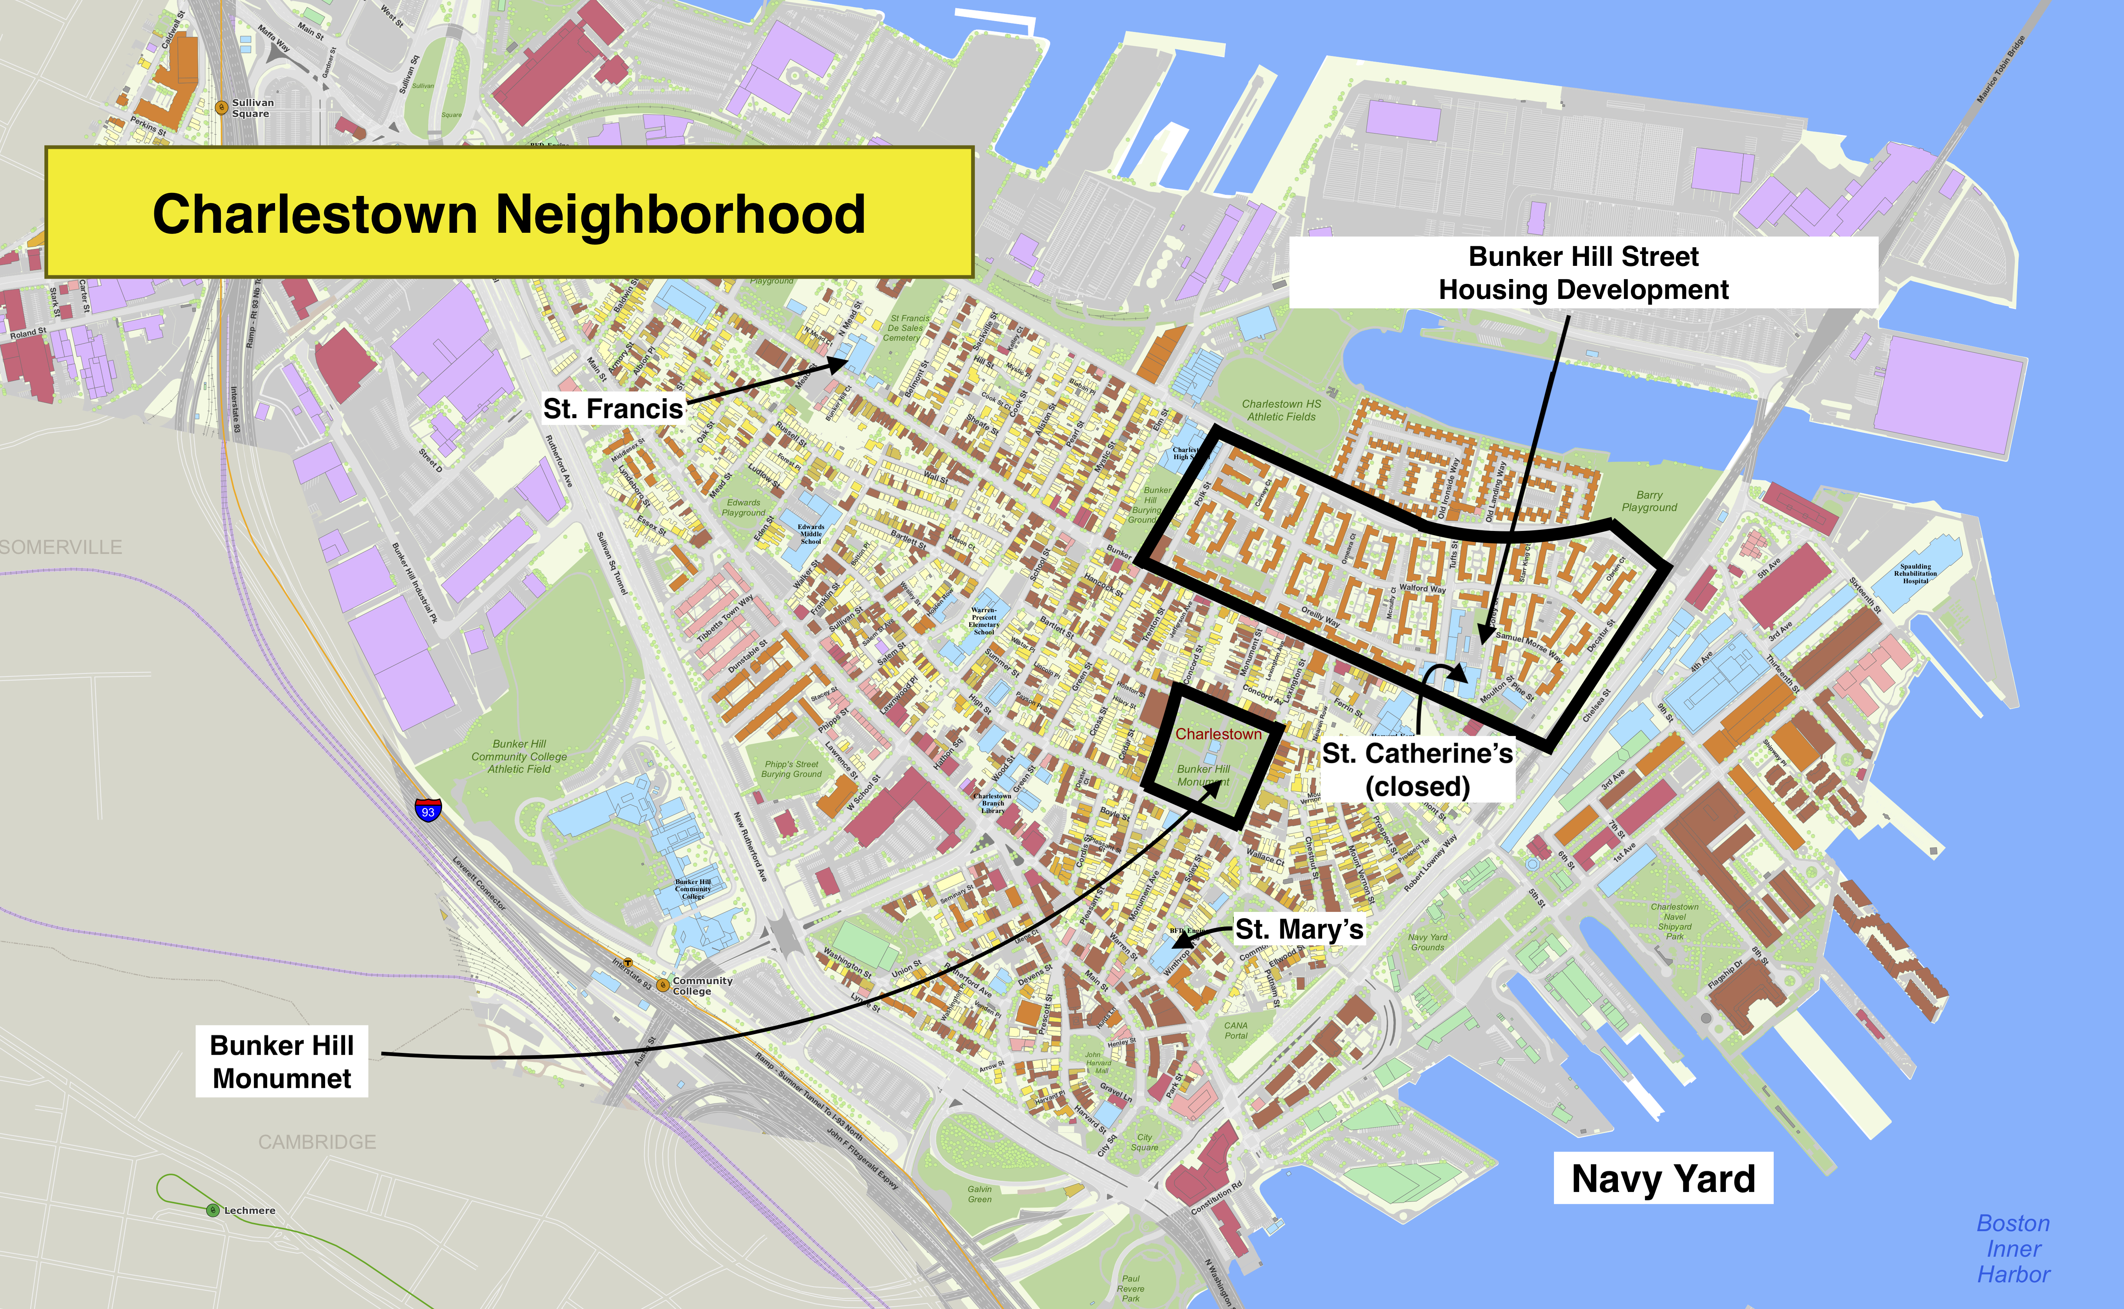

Slide 6
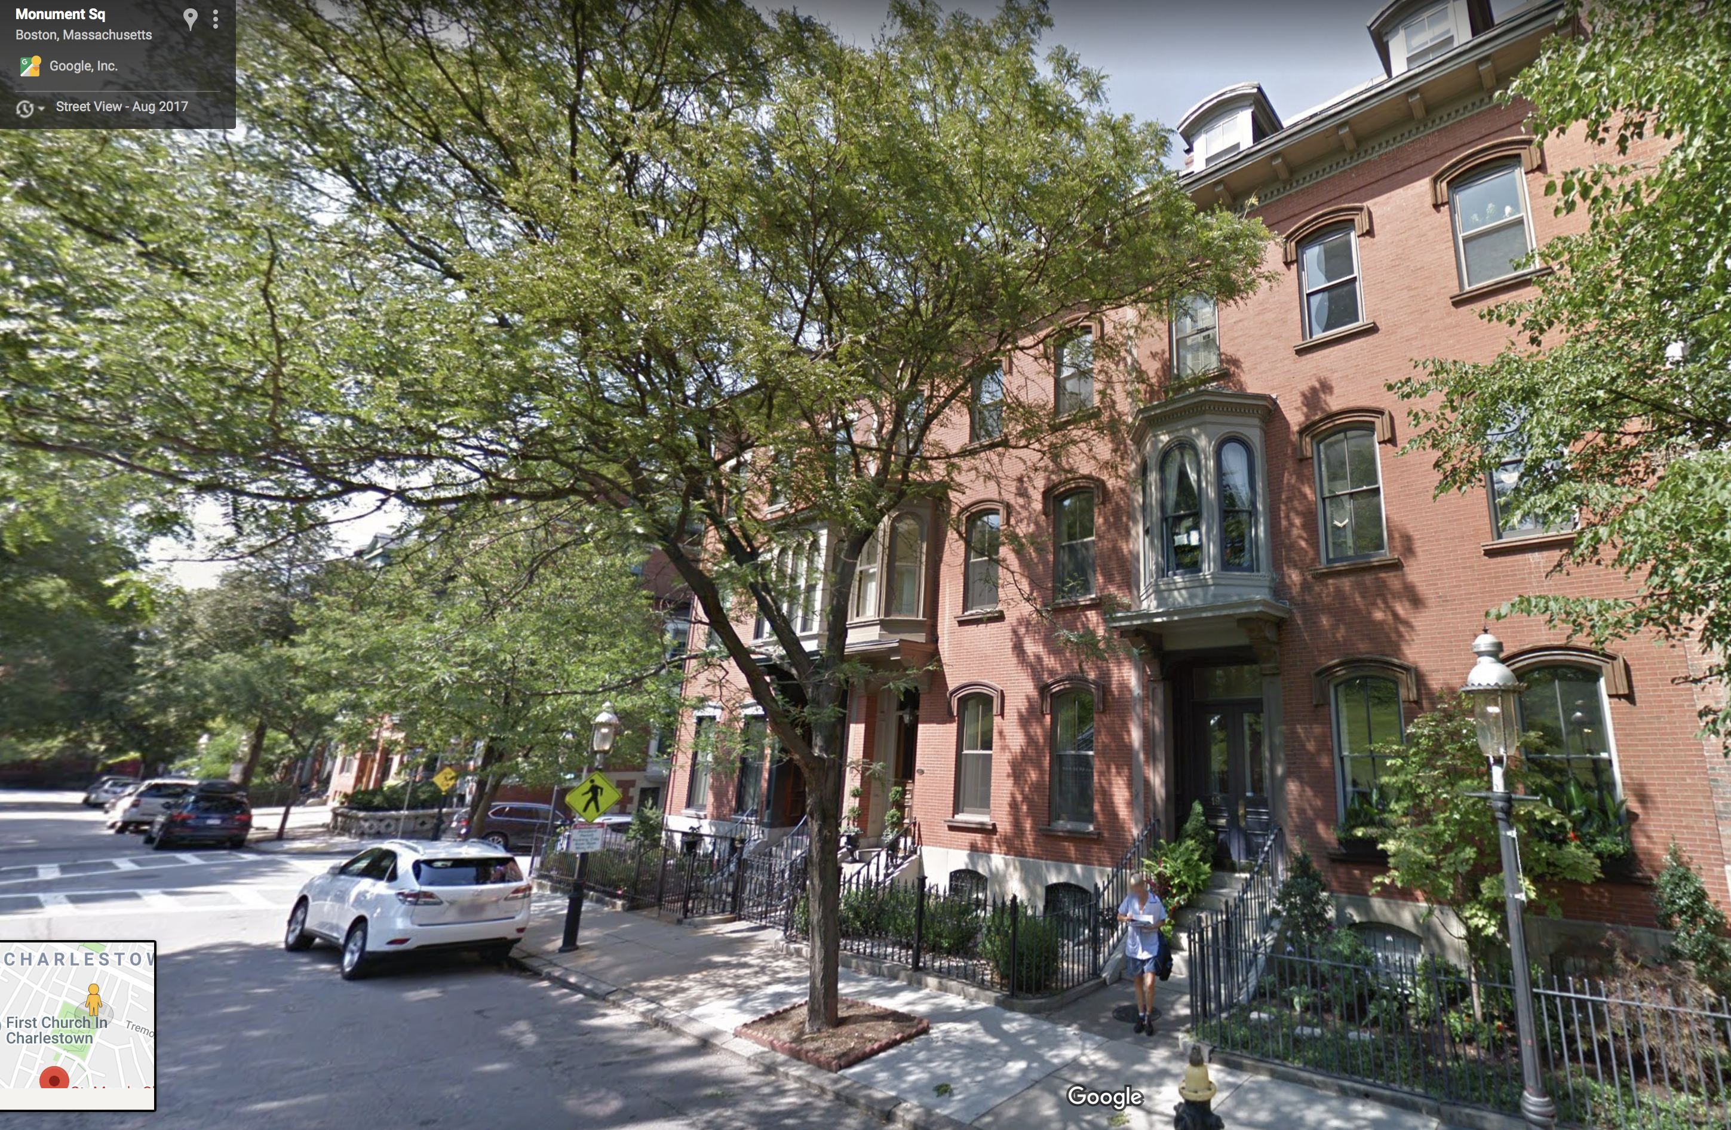

Slide 7
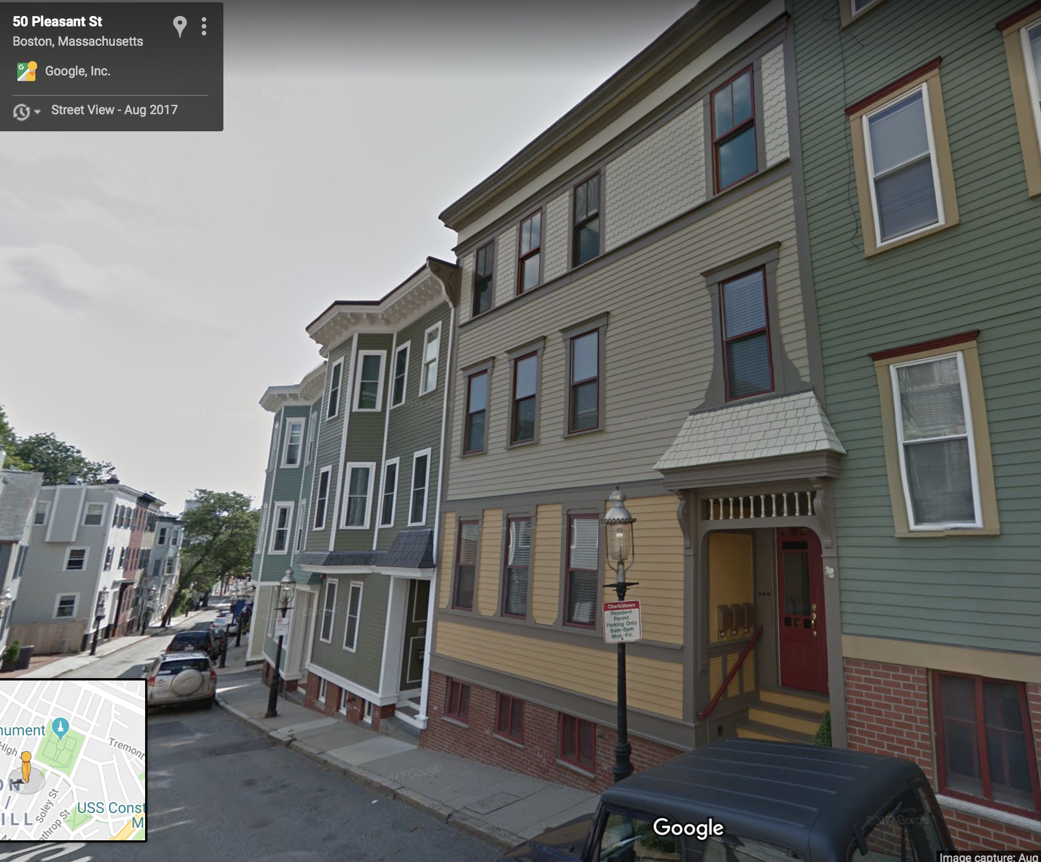

Slide 8
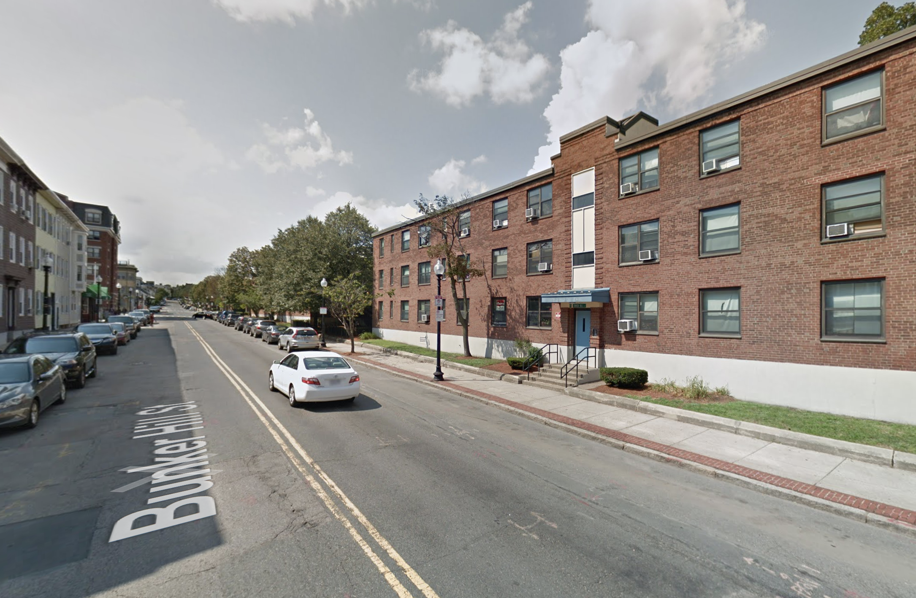
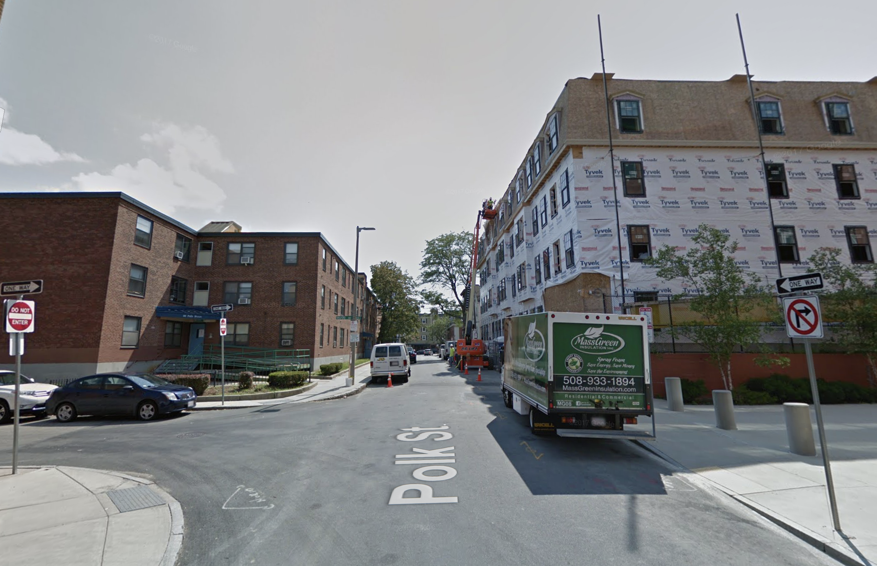

Slide 9
Charlestown, MA
One square mile
Population: 16,439 (2010)
Historically 3 Catholic Churches
  “Territorial parishes”
  St. Francis de Sales
  St. Catherine of Siena
  St. Mary’s
Merged in 2006

Slide 10
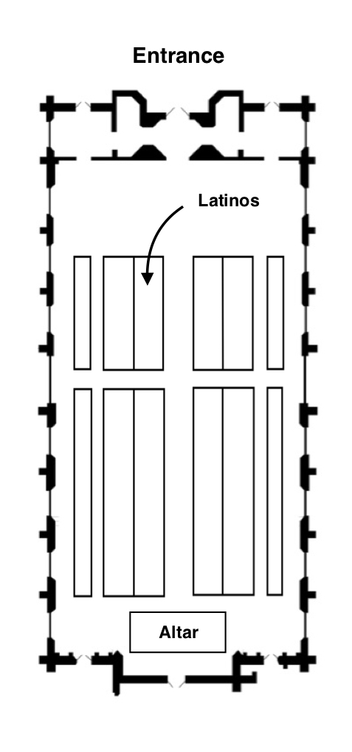
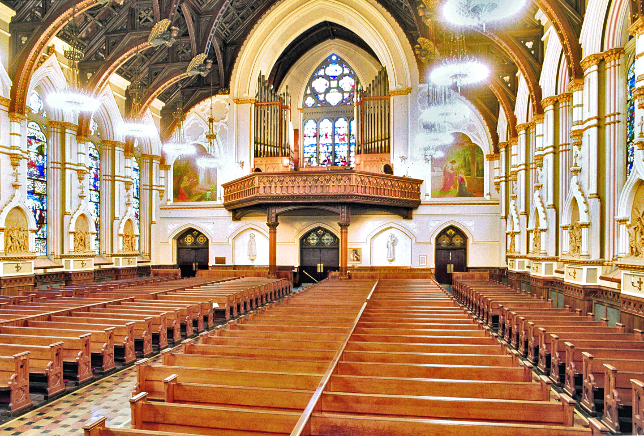
Interior of St. Mary’s. Photo courtesy of William T. Van Pelt (1999).

Slide 11
Erick Berrelleza
Boston University ebsj@bu.edu

