Slide 1
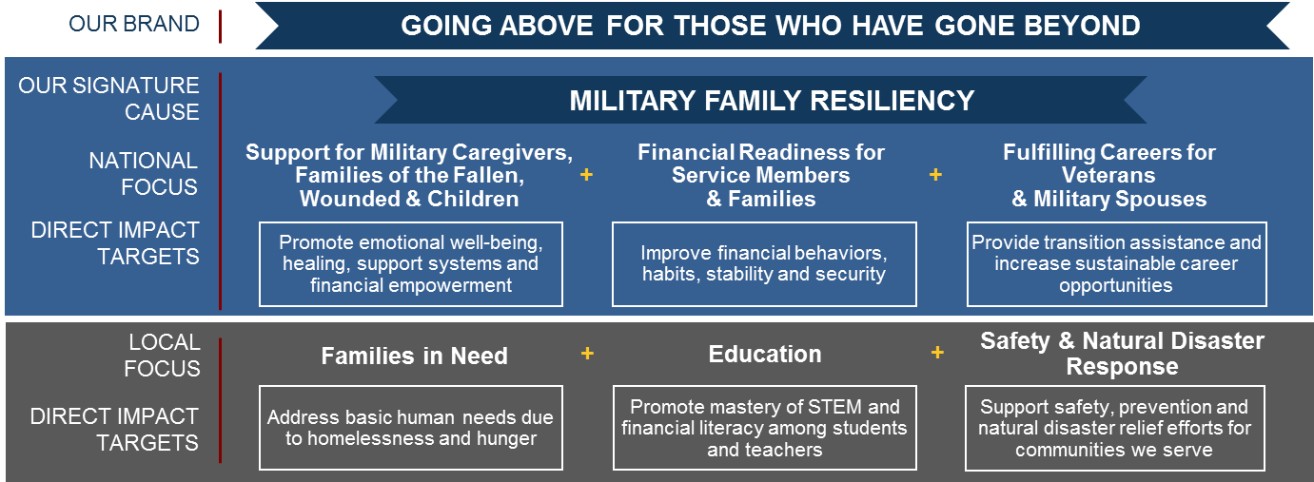
CORPORATE RESPONSIBILITY
For Public Use: March 2018
THE MISSION of the association is to facilitate the financial security of its members, associates, and their families through provision of a full range of highly competitive financial products and services;
in so doing, USAA seeks to be the provider of choice for the military community.
1
CR Purpose: To lead and inspire actions that improve lives in the military and local community; in so doing, reinforce the authenticity of USAA.
$38.4
MILLION
60
PERCENT
1.6M
25
11
Total 2018 philanthropic budget , representing 1% of USAA PTI (and an increase from $28.4M in 2017)
Of philanthropic dollars projected to benefit nonprofit organizations serving military families in 2018
Projected lives touched in 2018 as a result of philanthropic investments in support of the military and local community
Signature alliances with nonprofit organizations – robust, branded collaboration designed to drive transformational impact (2018)
Third parties recognizing USAA for CR impact, including FORTUNE, One Star Foundation, Hiring Our Heroes (2017)
Sources: USAA, The USAA Foundation, Inc., David Reyes, USAA Corporate Responsibility Operations
2
3
USAA CORPORATE RESPONSIBILITY STRATEGY
CORPORATE RESPONSIBILITY RESEARCH
Source: MRCI CC1320 (Hageman); FH/MRCI - Qualitative
Quantitative Research: Which of these programs should USAA consider?
Veteran Hiring
Families of the Fallen
Wounded, Injured and ill Service Members
Supporting Military Spouses & Children
Advice & Resources During Military Transitions
CURRENT STATE: Alignment of philanthropic investments with USAA CR strategy
Base: Total Respondents. Q. 19 If you were given the opportunity to tell USAA where to focus its efforts to give back to the military community, which of these areas would you consider? Source: MRCI CC 1320 (Hageman)
Validation Research: Potential gaps in addressing needs among military families
VETERAN AND SPOUSE HIRING
FINANCIAL LITERACY
CAREGIVER SUPPORT
SPOUSE EDUCATION SUPPORT
CHILD EDUCATION SUPPORT
FAMILIES OF FALLEN SUPPORT
OTHER SUPPORT
CR: BEST IN CLASS
1,300
HOMELESS VETERANS PROVIDED PERMANENT HOUSING IN SAN ANTONIO
$5M
NATURAL DISASTER PHILANTHROPIC SUPPORT
112%
INCREASE IN INDIVIDUALS ENGAGED IN FINANCIAL READINESS
36K
COURSES COMPLETED BY 11K USERS DURING FIRST YEAR
15
SA SCHOOL DISTRICTS ELEVATING STEM FOR 26K STUDENTS & TEACHERS
CR: FINANCIAL SERVICES
USAA funding contributed to this outcome and infrastructure for general homelessness
USAA, The USAA Foundation, Inc., USAA employees, Retirees & RealCo
268K service members and Junior ROTC served by USAAEF in 2017 vs ‘16
USAA & PsychArmor School for Military and Veteran Caregivers
USAA investment to launch STEMvest with Discovery Education
Source: April 2014, company annual reports, CSR reports, websites. Evaluated 19 competitors and those with best-in-class corporate responsibility programs.
The USAA Foundation, Inc. and The USAA Educational Foundation are nonprofit organizations and do not endorse or promote any commercial supplier, product or services. USAA is the sponsor of The USAA Educational Foundation Inc.
Sources: David Reyes, Corporate Responsibility Operations; City of San Antonio; David Reyes, USAA CR Operations; Dan Cable, The USAA Educational Foundation; PsychArmor Institute; Discovery Education

