Slide 1
Speed Dating and Breaking Up: Assessing your Corporate Citizenship Partnerships from Start to Finish
Stewart Rassier, Director, Executive Education & Advisory Products, Boston College Center for Corporate Citizenship

Slide 2
Ice Breaker
Think of a partnership you have with a non-profit organization.
How would you describe that relationship with 1, 2 or 3 words?
Write those words on a sticky note.
Silently walk around the room and review sticky notes (3 minutes)
Silently find 3 colleagues you should group with.
In groups of 4 describe your experience in 1 minute or less.

Slide 3
Agenda
Can I Get Your Number? Context for Partnership
Non-Profit “Speed Dating” Getting to know a NPO through their 990 Form
“Breaking Up” with your Non-Profit Partner Exit Strategies

Slide 4
Can I Get Your Number? Context for Partnership
International Rescue Committee
2 miles away
The International Rescue Committee responds to the world’s worst humanitarian crises and helps people whose lives and livelihoods are shattered by conflict and disaster to survive, recover, and gain control of their future.

Slide 5
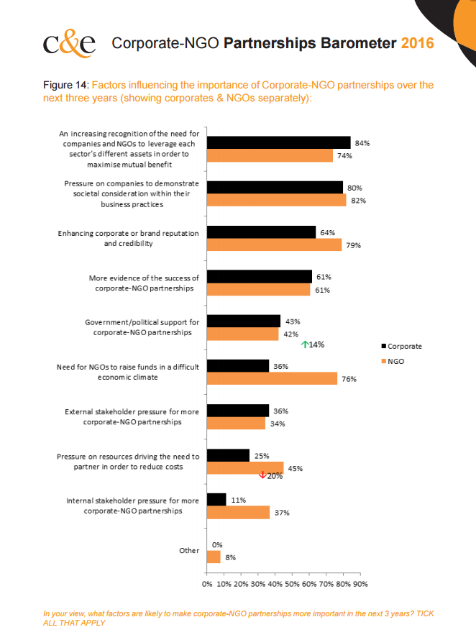
3 Drivers for Partnerships
Top Drivers for Corporations
Different Assets
Demonstrate Commitment to Community
Brand Reputation & Credibility
Source: 2016 Report of the Factors Influencing the importance of Corporate-NGO partnerships
Notes:
What is causing this increase in collaboration? The most significant reasons are an increasing recognition of the need for companies and NGOs to leverage each sector’s different assets, pressure on companies to demonstrate societal consideration, and enhancing corporate or brand reputation and credibility.

Slide 6
% of total contribution to NPOs by companies
5%
Source: Giving USA Foundation, Giving USA 2017

Slide 7
% of nonprofits who could not meet demand for their services
52%
Source: Nonprofit Finance Fund State of the Sector Survey 2015, Council on Nonprofits
Notes:
2015 was the third year in a row that more than half of nonprofits could not meet demand.

Slide 8
% who said that community needs simply go unmet when they cannot provide services.
71%
Source: Nonprofit Finance Fund State of the Sector Survey 2015, Council on Nonprofits

Slide 9
% of funders ask NPOs to collect data to capture the effectiveness of programming
89%
Source: Stanford: Improving Corporate-Nonprofit Partnerships: 3 ways corporations can more effectively partner with nonprofits

Slide 10
% of funders who "rarely" or "never" cover the costs associated with measuring program outputs or outcomes
68%
Source: Stanford: Improving Corporate-Nonprofit Partnerships: 3 ways corporations can more effectively partner with nonprofits

Slide 11
% of nonprofits think they can have an open conversation with their funders about flexible capital for organizational growth or change
6%
Source: Stanford: Improving Corporate-Nonprofit Partnerships: 3 ways corporations can more effectively partner with nonprofits

Slide 12
% of nonprofits comfortable talking with their funders about working capital needs
8%
Source: Stanford: Improving Corporate-Nonprofit Partnerships: 3 ways corporations can more effectively partner with nonprofits

Slide 13
Speed Dating: Reviewing an NPOs 990 Form
International Rescue Committee
2 miles away
The International Rescue Committee responds to the world’s worst humanitarian crises and helps people whose lives and livelihoods are shattered by conflict and disaster to survive, recover, and gain control of their future.

Slide 14
IRS Compliance Checklist
Verify the recipient's eligibility to receive a charitable gift.
Determine if the recipient is a supporting organization. lf it is, determine what type.
Confirm that the recipient does not appear on the Office of Foreign Assets Control (OFAC) at the U.S. Department of the Treasury list of organizations and persons linked to terrorism.
Source: “New Rules for Grantmakers and Donors,” Guidestar
Notes:
Verify the recipient's eligibility to receive a charitable gift.
Establish whether the organization is allowed to receive tax-deductible contributions.
Confirm the recipient’s foundation and deductibility status.
Determine whether the recipient is in good standing with the IRS.
Determine if the recipient is a supporting organization. lf it is, determine what type.
A supporting organization is a charity established for the purpose of providing support to another charity.
Confirm that the recipient does not appear on the Office of Foreign Assets Control (OFAC) at the U.S. Department of the Treasury list of organizations and persons linked to terrorism.
Office of Foreign Assets Control (OFAC) at the U.S. Department of the Treasury list of terrorism-related organizations based on the USA PATRIOT (Unite and Strengthen America by Providing Appropriate Tools Required to Intercept and Obstruct Terrorism) Act.
Penalties stemming from gifts to ineligible supporting organizations are particularly steep and put organizations at risk of excise taxes.
Charitable deductions are disallowed and may be required to pay penalties to the IRS.
Giving money to an organization that the U.S. government has named an SDN is a crime.
Contributions to nonprofits on the OFAC lists put donor at risk of prosecution.
To prevent such outcomes, grantmakers and donors should:
Perform due diligence in the appropriate resources before the grant or contribution is made.
Document research , especially the research date, can be kept in electronic or printed form.

Slide 15
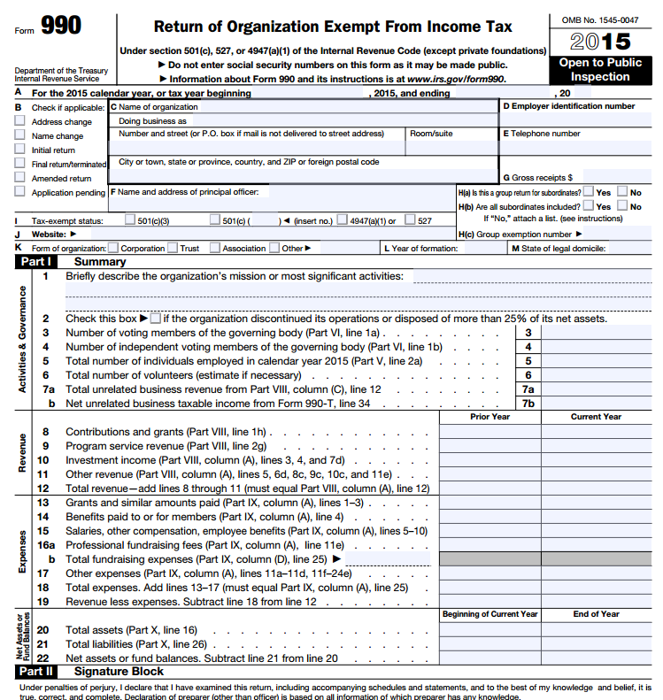
Form 990
The Form 990 is an information return, not an income tax return, since the organizations that file it do not pay income tax. In addition to being the main IRS reporting form for nonprofits, is the basic component of the annual report that must be filed with a large number of state offices that regulate charitable solicitation. The 990 serves two purposes:
Provides information that helps the IRS and state charity regulators enforce laws that govern nonprofits.
Provides transparency into and encourages accountability of a nonprofit.
The primary audience for 990s used to be the IRS, but since an update in 2008 to increase transparency and accountability, the general public – especially donors and other stakeholders – is now as important an audience as the IRS.
The Form 990 is a long and complex financial document. In the accompanying handout, we will show you what is important and how to use a Form 990 when assessing the health on a nonprofit.
Notes:
The Form 990 is a key document for an NPO’s transparency. It is different than a tax return, and contains rich information about the nonprofit. It is intimidating at first, but with a little practice, you can easily find critical information about the partners with whom you work.

Slide 16
Resource: GuideStar
GuideStar's Mission
To revolutionize philanthropy and nonprofit practice by providing information that advances transparency, enables users to make better decisions, and encourages charitable giving.
Free reports from GuideStar
What you need to know about nonprofit executive compensation (November 2015)
Data-Driven Funders: In Search of Insight (April 2016)
Unlocking the world’s largest nonprofit database (Feb. 2016)
US Veterans Organizations by the Numbers (November 2015)
GuideStar data at a glance
1.8 million IRS-recognized tax-exempt organizations.
5.4 million Form 990 images.
3.2 million digitized Form 990 records.
6.6 million individuals in the nonprofit sector.
Notes:
The U.S. nonprofit sector is large and amazingly diverse. It can be complex—nonprofit is not necessarily the same as tax-exempt, not all tax-exempt organizations are charities, and tax-exempt organizations have special rules they must follow in order to retain their status.
GuideStar is a free resource that you should become familiar with, if you aren’t already! The site contains information on IRS-recognized tax-exempt organizations, and is where you can go to find a grantee’s Form 990, which they are required to submit to the IRS each year. GuideStar also publishes helpful reports providing information on topics like nonprofit executive compensation and veterans’ organizations.

Slide 17
Scavenger Hunt Form 990 Exercise
You have received a 990 from BELL (Building Educated Leaders for Life).
BELL is a national nonprofit with headquarters in Boston’s Dorchester neighborhood. BELL is a typical nonprofit, partners with regional corporations, and has a corporate presence on its national board of directors.
Take a moment to look through BELL’s 990. Then answer the questions on the worksheet.
You will have 15 minutes to work as a team to complete the worksheet.
We will take time as a class to review answers and discuss what you found.

Slide 18
Breaking Up:
Exiting a NPO Partnership
International Rescue Committee
2 miles away
The International Rescue Committee responds to the world’s worst humanitarian crises and helps people whose lives and livelihoods are shattered by conflict and disaster to survive, recover, and gain control of their future.
Notes:
Change in senior leadership
Lack of accountability
Lack of results
The perception or reality that the current partnership is not allowing the corporation to make the greatest impact on the community
Failure to spread ownership
The development of a new philanthropic focus
Reduced budget or other resource constraints
The achievement of set partnership goals
Diminishing quality of results and impact
Strategy implications when organizations develop new relationships with other funders
Unresolved conflicts of interest
Poor governance

Slide 19
4 “C”s of Exit Strategies
Challenges
Consensus
Consistency
Customize
Notes:
Key points of value for exit strategies:
Maintain consistent messaging about why you are exiting the partnership and reinforce your commitment to citizenship through the support of other nonprofits and / or social / environmental issues.
Anticipate and prepare for challenges that will come up as you implement your exit strategy.
Build consensus among internal and external stakeholders. Some groups will support your decision, others will be upset by ending the partnership.
A quality exit strategy should allow a company to develop a customized approach to address the specific needs of partners involved in the transition.
Keep these in mind as you implement your exit strategy.
https://vimeo.com/30812983, http://www.networkflip.com/corporate-nonprofit-partnerships-developing-an-effective-exit-strategy/
The Partnering Initiative, Moving On: Effective Management for Partnerships Transitions, Transformations and Exits
Sources: Adapted from The Partnering Initiative, Moving On: Effective Management for Partnerships Transitions, Transformations and Exits; Future Leaders in Philanthropy, Corporate-Nonprofit Partnerships: Developing an Effective Exit Strategy, http://www.networkflip.com/corporate-nonprofit-partnerships-developing-an-effective-exit-strategy/, https://vimeo.com/30812983.

Slide 20
Example: Nike and LIVESTRONG
Notes:
A slightly extreme reason for exiting a relationship has to do with more urgent and reputation-threatening reasons. Nike had a longstanding partnership with the Livestrong Foundation. However, when Lance Armstrong was shown to have participated in doping, the company made it clear that they were victims as well. They terminated their contract and stated clearly that they did not condone his behavior. Nike said it would honor the financial terms of the contract until it expired because of the agreement they made and their continued belief in empowering people affected by cancer. In a case like this, the rules about exiting a partnership for the more typical reasons go out the window – the point here is to remember that your ultimate responsibility is to your company, and maintaining partnerships that support your mission and goals.

Slide 21
5 Steps Towards the Exit
Secure internal champions
Senior leaders and ambassadors
Identify key external stakeholder
Advocates and critics
Examine company’s transition resources
Cash, non-cash, influence
Determine company’s transition plan
1,2, and 3 years
Communicate the exit
Celebrate and recognize past success.
Why is the company exiting?
How the transition will happen?
Notes:
An effective exit plan requires collaboration within a company at all levels. Most likely, everyone from senior management to Human Resources will be involved in the plan.
Create a cross-functional planning team:
Outline key responsibilities of the team and individual roles.
Understand implications for various business units.
Schedule regular meetings to ensure procedure is on schedule.
Inform senior leaders as needed:
Secure buy-in from the appropriate decision-makers throughout the planning process.
Provide talking points to senior leadership so they are never caught off guard.
So who might you engage internally?
Communications / Marketing – for communications and PR
Sales – if sales people are using the partnership as a selling point
HR – could be using the partnership as a recruiting and retaining tool
Employee affinity groups – may support the partnership or may not support it
IT – may have systems in place to support partnership. Will also be able to support communications plan re: exiting
https://vimeo.com/30812983, http://www.networkflip.com/corporate-nonprofit-partnerships-developing-an-effective-exit-strategy/
The Partnering Initiative, Moving On: Effective Management for Partnerships Transitions, Transformations and Exits
Sources: Adapted from The Partnering Initiative, Moving On: Effective Management for Partnerships Transitions, Transformations and Exits; Future Leaders in Philanthropy, Corporate-Nonprofit Partnerships: Developing an Effective Exit Strategy, http://www.networkflip.com/corporate-nonprofit-partnerships-developing-an-effective-exit-strategy/, https://vimeo.com/30812983.
By creating a plan that informs and builds consensus with key internal and external stakeholders, you can mitigate the risk of your (or your partner’s) reputation experiencing any negative effects.
A comprehensive plan consists of roles and responsibilities for champions, key message points, communications strategies, initial terms of agreement with community partners, and a detailed timeline.
We’ll review 6 steps to achieve an effective plan next.
https://vimeo.com/30812983, http://www.networkflip.com/corporate-nonprofit-partnerships-developing-an-effective-exit-strategy/
The Partnering Initiative, Moving On: Effective Management for Partnerships Transitions, Transformations and Exits
Sources: Adapted from The Partnering Initiative, Moving On: Effective Management for Partnerships Transitions, Transformations and Exits; Future Leaders in Philanthropy, Corporate-Nonprofit Partnerships: Developing an Effective Exit Strategy, http://www.networkflip.com/corporate-nonprofit-partnerships-developing-an-effective-exit-strategy/, https://vimeo.com/30812983.
Third – make sure to spend time examining transition resources.
Do not simply walk away from your partner overnight. Many nonprofits rely upon their partners support and an abrupt end to the relationship (unless in the event of a scandal) can have a negative effect on both the nonprofit and your company.
It is best practice to transition resources away from the partnership over a period of time, most often 1-3 years.
Several avenues of transition support exist.
In-kind donations, transition grants, community influence, and network access, as appropriate. It is important for both you and your partner to equally remain sensitive to the impact that the transition will have on all parties involved in the transition, particularly in terms of the community’s expectations.
Strong, concise, and clear communication can make or break you company’s exit strategy. Common tactics include issuing a press release and updating relevant information on an intranet, company website and social media outlets. Future plans in the community and in philanthropic endeavors should be announced in conjunction with your exit strategy plan.
You should highlight your other citizenship efforts to date and your company’s citizenship plans for the future.
Create separate FAQs for internal and external audiences.
Anticipate negative responses
No matter how much engagement you do ahead of time, you will still experience some negative responses.
Identify potential critics in advance and prepare an appropriate response.
Confidently stand by your decision.
Showcase your overall positive impact as a corporate citizen.
Sources: Adapted from The Partnering Initiative, Moving On: Effective Management for Partnerships Transitions, Transformations and Exits; Future Leaders in Philanthropy, Corporate-Nonprofit Partnerships: Developing an Effective Exit Strategy, http://www.networkflip.com/corporate-nonprofit-partnerships-developing-an-effective-exit-strategy/, https://vimeo.com/30812983.

Slide 22
Exit Plan Scenario Exercise
Directions:
Read the exit scenario provided.
Determine what your exit strategy will be based on the 5 Steps Towards the Exit.
These are illustrative examples, use your best judgment about what might be possible resources, constraints, and opportunities for your fictitious company.
You will have 15 minutes to prepare as a group.
There will be 5 minutes to share and answer questions with another group.

Slide 23
Gratitude! ccc.bc.edu ccc.bc.edu/learning @bcccc
6 Ways to Know More, Do More, Achieve More with @BCCCC
Read our Research.
Log on to a Webinar.
Make a Knowledge Request (Members only).
Follow us on Twitter - @bcccc.
Take a Course – online or in-person.
Attend our Conference.

