Slide 1
Aiming for impact: Aligning with the Sustainable Development Goals (SDGs)
Moderator: Mark Feldman, Principal + Managing Director, Cause Consulting
Anne Gross, Director, Corporate Citizenship, KPMG
Rob Vallentine, President, The Dow Chemical Company Foundation; and Director, Global Citizenship and North America Public Affairs, The Dow Chemical Company
Anne Warner, Senior Manager, Impact Measurement and Evaluation, Royal Bank of Canada

Slide 2
Connecting Business
Opportunity with Citizenship
New Ways to Think About Corporate Giving to Drive SDG Impact
Rob Vallentine
President, The Dow Chemical Company Foundation
Director, Global Citizenship and North America Public Affairs

Slide 3
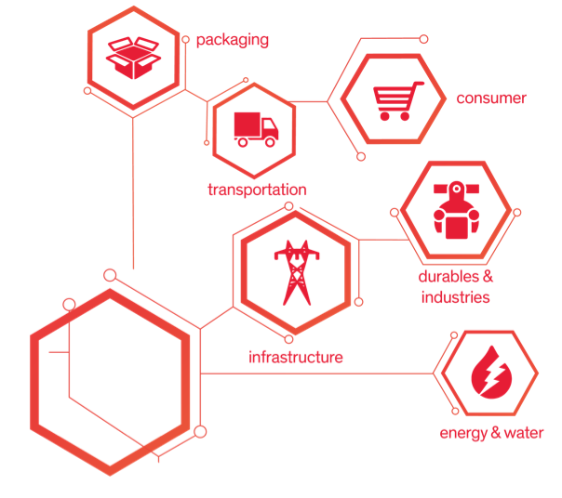
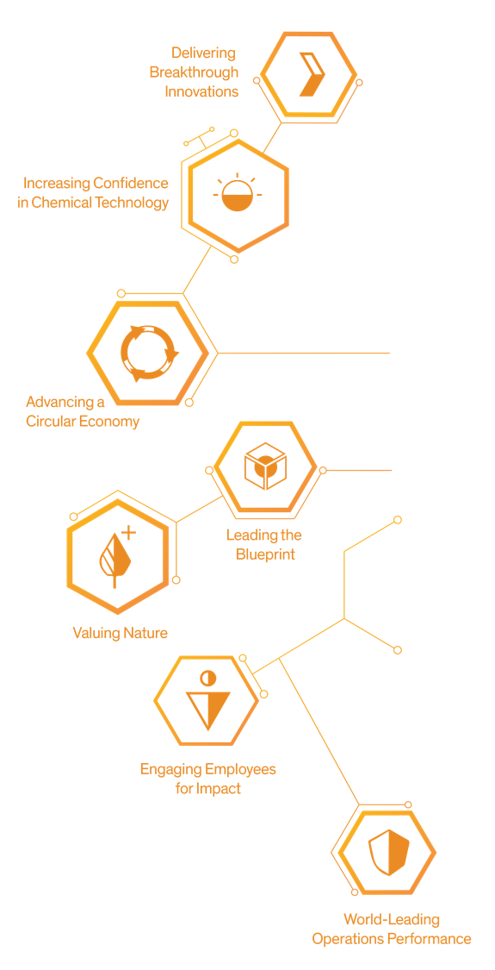
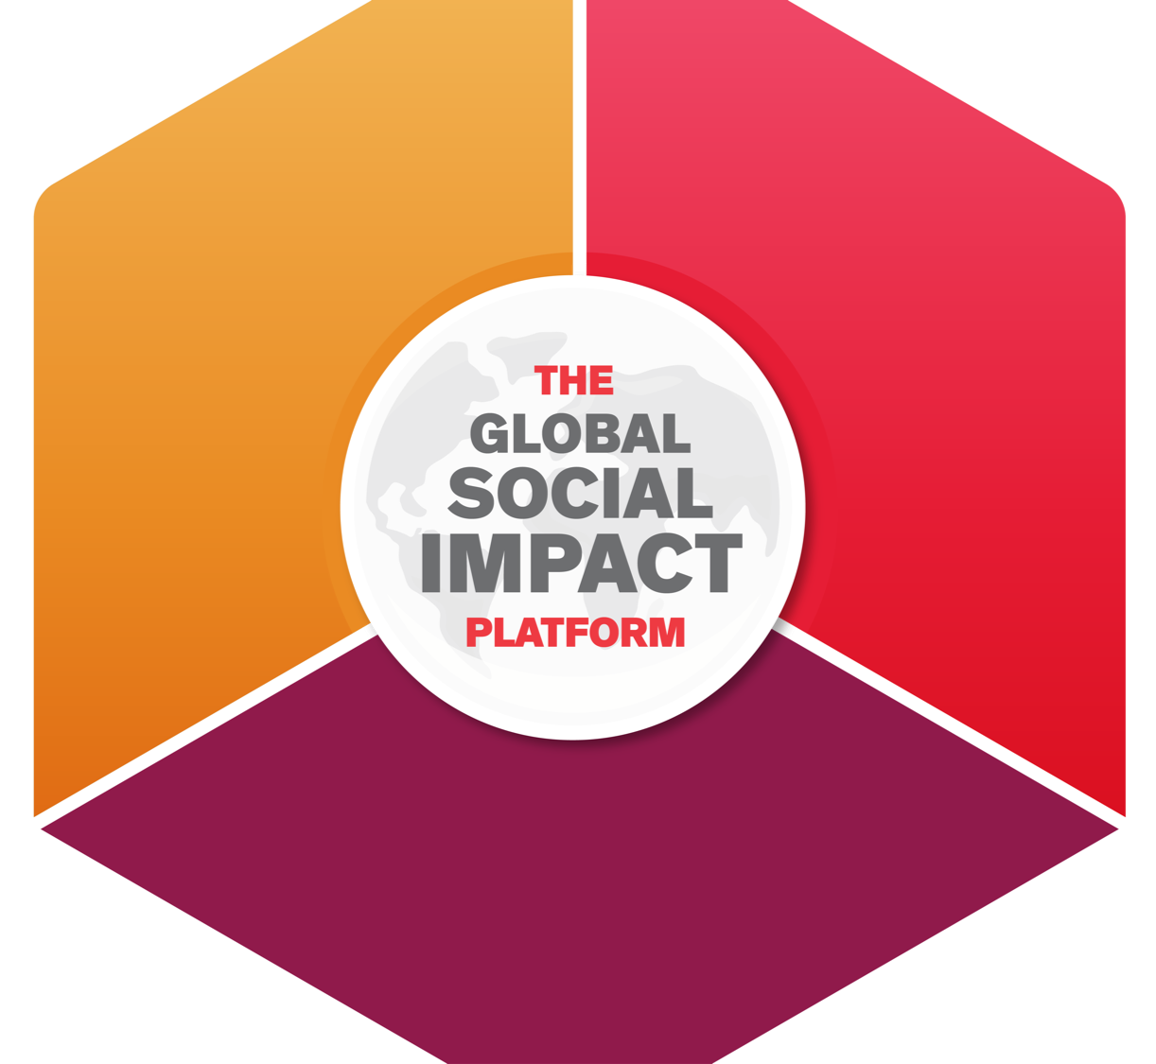
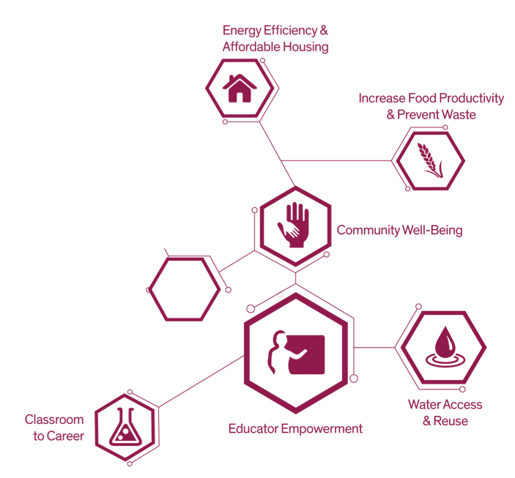
Global Social Impact Making a difference at the intersection of sustainability, citizenship and innovation
Innovation
.
Sustainability
Global Citizenship

Slide 4
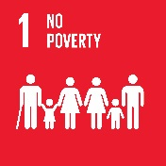
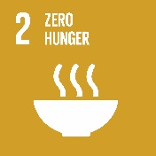













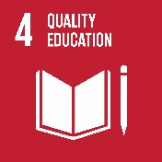
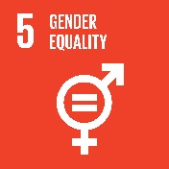
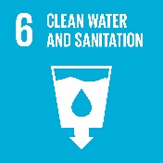
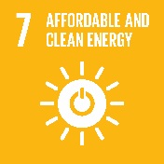
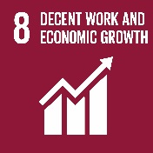
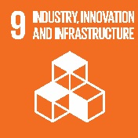
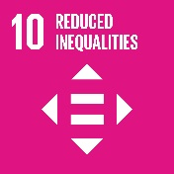
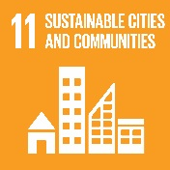
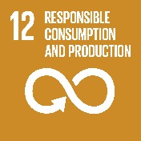
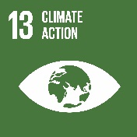
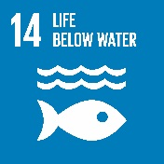
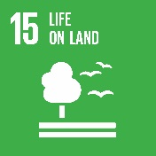

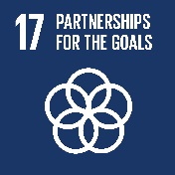
Dow’s 2025 Sustainability Goals Align by Design to UN SDGs
1
2
3
4
5
6
7
8
9
10
11
12
13
14
15
16
17
Delivering Breakthrough Innovations
Advancing a Circular Economy
Safe Chemistry for a Sustainable Planet
World-Leading Operations Performance
Circular Economy | Food Security |  | Educator Empower-ment | Classroom to Career
Leading the Blueprint
Valuing Nature
Engaging for Impact
Community Well-Being

Slide 5
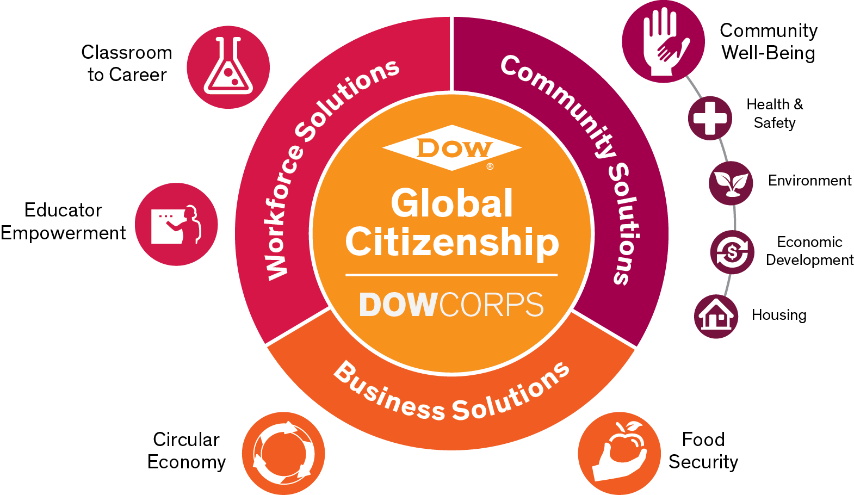
Dow’s Global Citizenship Priority Areas

Slide 6
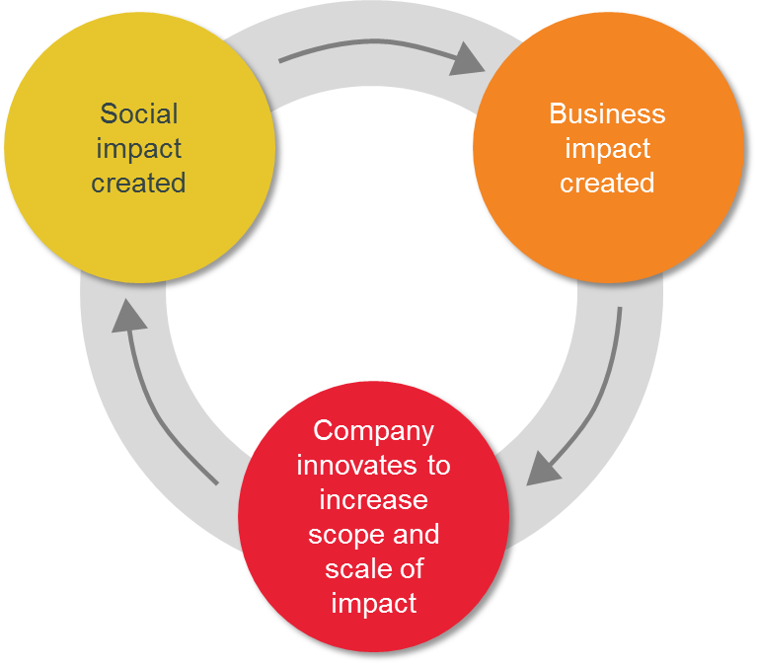
Business Impact Fund – Shared Value
WHAT: Increase profits, reduce costs, and/or enhance competitiveness by solving social problems.
Why: Business could have a far greater impact on social issues through their business practices than through charitable giving
Corporate Philanthropy
Corporate Social Responsibility
Shared
Value
Charitable giving to meet community expectations.
Indirect business value via engagement on social or environmental issues.
Direct business value created by solving social problems.
Ways Business Can Influence Societal Change
2

Slide 7
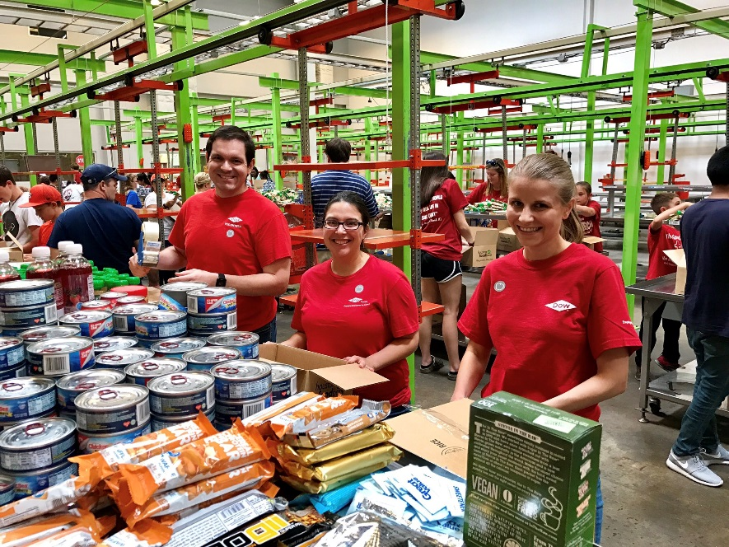
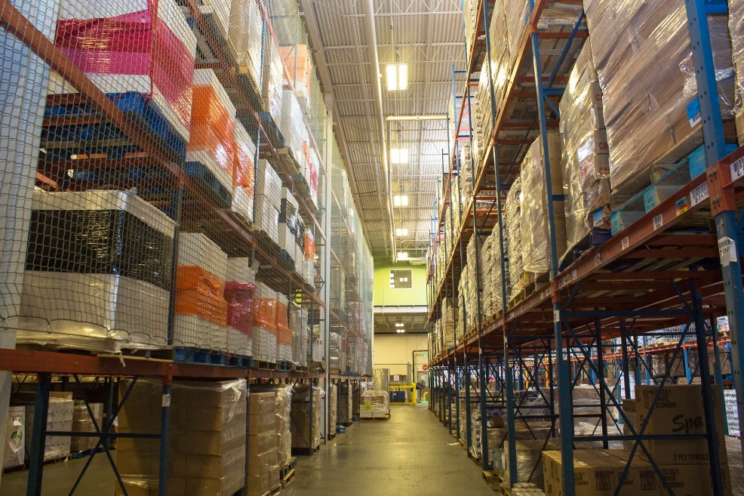
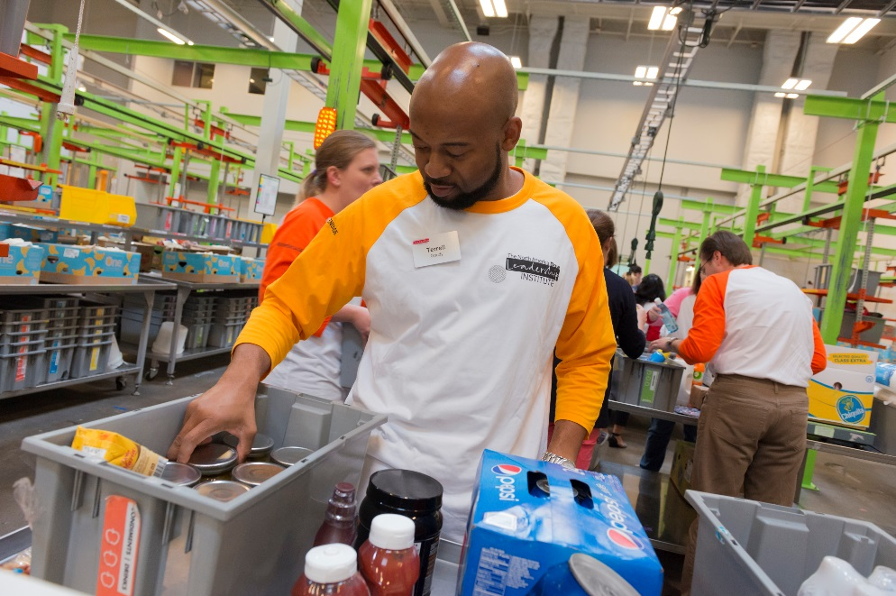





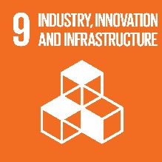

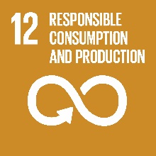
Case Study: Produce Rescue Center – Houston, Texas
Problem: 40% of food waste occurs at retail and consumer stages, limiting the opportunity to distribute to families in need.
Solution: Creation of the Produce Rescue Center to collect, sort and redistribute nutritious produce rejected by retailers. Dow packaging was used to extend produce shelf life and increase the available supply of nutritious food.
Partners: Dow Packaging & Specialty Plastics business, local Dow team, Montgomery County Food Bank, customer and industry/local stakeholders

Slide 8
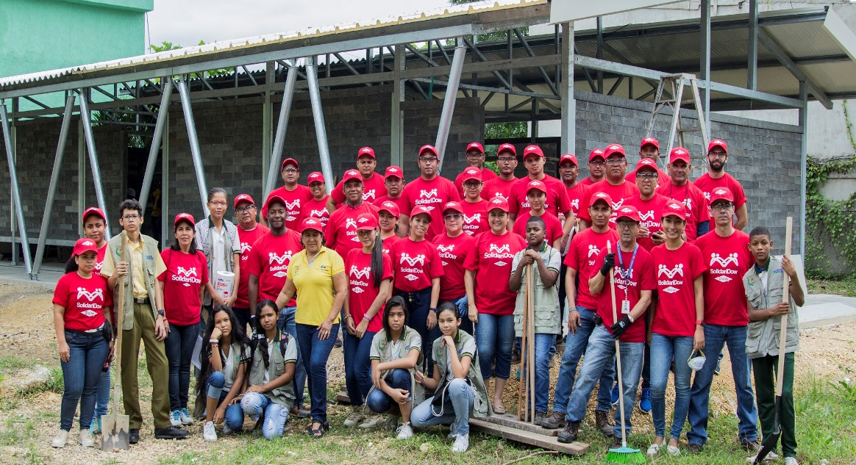
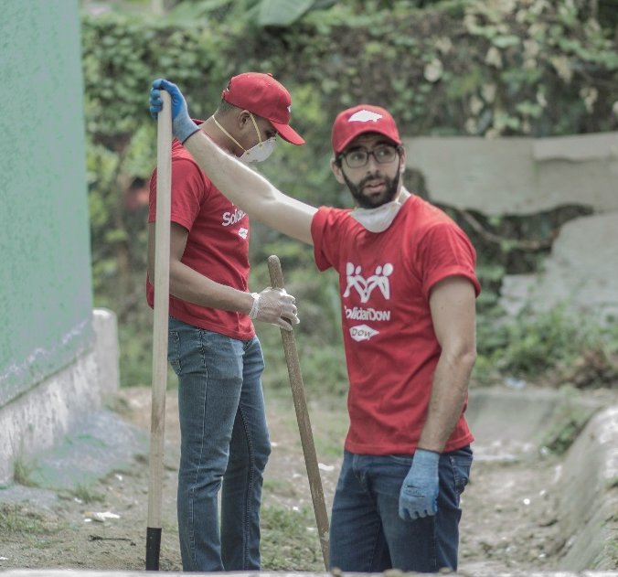
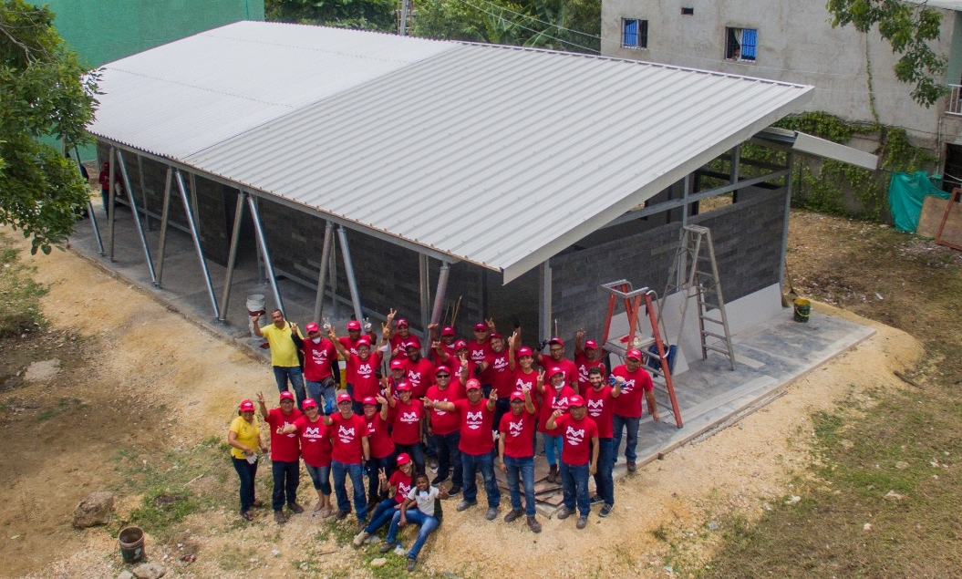

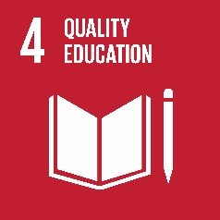

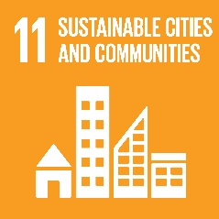
Case Study: Green Classrooms – Cartagena, Colombia
Problem: A need to develop educational infrastructure in a sustainable way in a vulnerable zone of the community.
Solution: More than 200 children have benefited from the construction of two classrooms built with 100% recycled plastic bricks.
Partners: Dow Packaging & Specialty Plastics Business, Local Dow team, Conceptos Plásticos, Rochester School, City Secretary of Education and Fundación Mamonal

Slide 9
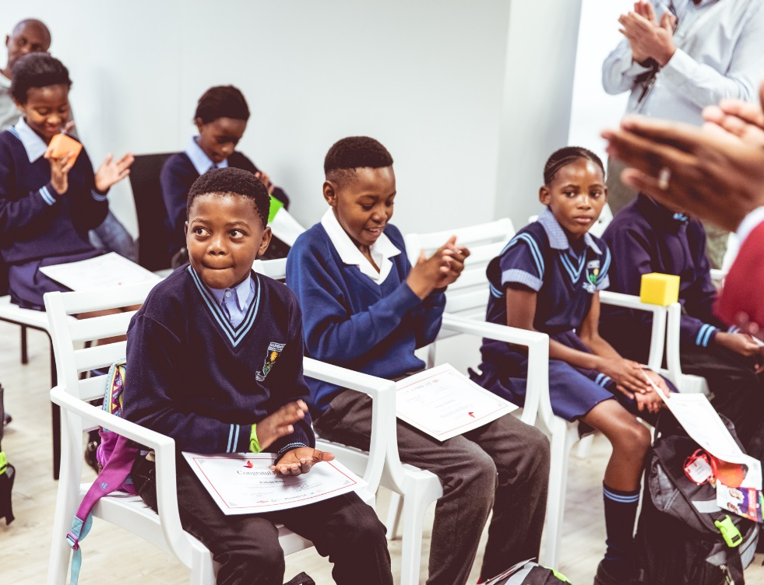
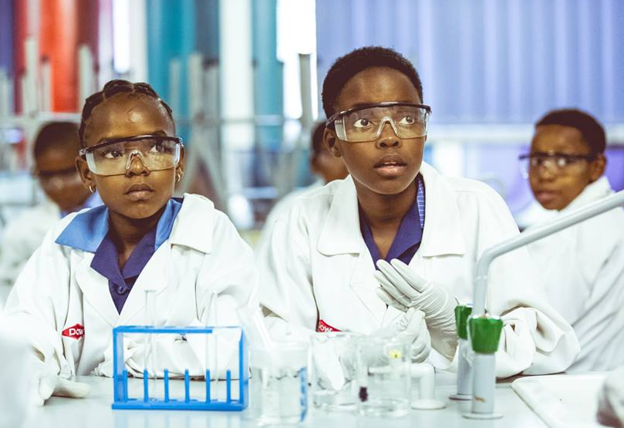
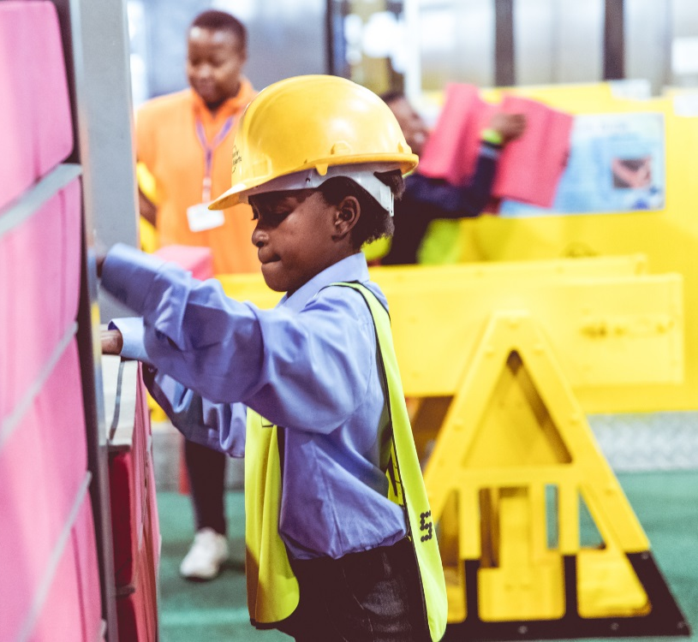


Case Study: Project Butterfly – South Africa
Problem: In need of behavioral and educational change, one of South Africa’s most pressing and visible environmental issues is litter.
Solution: Educating and recognizing students for taking action and making a difference through the recycling and reuse of plastic.
Partners: Dow Packaging & Specialty Plastics Business, Local Dow team, Plastics SA, youth led recycling organisation Destination Green, Recycling education initiative, Aqua Amazing and Mashemong Primary School.

Slide 10
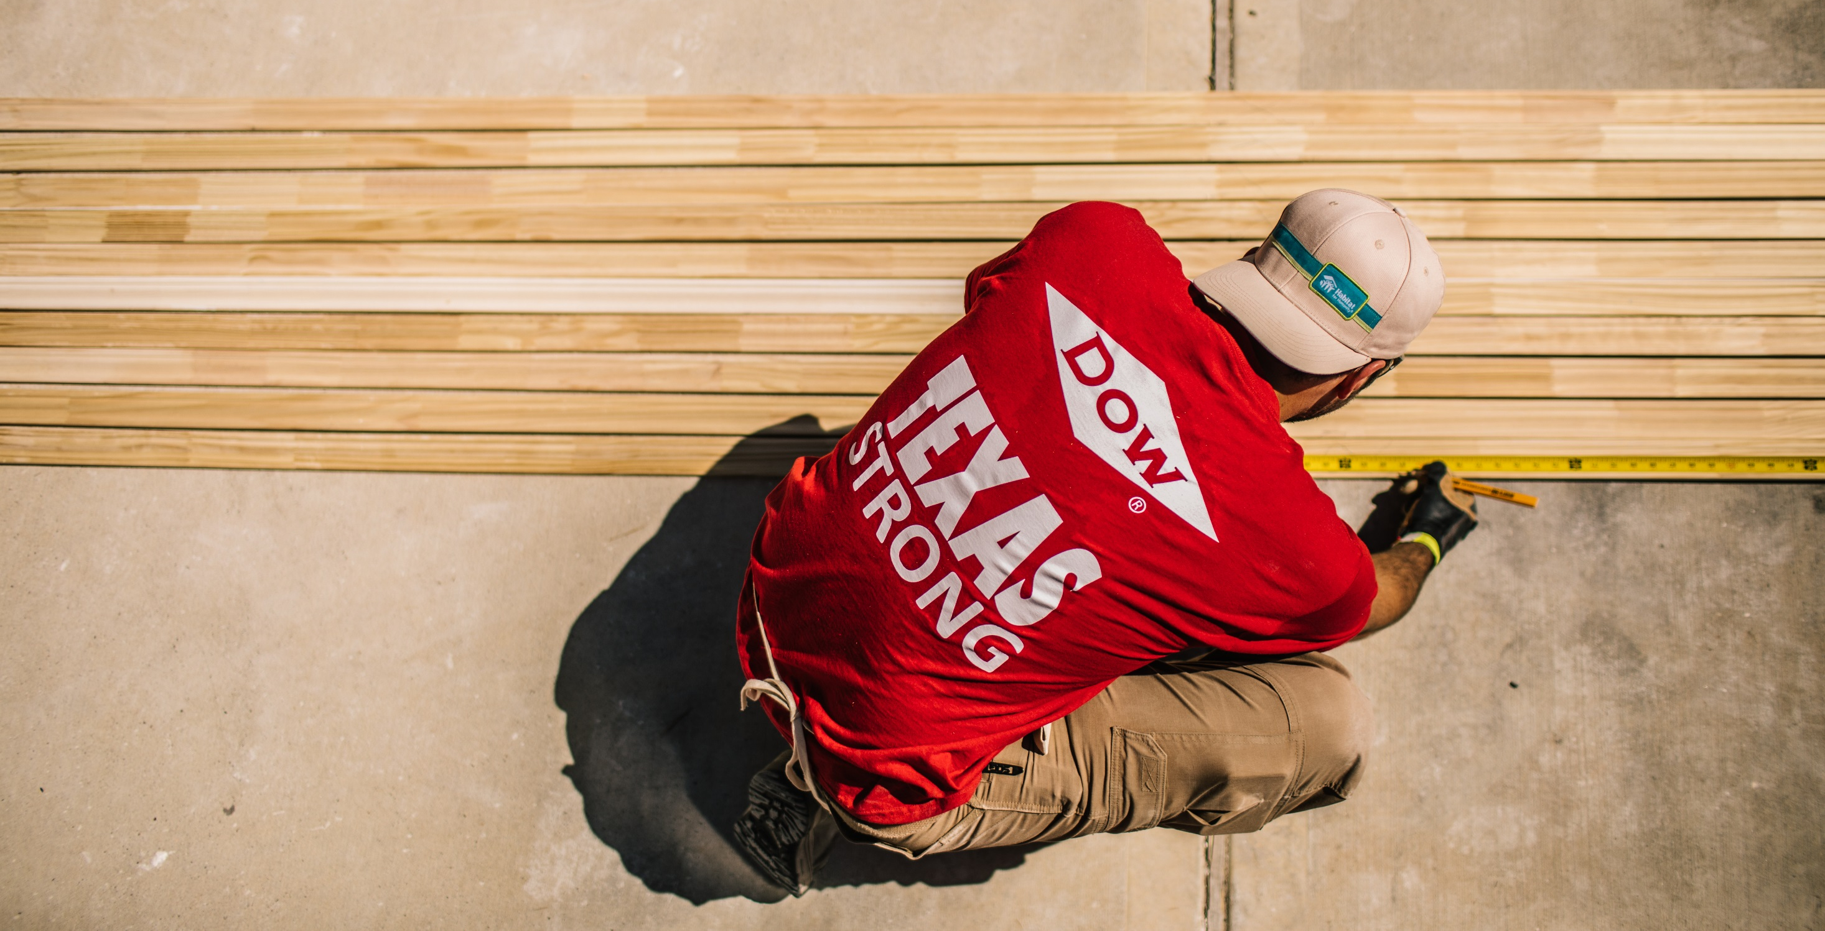


Rob Vallentine
rmvallentine@dow.com
@DowCorps

Slide 11

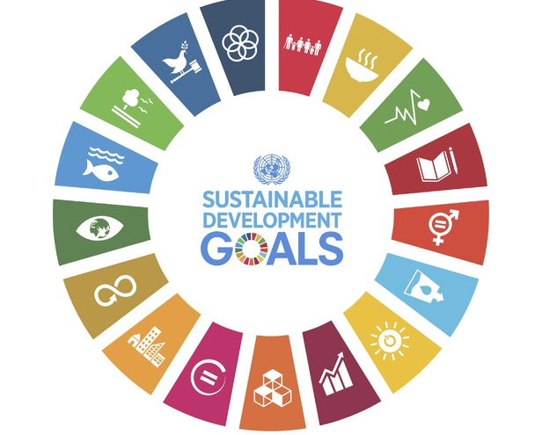
ALIGNING MEASUREMENT TO THE SUSTAINABLE DEVELOPMENT GOALS
Boston College Corporate Citizenship Conference, April 10, 2018
Anne Warner, Senior Manager Impact Measurement and Evaluation
Royal Bank of Canada
Notes:
RBC is the largest financial institution in Canada. It’s the 13th largest global financial institutions by market cap.
We invest 100 M to 6500 orgs per year including investment to charitable partners through the RBC foundation.

Slide 12
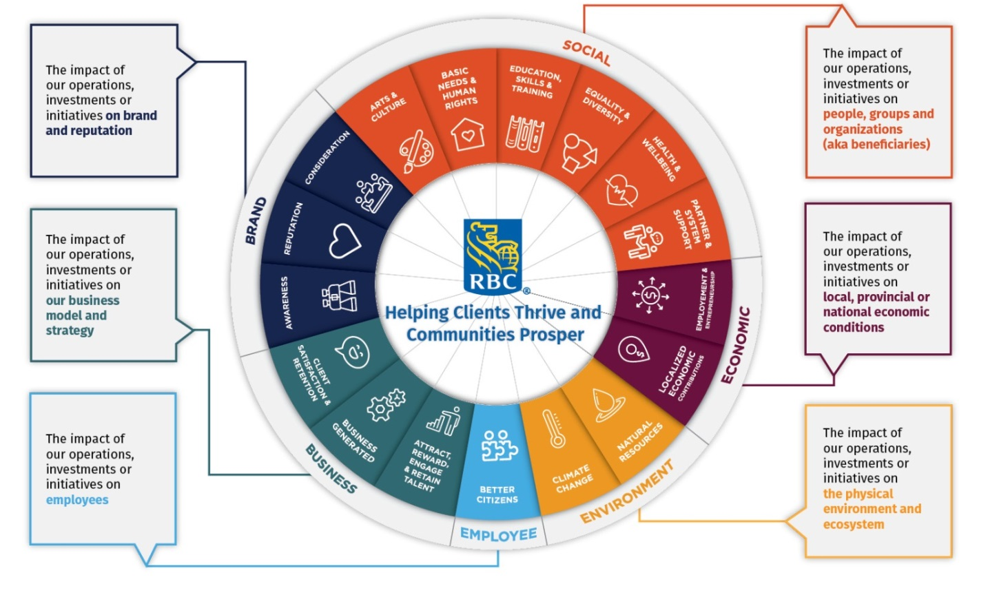
Royal Bank of Canada (RBC) Impact Measurement Framework (IMF)
Notes:
Impact categories demonstrating that impact is holistic (not only social, environmental, economic, and environmental). We also incorporate brand and business.
Impact areas associated with each impact category.
Used the SDGs to inform impact area names (ex: Climate Action (Climate Change), Good Health and Wellbeing (Health and Wellbeing)).
Each impact area has outcomes and indicators associated with it. The SDGs were used to inform those outcomes and indicators.
Each program or focus area is associated with different impact areas so this wheel can be used to assess an entire program.
RBC’s purpose is the anchor.
Balance business benefits and social aspects.

Slide 13

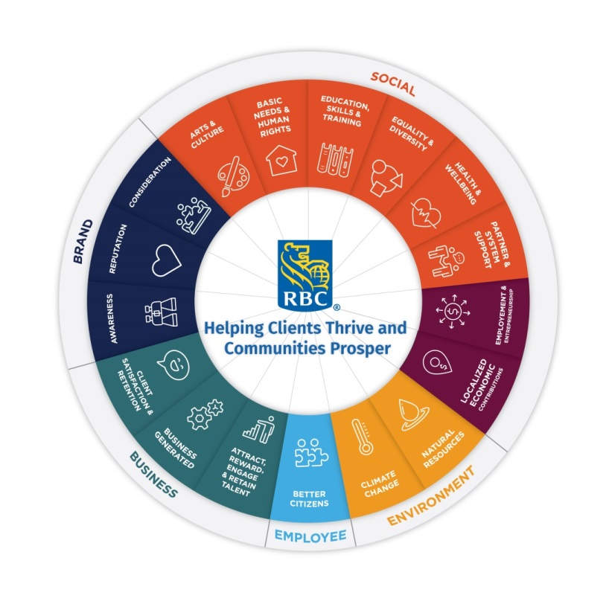

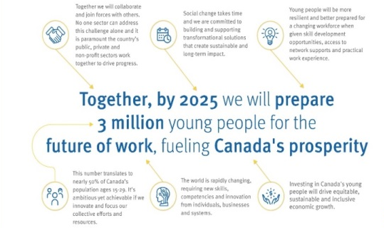
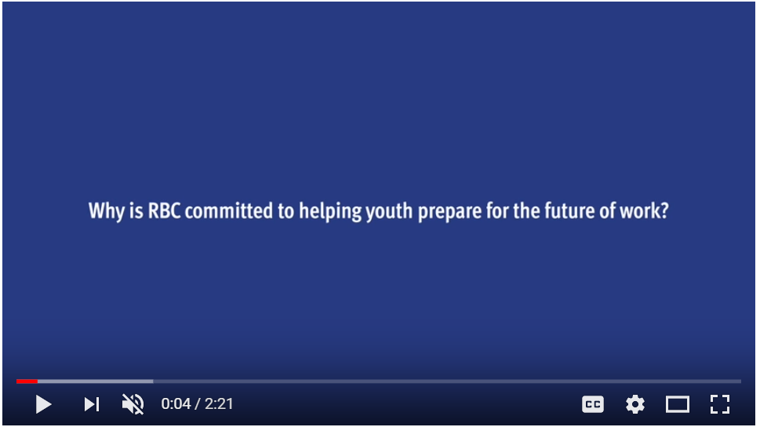





RBC Future Launch Program Objectives
Equality and Diversity
Provide underserved youth equitable access to Future Launch programming, empowering and promoting the inclusion of all.
Education, Skills and Training
Prepare young people for the future of work through networking and advice, practical work experience, or 21st century skills development.
Partner and System Support
Support cross-sector innovation and partner capacity building by encouraging and promoting effective public, public-private and civil society partnerships to support policy and social sector innovation.
Employment & Entrepreneurship
Fuel Canada's prosperity by reducing the proportion of youth not in employment, education or training.
RBC Future Launch
Overview
Impacts
Highlights
RBC Future Launch is a 10-year, $500-million commitment to help young people overcome critical barriers that are impacting their progress, including:
A lack of relevant skills
A lack of relevant experience
A lack of knowledge networks
Resources:
> RBC Career Launch
> RBC Amplify
> RBC Future Launch Youth Forums
> Launching Careers Playbook
> RBC@McMaster
> It All Adds Up
> Our intended outcomes
> Alignment to United Nations Sustainable Development Goals
> How we measure success
Notes:
I’d like to illustrate how we integrate the SDGs into our IMF through one of our priority projects – RBC Future Launch. Future Launch is a 500M 10 year commitment to help prepare young people for the future of work by improving skills, growing networks and offering practical work experiences.
The wheel highlights which impact areas are the focus of FL…while those shaded are not material to FL.
On the left hand-side are the social and economic objectives of FL. Each of these are correlated to SDGs and SDG targets and KPIs when applicable.
Make more applicable to corporations vs. government

Slide 14

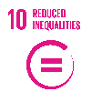
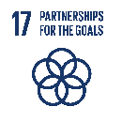

Program Specific Mapping and the SDGs
Education, Skills & Training
4.3: By 2030, ensure equal access for all women and men to affordable and quality technical, vocational and tertiary education, including university.
4.4: By 2030, substantially increase the number of youth and adults who have relevant skills, including technical and vocational skills, for employment, decent jobs and entrepreneurship.
10.2: By 2030, empower and promote the social, economic and political inclusion of all, irrespective of age, sex, disability, race, ethnicity, origin, religion.
17.16: Enhance the global partnership for sustainable development, complemented by multi-stakeholder partnerships that mobilize and share knowledge, expertise, technology and financial resources, to support the achievement of the sustainable development goals in all countries, in particular developing countries.
17.17: Encourage and promote effective public, public-private and civil society partnerships, building on the experience and resourcing strategies of partnerships
8.3 Promote development-oriented policies that support productive activities, decent job creation, entrepreneurship, creativity and innovation, and encourage the formalization and growth of micro-, small- and medium-sized enterprises, including through access to financial services
8.6: By 2020, substantially reduce the proportion of youth not in employment, education or training.
RBC Future Launch
Overview
Impacts
Highlights
Equality & Diversity
RBC Future Launch is a 10-year, $500-million commitment to help young people overcome critical barriers that are impacting their progress, including:
Partner and System Support
A lack of relevant skills
A lack of relevant experience
A lack of knowledge networks
Resources:
> RBC Career Launch
> RBC Amplify
> RBC Future Launch Youth Forums
> Launching Careers Playbook
> RBC@McMaster
> It All Adds Up
> Our intended outcomes
> Alignment to United Nations Sustainable Development Goals
> How we measure success
Employment & Entrepreneurship
Notes:
Challenges
Make more applicable to corporations vs. government

