Slide 1
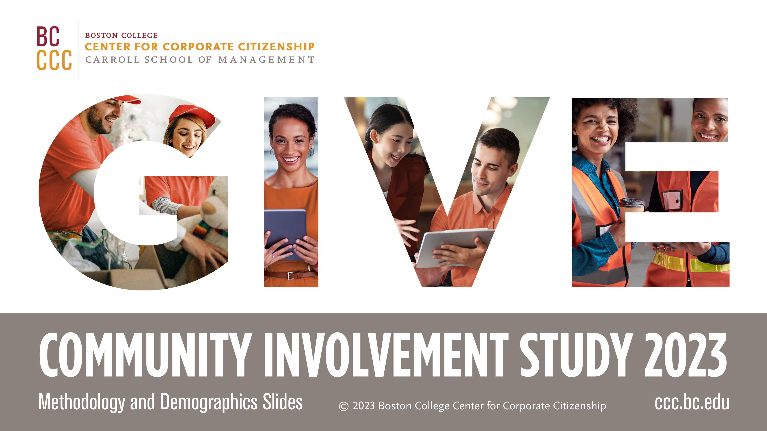

Slide 2



Methodology
Survey
210 companies
Mostly U.S.-based medium
and large companies
Conducted October-December 2022
History
The survey has been conducted 14 times since 1995.
Examines how companies
are investing in their communities.
Corporate citizenship professionals and executives provide insight into how their companies are managing and executing their community involvement programs.
Criteria
and Specifics
Data in figures and throughout the text refers to survey responses based on the entire company, unless otherwise noted Ninety-three percent of the survey responses are based on the entire company.
Cash giving directly from the company and non-cash contributions were supplemented with data available from public sources or non-surveyed companies. Cash giving through the foundation was based on data from Candid’s Foundation Directory Online where indicated. Multi-year commitment data was mainly sourced from company websites.
The company demographic data (e.g., industries and revenue) provided in the survey responses were cross-referenced with sources of information about corporate demographics, including databases and company websites.

Slide 3
Industry
Note: Industries based on the Global Industry Classification Standard (GICS)
Notes:
One-fifth of the companies in this study are based in the financials industry, which was also the most represented industry in the prior study.

Slide 4
Company revenue

Slide 5
Business type

Slide 6
Company type

Slide 7
Company operations
Notes:
Approximately 60% of companies in the current study operate globally, compared to 53% in the 2019 study.

Slide 8
Employee size

Slide 9

About the Center for Corporate Citizenship
Based in the Carroll School of Management, the Boston College Center for Corporate Citizenship combines the most valuable aspects of a professional community and the resources of a leading academic institution for our members. We integrate the perspectives and experience of some of the leading corporate citizenship professionals in the field today with management best practices, helping you align your corporate citizenship objectives and business goals. Center resources support positive outcomes for your functional area, your organization as a whole, and for you as a leader.

