Slide 1
Distributed Machine Learning in Vehicular Clouds
CarML:
Anran Du
May 7th, 2021
Advisor: Prof. Lewis Tseng

Slide 2
Table of Contents
Background
CarML: Architecture
CarML: Design and Results
Future Work

Slide 3
Background
1

Slide 4
Why Distributed Machine Learning?
Wide demand for big data
Exponential growth in training data size
Centralized ML ⇨ Distributed ML

Slide 5
Why Vehicles?
Abundant computation resources
e.g., modern Tesla equipped with ML-specialized chips
Idle computation resources
Identical backup computation unit for safety and redundancy

Slide 6
Architecture
2

Slide 7



Top Layer:
Cloud Server
LAN
Middle Layer:
Edge Servers
4G/5G
Bottom Layer:
Vehicles
mmWave

Slide 8


𝛁_{avg}
𝛁
𝛁

Slide 9
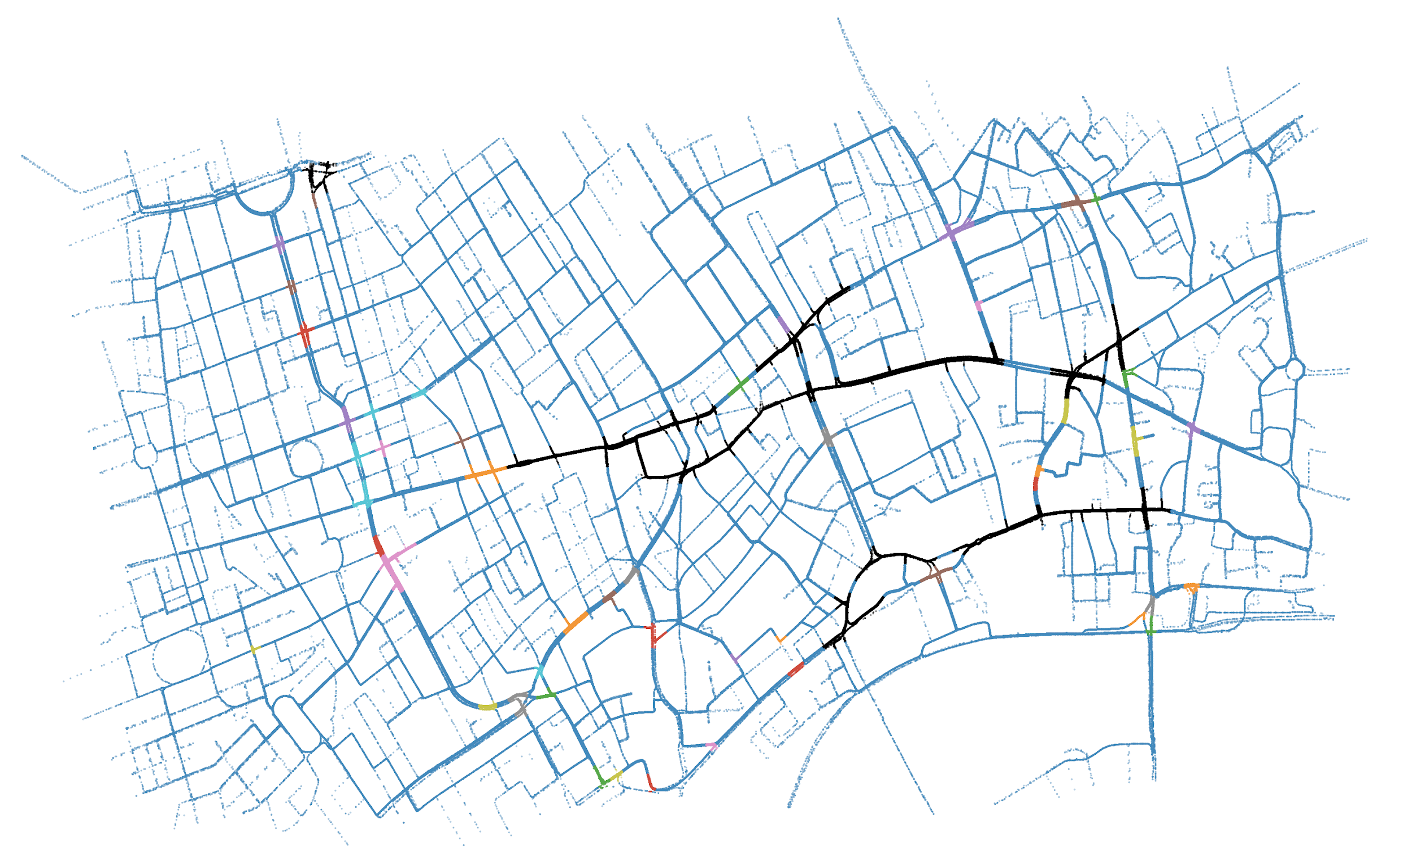
Simulator
A map of a part of London generated by SUMO
4,774 seconds
Total 6,374 vehicles; Peak 667 vehicles
DNN on MNIST
200 mini-batches
10 sec/mini-batch/vehicle
Cloud
Server

Slide 10
Design and Results
3
RSU Placement
Data Distribution
Communication Synchrony
Fault-tolerance

Slide 11
RSU Placement
Why?
Improves performance
Good Placement ⇨ More vehicles in range to complete tasks
Place RSUs at junctions with highest traffic density
Solution
Density-based Spatial Clustering of Application with Noise (DBSCAN)
Historical traffic pattern
Scatter plot of vehicle traces in each second

Slide 12
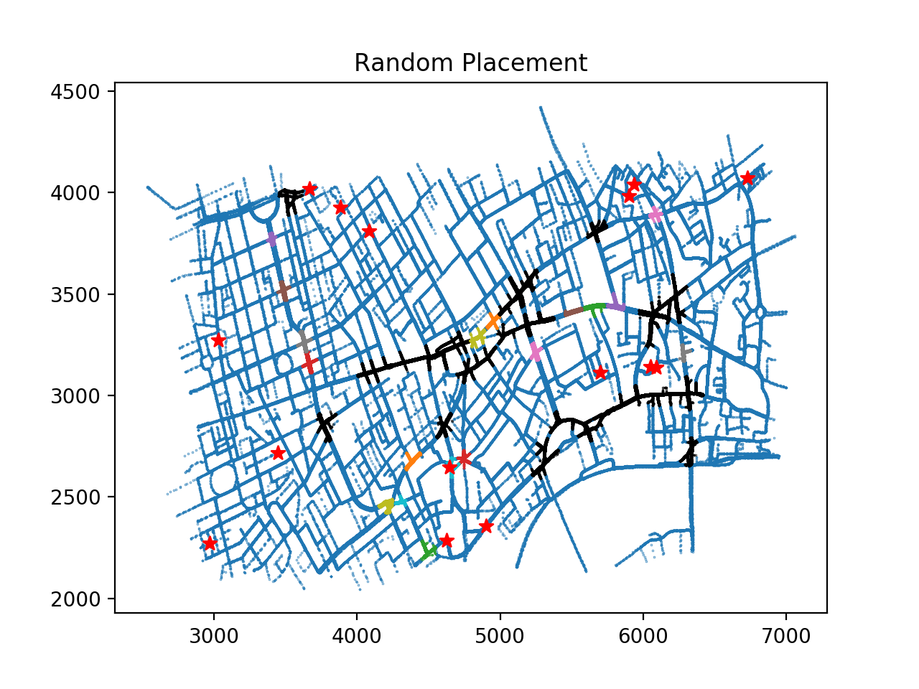
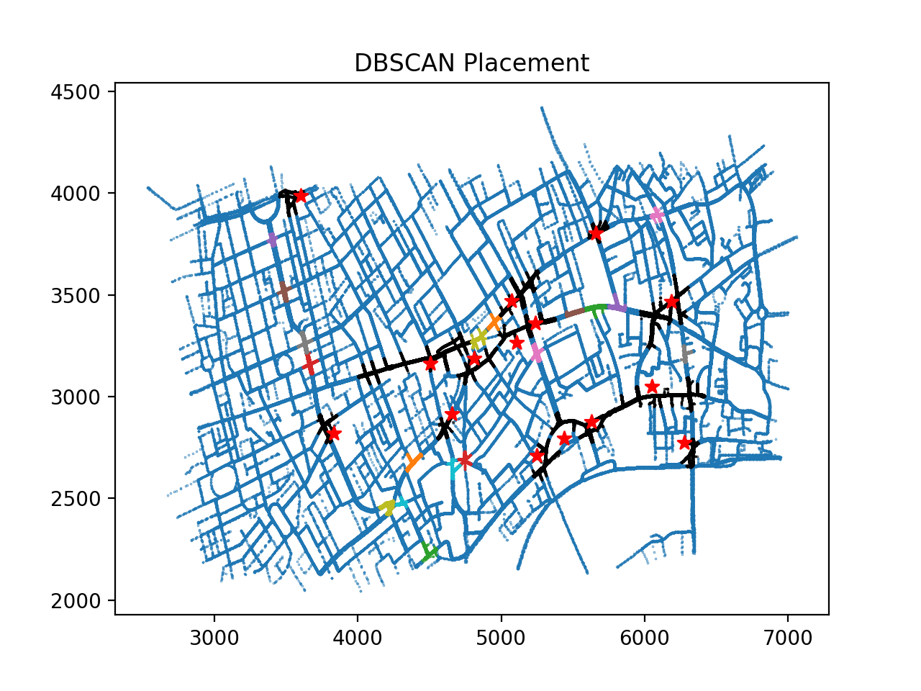
Random v.s. DBSCAN Placement

Slide 13
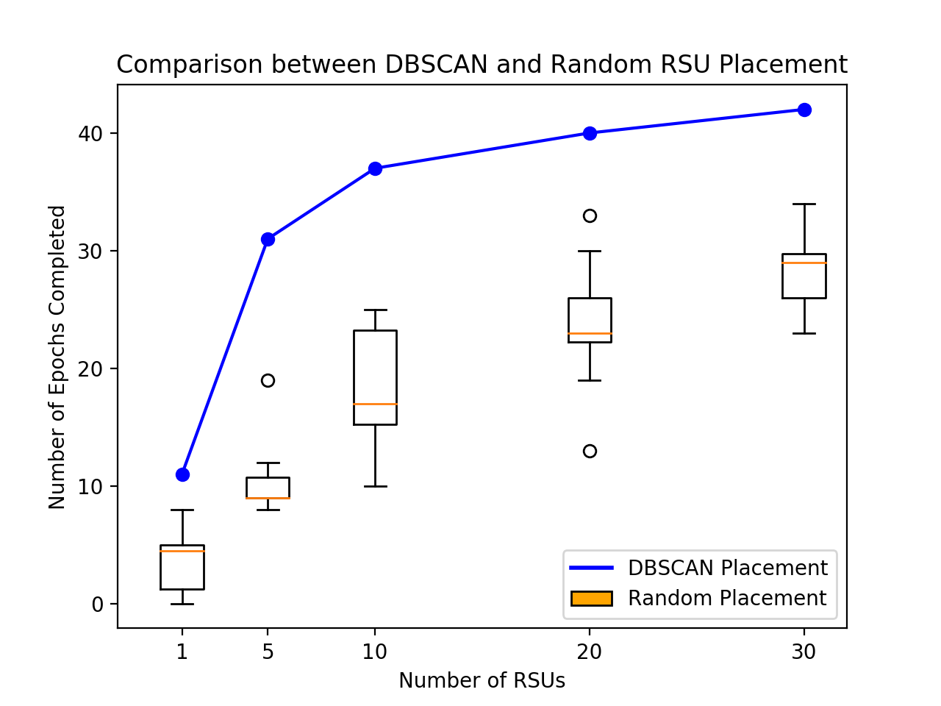
RSU Placement
Random v.s. DBSCAN Placement
On average, DBACAN improved performance by 50% to 100%

Slide 14
Data Distribution
Why?
Limited storage at each RSU
Communication cost
Solution
Distribute data based on traffic density
Send out small batches of data periodically

Slide 15
Communication Synchrony
Bounded Staleness
1 ⇨ Complete synchronous
1 < i < n ⇨ Bounded asynchronous
n <= i ⇨ Complete asynchronous
*n = number of cars on the road

Slide 16
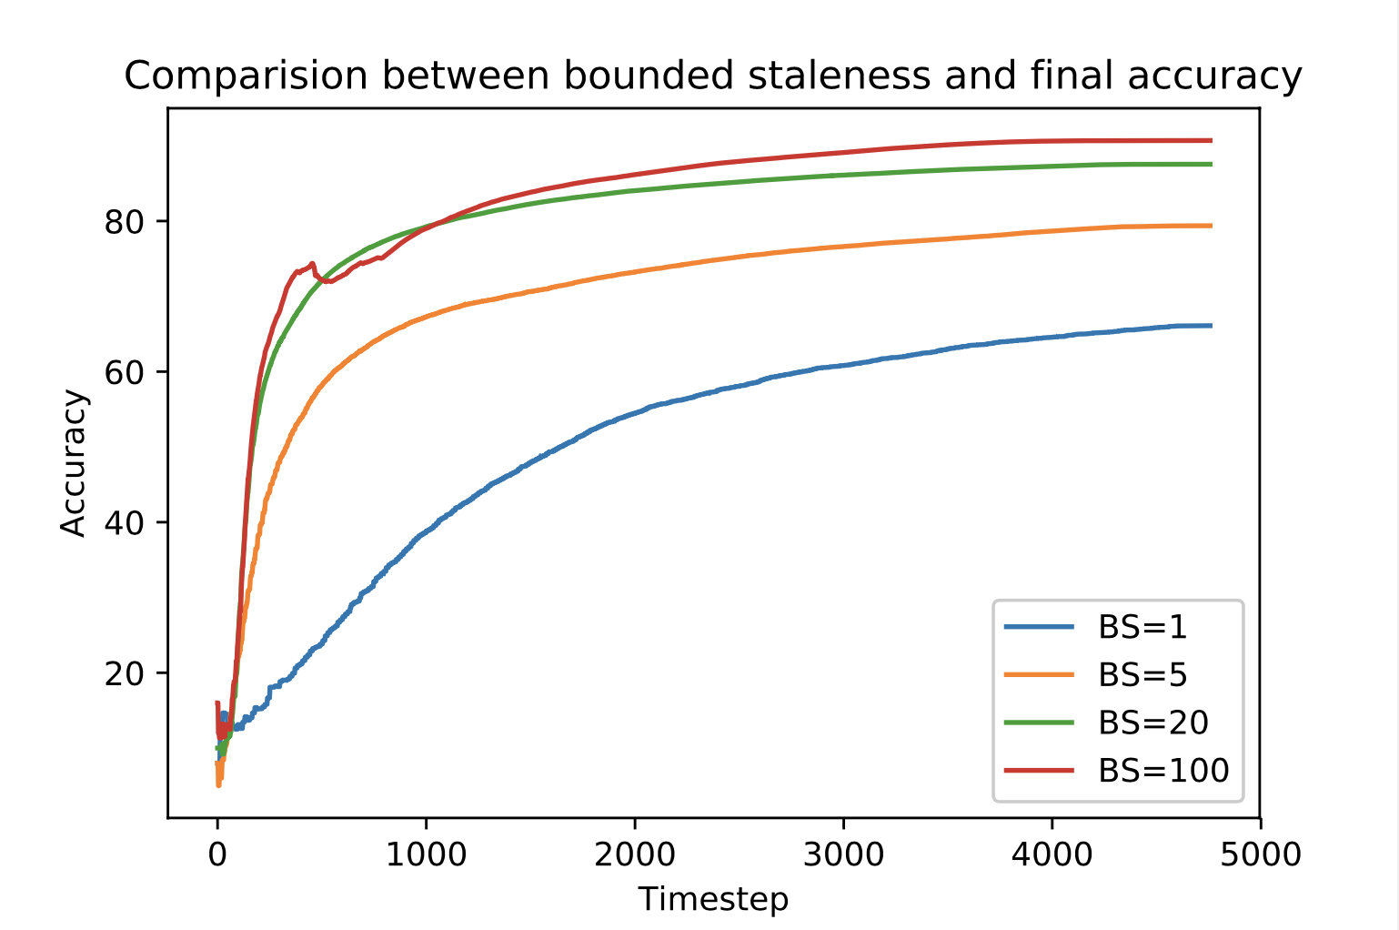
Communication Synchrony
Bounded Staleness | Number of Epochs Completed
1 | 0
5 | 2
20 | 13
100 | 54

Slide 17
Fault-Tolerance
RF = 1
Approach 1 - Replication
Pro - Simplicity and small overhead at RSU and cloud server
Con - Higher storage expanses and lower efficiency
RF = 3

Slide 18



Fault-Tolerance
Untrained
Training
Trained
Approach 2 - Fault-tolerance
Pro - 100% fault proof
Con - Larger overhead at RSUs and cloud server

Slide 19
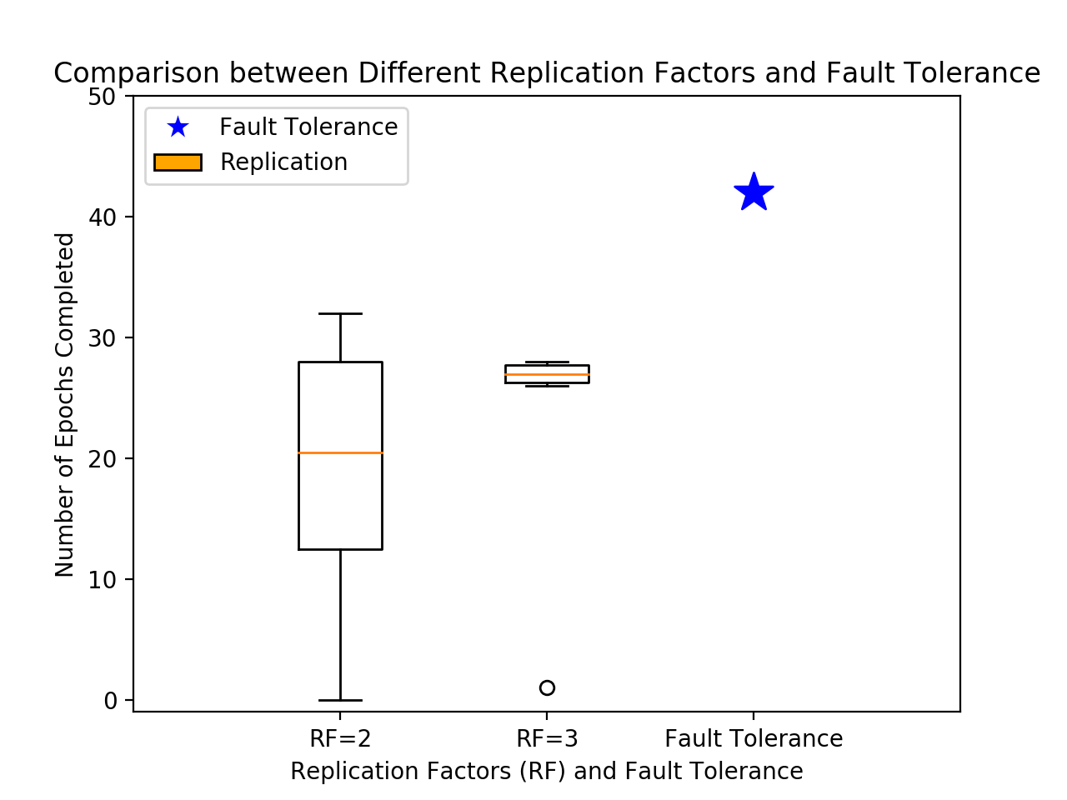
Fault-Tolerance
1% chance of failing/vehicle/second
Low RF ⇨ High variance
High RF ⇨ Fewer epochs
Fault-tolerance ⇨ Reliable and efficient

Slide 20
Future Work
4

Slide 21
Future Work
More complex dataset
A distributed simulator
Incorporating Federated Learning

Slide 22
Special Recognition
Yicheng Shen
My partner during my research
Prof. Lewis Tseng
Supervisor of my Honors Thesis

Slide 23
Thanks!
Any questions ?

