Slide 1
I-CARE4OLD
Individualized Care for Older Persons with Complex Chronic Conditions in Home Care and Nursing Homes

Slide 2
I-CARE4OLD
Funding Source:
European Union
Horizon 2020
Call: H2020-SC!-BHC-2018-2020
Better Health and Care, Economic Growth
and Sustainable Health Systems
Notes:
Funding Program - Horizon

Slide 3
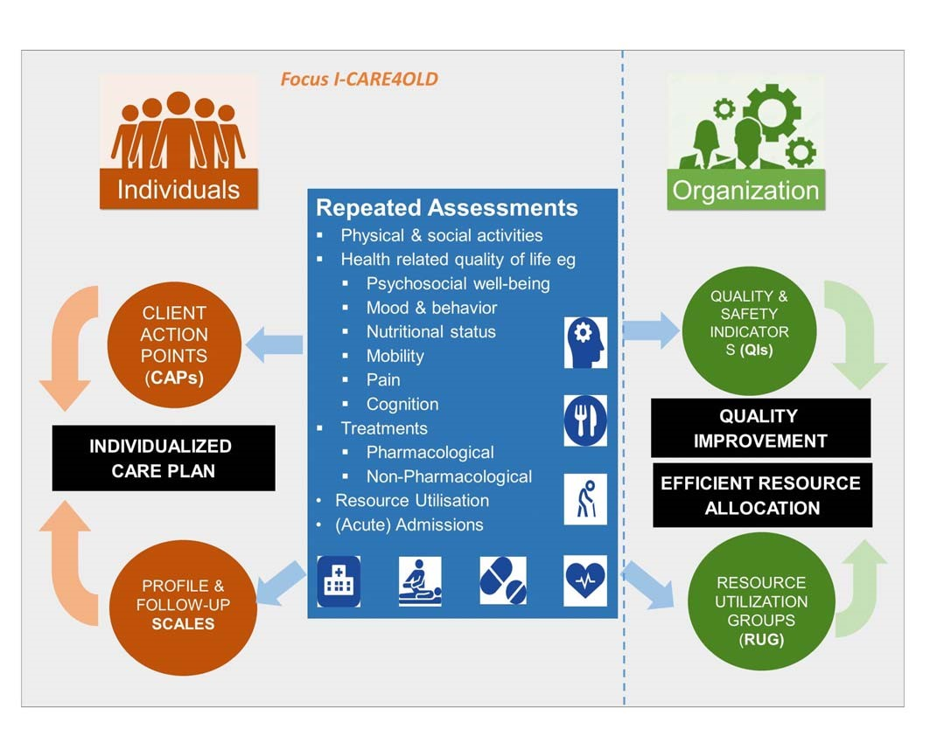
I-CARE4OLD

Slide 4
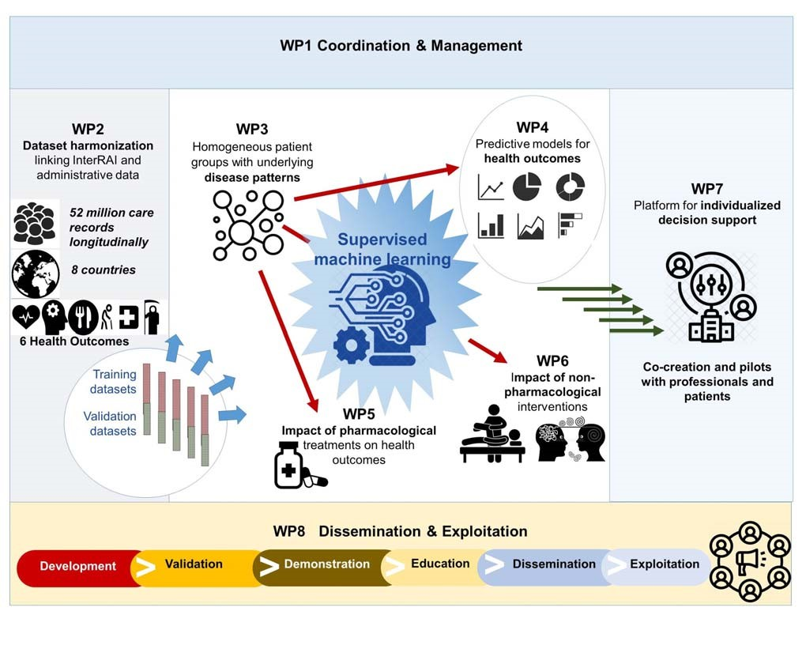
I-CARE4OLD
Notes:
8 WORK PACKAGES –ORGANIZATION OF THE PROJECT

Slide 5
I-CARE4OLD

Slide 6
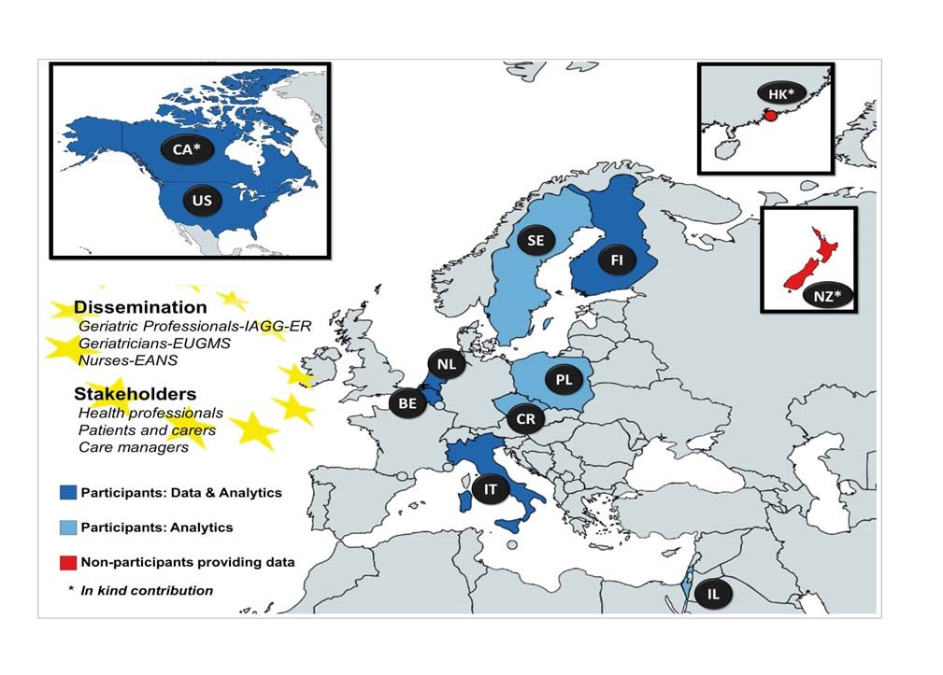
I-CARE4OLD
Notes:
Balanced geographical spread – northern Europe, central Europe, Eastern Europe, Mediterranean region and non-European countries of Israel and US/ Canada

Slide 7
I-CARE4OLD

