Slide 1
The Challenge of Naming Human Experience
Peggy L Chinn, RN, PhD, FAAN
2021 NANDA Annual Conference
June 16, 2021

Slide 2
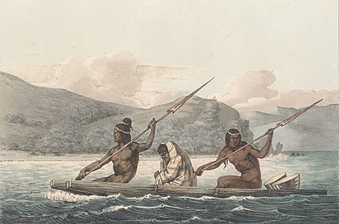
Acknowledgement of the Land
Oakland, California - Unceded ancestral homeland of the Muwekma Ohlone people
Source: http://www.muwekma.org/
Notes:
A vast territory that was the indigenous homeland of the Muwekma Ohlone Tribe stretching from what is now called Santa Cruz to the south of San Francisco and Napa to the north. From the ocean to the west, to the hills separating the coastal region from the fertile central valley to the east.
We honor this ancestral, and unceded territory of the Ohlone Nation as the traditional right holders and custodians. We honor and respect all those whose historical relationships with the land continue to this day. We hold up our hands in respect to the Elders, both past, present, and future, for they hold the memories, the traditions, the culture, and hopes of Indigenous Peoples.

Slide 3
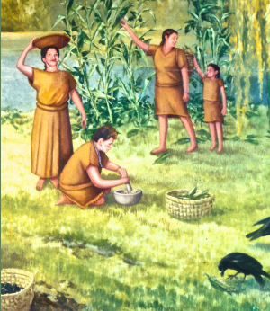
Acknowledgement of the Land
Boston Massachusetts - Unceded ancestral homeland of the Pawtucket, Massachusett, Nipmuc, and Wampanoag people
Source: http://massachusetttribe.org/life-of-the-indigenous-massachusett-at-ponkapoag-plantation
Notes:
A vast territory that was the indigenous homeland of the Muwekma Ohlone Tribe stretching from what is now called Santa Cruz to the south of San Francisco and Napa to the north. From the ocean to the west, to the hills separating the coastal region from the fertile central valley to the east.
We honor this ancestral, and unceded territory of the Ohlone Nation as the traditional right holders and custodians. We honor and respect all those whose historical relationships with the land continue to this day. We hold up our hands in respect to the Elders, both past, present, and future, for they hold the memories, the traditions, the culture, and hopes of Indigenous Peoples.

Slide 4

Names Matter!
Words Matter!
Context Matters!

Slide 5

Nursing - the verb
Nursing - the noun
https://nursology.net/

Slide 6

Doctor a drink (action)
Nurse a drink
(process)

Slide 7


We do not know what nursing is.
We need a single definition of nursing.
Theories are not useful.
Nursing is concrete - theory is too abstract.
“We don’t know” is cultural noise pollution.
Robust definitions = rich meanings
Nurses use theories daily.
Abstraction = flexible
Notes:
https://textbooks.lib.wvu.edu/badideas/badideasaboutwriting-book.pdf

Slide 8
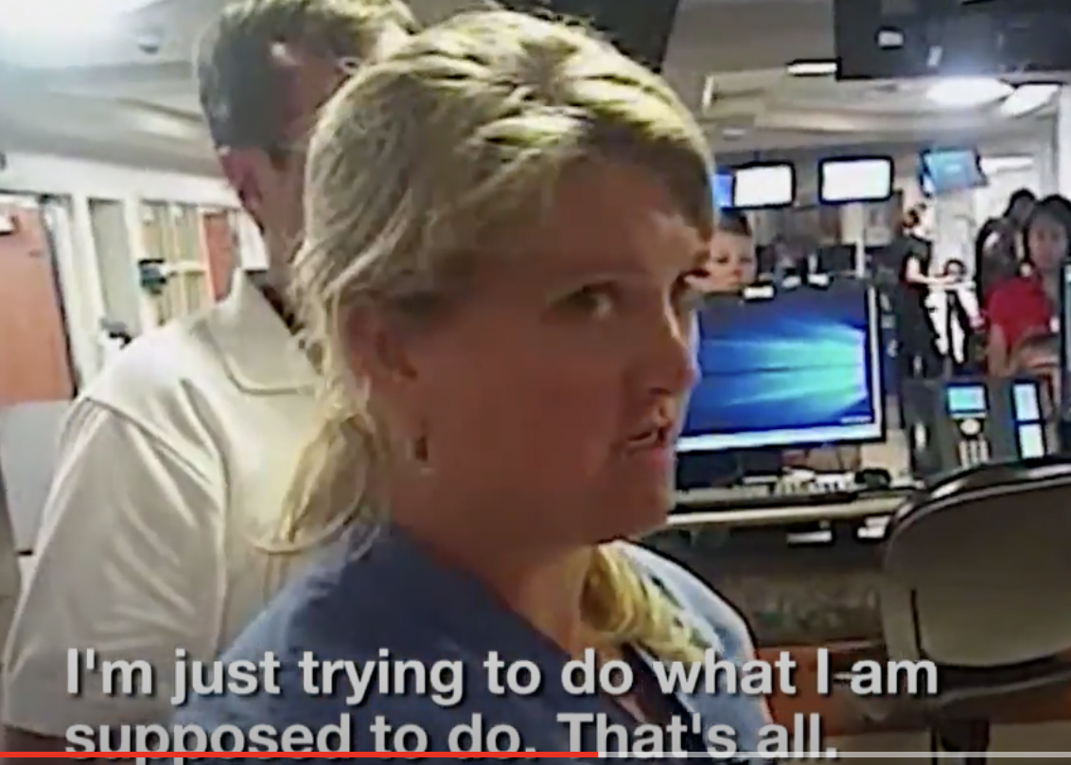
“We are the ones who know the patient”
Alex Wrubels, RN, 2018

Slide 9
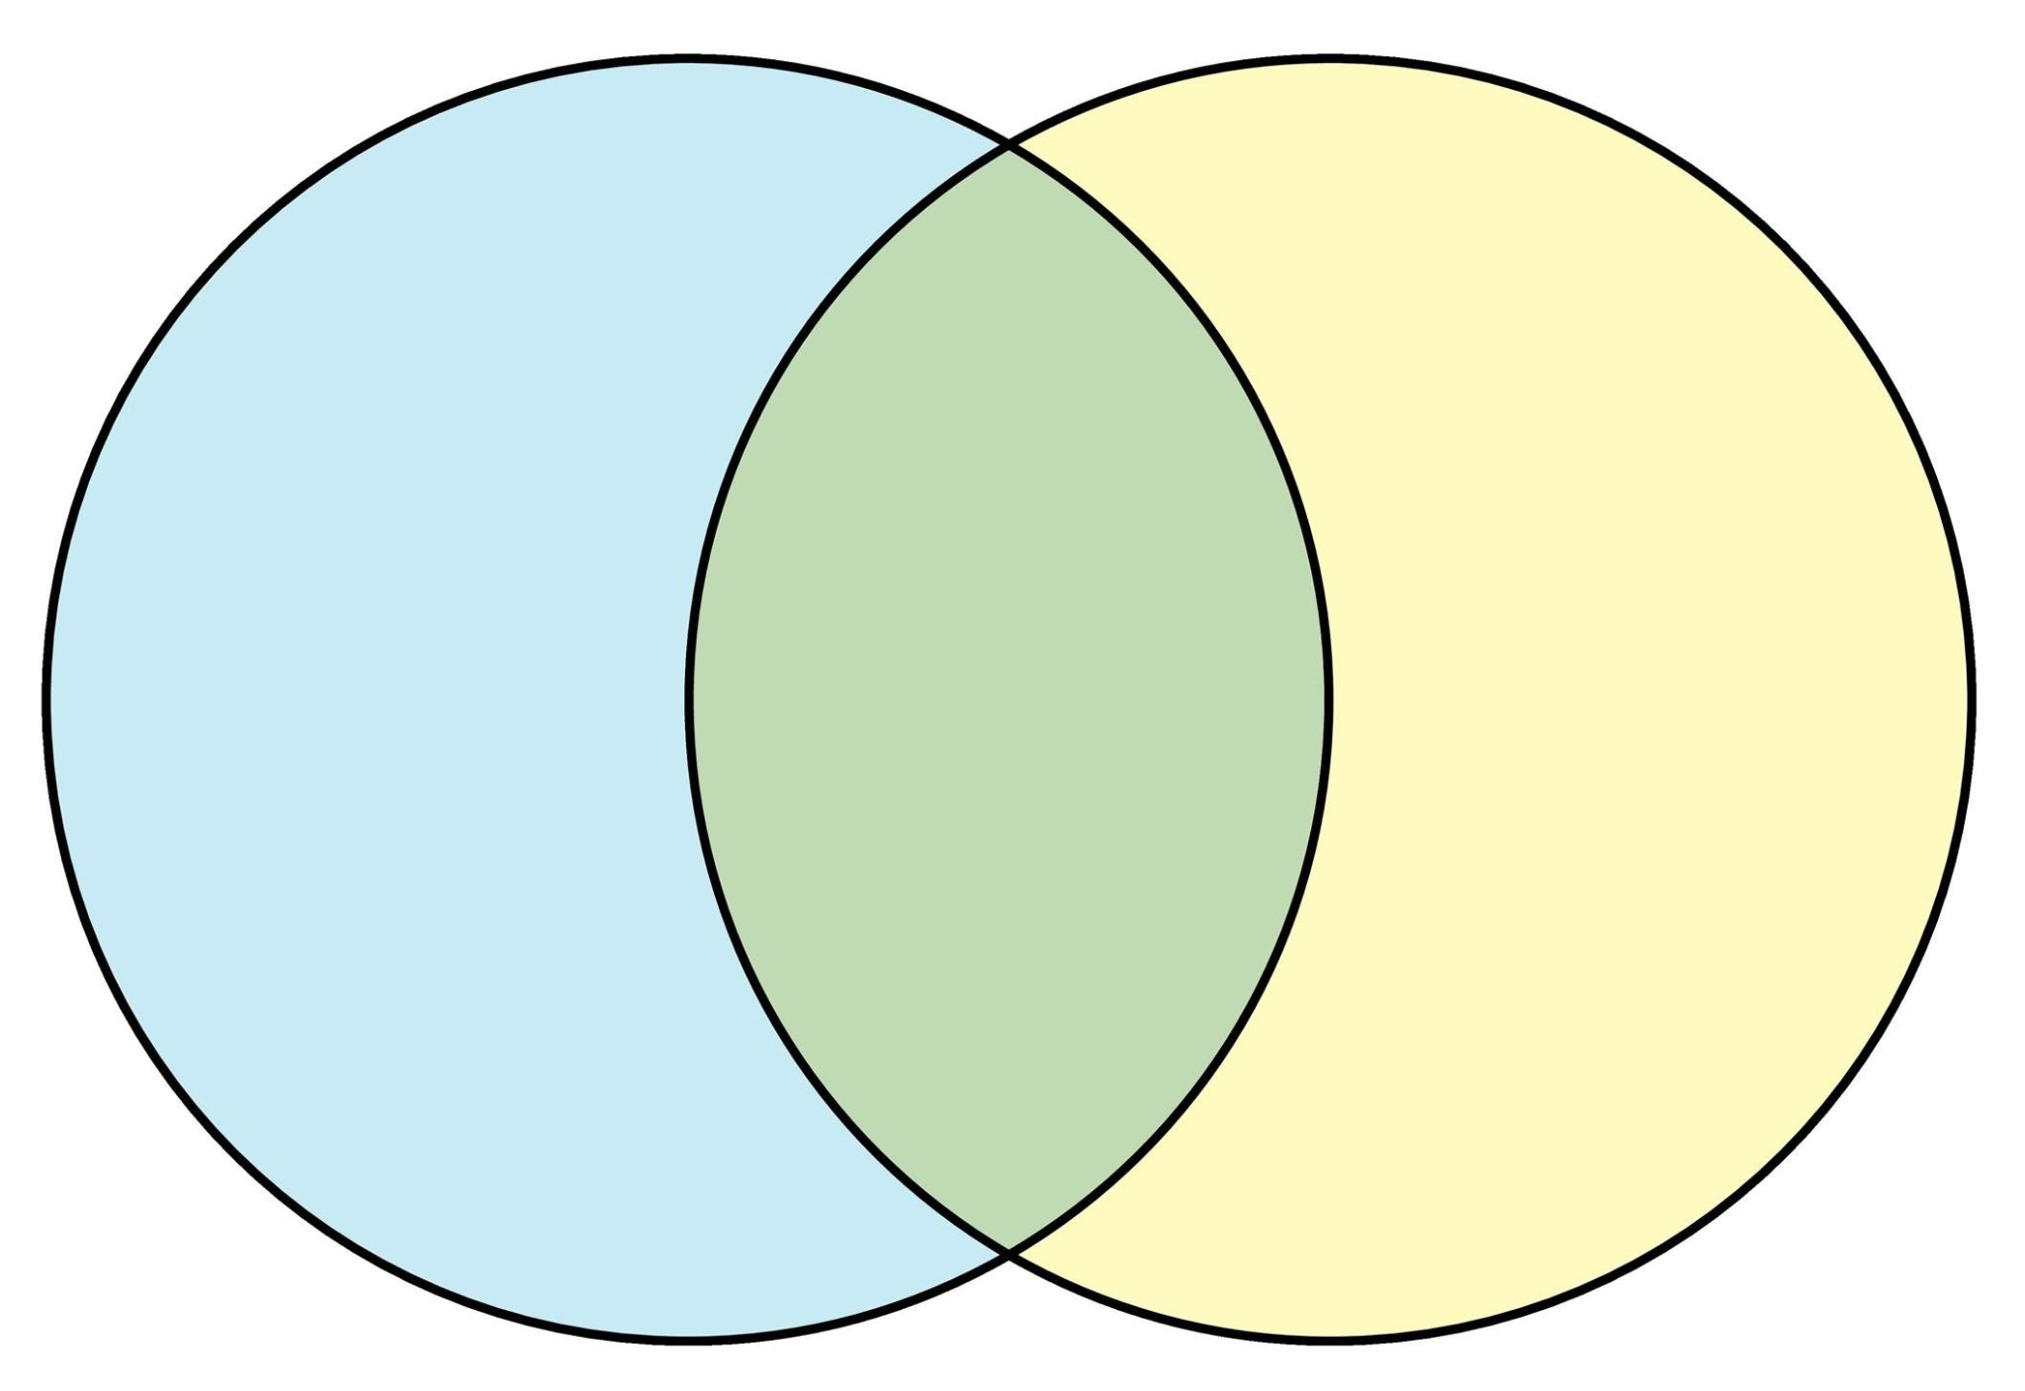
Nursology
Knowledge of human health experiences - responses
Patient
Knowledge of nursing healing practices

Slide 10

“A nursing diagnosis is a clinical judgment concerning a human response to health conditions/life processes, or a vulnerability for that response, by an individual, family, group or community. A nursing diagnosis provides the basis for selection of nursing interventions to achieve outcomes for which the nurse has accountability.”
https://nanda.org/publications-resources/resources/glossary-of-terms/

Slide 11


Knowing the “patient”
Knowing the context
Knowing nursing healing practices that support forward movement
Definitions of “nursing” suggest common elements of:

Slide 12

Roper - 1976
“ . . . nursing is helping a person towards [their] personal independent pole of the continuum of each activity of daily living; helping [them] to remain there; helping [them] to cope with any movement towards the dependent pole or poles; in some instances encouraging [them] to move towards the dependent pole or poles, and because [people are] finite, helping [them] to die with dignity.
Notice -
Created to address changes in hospitals in Scotland
Movement forward
Both Nursology dimensions

Slide 13
ANA Scope of Practice
“Nursing is the protection, promotion, and
optimization of health and abilities; prevention of illness and injury; facilitation of healing; alleviation of suffering through the diagnosis and treatment of human response; and advocacy in the care of individuals, families, groups, communities, and populations.”
Notice -
Created for public understanding of nursing.
Movement forward
Both Nursology dimensions

Slide 14
ICN Global Definition
“the phenomena of particular concern to nurses are individual, family, and group ‘responses to actual or potential health problems’ (ANA, 1980, P.9). These human responses range broadly from health restoring reactions to an individual episode of illness to the development of policy in promoting the long-term health of a population.”
Notice -
Created to explicitly include population health.
Movement forward
Both Nursology dimensions

Slide 15
Definitions from Nursing Theory
Point to -
  A common purpose
  Embracing diversity
Theory -
A Vision

Slide 16
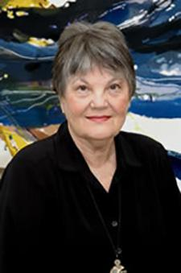
“Caring in the human health experience”
Newman, Sime & Corcoran-Perry, 1991

Slide 17
Facilitating humanization, meaning, choice, quality of life, and healing in living and dying. Willis, Grace & Roy, 2008
Nurturing human flourishing in an intersubjective relationship. Jacobs 2013

Slide 18

NANDA has a strong history of establishing language consistent with the fundamental values and purposes of nursing
Key terms -
Readiness . . .
Risk . . .
Disturbed . . .
Delayed …
Decreased ..
Dysfunctional …
Maladaptive ...
== knowing the patient, context & path to move forward

Slide 19

First: let’s debunk a few myths about writing success
Particular Response
Population Evidence

Slide 20
Nurses respond to a particular situation, a particular human response.
Diagnoses and the practice that flows from it depends on generalized evidence.
Challenge of “particularizing the general”

Slide 21
Nursing process is “. . .systematic decision-making processes by which nurses apply knowledge to their practice. . . “
“. . .the manner in which nurses systematically deal with multiple inputs within a dynamic and complex context and generate reasoned and defensible actions toward a valued outcome for the clients they serve.” (Thorne & Sawatsky 2013, p.6)

Slide 22
Herein lies the key to today’s nursing theory connection
Early nursing theories/perspectives framed the process of naming human responses (the general)
Nursing action today flows from the situation and is guided by a rich array of nursing theories (the situation)

Slide 23
“History” of NANDA and Nursing Theory
Nursing theory was just emerging during the 1st 5 conferences.
Theorists present developed a theoretical frame reflected in today’s axes and terminology
They recognized they could not settle on “just one” theory from the dozen in existence at the time

Slide 24
Health of unitary man/human
Man/human environmental interactional patterns
Exchanging/Communicating/Relating/Valuing/Choosing/ Moving/Perceiving/Knowing/Feeling
Callista Roy Report of the nurse theorist group, Fifth National Conference, 19

Slide 25
Today there are
69
nursing theories on the Nursology.net website

Slide 26
Unexpected physical disability
  Roy’s Adaptation Model
  Self transcendence
  Emancipatory theory of compassion
The theory that guides practice flows from the situation

Slide 27
Domestic violence
  Strengths based nursing
  Critical Caring Theory
  Society to cells resilience theory
The theory that guides practice flows from the situation

Slide 28
The “nursing” in nursing diagnoses
Consistent with nursing’s theoretical “gaze” on health
Reflects a relational imperative
7 axes represented in the diagnostic labels reflect the complexity of the scope of nursing

Slide 29

Invitations
Join in affirming our disciplinary perspective and the richness of theory that informs our work
Reach for Margaret Newman’s fullest expression of “health as expanding consciousness” in embracing our diversity

