Slide 1
NANDA-I AWARDS
2021

Slide 2
In Memorium

Slide 3
MERCEDES UGALDE APALATEGUI Spain

Slide 4
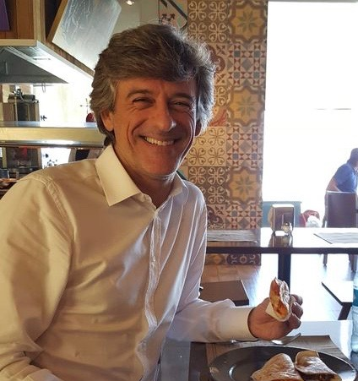
MARCELO CHANES Brazil

Slide 5
MERIDEAN MAAS USA

Slide 6
The Awards

Slide 7
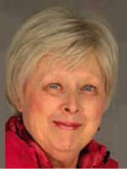
Rosemary Caroll-Johnson Award
Dr. Caroll-Johnson was a pioneer in oncology nursing, and edited NANDA-I’s International Journal of Nursing Terminologies and Classifications, along with Oncology Nursing Forum, Journal of Hospice & Palliative Nursing, and co-editing Psychosocial Nursing Care and Cancer Continuum.
This award, presented by the Editor of The International Journal of Nursing Knowledge, acknowledges the best paper published during the previous two-year cycle of the journal.

Slide 8
Rosemary Caroll-Johnson Award Recipients
Call for the Use of Axial Terms: Toward Completeness of NANDA-I Nursing Diagnoses Labels (July, 2019)
Susana Miguel RN, MSc
Joana Romeiro RN, MSc
Helga Martins RN, MSc
Tiago Casaleiro RN, MSc, MRS
Sílvia Caldeira PhD, MSc, RN
T. Heather Herdman PhD, RN, FNI

Slide 9
NANDA INTERNATIONAL EDITOR’S AWARD
The Editor’s Award is presented by the Editor of The International Journal of Nursing Knowledge, to recognize outstanding contribution to the advancement of the NANDA-I journal.

Slide 10
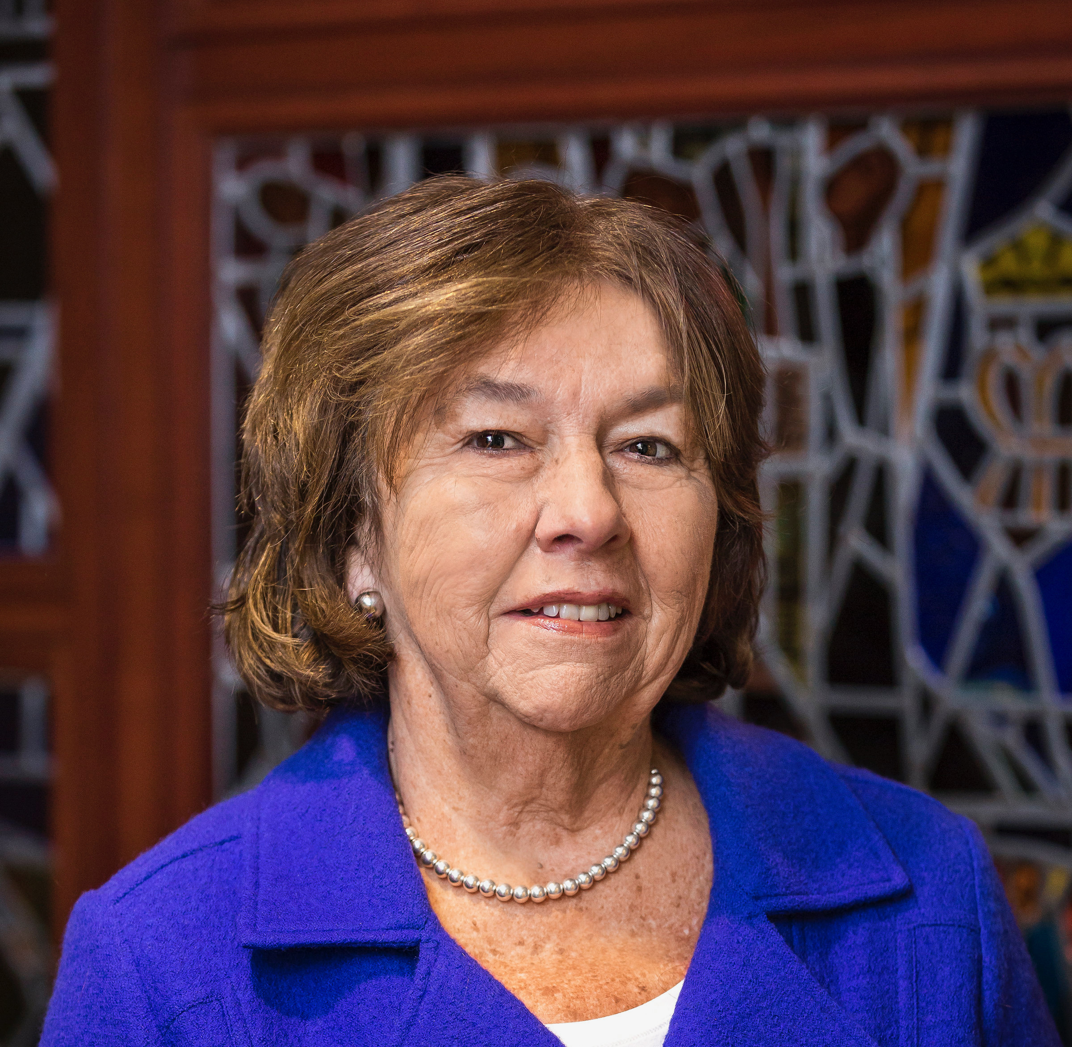
Editor’s Award Recipient
Dorothy A. Jones, Ed.D, APRN, FNI, FAAN

Slide 11
THE NANDA INTERNATIONAL UNIQUE CONTRIBUTION AWARD
The Unique Contribution Award is presented by the NANDA-I Board of Directors, to those individuals who have made an outstanding contribution to the advancement of nursing diagnosis.
This year we have four recipients.

Slide 12
Unique Contribution Award Recipients
Sílvia Caldeira PhD, MSc, RN
Camila Takao Lopes, PhD, RN, FNI
Viviane Silva, PhD, RN, FNI
Christopher J. Grillo, Associate Dean, Finance & Administration, Boston College Connell School of Nursing

Slide 13
NANDA INTERNATIONAL FOUNDER’S AWARD
The Founder’s Award is presented by the NANDA-I Board of Directors, to those individuals who have made a lasting, internationally-reaching contribution to education, implementation, development, research, and/or informatics applications of nursing diagnoses.
We have two recipients of the Founder’s Award this year.

Slide 14
Founder’s Award Recipient
Marcos Venícios de Oliveira Lopes, RN, PhD, FNI

Slide 15
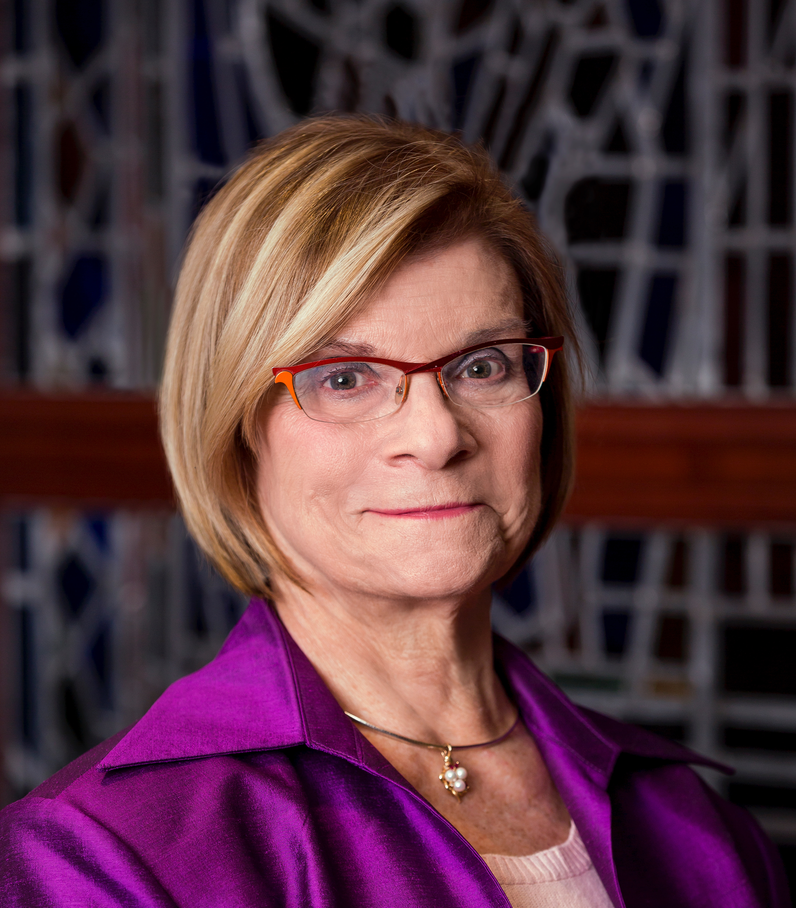
Founder’s Award Recipient
Susan Genarro, PhD, RN, FAAN
Dean and Professor, Connell School of Nursing, Boston College

Slide 16
NANDA INTERNATIONAL MENTOR AWARD
This is the highest honor awarded by NANDA-I, and is bestowed by the NANDA-I President. This award recognizes a nurse leader who significantly influenced the use of NANDA-I terminology within professional nursing practice, education, research, health policy, or informatics. This individual has been a formal or informal leader within NANDA-I, and has invested in the professional development of others.

Slide 17
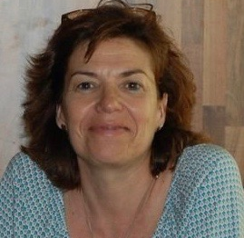
Mentor Award Recipient
Rosa Rifà Ros, RN, PhD

Slide 18
NANDA International Foundation Grant Awards
Prof. Dickon Weir-Hughes, President

Slide 19
NANDA Foundation Awards - 2020
Principal Investigator | Project Title
Suellen Emidio, PhD, RN, Lecturer, Anhanguera University, Brazil | Clinical validation of the defining characteristics of nursing diagnoses related to breastfeeding
Susana Miguel, PhD student, Institute of Health Sciences, Catholic University of Portugal, Portugal | Nursing diagnoses ‘disturbed body image’ and situational low self-esteem’ in head and neck cancer patients: differential clinical validation using Q methodology
Iyanuoluwa Oreofe Ojo, Lecturer, Department of Nursing, University of Ibadan, Nigeria | Nurse led intervention on nurses documentation of nursing diagnostics in a state hospital in Nigeria
Luca Bertocchi, PhD student, University of L’Aquila, Italy | Impact of nursing diagnoses on patient and organizational outcomes: a systematic review update

Slide 20
NANDA International Fellows

Slide 21
NANDA International Fellows – Class of 2021
The community of NANDA-I Fellows represents nursing leaders with standardised nursing language expertise in the areas of education, administration, clinical practice, informatics and research.
NANDA-I Fellows contribute their time and energy to the organization in a variety of areas, in order to move forward the goal to provide evidence-based clinical decision support to nurses worldwide.
This year we are pleased to announce three new NANDA International Fellows.

Slide 22
Elenice Carmona, PhD, OGNP, RN School of Nursing - University of Campinas (UNICAMP), Brazil

Slide 23
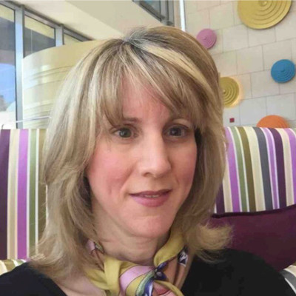
Frances Barrett Foster, MS, NP, RN
Vice President, Massachusetts Eye Research and Surgery Institution

Slide 24
Rita de Cassia Gengo e Silva Butcher, PhD, RN
Graduate Program in Adult Health Nursing (PROESA), School of Nursing, University of São Paulo

Slide 25
Congratulations to All NANDA-I Recipients!
It is your contributions that power this Association, and which ensure that nursing has a voice at the multidisciplinary table for patient care.

