Slide 1

Advancing NANDA’s Language through Integration into Current Data Platforms
Connie White Delaney, PhD, RN, FAAN, FACMI, FNAP

Slide 2

Disclosures/Acknowledgements
No financial disclosures relevant to this presentation.
Gratitude for engagement in big data science

Slide 3
Thanking you
for the honor
of being
with you …and you with me

Slide 4
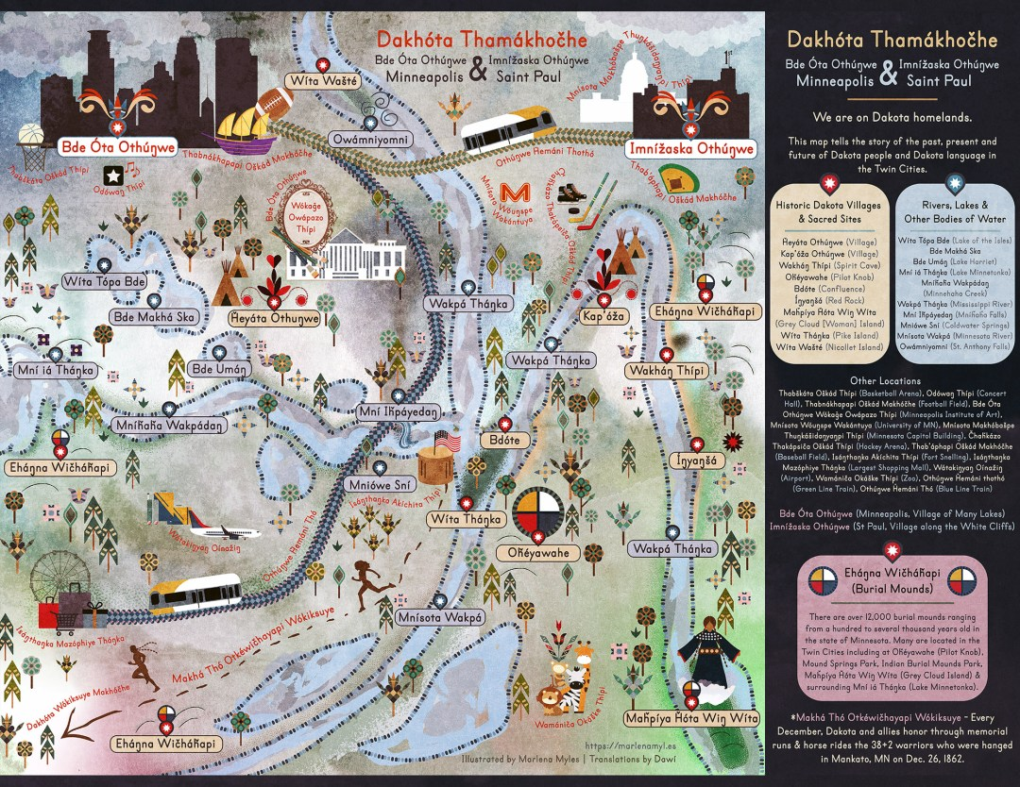
And you with me
We acknowledge that the School of Nursing at the Twin Cities campus of the University of Minnesota -- where we are virtually linked today – is built within the traditional homelands of the Dakota People.
We recognize the longstanding relationship between the land and the Dakota people- the traditional stewards of this land.
We also acknowledge the violence of colonialism and ongoing racism toward Indigenous People.
We are growing in our realization that the health care system, meant to protect and heal people, has supported structures of racism causing ongoing trauma and health inequities.

Slide 5
And you with me
As part of the process to heal the land and the community, we reflect on these questions:
What are our obligations to the people who first inhabited this land?
How do we figure out what our responsibilities are to this land?
How can we be good guests here?
How can we support existing local struggles?
How can we work together to promote our shared vision to ensure optimal health and wellbeing for all people and the planet?
By living here, working here and using the resources of this place, and in this moment, we now participate in this experience, our shared dialogue at NANDA-I conference.

Slide 6
Celebrating almost 50 years
Marjorie Gordon’s Legacy
Exceptional passionate leaders
Organizational evolution to true global community
Robust strategic plan
And there is more …
Some Gifts
of
Yesterday

Slide 7
We were reminded that names matter; words matter; context matters
  Darnella Frazier, “a bouquet of humanity” (Keith Ellison, MN Attorney General) – 1 person, 1 video, 2021 Pulizer Price Special Citation
  Expanded consciousness - Exploring consciousness with >50 Sanskrit words in ways English cannot (Atman, Dharma, Maya, Samadhi…)
  Margaret Newman’s collaboration with Sheila Corcoran Perry – co-author with Judith Graves on the seminal paper defining “nursing informatics”
UPSTANNDERS – PERSON WHO IS CHOSEN TO MAKE A DIFFRENECE IN THE WORLD BY SPEAKING OUT –
Names, Words, Context
Some Gifts
of
Yesterday

Slide 8
NANDA – Day 1
Emphasis on collaboration & international focus – we are global
Key collaborators, within and beyond nursing
Social networks
Partner with other languages
Snomed-CT
Research
  Population
  Settings
  Innovation
Emphasis on process, and questioning “what is lost in EHRs”
PAUSE - REFLECTIONS
Health Professions/Disciplines - NursING
Technology, Creativity, Heart

Slide 9
Advancing NANDA’s Language through Integration into Current Data Platforms
What is big data and what is needed for inclusion of NANDA-I data in current data platforms?
What is the necessary level of specificity needed for incorporation and retrieval of NANDA language?
How does data mining for nursing currently take place?
How can we create data that aligns with nursing’s focus?

Slide 10
The Data Trilogy
Data Analytics (DA) is the science of reporting and analyzing raw data with the purpose of drawing conclusions about that information.
Data Science is an interdisciplinary field about
processes and systems to extract knowledge or
insights from data in various forms. It is a is a continuation
of data analysis fields such as statistics, machine learning, data mining, and predictive analytics.
Big Data: Electronic data sets so large and complex
that they are difficult (or impossible) to manage with
traditional software and/or hardware.
Raghupathi and Raghupathi. (2014) Big data analytics in healthcare: promise and potential. Health Information
Science and Systems, 2:3 http://www.hissjournal.com/content/2/1/3

Slide 11
Big Data Characteristics
Volume (Terabyte – 1 trillion Gigabytes, laptop is 4G’s)
Velocity (Speed data is stored & accessed – streaming/real time)
Variability (Multiple representation for the same term)
Variety (Structured, unstructured, audio, video, XML, streaming)
Veracity (Accuracy and completeness of data)
Visualization (Ability to visualize patterns/signals in the data)
Value (Capacity of the data to provide value)
Notes:
Volume: How big is big data – If data in storage is in terabytes (one trillion gigabytes) then its big dataish. A typical laptop has about 4 gigabytes of RAM
Velocity
Velocity is the speed in which data is accessible. I remember the days of nightly batches, now if it’s not real-time it’s usually not fast enough.
Variety
Variety describes one of the biggest challenges of big data. It can be unstructured and it can include so many different types of data from XML to video to SMS. Organizing the data in a meaningful way is no simple task, especially when the data itself changes rapidly.
Variability
Variability is different from variety. A coffee shop may offer 6 different blends of coffee, but if you get the same blend every day and it tastes different every day, that is variability. The same is true of data, if the meaning is constantly changing it can have a huge impact on your data homogenization.
Veracity
Veracity is all about making sure the data is accurate, which requires processes to keep the bad data from accumulating in your systems. The simplest example is contacts that enter your marketing automation system with false names and inaccurate contact information. How many times have you seen Mickey Mouse in your database? It’s the classic “garbage in, garbage out” challenge.
Visualization
Visualization is critical in today’s world. Using charts and graphs to visualize large amounts of complex data is much more effective in conveying meaning than spreadsheets and reports chock-full of numbers and formulas.
Value
Value is the end game. After addressing volume, velocity, variety, variability, veracity, and visualization – which takes a lot of time, effort and resources – you want to be sure your organization is getting value from the data.

Slide 12
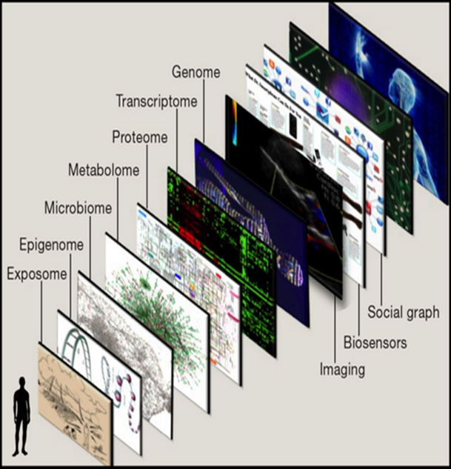
Is This Big Data?
The digital information available on one persons life, encompasses more than the entire Library of Congress.
Topel, E. (2015). The Patient Will See You Now. Basic Books, New York.
Notes:
Is one patient with a large volume of data a “big data” project? Probably not. If you are trying to develop a clinical decision support alert for the general population by streaming physiological data from one person, it is of virtually no value.

Slide 13
Public and Private Databases
Public and Private
Medicare Claims Use Files (ResDac)
National Center for Health Statistics (CDC)
Agency for Healthcare Quality (AHRQ)
  Medical Expenditure Panel Survey
  Healthcare Cost and Utilization Data (HCUP)
Patient Centered Outcomes Research Institute (PCORI)
Clinical Transformation Science Institute (CTSI)
Healthcare Cost Institute (HCI)
OptumLabs Data Warehouse (OLDW)
Optum Insight
National Science Foundation Big Data Hubs
National Institute of Health Clinical Registries

Slide 14
Big Data Research Today
Criteria
Author :Nurse
Published in a peer reviewed journal
Focus: Nursing practice
Multivariate analysis or contemporary methods
At least 1 of 3 big data V’s
Period: 2009 - 2015
Results
650 manuscripts (17 nursing informatics journals)
17 studies in 18 articles
  6 studies: knowledge discover
  5 studies: predict process & outcomes
  6 studies: impact of technical or nursing interventions on outcomes
Westra et al. Working paper3 Big Data Science: A Literature Review of Nursing Research Exemplars
Notes:
Westra et al reviewed 650 journal articles identified in 17 key nursing informatics, general biomedical informatics, and nursing research journals in the Web of Science database. 13 key nursing informatics, general biomedical informatics, and nursing research journals and identified relevant studies published from 2009 through 2013. After screening for inclusion and exclusion criteria, 17 studies published in 18 articles were identified as big data nursing research applied to practice.

Slide 15
Big Data Research Today
Delaney, C., Weaver, C., Sensmeier, J., & Pruinelli, L. (in process). Nursing and Informatics for the 21st Century: An International Look at Practice, Trends and the Future. Third Edition. Healthcare Information and Management Systems Society (HIMSS.
Delaney, C. W., Englebright, J., & Clancy, T. (Guest Editors). (2021). Nursing Big Data Science. Special Issue - Journal of Nursing Scholarship.
Delaney, C., Weaver, C., Warren, J., Clancy, T., & Simpson, R. Editors. (2017). Big Data- Enabled Nursing: Education, Research and Practice. Springer. ISBN: 978-3-319-53299-8

Slide 16

Where is big data research in Nursing being conducted?
University of Pennsylvania
University of Minnesota
Columbia University
University of Michigan
Duke
Michigan State University
Cincinnati Children's Medical Center
University of Alabama
University of California
University of Minnesota

Slide 17
Three Major Shifts of Big Data Research
[credit Karen Monsen]
The first is the ability to analyze vast amounts of data about a topic rather than be forced to settle for smaller sets.
The second is a willingness to embrace data's real-world messiness rather than privilege exactitude.
The third is a growing respect for correlations rather than a continuing quest for elusive causality.
Viktor Mayer-Schönberger and Kenneth Cukier: Big Data - A revolution that will transform how we live, work and think; John Murray Publishers, London, 2013

Slide 18
“More, Messy, Good Enough” (p. 12, Mayer-Schonberger & Cukier, 2013)
‘Big Data’ changes the scientific paradigm
  More data means less sampling error
  Messy means we can try to understand and account for the biases inherent within observational data
  Good enough means we can let go of our fixation on causation
    Description
    Pattern Discovery
  Hypothesis generation
    Letting the data give voice to nurses and patients
Hey, T., Tansley, S., & Tolle, K. (2009). The fourth paradigm: Data intensive scientific discovery. Redmond, WA: Microsoft Research.
Mayer-Schonberger, V. & Cukier, K. (2013) Big Data: A revolution that will transform how we live, work, and think. Houghton Mifflin Harcourt, Boston.
Notes:
We can analyze far more data
Sampling is an artifact of information scarcity
With less sampling error we can tolerate more measurement error
We can be satisfied with learning what is happening by discovering patterns and correlations that offer novel and valuable insights

Slide 19
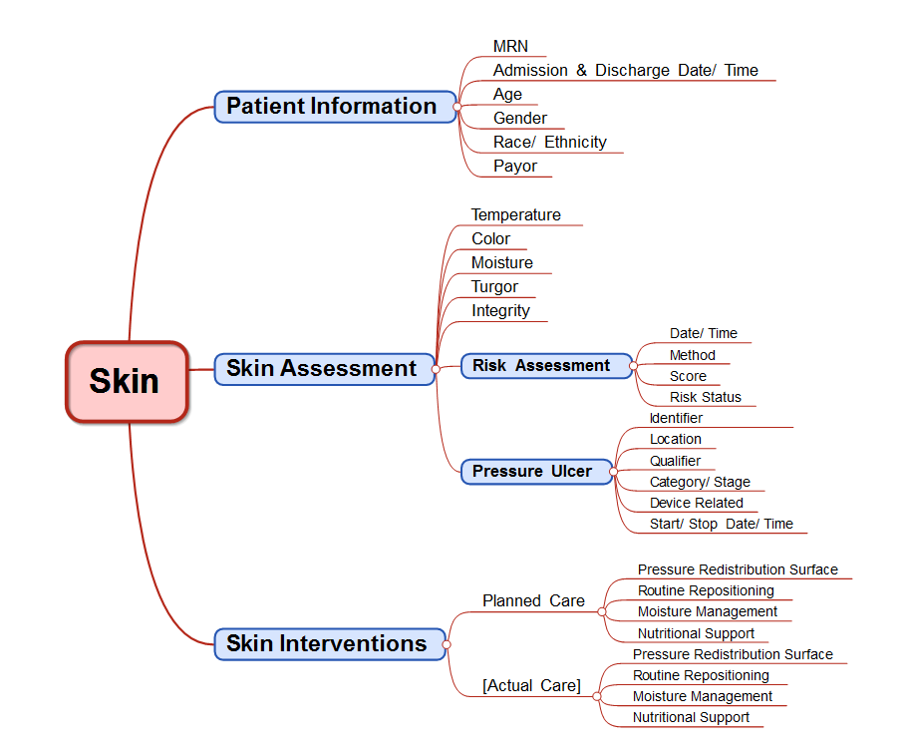
NDNQI - Skin/ Pressure Ulcer
Information Model
[credit Karen Monsen]

Slide 20
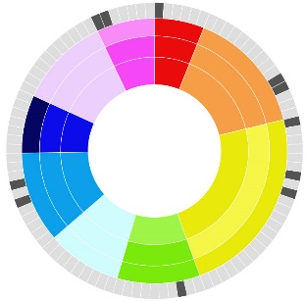
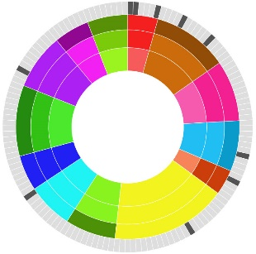
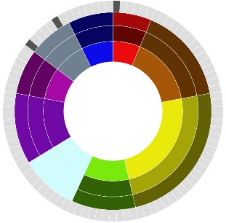
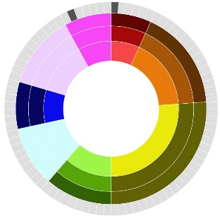
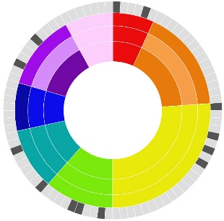
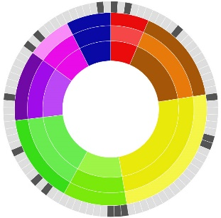
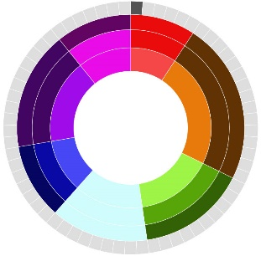
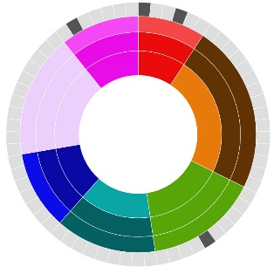
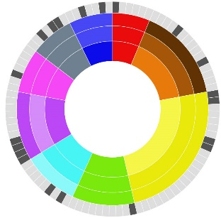
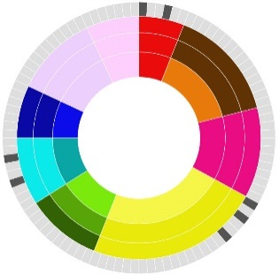
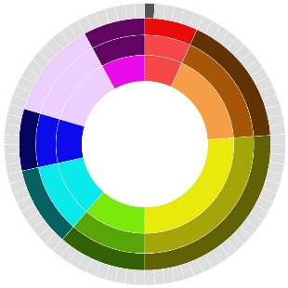
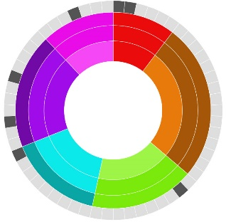
Using Data Visualization to Detect Client Risk Patterns
Monsen, K. A. et al., 2014
Each image (sunburst) was created in d3 from public health nursing assessment data for a single patient. Data were generated by use of the Omaha System signs and symptoms and Problem Rating Scale for Outcomes
Key:
Colors = problems
Shading = risk
Rings = Knowledge, Behavior, and Status
Tabs = signs/symptoms
Documentation patterns suggest a comprehensive, holistic nursing assessment.
Kim et al. found that the presence of mental health signs and symptom tends to be associated with more diagnostic problems and worse patient condition
Kim, E., Monsen, K. A., Pieczkiewicz, D. S. (2013). Visualization of Omaha System data enables data-driven analysis of outcomes. American Medical Informatics Association Annual Meeting, Washington D. C. Funded by a gift from Jeanne A. and Henry E. Brandt.

Slide 21
Big Data Research
Extended Clinical Data
Bonnie L. Westra, PhD, RN, FAAN, FACMI, Beverly Christie, DNP, RN; Connie W. Delaney, PhD, RN, FAAN, FACMI; Grace Gao, DNP, RN; Steven G. Johnson, MS; Anne LaFlamme, DNP, RN; Jung In Park, PhD-C, RN; Lisiane Pruinelli, PhD-C, RN; Suzan Sherman, PhD, RN; Piper Svensson-Ranallo PhD; Stuart Speedie, PhD
Demonstrate feasibility of creating a hierarchical flowsheet ontology in i2b2 using data-derived information models
Demonstrate the applicability of flowsheet data to nursing / interprofessional research

Slide 22
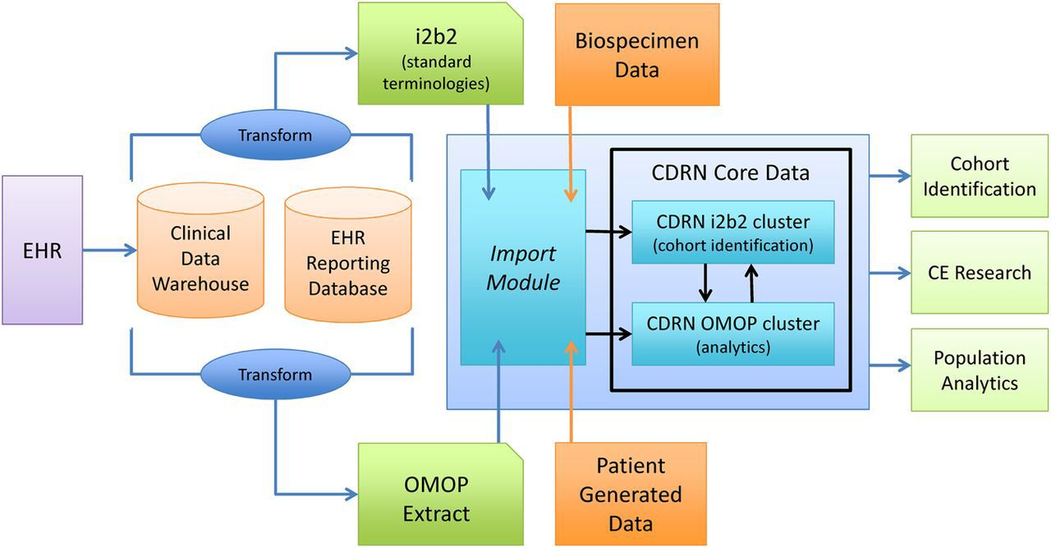
Requirements for Useful Data
Common data models
Standardized coding of data
Standardized queries
Notes:
OMOP worked to design experiments testing a variety of analytical methodologies in a range of data types to look for drug impacts that are already well-known.
Mini-Sentinel is a pilot project sponsored by the U.S. Food and Drug Administration (FDA) to create an active surveillance system - the Sentinel System - to monitor the safety of FDA-regulated medical products.
Informatics for Integrating Biology and the Bedside (i2b2) is an NIH-funded National Center for Biomedical Computing (NCBC) based at Partners HealthCare System in Boston, Mass.

Slide 23
Vision – Inclusion of Nursing and Other Interprofessional Data
Clinical Data
NMDS
Management Data
NMMDS
Other Data Sets
Continuum of Care
23
Notes:
23

Slide 24
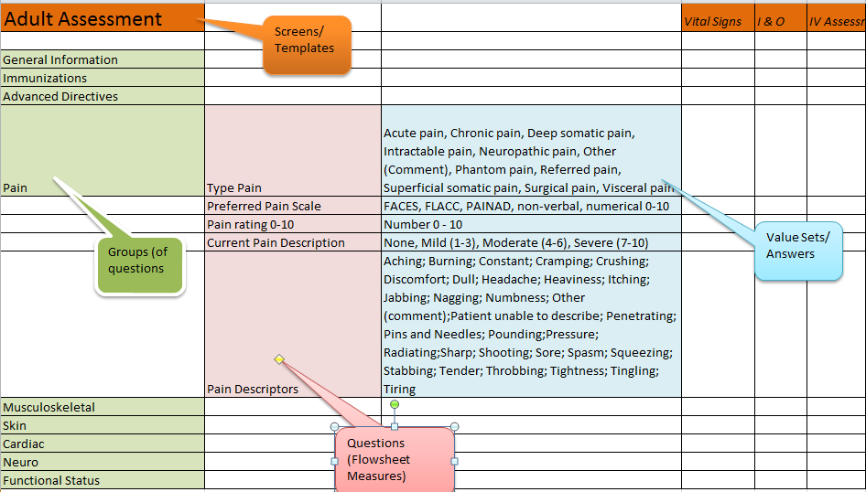
Example Flowsheet
Notes:
On this slide is an example of a flowsheet in the electronic health record system. At the top are tabs. These are called templates or a template is the view on the screen. A template includes groups of questions highlighted in green. In the middle of the screen highlighted in pink is a single question, that is called a flowsheet measure and is the observation documented by a nurse or other clinician. On the right-hand side highlighted in blue is an example of the kinds of answers that can be selected to answer the question. These are known as value sets.

Slide 25
Flowsheet Data Challenges
Volume of data
There are multiple measures for the same concepts
  Different people building screens
  Software upgrades
  Discipline/ practice specific needs
No information models exist
  Data driven information modeling required
Notes:
Important to understand about flowsheet data is that it is non-standard the design of flowsheets very within an electronic health record the variability is due to preferences of clinicians, the type of data required for specific discipline such as physical therapy, or data for a specific setting such as the ICU. This results in multiple measures for the same concepts. Additionally these flowsheet measures change over time as well as across the templates and rooms of questions. As result if the data were useful for research, these multiple measures for the same concepts need to be harmonized. Consider the research question quote what interventions were effective in pain management for patients that have osteosarcoma with surgery, chemotherapy, and radiation and who receive care between October 1, 2011 and December 31, 2014. The population includes all ages, care is provided in multiple settings such as outpatient, ICU, med – search units, and possibly transitional care. Documentation is done by nurses, therapists, and dietitians all of who have their own templates and therefore considerable duplication of flowsheet measures.

Slide 26
Information Model Development Process
Identify Clinical Data Model Topic
Identify Concepts
Map Flowsheets to Concepts
Present
Validate
Notes:
Are goal therefore was to develop a standardized process for normalizing flowsheet measures by mapping them to concepts of interest to researchers. We started by first identifying topics of interest for creating clinical data models. We then identified concepts within these topics and then map them to flowsheets. We also did a bottom-up approach then of looking within groups where we found these flowsheets to identify additional concepts that might important to researchers. Once a model was created and flowsheet measures were mapped investigator presented this to the entire group for feedback. Multiple iterations were done in order to validate the model and the mapping as well as develop consistent rules to be used across the development of additional models.

Slide 27
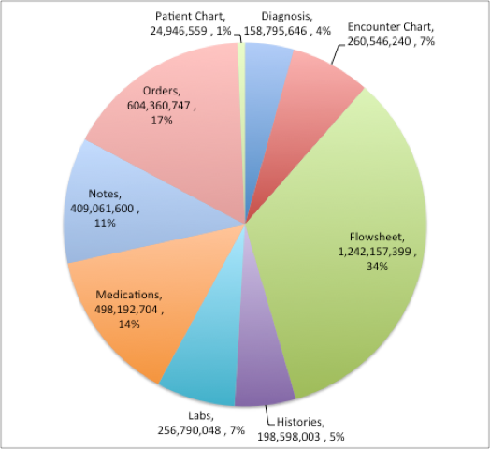
UMN – Academic Health Center
Clinical Data Repository (CDR)
Flowsheets constitute 34% of all data
14,564 measure types
2,972 groups
562 templates
1.2 billion observations
2,000 measures cover 95% of observations
Notes:
Get better graph
Just counting observations, not a measure of importance

Slide 28
Sample Data Source - Clinical Data Models
  Flowsheet Data from 10/20/2010 - 12/27/2013
  66,660 patients
  199,665 encounters
T
562
Groups
2,696
Data Points
153,049,704
Flowsheet Measures
14,550

Slide 29
Development Process Details
Identify clinical topic important to researchers/ operations
Develop a list of concepts from research questions, clinical guidelines and literature
Search for concepts in templates/groups/measures
  Search associated groups for additional concepts
Add matched concepts to running list
Categorize into assessment and interventions
Organize into hierarchy
Combine similar concepts that have similar value sets
Validated by a second researcher
Notes:
Example: Skin Integrity
#7: Musculoskelatal – same value sets, but different questions – combo matters

Slide 30
Flowsheet Information Models
Pain | Cardiovascular System
Falls/ Safety | Gastrointestinal System
Peripheral Neurovascular (VTE) | Neuromusculoskeletal System
Genitourinary System/ CAUTI | Respiratory system
Pressure Ulcers | Vital Signs, Height & Weight

Slide 31
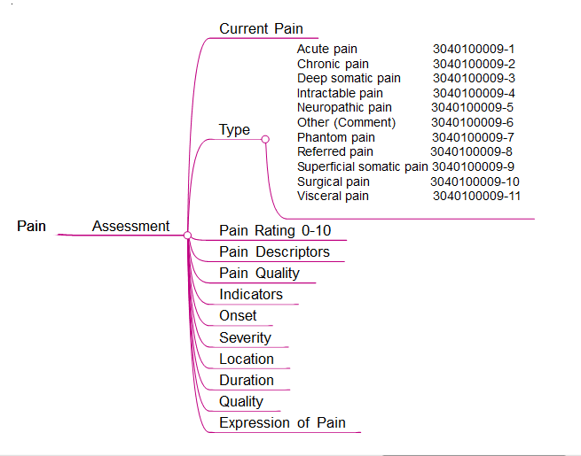
Example Information Model
Notes:
Each information model was composed of a hierarchy of increasingly granular terms. Level 1 represents the major concept i.e. pain, Level 2 addresses a term for care planning (assessment, problem, goal, intervention, or outcomes), and Level 3 up to Level 5 contains a concept related to pain such as type of pain; pain indicators, locations, or orientation; with finer levels of granularity as shown in Figure 1.

Slide 32
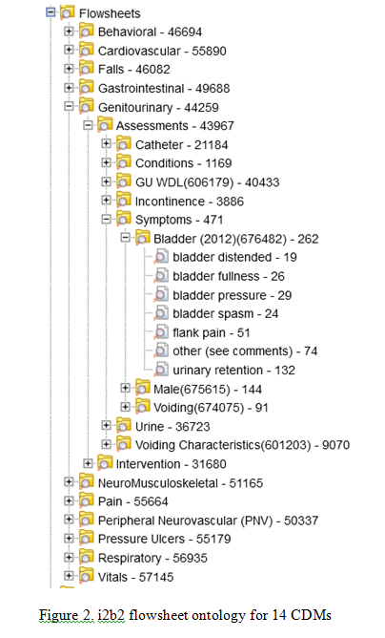
Create Flowsheet Ontology in i2b2
  14 information models - approximately 81 million new rows
  i2b2 OBSERVATION_FACT table
  I2b2 – every row has to be unique
Notes:
As the first step in the ETL process of loading EHR flowsheet data into i2b2, we created a master look-up table. For measures whose values were numeric, the lookup table entry consisted of the flowsheet measure identifier from the EHR. When the choice list was associated with a measure, we constructed separate measure-choice list combinations that each had a unique identifier based upon the EHR measure identifier, followed by a number for each choice list i.e. 12345-1, 12345-2, etc. Each of the resulting identifiers represents a separate i2b2 concept ending in a leaf node.

Slide 33
Informatics Issues Encountered
Redundancy – flowsheet and value sets
  7 blood pressure and 10 heart rate measures
  Mapped multiple flowsheet measures to same concept
Variations in value sets
  Created a unique list of all for same concept
Measures with similar names represented different concept – i.e. search “display name” – Urine Output
  R IP URINE FOLEY
  URINE OUTPUT
  URINE OUTPUT.MODIFIED ALDRETE
  R NEPROSTOMY URINE OUTPUT
  URINE OUTPUT (ML)

Slide 34
Technical Issues Encountered
Free text response
  Included name of measure, no data included in i2b2
Multi-response items
  Created a separate row OBSERVATION_FACT table
Choice list - comment or “other” option
  Created a row for each type of comment
Numeric response measures - units of measure not clearly identifiable
  Modified name to include unit of measure
Mapping issues
  Changed names to exclude “* | / \ “ < > ? %”
  Constructed synthetic value item id’s
Names must be unique within first 32 characters
  Changed from fully specified names to multiple levels

Slide 35
Falls/ Fall Risk Concepts
You plan to use a clinical data repository to predict who is likely to fall and what interventions prevent falls.
What are the concepts related to
  Risk assessment?
  What interventions prevent falls?
  Do all disciplines in all units/ settings use the same risk assessment instrument?
How is the outcome of falls captured in the EHR?

Slide 36
NOTE
Flowsheet data represent the largest portion of CDR, rich source of nursing and interprofessional clinical data
Created 10 information models, 81M observations
Transformed models for flowsheet measures into i2b2
Identified a number of informatics and technical issues and developed processes for managing these issues
Continue to clean up information models
External validation initiated
Flowsheet data can extend knowledge of interprofessional evidence-based practice to improve health outcomes

Slide 37
Next Steps
Mapping entire EHR flowsheet data in CDR
External validation of information models with additional organizations
  Adding conceptual definitions, synonyms
Collaborate with Nursing Knowledge Big Data Science Workgroup
  Modeling and Encoding - Mapping to standardized terminology – LOINC/ SNOMED CT
  Clinical Data Analytics – Pursue integration with common data models
Demonstrate comparative effectiveness research with in and/or across organizations

Slide 38
A Data Mining Approach to Determine Sepsis Guideline Impact on Inpatient Mortality and Complications
Michael Steinbach, PhD; Bonnie L. Westra, PhD, RN, FAAN, FACMI; György J. Simon, PhD
Lisiane Pruinelli, MSN, RN, PhD-C; Pranjul Yadav, PhD-C;
Andrew Hangsleben; Jakob Johnson; Sanjoy Dey, PhD;
Maribet McCarty, PhD, RN; Vipin Kumar, PhD; Connie W. Delaney, PhD, RN, FAAN, FACMI

Slide 39
Aim
The overall aim is to evaluate and extend evidence-based guidelines for patients with health disparities for the prevention and management of sepsis complications
Map EHRs data to SSC guideline recommendations
Estimate the compliance with the SSC guideline recommendations; and
Estimate the effect of the SSC individual recommendations on the prevention of in-hospital mortality and sepsis-related complications

Slide 40
Data Source
De-identified EHR data obtained, after Institutional Review Board approval
  Data obtained from a Midwest hospital
  All data from patients hospitalized between 1/1/09 - 12/31/11 (including all encounters through 12/31/13)
  Billing diagnosis code of sepsis (ICD-9: 785.5*, 038.*, 998.*, 599.*, 995.9*)
1,993 patients (1,270 with little missing data)
  189 (177) Severe sepsis/ septic shock (995.92 and 785.5*)
  1,804 (1,093) Other sepsis diagnoses
Exclusion criteria:
  Patients with cardiogenic shock
  Patients with no antibiotic therapy

Slide 41
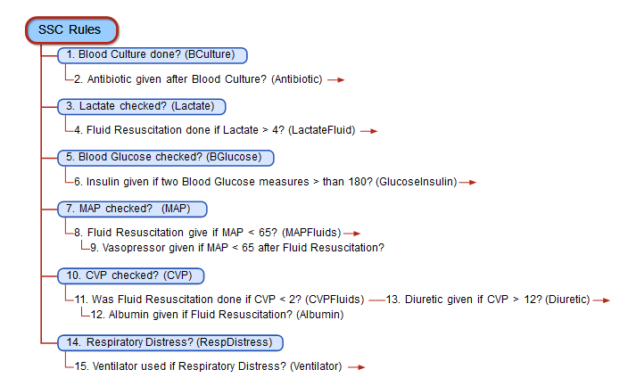
SSC guideline - Interventions

Slide 42
Advancing NANDA’s Language through Integration into Current Data Platforms
What is big data and what is needed for inclusion of NANDA-I data in current data platforms?
What is the necessary level of specificity needed for incorporation and retrieval of NANDA language?
How does data mining for nursing currently take place?
How can we create data that aligns with nursing’s focus?
There is more
What to anticipate

Slide 43
Integrative Health Knowledge Representation Research Team
Co-PI: Robin R. Austin, PhD, DNP, DC, RN-BC, FAMIA, FNAP
Co-PI: Connie W. Delaney, PhD, RN, FACMI, FNAP, FAAN
Team members: Elena Geiger-Simpson, DNP, PMHNP, RN; Sheng-Cheih Lu, PhD; Mary Koithan, PhD, CNS, RN, FAAN; Mary Jo Kreitzer, PhD, RN, FAAN
Analysis of current integrative health term represented within SNOMED CT
  Examine non-mapped terms, propose new codes for SNOMED CT
  Analyze exactly how therapies documented within various EHR systems
Austin, R. R., Lu, S. C., Geiger-Simpson, E., Ringdahl, D., Pruinelli, L., Lindquist, R., ... & Delaney, C. W. (2021). Evaluating Systemized Nomenclature of Medicine Clinical Terms Coverage of Complementary and Integrative Health Therapy Approaches Used Within Integrative Nursing, Health, and Medicine. Computers, Informatics, Nursing: CIN.

Slide 44
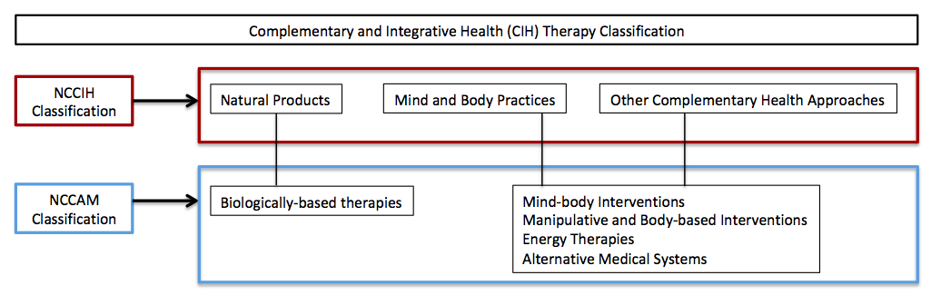
Classification Terms

Slide 45
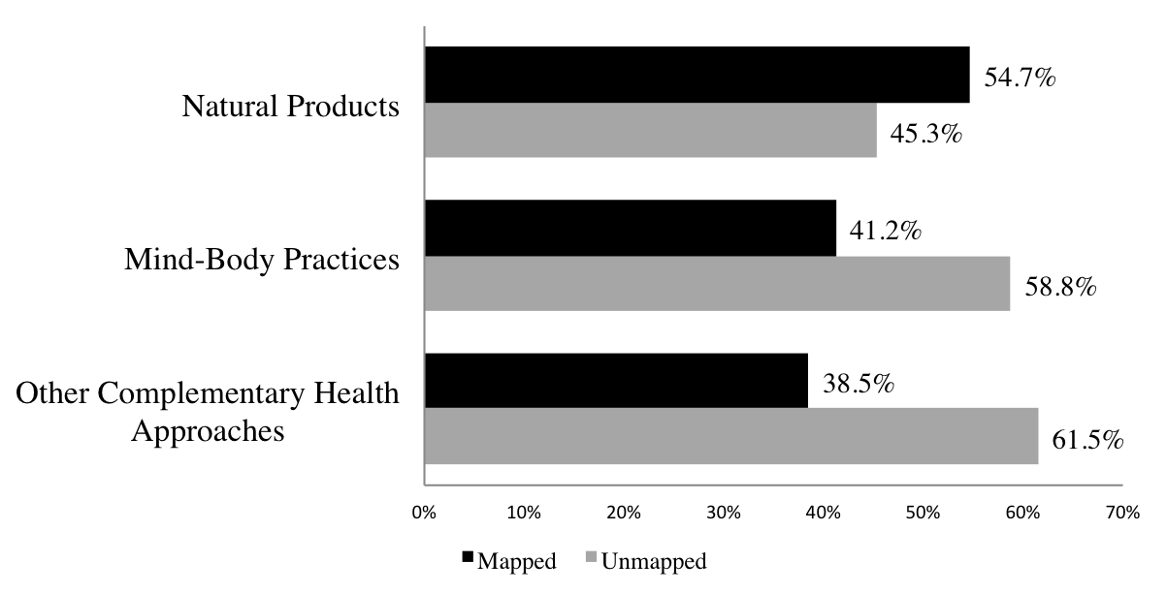
NCCIH Classification
Mapped and Unmapped Terms

Slide 46
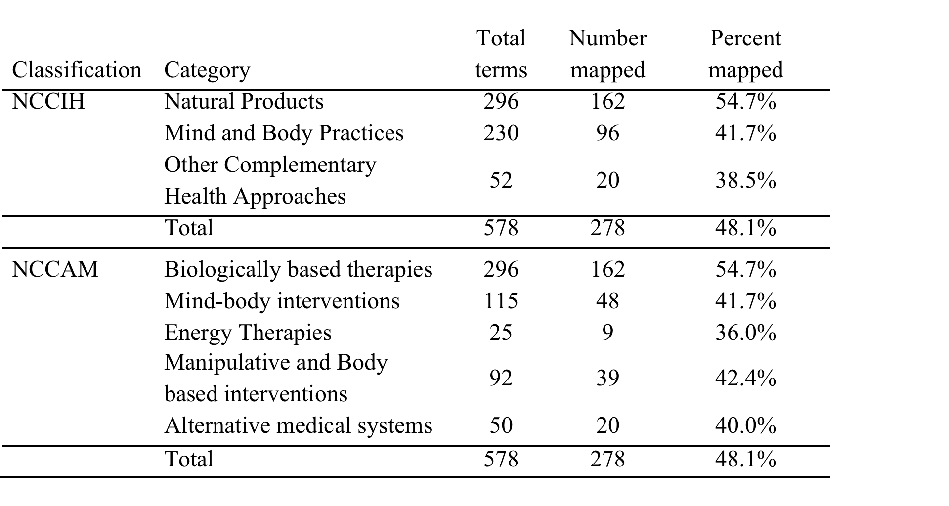
Percent Mapped

Slide 47
Examples
Complementary Integrative Therapy | NCCIH | NCCAM | SNOMED CT Code | SNOMED CT Descriptor
Aromatherapy | Natural Products | Alternative medical systems | 394615007 | Aromatherapy
Lavender | Natural Products | Biologically-based therapies | - | -
Massage | Mind-body Practices | Manipulative and Body based interventions | 229499000 | Body massage
Myofascial Release | Mind-Body Practices | Manipulative and Body based interventions | 404939002 | Myofascial release
Trigger point massage | Mind-Body Practices | Manipulative and Body based interventions | - | -
Therapeutic touch | Mind-Body Practices | Energy Therapies | 386475005 | Therapeutic touch
Healing touch | Mind-Body Practices | Energy Therapies | - | -

Slide 48



National Center for
Interprofessional Practice and Education
Redesigning both education & healthcare delivery simultaneously to be better integrated and more interprofessional for improved outcomes.
    Improved health of populations
    Improved experience of care
    Decreased cost
    Improved health professionals’ satisfaction & well-being

Slide 49
National Center Strategic Imperatives
Vision
Optimize health in our communities by aligning the education and health system outcomes that matter most to the individuals, families, and populations served.
Mission
The National Center works across the continuum of care and learning to transform how practice, education and research is designed to improve health for individuals, families, and populations within communities.
nexusipe.org

Slide 50
National Center Strategic Imperatives
Build Capacity to Advance IPE through learning, scholarship and research
Design curriculum together with community within the Nexus
Address racism and caste within the health care team so all members can contribute to superior outcomes for those being served
Engage individuals, families and communities in the Nexus for what matters most to them
Generate new knowledge to improve outcomes that advance health among individuals, families and communities

Slide 51
IPE Knowledge Generation
Supports collaboration linking locally generated data on individual programs to additional data across programs
Blends what is currently known about interprofessional research and evaluation approaches to leverage the burgeoning science of big data used in health systems worldwide

Slide 52
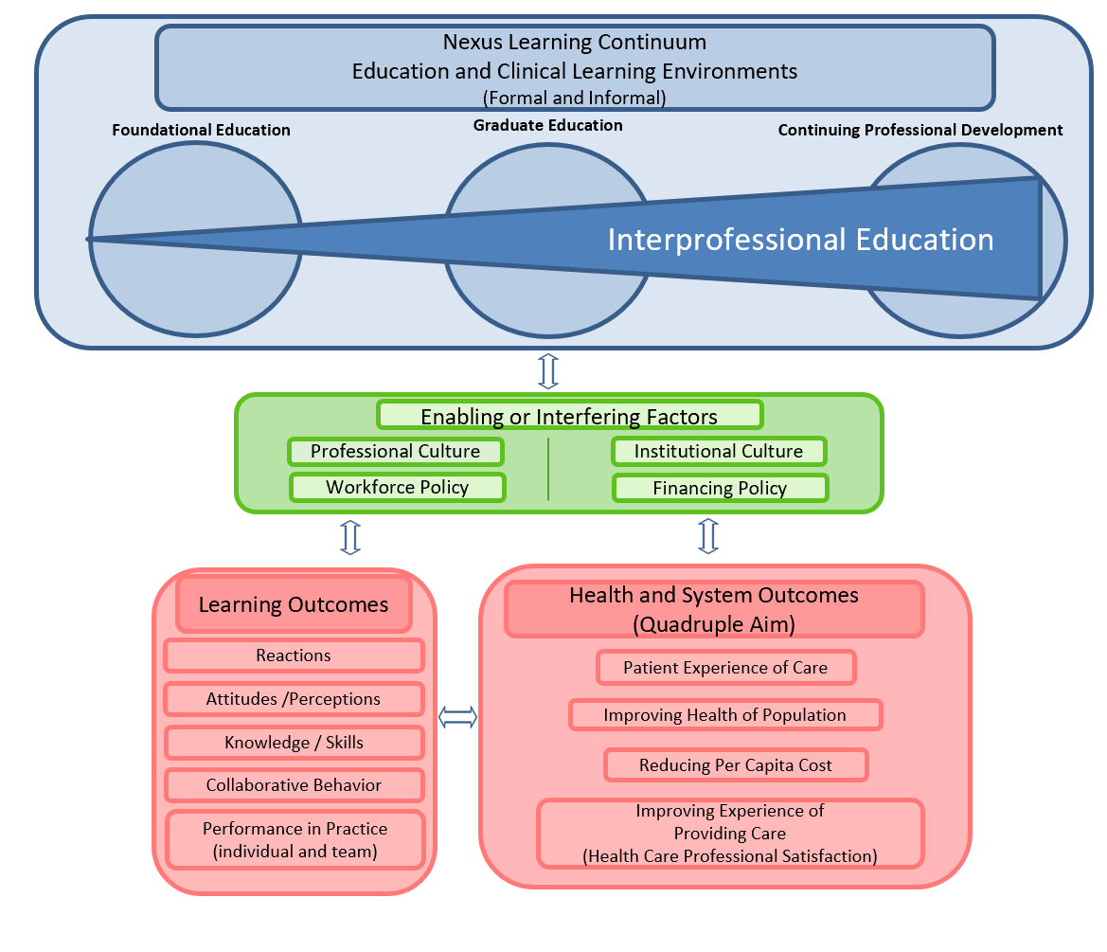

National Center Expanded Model: Defining Measures
IPE Core
Data Set
Interprofessional Competencies (ICCAS)
Interprofessional Education Learning Environment Survey
Interprofessional Clinical Learning Environment Survey
Critical Events of IPE
Teamness (ACE-15)
Health and Systems
Outcomes (Quadruple Aim)
Theoretical Framework: Institute of Medicine Measuring the Impact of Interprofessional Education on Collaborative Practice and Patient Outcomes. 2015

Slide 53
Key Principles
The Nexus – Education informed by and within practice, including Academic-Practice and Academic-Community partnerships.
Knowledge Generation – Interprofessional informatics, action research, developmental evaluation; real time evidence to inform practice.
Place-Based IPE – Think globally, act locally; design and measure impact on local community, address inequity and improve health.
Starting with the Patient– Design interventions with deep patient/family/ community/ population engagement and work back from there.
Expanded Definition of Who Is on the Team – A broad spectrum of health professionals and paraprofessionals, patients and communities but also social scientists, data scientists, educators – to maximize patient/ community engagement, design, and knowledge generation.
Quadruple Aim – Improve experience of care, improve health, increase value, support the healthcare team.
Notes:
We have articulated 6 key principles that inform our work in the Nexus
We believe that until we start collecting consistent data across sites, we will not move the field. The approach is not static but we support people in their development as well as data collection for their own efforts.
What has informed our thinking – working with over 70 sites and 100 IPE programs. Some were HRSA-funded.

Slide 54
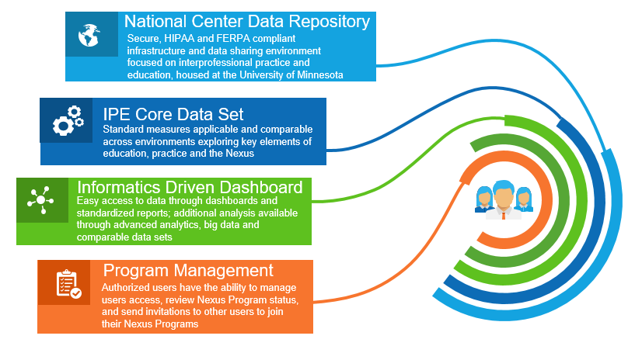
Infrastructure:
Functionality of the National Center IPE Information Exchange
Notes:
THE OVERALL INFRASTRUCTURE / SYSTEM INCLUDES 4 COMPONENTS:
DATA REPOSITORY
IPE CORE DATA SET
DASHBOARD
PROGRAM MANAGEMENT

Slide 55
Mapping the IPE Core Data Set
Components | Interprofessional Learning Continuum | Quadruple Aim Outcome(s)
Interprofessional Collaborative Competencies (ICCAS) | Learning Outcomes
Interprofessional Education Learning Environment Survey (IELES) | Learning, Health and System Outcomes | Provider/student wellbeing, Cost
Interprofessional Clinical Learning Environment Survey (ICLES) | Learning, Health and System Outcomes | Provider wellbeing, Cost
Critical Events of IPE | Enabling and Interfering Factors | Provider/ student wellbeing, Cost
Collaborative Environment (ACE-15) | Provider/Staff wellbeing | Provider/Staff wellbeing
Quadruple Aim Outcomes | Health and System Outcomes | Patient Experience, Population Health, Cost
Notes:
ICCAS = interprofessional collaborative competency attainment survey (i.e. do individual learners (however defined) learn core IPE competencies?
ACE-15 = Assessment for Collaborative environments (i.e. teamness)

Slide 56
Collecting and Sharing Health and System Outcomes Data
IPE innovators are working with a wide variety of community partners and practice settings. The following are exemplar sources of health and system outcomes data.
Health & Systems Data Type: | Data Sources and/or Instruments:
Patient/client/people/families use of services, targeted outcomes | Electronic Health Records (EHR), other patient/client records
Patient health-related quality of life, self-report | Short Form Health Survey (SF-12 or SF-36)
Patient/client/people/families experience, satisfaction | CAHPS or other measures of experience with care
Health professionals and practice setting staff job satisfaction, retention, perceptions of working environment | Staff, Professionals Satisfaction Surveys, Human Resources records, etc.
Notes:
The National Center Knowledge Generation project is powered by the National Center Interprofessional Information Exchange. Built on the University of Minnesota CTSI platform, and benefiting from the expertise of big data scientists and informaticists (Connie Delaney et al) – this provides an opportunity to collect elements of the Core Data Set and provide reports back to individual programs (their performance over time and relative to other programs) and importantly – allows identification of common enabling and interfering factors across programs and clinical settings.
The data infrastructure allows us to build interfaces to bring de-identified data from various sources (EHRs and others) into the NCIIE. Once the interfaces are built, this enables ongoing, near real-time program assessment.
Early learning has, for instance, identified that starting from the needs of the patient and/or community and building the IPE intervention out from there is a critical success factor across many settings.

Slide 57
Summary
IPE in in the Nexus of practice and education enables learning for students and practicing health care teams while improving meaningful Quadruple Aim outcomes for individuals and populations
Real-time developmental evaluation of IPE allows for continuous quality improvement at the local level
A Core Data Set of common, cross cutting IPE metrics allows real-time learning and quality improvement of individual programs and cross-program learning to inform IPE broadly
Tracking Critical Events of IPE provides local teams a structured opportunity to assess, reflect and address enabling and interfering factors, and informs future program design
Examining the synergy of team-identification and the IPE core data set will address the quadruple aims.

Slide 58
References
Delaney CW, AbuSalah A, Yeazel M, Kertz JS, Pejsa L, Brandt BF 2020. National center for interprofessional practice and education IPE core data set and information exchange for knowledge generation. Journal of Interprofessional Care; https://doi.org/10.1080/13561820.2020.1798897
Institute of Medicine 2015. Measuring the Impact of Interprofessional Education on Collaborative Practice and Patient Outcomes. Washington, DC: The National Academies Pres. https://doi.org/10.17226/21726
National Center for Interprofessional Practice and Education, https://nexusipe.org/

Slide 59

The United Nations Sustainable Development Goals (SDGs) are 17 goals with 169 targets that all 191 UN Member States have agreed to try to achieve by the year 2030.
Health has a central place in SDG 3: Ensure healthy lives and promoting well-being for all at all ages, underpinned by 13 targets that cover a wide spectrum of WHO’s work.
Almost all of the other 16 goals are directly related to health or will contribute to health indirectly.
The new agenda, which builds on the Millennium Development Goals, aims to be relevant to all countries and focuses on improving equity to meet the needs of women, children and the poorest, most disadvantaged people.
https://www.who.int/data/gho/data/themes/sustainable-development-goals/GHO/sustainable-development-goals

Slide 60
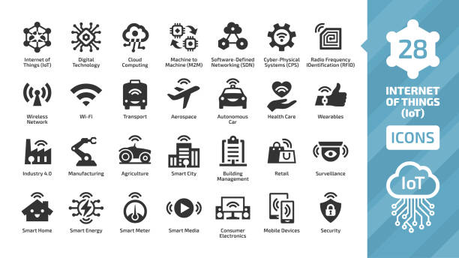
IoT

Slide 61
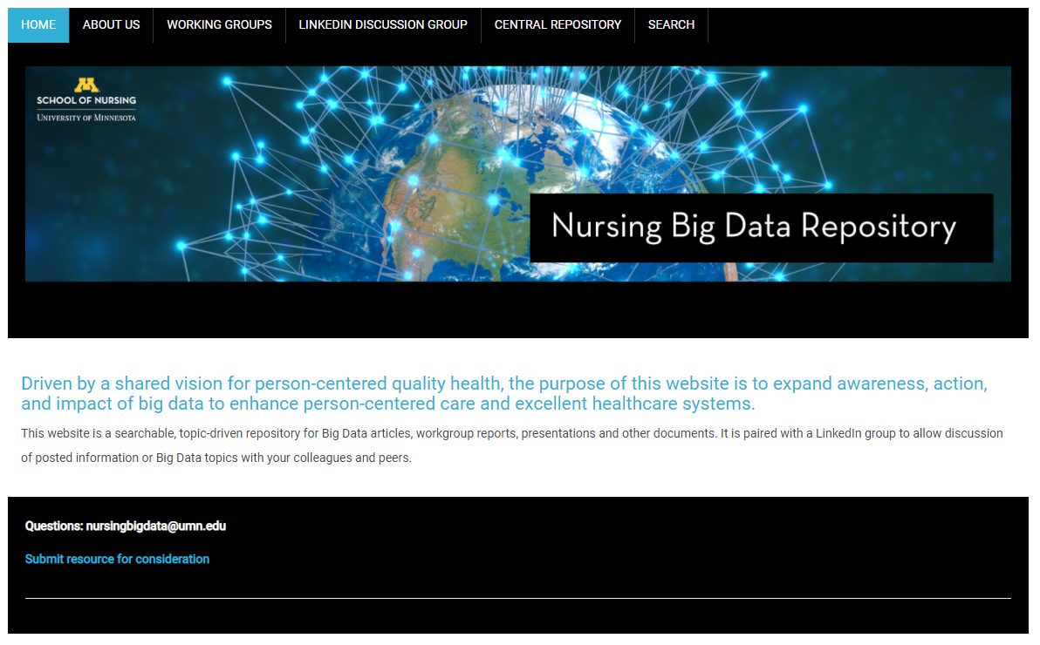
Social Media

Slide 62
What matters?
Education of all faculty and students – AACN
Education of all CNE/CNOs – AONL
Team, collaboration
Research such as NANDA’s priroities
Leverage
Speed
Mobile
Voice of people

Slide 63
Advancing NANDA’s Language through Integration into Current Data Platforms
What is big data and what is needed for inclusion of NANDA-I data in current data platforms?
What is the necessary level of specificity needed for incorporation and retrieval of NANDA language?
How does data mining for nursing currently take place?
How can we create data that aligns with nursing’s focus?

Slide 64


Lovitude™ in Northern Lights
Registered Trademark of Anne Pryor
We shall not cease from exploration, and the end of all our exploring will be to arrive where we started and know the place for the first time.
T. S. Eliot

