Slide 1
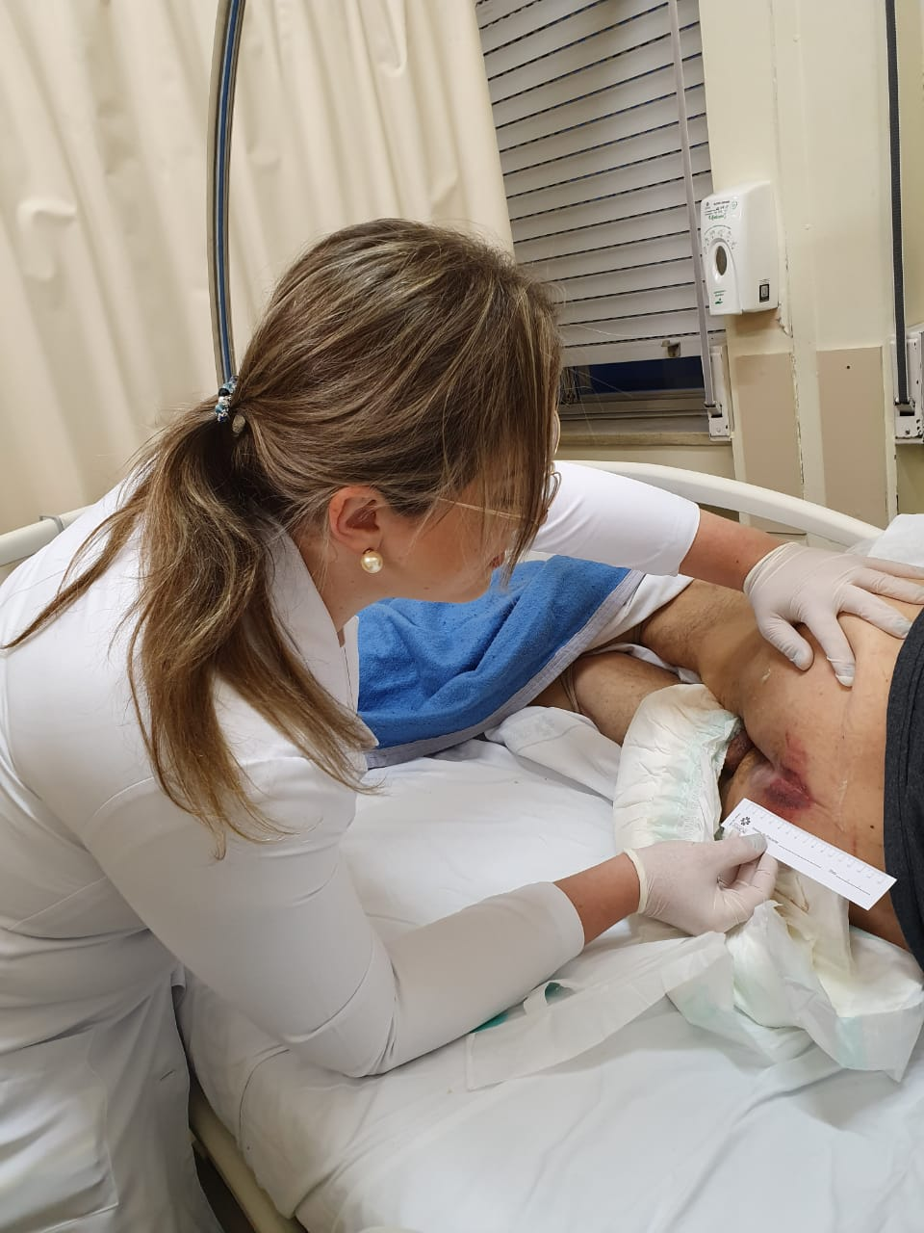
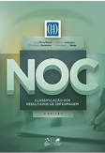

PURPOSE: To develop an instrument to evaluate patients with pressure injury based on Nursing Outcomes Classification/NOC.
METHOD: the consensus study among experts
Local: Brazilian university hospital.
Sample: 10 nurse specialists in care patients with pressure injuries (PI).
Data collection: The researchers selected Tissue Integrity: Skin and Mucous Membranes (1101) and Wound Healing: Secondary Intention (1103) outcomes and 40 clinical indicators from NOC, based on previous studies. These were submitted to the opinion of specialists in two meetings, in which they selected the most suitable for evaluation of the patient with PI.
Analysis data: The decision was made with 100% consensus among the specialists.
Ethical aspects: The study was approved by the Research Ethics Committee (2018-0390).
IMPACT: The development of this instrument allowed defining the most applicable indicators for the patients evaluation with PI, facilitating its application in nursing clinical practice.
AN INSTRUMENT TO EVALUATION OF PRESSURE INJURY PATIENTS BASED ON NURSING OUTCOMES CLASSIFICATION – NOC
Amália de Fátima Lucena, Cássia Teixeira dos Santos, Franciele M. Barbosa, Thayná de Almeida , Raquel S. Einhardt , Ana Carolina Eilert
RESULTS: The final instrument was composed of two outcomes and 17 indicators by NOC
NURSING OUTCOMES (codes) | INDICATORS (codes)
Tissue Integrity: skin and mucous membranes (1101) | Blanching (110122) Erythema (110121) Sensation (110102) Tissue perfusion (1101111) Hydration (110104) Thickness (110109) Necrosis (110123)
Wound Healing: secondary intention (1103) | Foul wound odor (110317) Blistered skin (110310) Macerated skin (110311) Undermining (110315) Wound inflammation (110322) Exudate/Drainage (110303, 110304, 110305, 110306) Granulation (110301) Tunneling (110314) Scar formation (110320) Decreased wound size (110321)

