Slide 1

Children and Environmental Toxins
May 14, 2019
Dr. Philip Landrigan ‘63

Slide 2

ENVIRONMENTAL THREATS
TO CHILDREN’S HEALTH
…
A STRATEGY
TO EMPOWER PARENTS
Philip J. Landrigan, M.D., M.Sc., F.A.A.P.
Director, Program in Global Public Health and the Common Good
Schiller Institute for Integrated Science & Society
Boston College
Boston College Energy and Environment Alumni Network
May 14, 2019

Slide 3
THE ENVIRONMENT PLAYS A CRITICAL ROLE
IN SHAPING
CHILDREN’S HEALTH
Over the past century, patterns of health and disease in American children have changed profoundly:
  Infant mortality has fallen by 90%
  Life expectancy has nearly doubled from 48 years in 1900 to 80 years today
  The ancient infectious diseases – smallpox, cholera, yellow fever, tetanus, pertussis and measles - no longer kill thousands of children each year
  Chronic, non-communicable diseases are now the major causes of illness, disability and death in children. These diseases are on the rise.
In the same time, our environment has changed:
  Air pollution is down 70% since 1970
  Lead levels have fallen by more than 90%
  The worst hazardous waste sites have been contained and remediated
  But chemical pollution has quietly and invisibly become much worse

Slide 4
GOALS OF THIS TALK
  To explore these trends in disease and environment
  To examine the connections between them
  To talk about solutions

Slide 5
PREVALENCE OF ASTHMA,
USA, 1980-2004
1111111111111111
Children <18
All Ages
Source: CDC MMWR, October 19, 2007 / 56(SS08);1-14;18-54

Slide 6
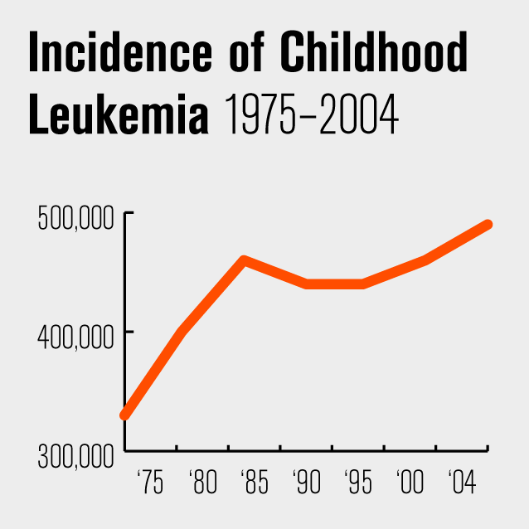
Source: National Cancer Institute

Slide 7
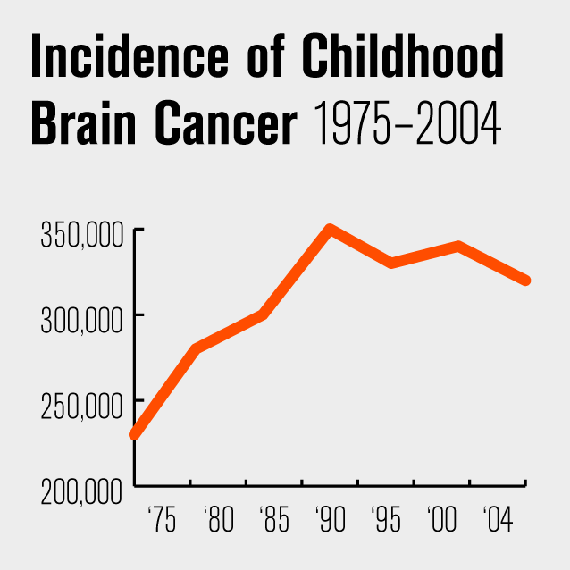
Source: National Cancer Institute

Slide 8
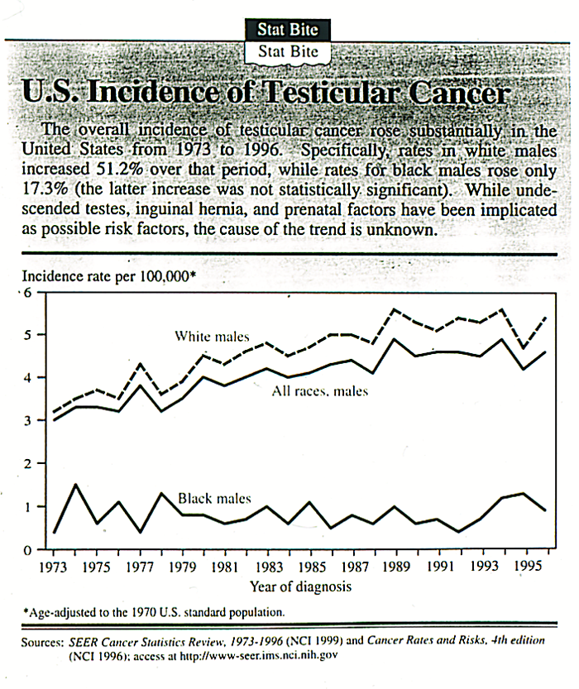
INCIDENCE OF
TESTICULAR CANCER, USA

Slide 9
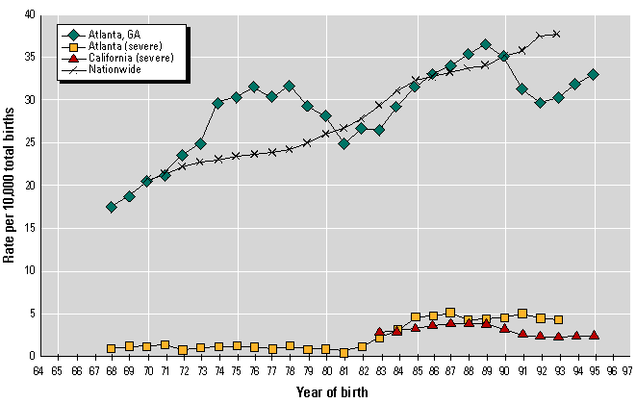
INCREASING INCIDENCE OF
MALE REPRODUCTIVE BIRTH DEFECTS

Slide 10
INCREASING INCIDENCE OF NEURODEVELOPMENTAL DISABILITIES
Affect 10-15% of all children
Include: Dyslexia
ADHD
Mental Retardation
Autism
Reported incidence is increasing

Slide 11
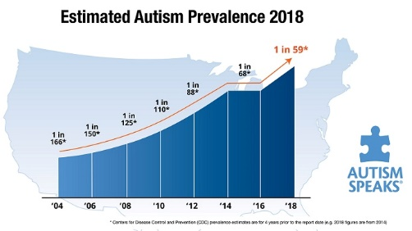
INCREASING PREVALENCE OF AUTISM

Slide 12
THOUSANDS OF NEW CHEMICALS HAVE BEEN MANUFACTURED AND
RELEASED TO THE ENVIRONMENT

Slide 13
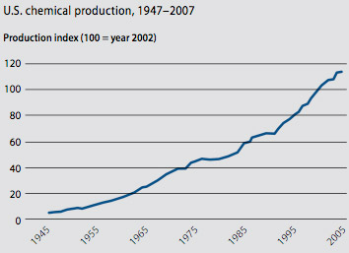
GROWTH IN CHEMICAL MANUFACTURE
SINCE WORLD WAR II
111111111111111111111111111111111

Slide 14
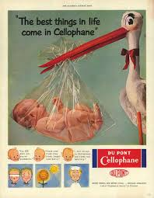
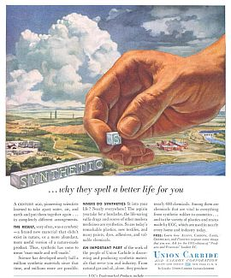
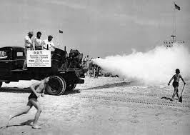
NEW CHEMICALS ARE INTRODUCED WITH GREAT ENTHUSIASM AND LITTLE DUE DILIGENCE…
…AND THEN BELATEDLY THEY ARE FOUND TIME AND AGAIN TO HAVE CAUSED
GREAT HARM TO THE ENVIRONMENT AND TO CHILDREN’S HEALTH

Slide 15
CHILDREN’S EXPOSURES TO
CHEMICALS TODAY
80,000+ chemicals in commerce
These are mostly new man-made chemicals invented since 1950. Never before existed on earth
Used in millions of consumer products
Widely disseminated in the environment.
Ubiquitous in places where children live, learn and play
Nearly universal human exposure
Global production is on track to double in the next 25-30 years
Majority have never been tested for safety or toxicity

Slide 16
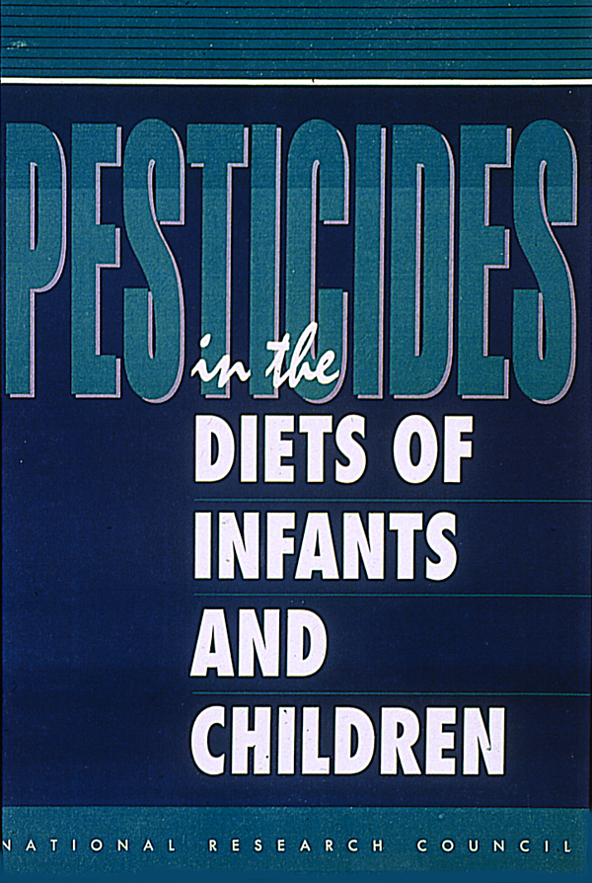
CHILDREN ARE UNIQUELY SENSITIVE
TO TOXIC CHEMICALS IN THE ENVIRONMENT
Proportionately greater exposure than adults
Diminished ability to break down and excrete many chemicals
Exquisite vulnerability
More years of future life
National Academy of Sciences, 1993

Slide 17
TOXIC CHEMICALS CAUSE
DISEASE IN CHILDREN
Air pollution causes asthma
Phthalates cause birth defects of the male reproductive organs
Benzene and 1,3-butadiene cause leukemia
High-fructose corn syrup causes obesity and diabetes
Lead, mercury, pesticides, PCBs and more cause brain injury that leads to reduced IQ, shortened attention span and disrupted behavior

Slide 18
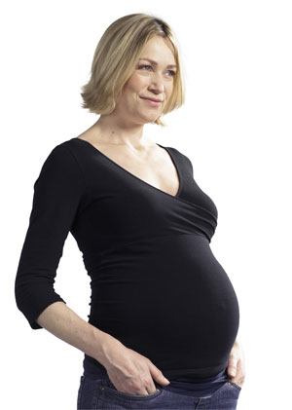
THE DEVELOPING HUMAN BRAIN IS EXQUISITELY SENSITIVE TO TOXIC CHEMICALS
Toxic chemicals can injure the developing brains of infants and young children at the lowest levels detectable – at levels far below those that harm adults
There are no safe exposure “thresholds” in the womb or in early postnatal life
This susceptibility reflects the human brain’s wondrous and extraordinary complexity
Brain damage caused by toxic exposures in early life can be permanent, irreversible and untreatable
Prevention of exposure is the only logical treatment

Slide 19
CHEMICALS NOW KNOWN TO DAMAGE
THE DEVELOPING HUMAN BRAIN
Lead
Methyl Mercury
Polychlorinated Biphenyls (PCBs)
Arsenic
Manganese
Organic solvents, e.g., Ethanol and Toluene
Organophosphate pesticides - Chlorpyrifos
Organochlorine pesticides
Phthalates
Bisphenol A
Brominated flame retardants
Polycyclic aromatic hydrocarbons
Notes:
19

Slide 20
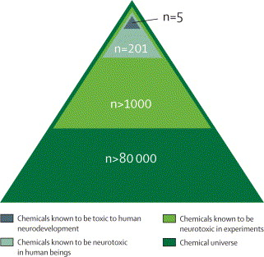
ARE THERE STILL OTHER NEUROTOXIC CHEMICALS NOT YET DISCOVERED?
n=12
Grandjean & Landrigan, The Lancet, 2006

Slide 21
THE GOOD NEWS:
DISEASE IN CHILDREN
CAUSED BY TOXIC CHEMICALS
CAN BE PREVENTED
Two key ingredients:
  Scientific discovery
  Will to act on and not ignore science
Example: The removal of lead from gasoline
EPA, 1976

Slide 22

LEAD USE IN GASOLINE DECLINED FROM 1976
THROUGH 1980
110
100
90
80
Lead used In gasoline
(1000 tons)
Gasoline lead
70
60
50
40
30
1975
1976
1977
1978
1979
1980
1981
Source: Annest, Pirkle, Makuc, et al., Chronological trend in blood lead levels between 1976 and 1980. NEJM 1983; 308;1373-7.
Year

Slide 23
LEAD IN GASOLINE AND LEAD IN BLOOD
NHANES II, 1976-1980
110
17
100
16
90
15
80
14
Lead used In gasoline
(1000 tons)
Gasoline lead
13
70
Blood lead levels (μg/dL)
12
60
11
50
Blood lead
10
40
9
30
1975
1976
1977
1978
1979
1980
1981
Source: Annest, Pirkle, Makuc, et al., Chronological trend in blood lead levels between 1976 and 1980. NEJM 1983; 308;1373-7.
Year

Slide 24
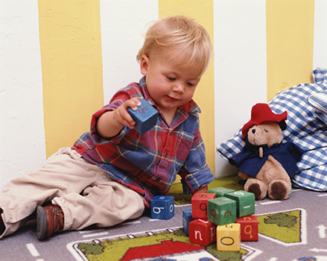
ENVIRONMENTAL DISEASE IS PREVENTABLE -
DECLINING BLOOD LEAD LEVELS IN THE U.S.
1976–1999
18
16
14
12
Blood Lead Levels (µg/dL)
10
8
6
4
2.7
2.0
2
0
1974
1976
1978
1980
1982
1984
1986
1988
1990
1992
1994
1996
1998
2000
Year

Slide 25
CONSEQUENCES OF REMOVAL OF LEAD FROM GASOLINE
95% reduction in blood lead levels in US children
95% reduction in incidence of lead poisoning
2-5-point gain in population mean IQ
$200 billion annual economic benefit to US each year since 1980 through increased economic productivity of more intelligent and creative children

Slide 26
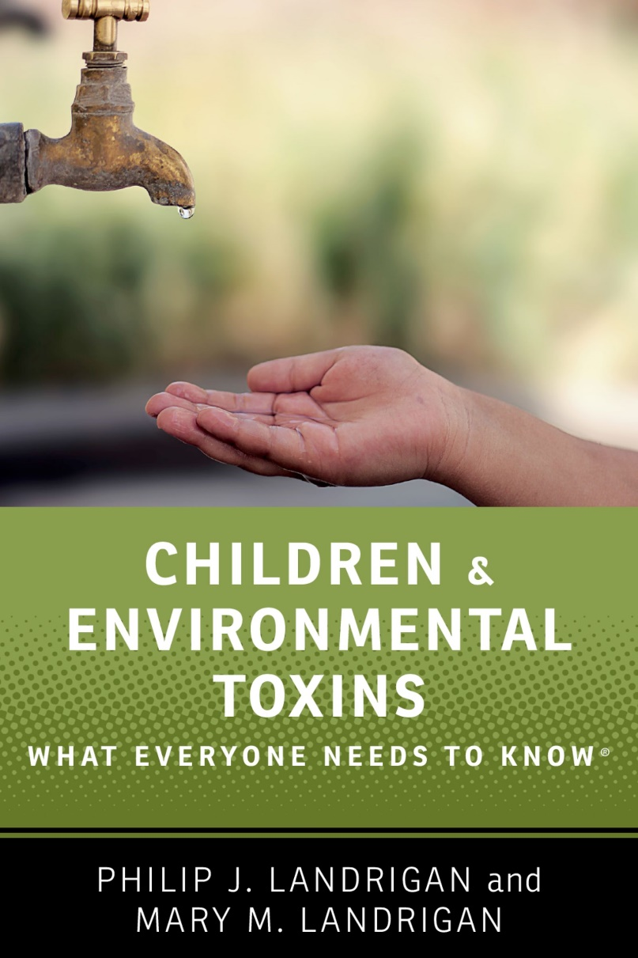
EMPOWERING PARENTS
TO PROTECT CHILDREN
Information
=
Power

Slide 27
EMPOWERING PARENTS
TO PROTECT THEIR CHILDREN
Home. Every parent is the CEO of their home.
Shop wisely
Eat wisely, and eat organic whenever possible
Minimize/avoid pesticides – Adopt Integrated Pest Management (IPM)
Watch out for the old hazards – lead, asbestos, radon
Leave a light carbon footprint

Slide 28
EMPOWERING PARENTS
TO PROTECT THEIR CHILDREN
Community
Join the PTA and the school board
  Work on school and daycare safety issues
  Think twice before you allow your school to put in a synthetic turf field
Make your voice heard at town meetings
  Get involved in local environmental issues
  Consider joining the local environment committee
Consider running for local office

Slide 29
EMPOWERING PARENTS
TO PROTECT THEIR CHILDREN
The Wider Society
Join an environmental organization
Write opinion pieces for your local newsletter
Consider running for state or federal office
VOTE!
This is not about politics…its about protecting America’s children and our country’s future

Slide 30

THANK YOU!

