Slide 1



BOSTON COLLEGE WORLDWIDE WEBINARS
A Taste of Health
Laura Plumb ’84
February 4, 2020

Slide 2

Medicine in Nature
5 Elements

Slide 3

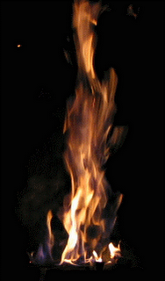

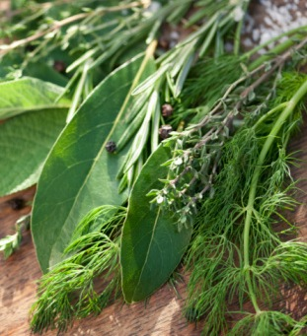
Space, Air, Fire,
Water, Earth

Slide 4

Doshas: Bio Energies

Slide 5


Air

Slide 6


Fire

Slide 7


Water

Slide 8

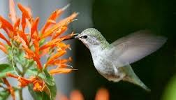
Vata

Slide 9


Pitta

Slide 10


Kapha

Slide 11
Balance

Slide 12



lauraplumb.com/doshaquiz

Slide 13

What Dosha Are You?
lauraplumb.com/doshaquiz

Slide 14
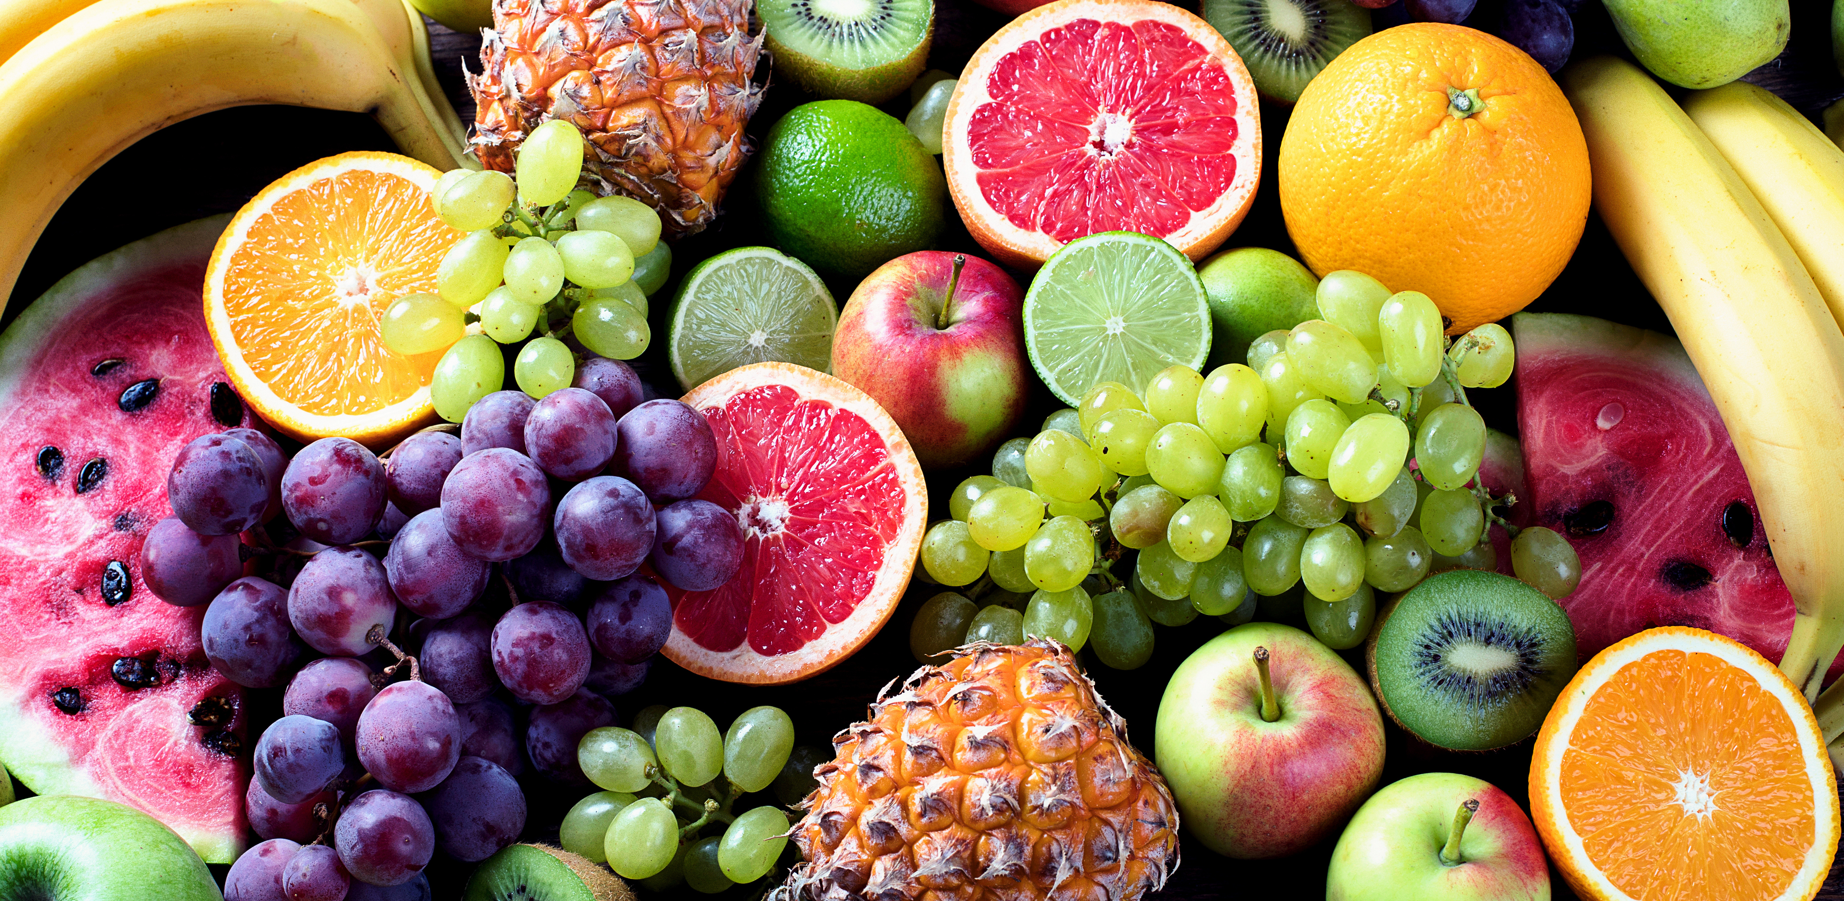
The Medicine in Food
6 Tastes

Slide 15
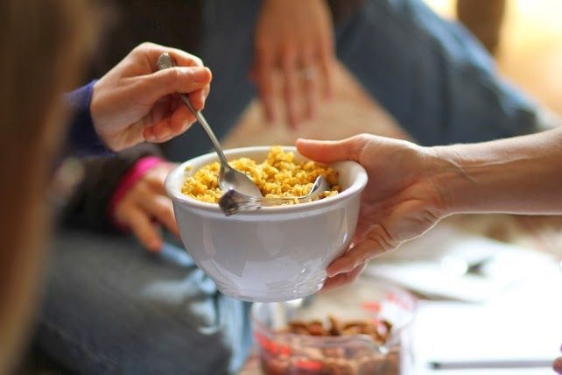

Food & The Six Tastes
Sweet
Sour
Salty
Pungent
Astringent
Bitter

Slide 16
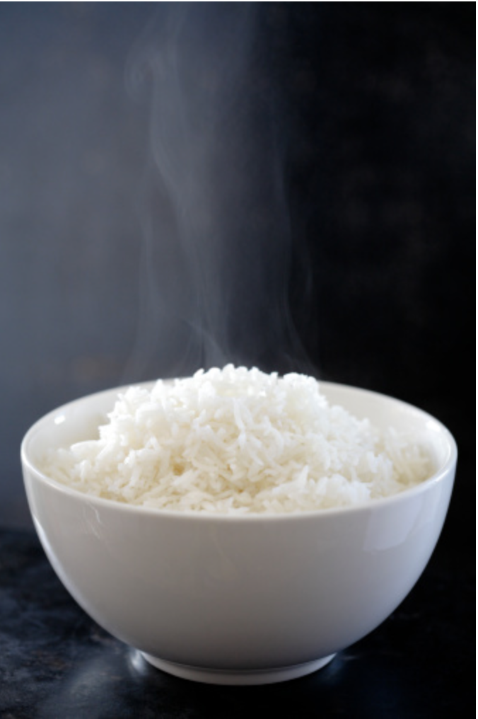
The Sweet Taste
Grains
Fruits
Roots
Nuts
Dairy
Meat

Slide 17
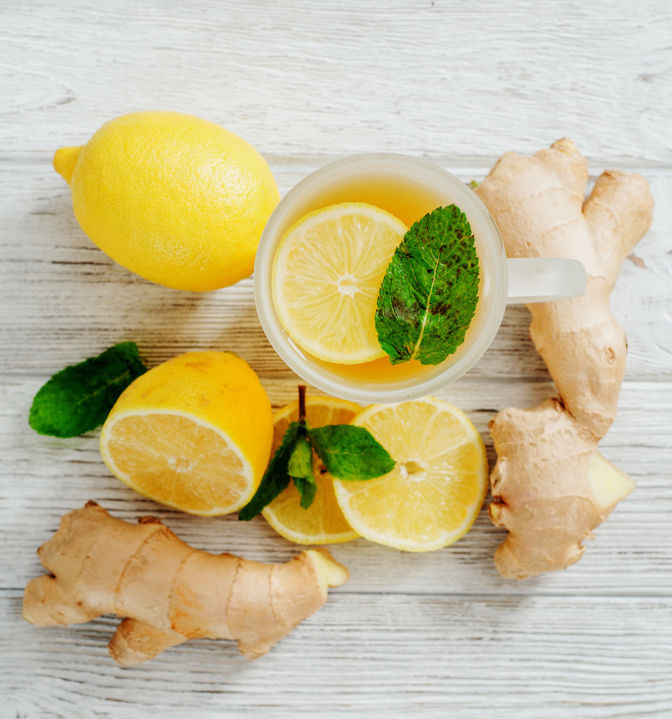
The Sour Taste
Citrus
Yogurt
Vinegar
Ferments
Tomato
Alcohol

Slide 18
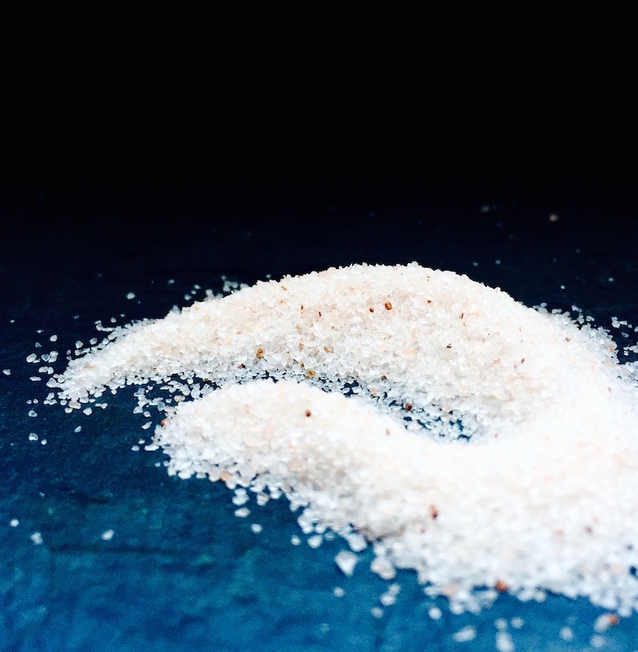
The Salty Taste
Salt
Fish
Seaweed
Sea Vegetables
Celery

Slide 19
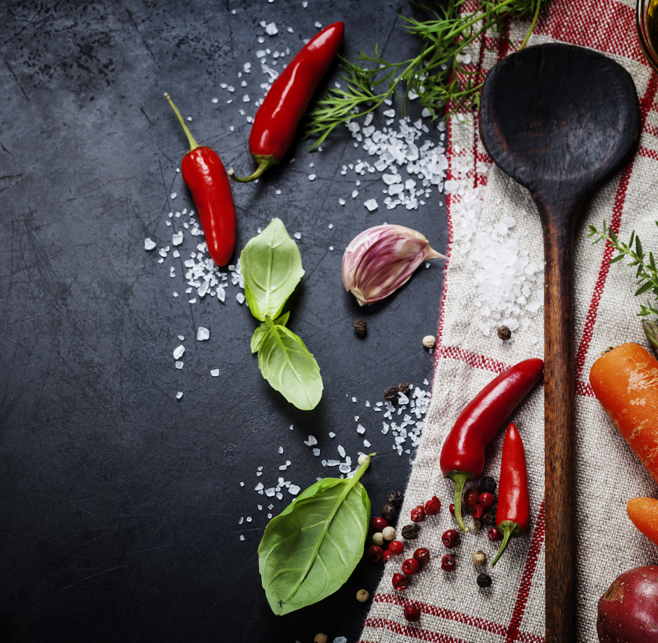
The Pungent Taste
Onion
Garlic
Chilies
Herbs
Watercress
Radish

Slide 20
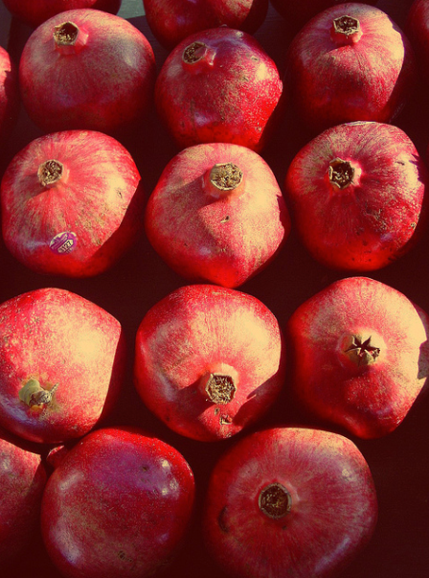
The Astringent Taste
Pomegranate
Apple
Cauliflower
Legumes
Tea
Quinoa

Slide 21

The Bitter Taste
Spinach
Radicchio
Zest
Aloe
Coffee
Dark Chocolate

Slide 22
The Six Tastes & Five Elements
Sweet: Earth & Water
Sour: Earth & Fire
Salty: Water & Fire
Pungent: Fire & Air
Astringent: Air & Earth
Bitter: Air & Space

Slide 23
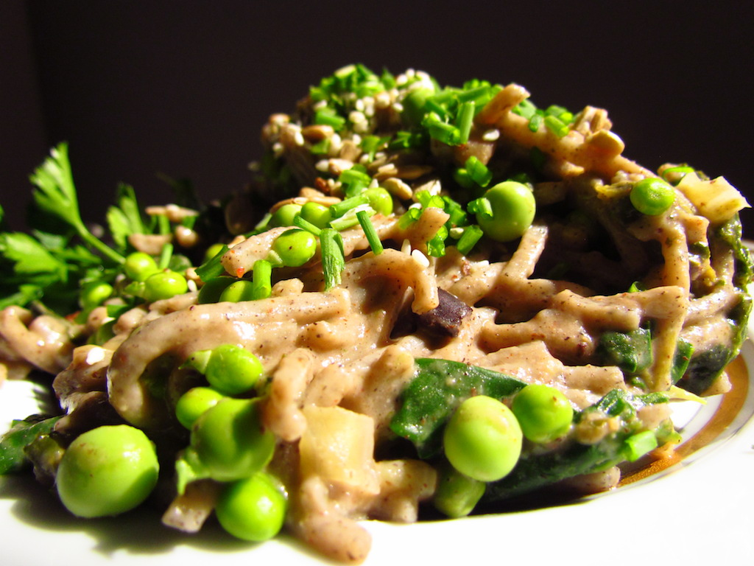
Eat All Six Tastes
Sweet
Sour
Salty
Pungent
Astringent
Bitter

Slide 24

A Six Taste Meal
Rice/Fish
Sauce/Lemon
Fish/Salt
Onion/Peppers
Leaves/Bran
Greens

Slide 25
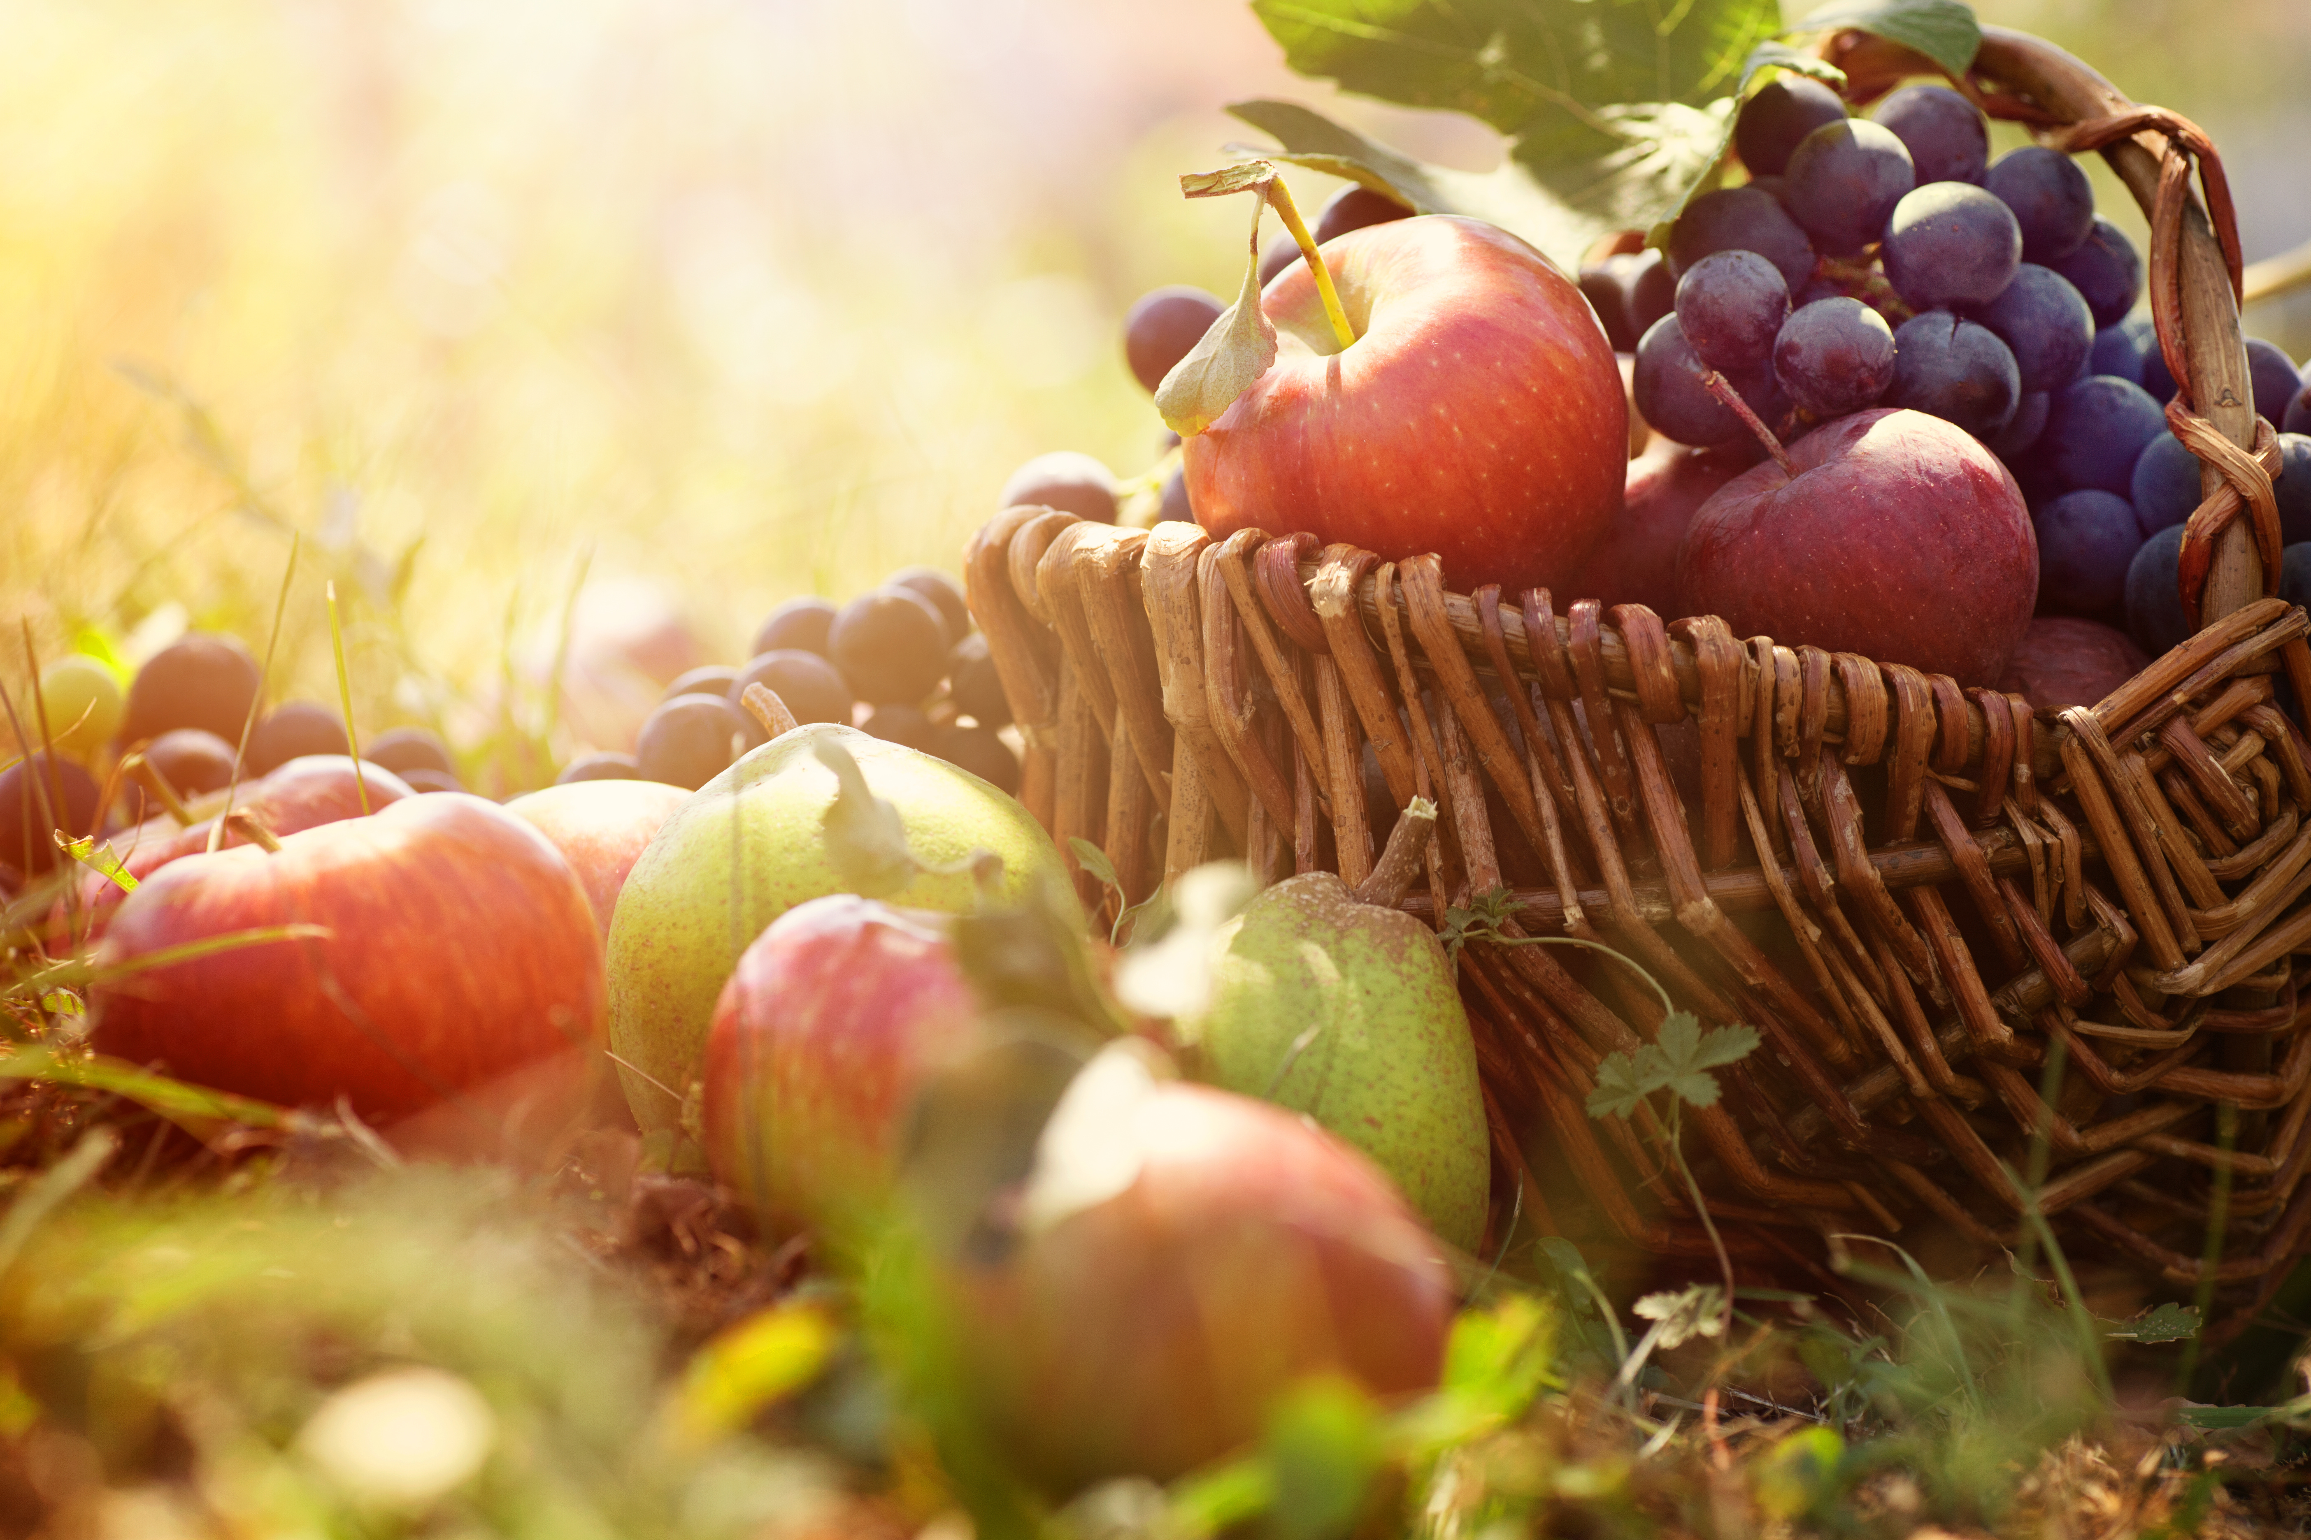
Seasons

Slide 26
The 4 Seasons of Health
Remember the Doshas?

Slide 27
Summer: Cool & Soothing
Source: food-alovestory.com

Slide 28
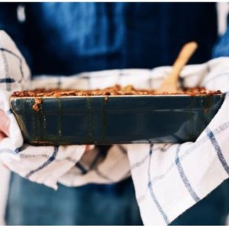
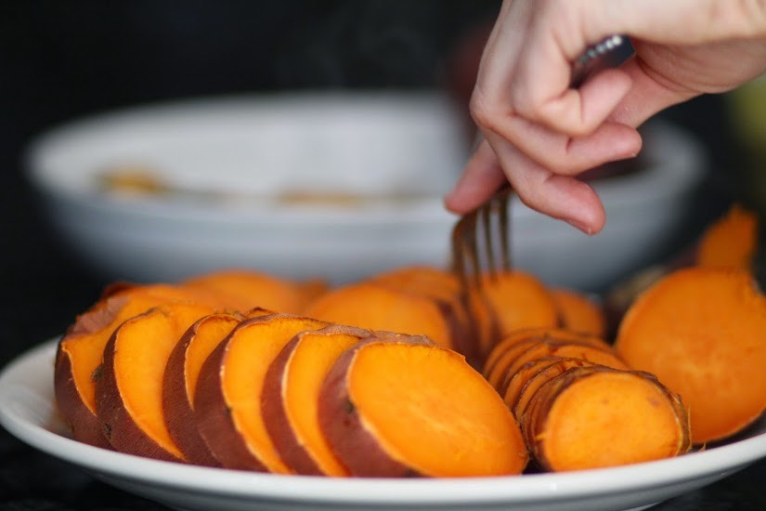
Autumn: Hearty & Grounding
Source: food-alovestory.com

Slide 29
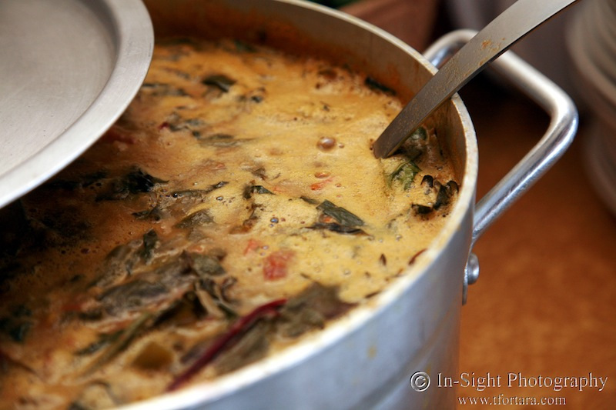
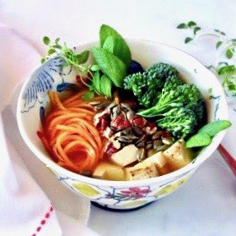
Winter: Warm & Spicy
Example
Source: food-alovestory.com

Slide 30
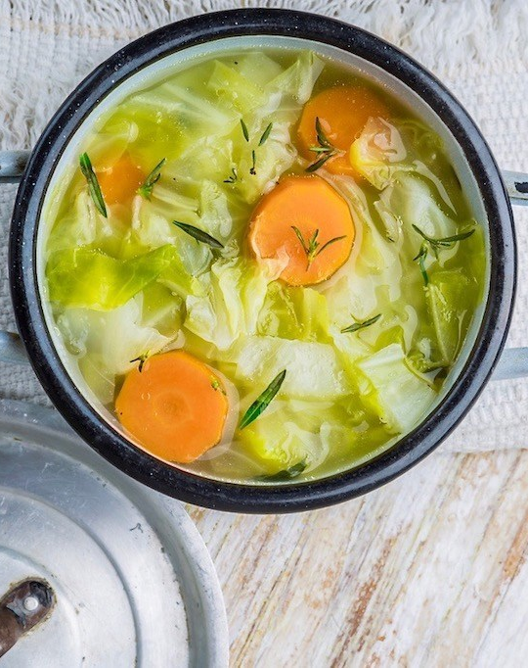
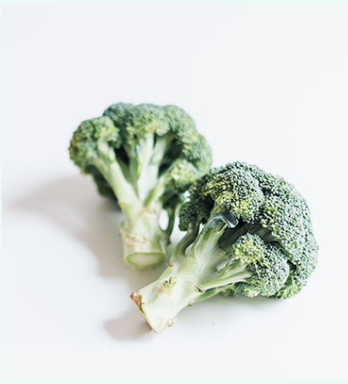
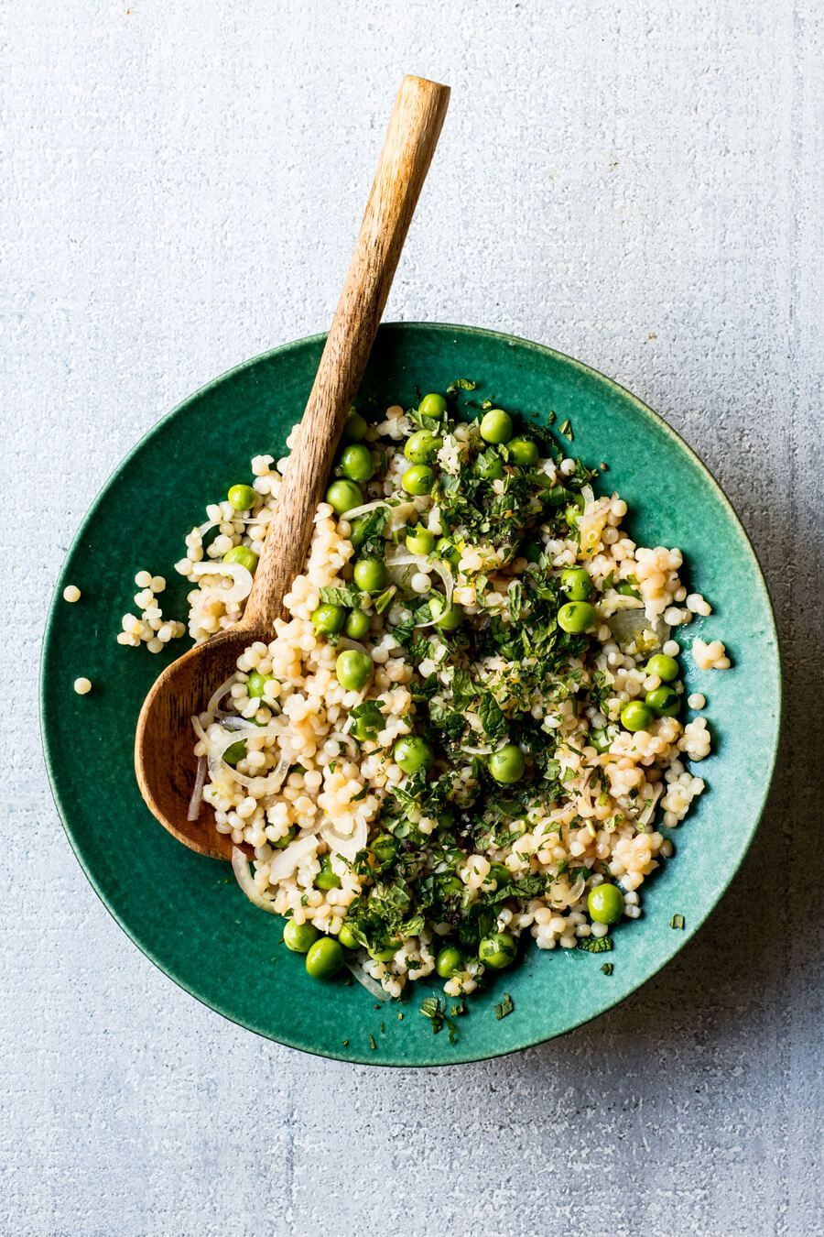
Spring: Light & Cleansing
Source: food-alovestory.com

Slide 31
All Dosha Spices
Ginger | “Universal medicine” IBS, weight loss, arthritis, dilates, stress
Cumin | Antioxidant, digestion, protects against memory loss
Coriander | Digestion, antioxidant, detoxifying, immune, colic, diarrhoea
Mustard Seeds | Pungent, bitter, digestive, cancer, diabetes, cholesterol, detox
Turmeric | Antioxidant, liver, immune, arthritis, regulates blood sugar
Fenugreek | Light, heating, asthma, cough, colic, diabetic neuropathy
Asafoetida | Carminative, bloating, soothing, excellent for beans

Slide 32
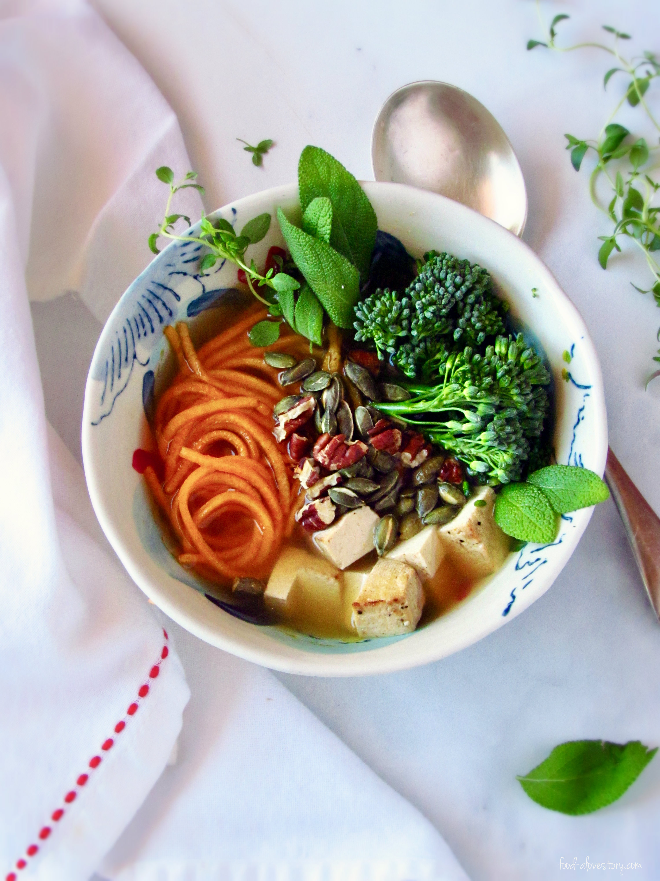
You Are Not What You Eat

Slide 33

You Are What You Digest

Slide 34
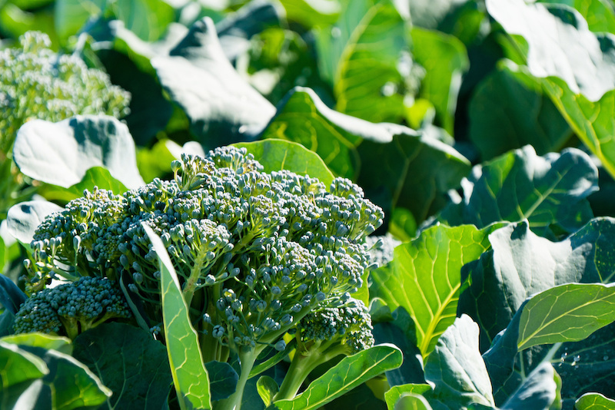
So What Are Superfoods?

Slide 35
Superfoods are the foods that you digest best

Slide 36
Seek Balance
Seasonal
Local
Organic
Fresh
Original
Prepared for Optimal Digestion
Sattva!

Slide 37


Slide 38

VEDAWISE.COM

Slide 39
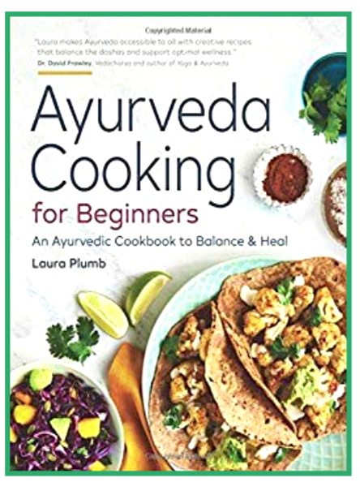
Q & A
lauraplumb.com
food-alovestory.com
laura@lauraplumb.com

