Slide 1
Strategies to prepare for your next promotion
Kim Meninger MCAS’97, CGSOM’08, MBA, BCC
Executive Coach

Slide 2
Agenda
What does it mean to strategically prepare for your next promotion?
Common Challenges
Preparation Framework
Clarity
Confidence
Connection
Questions
2

Slide 3
What Is Strategic Preparation?
Assessing your situation
Adopting a mindset of purpose and intention
Having an awareness of the role of micro-decisions
Remaining proactive
3

Slide 4
challenges
4

Slide 5
Challenges
Limited self-reflection
Reactive vs. proactive approach
Fear
Lack of prioritization
Dependency on others
Attachment to others’ expectations
5

Slide 6
Preparation framework
6

Slide 7
Clarity
7

Slide 8
Why Clarity?
Allows you to lead with purpose and intention
Empowers you to more fully utilize strengths
Provides greater certainty on direction
Offers a development roadmap
Increases overall satisfaction
8

Slide 9
Developing Clarity
What do YOU want?
Assess your options
Limit influence of others’ expectations
What are your values?
What do you care most about?
Who do you want to be?
Know how you want to show up
Prioritize authenticity
9

Slide 10
confidence
10

Slide 11
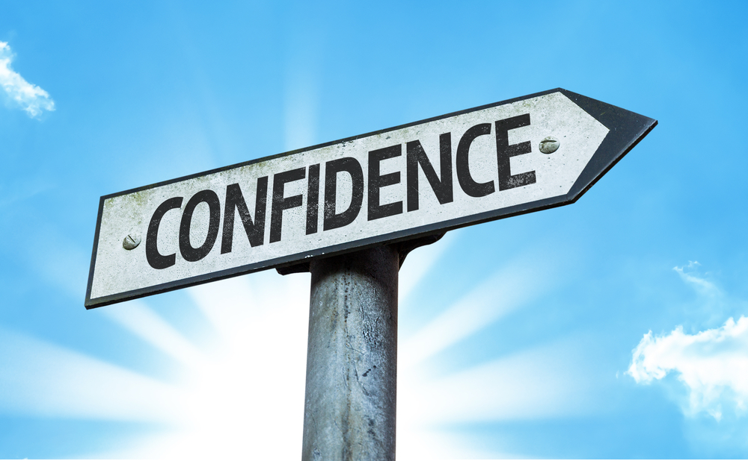
Why Confidence?
Makes us feel we deserve to take the next step
Influences our presence
Impacts our visibility
11

Slide 12
Growing Your Confidence
Own your strengths
Strive for balanced self-awareness
Share your expertise
Help others
Leverage your resources
Don’t try to do and know everything
12

Slide 13
connection
13

Slide 14
Why Connection?
Ensures you gain the support and advocacy you need
Strengthens your performance and overall value
Exposes you to new options and opportunities
14

Slide 15
Building Strategic Connections
Communicate your goals to others
Who needs to know?
Ask for help
Don’t expect to get there on your own
Consistently add value
How does your network benefit from relationships with you?
15

Slide 16
Additional Resources
Getting Ahead, Three Steps to Take Your Career to the Next Level, Joel A. Garfinkle
Who Gets Promoted, Who Doesn't, and Why, Second Edition: 12 Things You'd Better Do If You Want to Get Ahead, Donald Asher
For Women:
How Women Rise: Break the 12 Habits Holding You Back from Your Next Raise, Promotion, or Job, Sally Helgesen & Marshall Goldsmith
Impostor Syndrome Challenge – 7 Days to Greater Confidence
16

Slide 17
Questions?
Join Newsletter: Text LEADINGWOMEN to 66866
Email: Kim@ExecutiveCareerSuccess.com
Visit: www.ExecutiveCareerSuccess.com
Connect: www.LinkedIn.com/in/KimMeninger

