Slide 1
Spiritual Practices for Busy People
BOSTON COLLEGE WORLDWIDE WEBINARS
December 12, 2019
Presented by Dr. Colleen M. Griffith

Slide 2
The art of juggling…

Slide 3
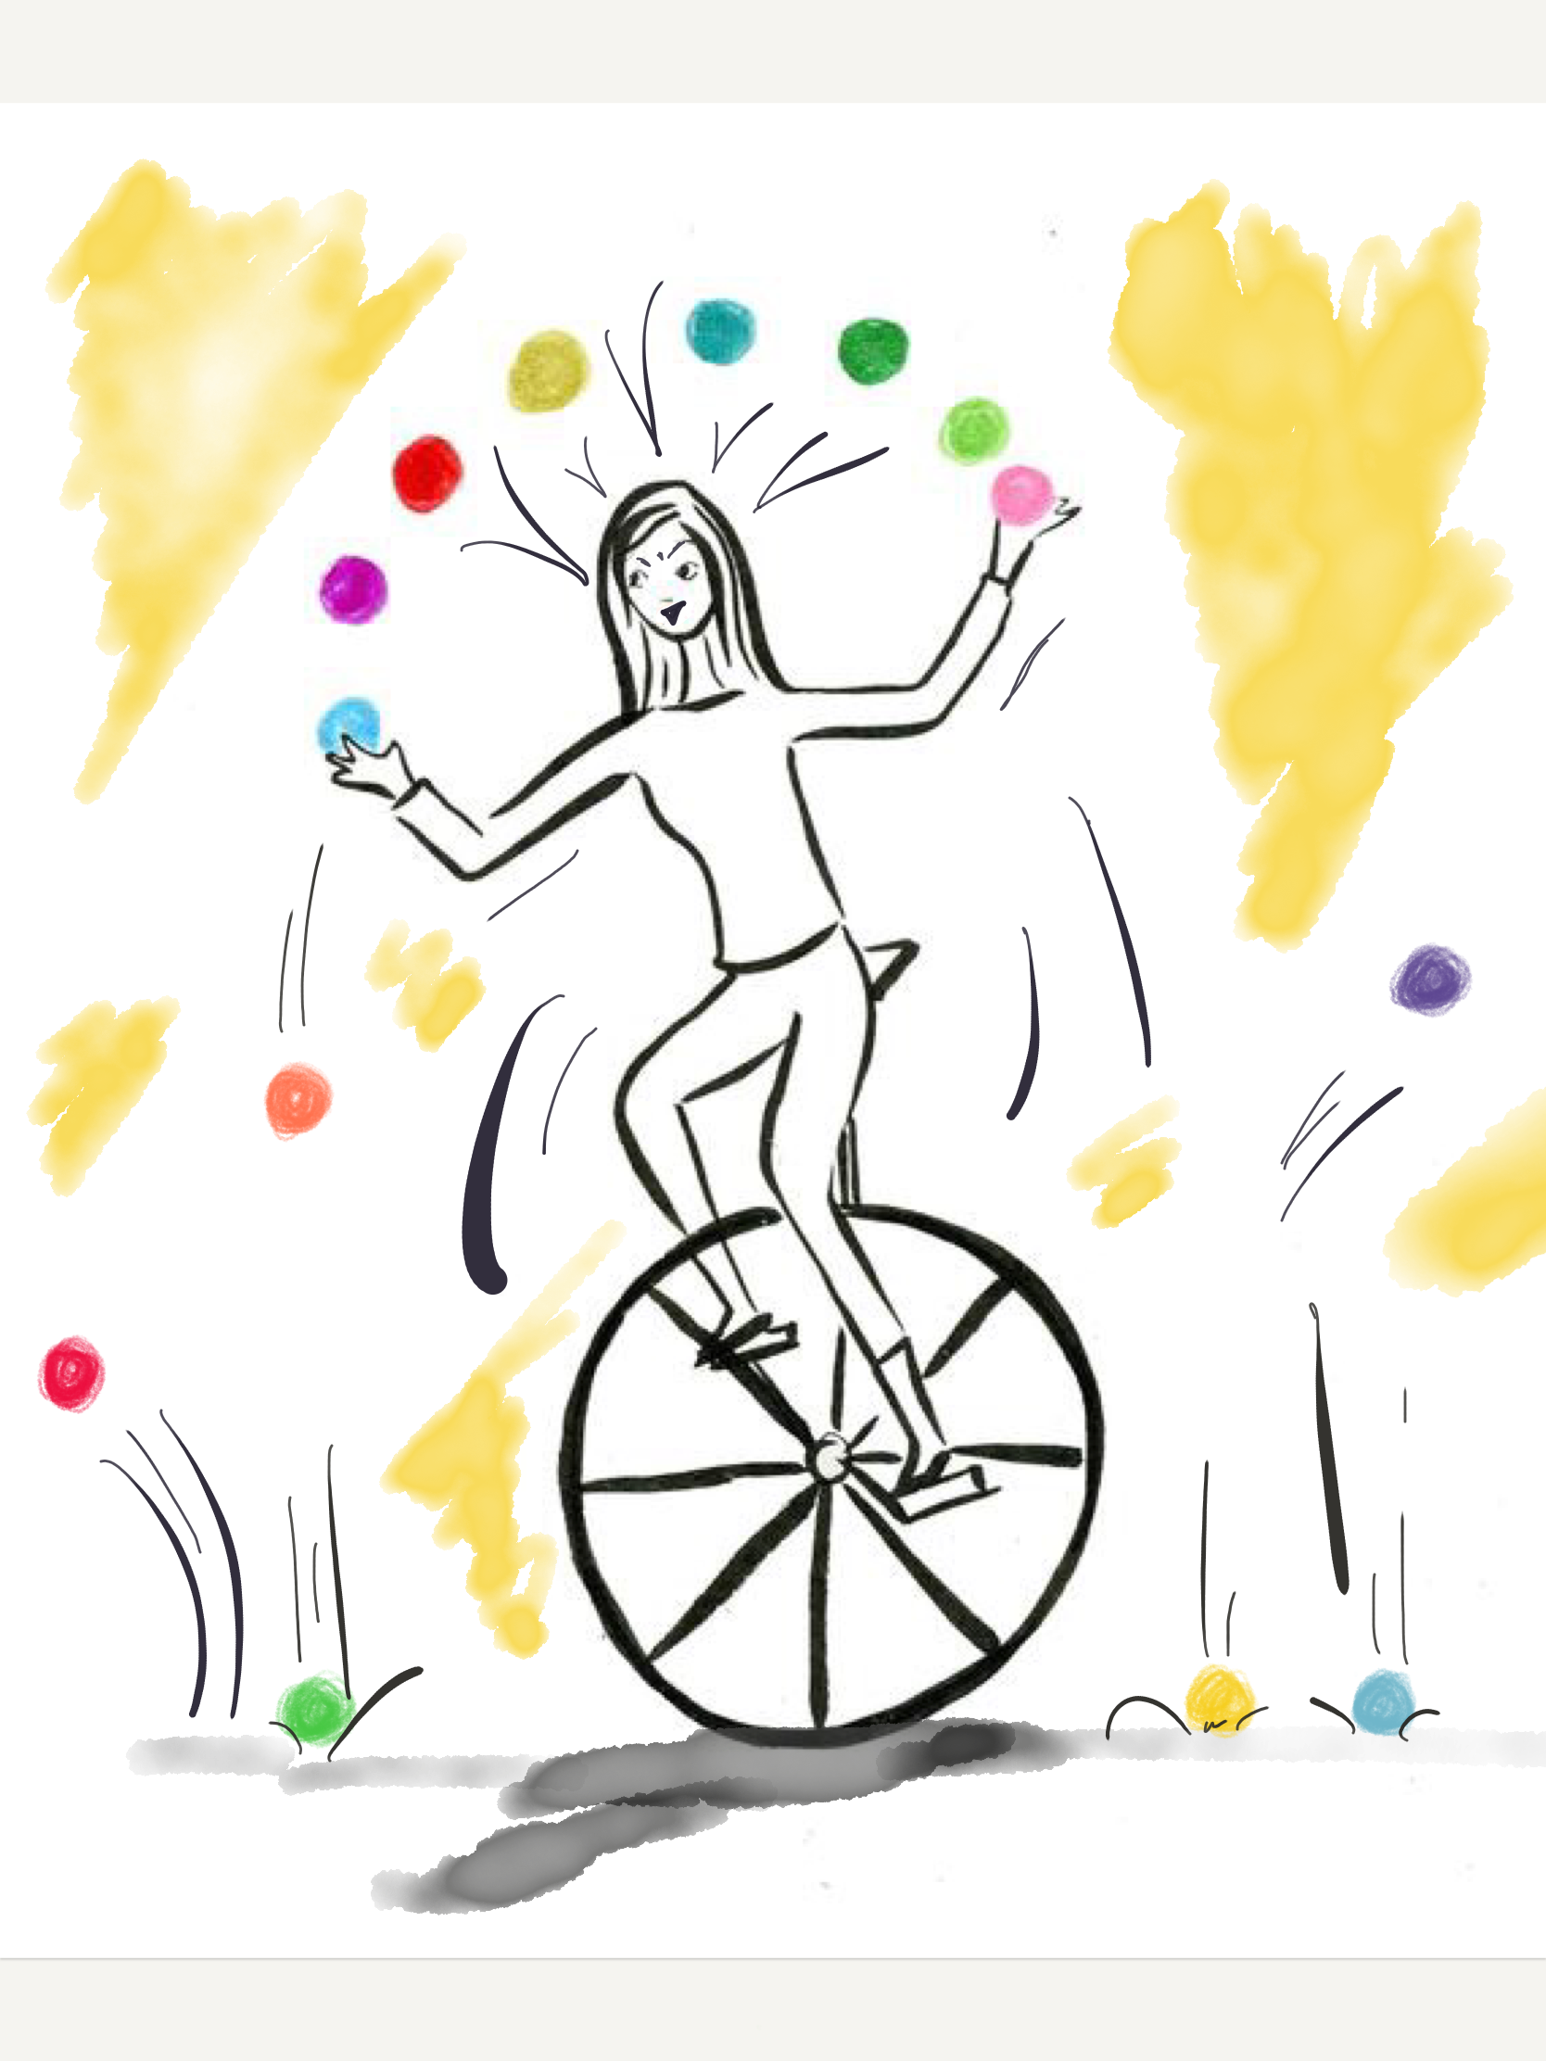

Slide 5
Holy Dexterity

Slide 6
Demon of Busyness

Slide 7
Overwhelmed
Overwrought
Anxious
Full of Worries

Slide 8
Demon of Busyness

Slide 9
Demon of Busyness

Slide 10
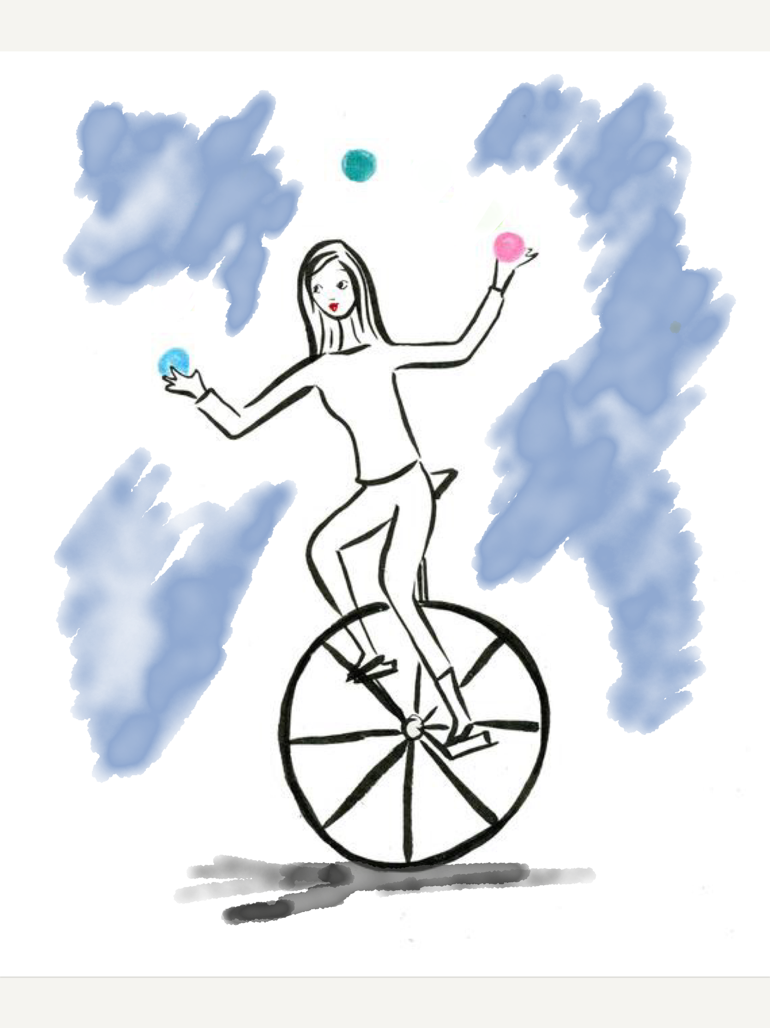
Resistance
Wide-awakeness
Reflectiveness
Discerning focus
Valuing of Balance

Slide 11
Practices of Prayer
Practices of Care
Practices of Beauty

Slide 12
Evelyn Underhill
1875—1941

Slide 14
St. Jane de Chantal
St. Elizabeth Seton
1572—1641
1774—1821

Slide 15
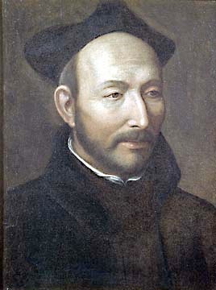
Ignatius of Loyola
1491—1556

Slide 17
Prayer of the Heart
Eastern Orthodox Spirituality
and
The Jesus Prayer

Slide 18
Hesed
Repetitive recitation
Attached to breath
Inhale address for God
Exhale word of hope
Bodily

Slide 19
Practices of Care

Slide 20
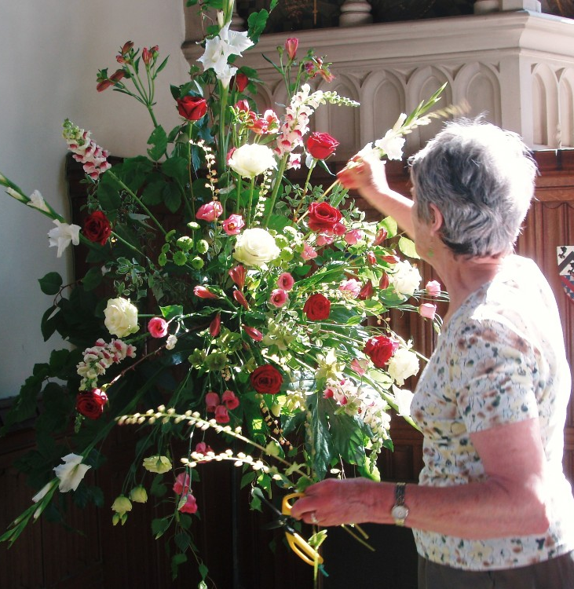
Practices of Beauty

Slide 22
Practices of Prayer
Practices of Care
Practices of Beauty

Slide 23
Additional Resources
Catholic Spiritual Practices: A Treasury of Old and New by Colleen Griffith and Thomas Groome, eds.
Prayer in the Catholic Tradition: A Handbook of Practical Approaches by Robert Wicks
Practicing Our Faith: A Way of Life for Searching People by Dorothy Bass

Slide 24
Spirituality Studies
BOSTON COLLEGE SCHOOL OF THEOLOGY AND MINISTRY
bc.edu/stm
Explore spirituality through one of our flexible 18-credit certificate programs.
Christian Spirituality
For those looking to enrich their faith life or broaden vocational skills, by studying an array of Christian spiritualties that will lend itself to examining prayer life, reflection and ways of being.

Slide 25
Comments, Questions, and Observations…
Dr. Colleen M. Griffith
griffc@bc.edu

