Slide 1
Nontraditional Ways to Navigate Grief and Trauma November 13, 2019
by Susan Hannifin-MacNab, MSW, PPSC

Slide 2
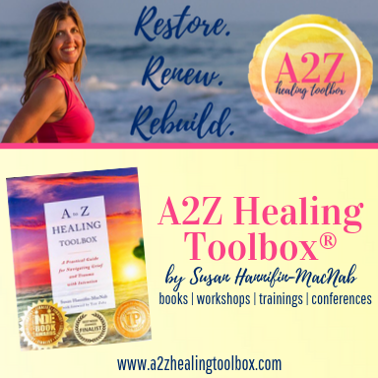
Welcome and Speaker Introduction
Notes:
I am a BC alum and graduate of the School of Education who later obtained a Masters of Social Work and credentials as a teacher and school social worker. I never intended to author a book, but when my husband died in a car accident (our son was 5), my life course changed directions. Now, I am an educator, social worker, author and small business owner of a heart-based company called A2Z Healing Toolbox®. I facilitate conference workshops, professional trainings and keynote presentations across North America on the topic of grief and trauma healing. All
information I will talk about here today comes from my recently published book, A to Z Healing Toolbox: A Practical Guide for Navigating Grief and Trauma with Intention. If you miss something I said, or want to review this material again, please know that you will be able to find this information in the book and its accompanying website.

Slide 3
Webinar Outline
What is Grief?
What is Trauma?
The 26 A2Z Healing Tools
Dive Deeper (Healing Tools B and C, of course!)
Additional Resources
Q & A
Contact Information

Slide 4
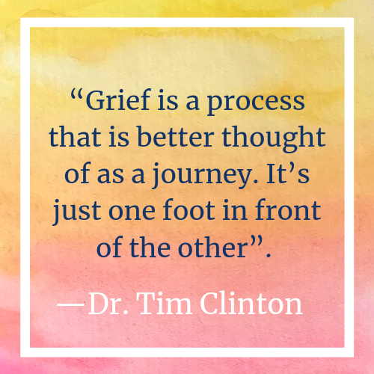
What is Grief?

Slide 5
PHYSICAL
upset stomach
pain exhaustion
sleep changes
appetite changes
dry mouth
muscle tension
clumsiness
low energy
shortness of breath
tightness in chest
tightness in throat
agitation
sensitivity to light, smells, sounds
BEHAVIORAL
crying
sobbing
wailing
difficulty crying
sitting quietly
staying busy to avoid emotion
avoiding situations that provoke grief
talking aloud to loved one
energy is channeled into activities
looking at photos and videos of loved one
keeping a home altar
carrying loved one’s belongings
wearing loved one’s clothes
repeatedly visiting ash site or cemetery
EMOTIONAL
shock
numbness
sadness
sorrow
guilt
regret
anger
rage
emptiness
relief
irritability
restlessness
listlessness
insecurity
betrayal
resentment
desire to join loved one
feeling helpless
feeling out of control

Slide 6
MENTAL
denial
disbelief
forgetfulness
confusion
disorientation
difficulty concentrating
shortened attention span
minimal motivation
retelling story of death
memories of past losses
dreams or images of loved one
expecting to hear from loved one
SPIRITUAL
mystery & wonder
questions about afterlife & mortality
questions about God & higher power
affirmation of spiritual/religious beliefs
doubting spiritual/religious beliefs
questions about the whereabouts of loved one
sensing the presence of loved one
SOCIAL
difficulty relating to old friends
making new friends
isolation
alienation
shifting roles
new responsibilities
not wanting to burden others
withdrawing from activities
low desire for conversation
holding grief in to help others
difficulty relating to those who aren’t grieving

Slide 7
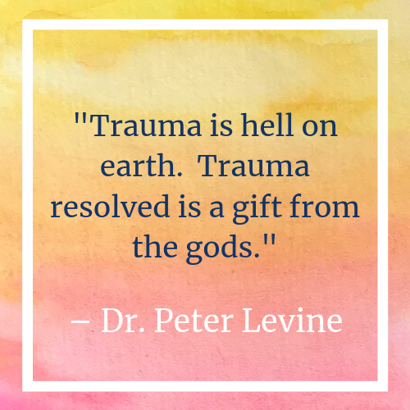
What is Trauma?

Slide 8
BEHAVIORAL
easily startled
jumpy
on edge
over-alert to danger
detached or withdrawn
fearful or nervous anger
outbursts irritability sleep
disturbances avoiding
thinking about trauma
avoiding people, places, activities, thoughts, feelings, conversations associated with traumatic event(s)
MENTAL/EMOTIONAL
difficulty experiencing emotion
mentally shut down
emotionally shut down
guilty or shameful
difficulty concentrating
sad or angry
flashbacks
nightmares
disturbing memories or images
SOCIAL
wanting to isolate from others
avoiding social interactions
feeling not understood by others
strained relationships
strengthened relationships
anxiety being with others
PHYSICAL
shallow breathing
muscle tension
headaches
nausea
hot or cold sweats
vomiting or diarrhea
trembling fatigue

Slide 9
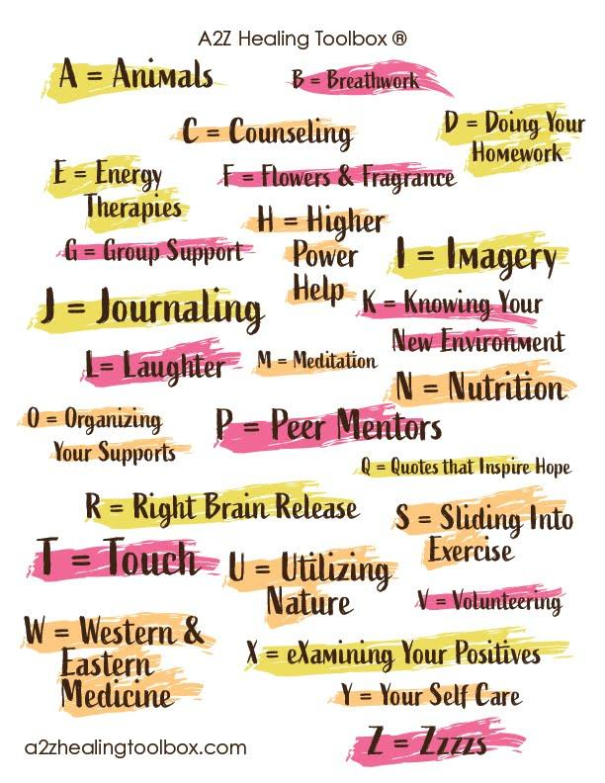
The 26
A2Z Healing Tools

Slide 10
Dive Deeper into Healing
Tools B= Breathwork and C = Counseling

Slide 11
Healing Tool B= Breathwork
includes nontraditional ways to re-learn how to breathe such as:
Straw Breathing
Vibrational Breathing
Biofeedback

Slide 12
Find a drinking straw; any size will do.
Hold the straw gently and put one end lightly between your lips.
Take one full breath in through your nose.
Blow slowly out through the straw until all air has been exhaled.
Repeat three times- inhale through your nose and exhale through the straw.
Practice several times a day to begin regulating the nervous system.
Keep straws handy—in your car, in your backpack, in your purse, in your office drawer.
How to Practice Straw Breathing

Slide 13
Repeat steps for Straw Breathing, but instead of exhaling through the straw, exhale the word “Vu”.
The body will vibrate upon exhale, thereby releasing stored anxiety, stress and trauma.
How to Use Vibrational Breathwork

Slide 14
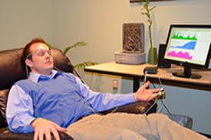
Biofeedback is a noninvasive technique that teaches how to bring the autonomic nervous system (heart-rate, blood pressure, muscle tension, rate of breath) under conscious control.
Electrical sensors are attached to fingers, stomach, and chest by a Biofeedback practitioner while you recline in a comfortable chair.
A computer screen gives feedback about the nervous system. Are your heart rate and breath rate completely disorganized, unregulated, and out of sync?
While hooked up to a computer and electrodes, the biofeedback practitioner guides you through regulated breathing exercises as you watch the screen.
Eventually (homework included!) you learn to match your breath to the ebb and flow of your heart rate.
What Does a Biofeedback Session Look Like?

Slide 15
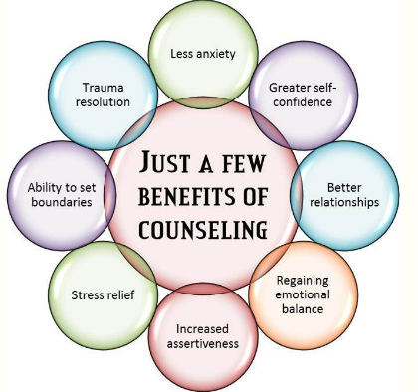
Healing Tool
C = Counseling
includes non-traditional therapies (and therapists!) such as:
Eye-Movement Desensitization and Reprocessing (EMDR)
Sandplay Therapy
Somatic Experiencing (SE)

Slide 16
Eye Movement Desensitization and Reprocessing (EMDR)
Developed by psychologist Dr. Francine Shapiro in the 1970s
Used to assist the mind and body in healing from distressing images and bodily sensations associated with PTSD
The EMDR practitioner assists individuals in coming to a more peaceful resolution of trauma by using bilateral movements to help desensitize and reprocess the trauma experience

Slide 17
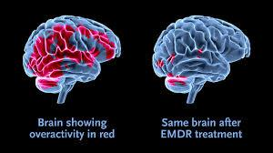
Eye Movement Desensitization and Reprocessing (EMDR)
This method releases emotional experiences that are trapped in the nervous system
The EMDR therapist methodically moves her hand, two fingers pointed up, back and forth in my field of vision
Your eyes follow her hand as it moves: left, right, left, right, left, right

Slide 18
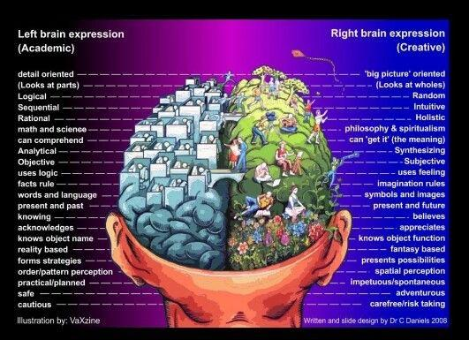
Sandplay Therapy
Developed by psychologist Dora Kalff in the 1950s
Uses the power of symbolic imagery to provide a safe space to connect with the unconscious mind, move through overwhelming feelings of grief, and process traumatic experiences
When people are in traumatizing, terrifying situations the left side of the brain often shuts down, leaving them temporarily unable to apply verbal expression, logic, reason, or order

Slide 19
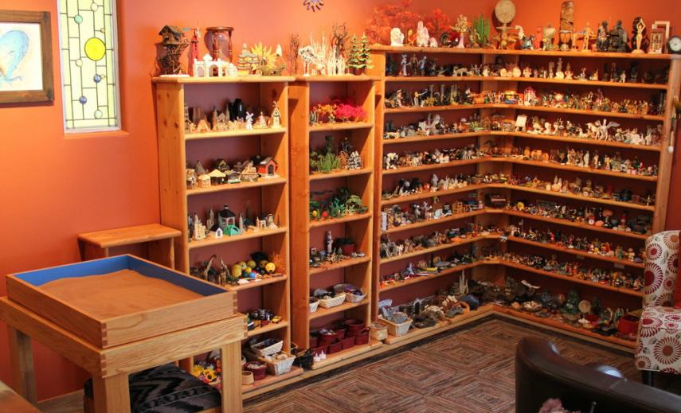
Sandplay Therapy
One of the best ways to assist traumatized people in their healing is to give them ways to use the nonverbal side of their brain (the right hemisphere) where color, sound, music, art, imagery, light, smell, intuition, and imagery are stored
Sandplay therapy is done by creating scenes in a tray of sand with miniature trinkets, symbols, statues, and figures

Slide 20
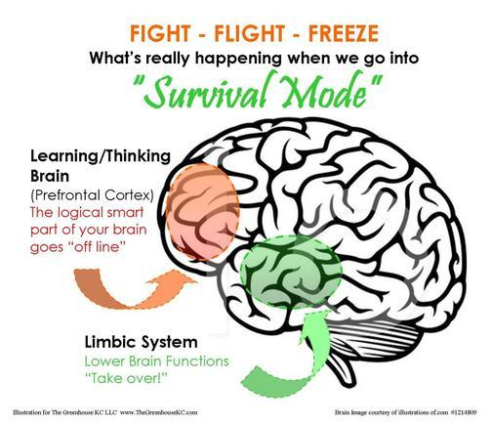
Somatic Experiencing
Developed by clinical psychologist Dr. Peter Levine in the 1970s
Used to assist the mind and body in healing from the distressing images and bodily sensations associated with PTSD
The SE practitioner assists individuals in trauma resolution by assisting in the release of residual physical tension that has been locked into the body and causes physiological disruption.

Slide 21
Additional Resources
A2Z Healing Toolbox (see Online Toolbox)
www.a2zhealingtoolbox.com
Biofeedback
www.biofeedback.org
Eye-Movement Desensitization and Reprocessing (EMDR)
www.emdr.com
Sandplay Therapy
www.sandplay.org
Somatic Experiencing (SE)
www.traumahealing.com

Slide 23
Contact Information
Susan Hannifin-MacNab, MSW, PPSC
Website: www.a2zhealingtoolbox.com
Email: susan@a2zhealingtoolbox.com

