Slide 1
Waste Management

Slide 2
Table of contents
01
02
03
04
Project Overview
Deliverables
Planning, engaging, and learning process
Community-engaged participatory action research
Results
Takeaways
Final product for Jesuit Refugee Services
Applying class theories, lessons learned

Slide 3
01
Project Overview

Slide 4
Plastic Waste Management
Beforehand: Research on usage of Plastic
  Looking at similar circumstances in other countries
Edjai: Trash Pickers
On-site: Plastic was not the biggest issue, but waste in general
Notes:
Make money by collecting things such as metal and plastic and selling that to other companies

Slide 5
More of a focus on Waste in General
One garbage disposal site
Narrow roads so unable to pick up trash from people in district -> burning of waste
Garbage trucks do not go that often to pick up trash
Limited environmental work due to governmental policy
Batteries?

Slide 6
02
Deliverables

Slide 7
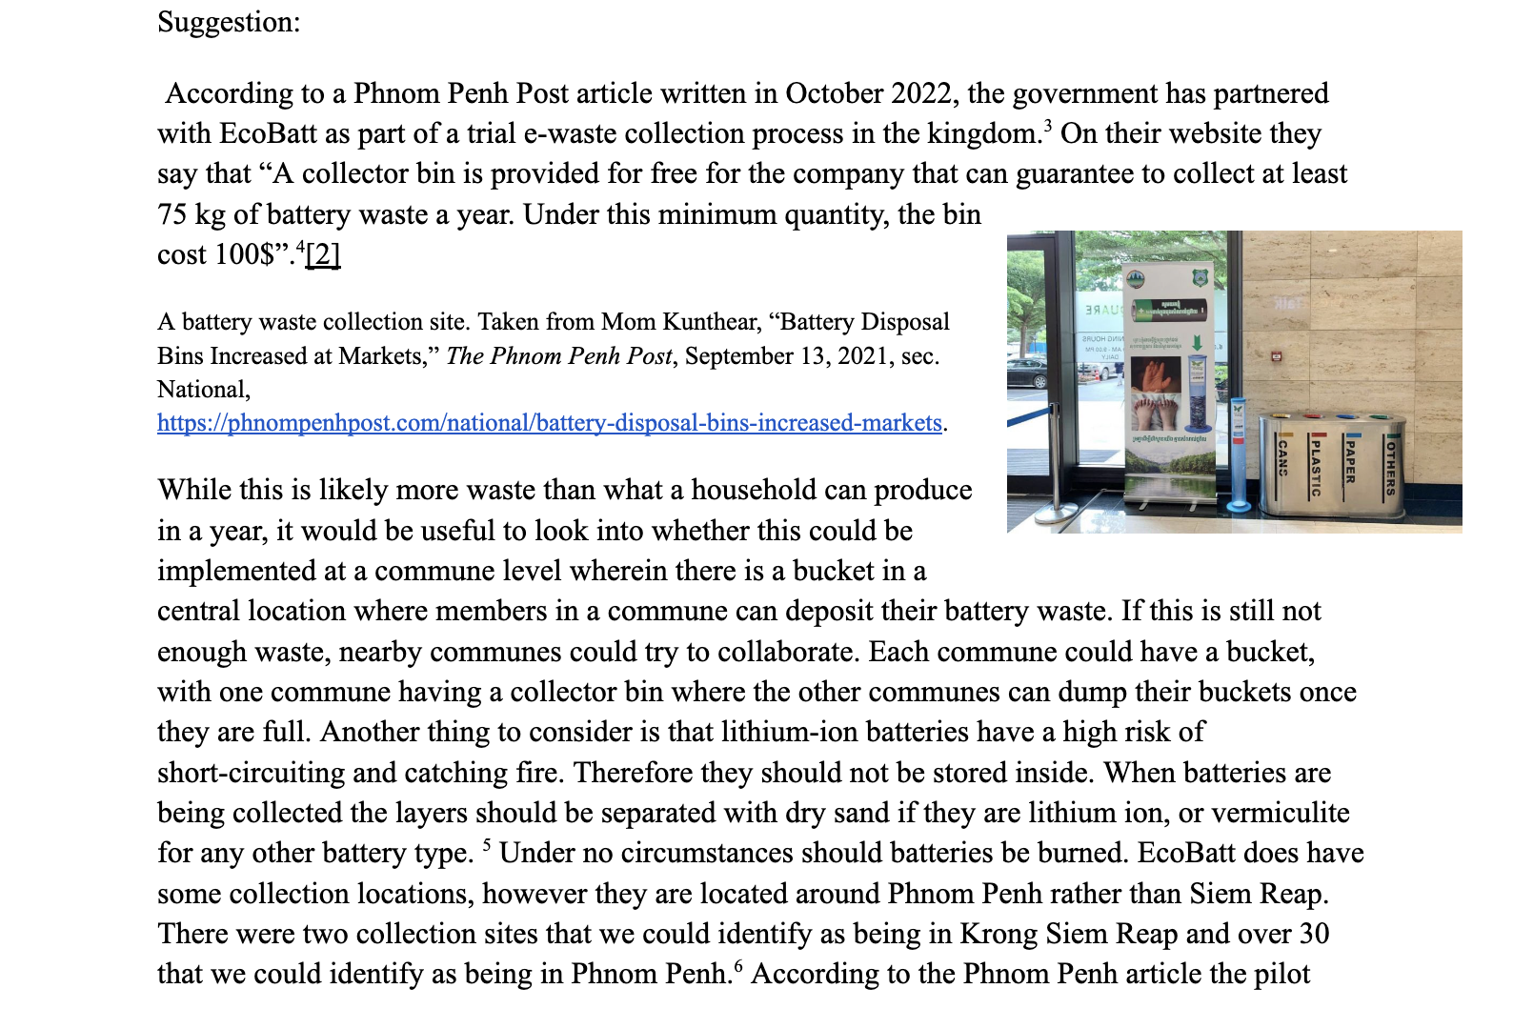
Recommendations & Guides
Reflection and conversation
Outline of our understanding of current situation
Suggestions for future work
Guides
  Ecobricks
  Advocacy
    Links to further work included

Slide 8
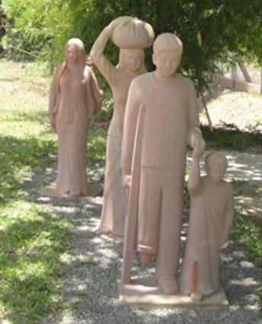
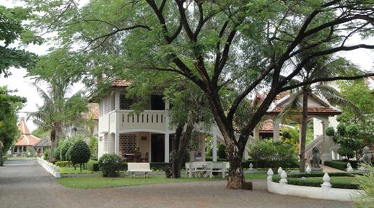
Future Deliverables
JRS Cambodia needs fundraising
Working with Schiller to promote BC initiatives

Slide 9
03
Results

Slide 10
Formatting
Report
Issues Witnessed/General Observations
  Plastic Bags
  Lack of trash pick-up in rural areas
Final Suggestions

Slide 11
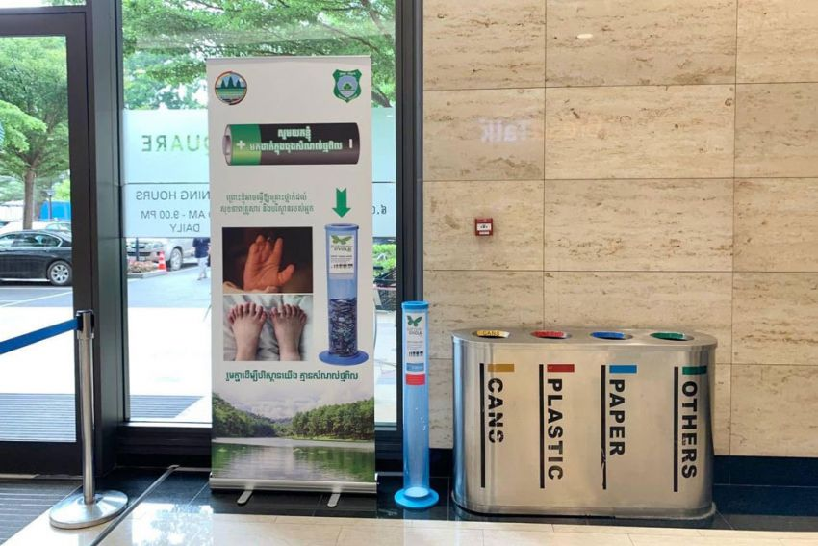
Final Ideas
Advocacy Campaigns
  Teach people how to handle waste and put pressure on businesses to enact better practices
  long-term
Batteries
  Small batteries
  Rural areas without electricity
  Ecobatt bins at the commune level
  Advocate for more even distribution of bins
Oils
  Store oil in oil-safe container
  Central oil collection center in commune
  Commune can sell oil

Slide 12
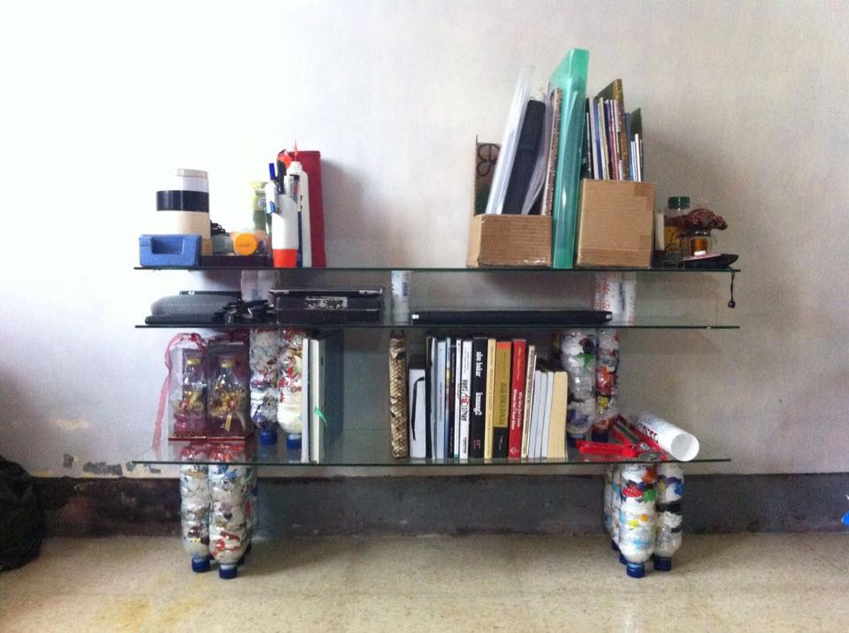
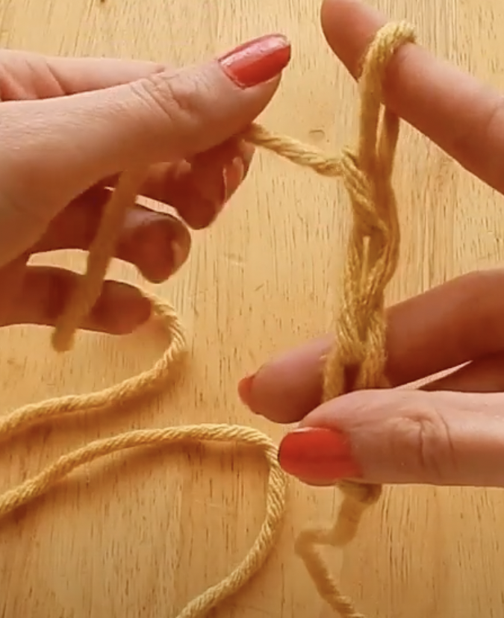
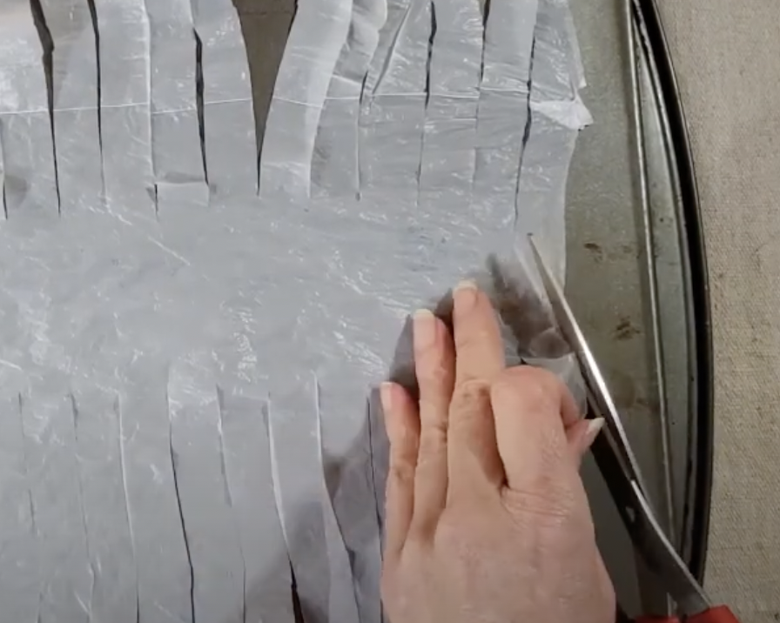
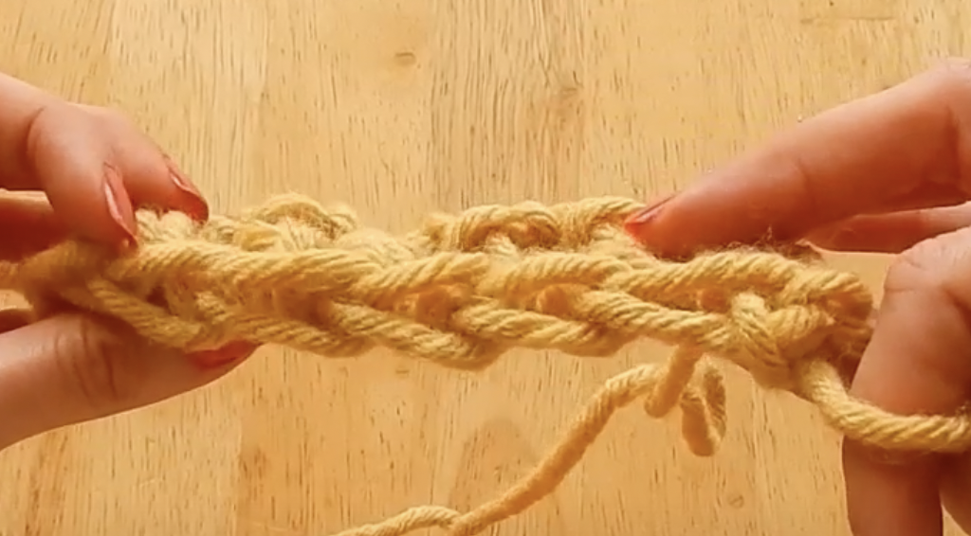
Final Ideas
Ecobricks
  Brick-like building materials made out of plastics
Plastic Yarn
  Cut-up plastic bags to use as yarn

Slide 13
04
Our Takeaways
Notes:
Now that we’ve kind of gone through our project in more detail I’d like to go through some of our big takeaways from the experience.

Slide 14
Applying Spring Theories
Values-based and servant leadership
  Parable of the Sadhu
Global inequalities and dynamics
Community-based mental health and psychosocial support
IDI assessment
Opened our minds and hearts to global citizenship before arriving in Cambodia, allowing to truly engage with the community in Siem Reap
Notes:
We started the spring semester with Dr. DeVoy’s talk on values-based and servant leadership. Some of us come from more quantitative and profit driven perspectives, such as economics or finance, so this was an important notion in opening our perspectives on leadership. We learned all about how we can lead for others, so we’re not as much focused on our personal interests, but rather what is best for the communities and people we serve and the organization we are in. In this class we studied the Parable of the Sadhu and I think this is one of the readings we did in the spring semester that most stuck out to us and most definitely stuck with me while in Cambodia. To give a quick overview, it details the journey of hikers up a mountain and the decisions to be made once they encounter a sadhu in critical condition. The hikers faced inner turmoil about how to proceed, but not once did they ask the sadhu what would be most helpful and I definitely believe this story strongly informed my understanding of servant leadership and in our plastics project is what allowed us to reframe our project and work on what the community was actually in need of, which was not necessarily plastics like we originally thought. Next we moved into a study of global inequalities and dynamics, studying the Bourbon Reforms and inequality in Latin America. This session gave us a greater understanding of how deeply ingrained inequities can be into law and culture, especially when it comes to gender. This was very important during our research because it encouraged us to not impose our Western values and norms on Cambodian culture. For example, we felt this the most strongly when visiting the rubbish pit. We found the stench difficult to work with, but made sure to check ourselves and our reactions, as many people work all day here to receive a sufficient income. The lecture on mental health and psychosocial support also proved important for us as a whole. We were able to lean on one another for support and encouragement when we encountered personal fears, challenges, and new experiences. We made sure to always be there for each other, to check in with others and ourselves, and to work as a caring and cohesive group. And then a final major influence from the spring semester was the IDI assessment. After going through our results in class and assessing our levels of cultural competency and awareness, we learned that we definitely had work to do and progress to make. So, we reflected and followed the IDI process during the rest of the spring and into the summer. We always kept the IDI fresh in our minds, aligning our actions to the assessment recommendations for improvement and keeping our project community engaged.

Slide 15
Reflecting on Our Experience
Invaluable experience immersed in a new culture
Incredible support from the JRS staff
Unique learning opportunity within context of the research focus
Notes:
We would also like to reflect on our experience in Cambodia as a whole, as many of us have agreed it was life-changing. We were so fortunate to spend these three weeks immersed in Siem Reap and learning from the culture. This was so invaluable and an experience most of us had never had before. A huge factor in how incredible our time was was the JRS staff. We quickly formed strong friendships with the staff and we learned so much from them. They graciously pointed us to local recommendations, challenged us to learn the Khmer language, and provided us with ample resources and opportunities to work on our projects and feel comfortable at the center. I cannot begin to describe and express the volume of knowledge I learned this past summer. In every interaction and outing there was something to be learned, whether formal or informal, direct or indirect.

Slide 16
Thank you!
We are so grateful to the Schiller Institute and cannot wait for more students to have this amazing opportunity.
Notes:
On that note, this presentation has been a great opportunity to reflect and share our experience and we would like to end by sharing our gratitude for Schiller and all of the incredible people involved in this program and all those that will have the chance to get involved in the future. Thank you.

