Slide 1
Accessible Agriculture
Working For and With Communities at JRS Cambodia
Notes:
Slides:
Description of project: accessible gardening (charlotte)
Cultural competencies: women gardening, economics, etc.
Deliverable: guide (Munachi)
Teamwork and applying concepts from the spring (Maddy)

Slide 2
Our Project – Accessible Agriculture
Community Identified
Realistic
Accessible agriculture for Cambodians living with mobility limitations, a common issue due to landmines
Time, student knowledge, community resources, distribution
Based in Community Engagement
We came in to our work with an open-mind and crafted the deliverable based on observations and conversations within the community.

Slide 3
Cultural Competency
Guiding Values and Beliefs
We avoided prescribing our culture’s values and norms onto the Cambodian people.
We made sure our manners, dress, and behavior were inoffensive to the unique cultural norms of Siem Reap.
We prioritized the needs, ideas, and desires of the community members. We believe that the personal stakeholders have the knowledge and resources to direct their own advancement.
Knowing that we will not remain in Cambodia, we ensured all of our deliverables would be accessible to community members given their current physical, financial, and emotional capacities.
We remained curious and open to discovering and honoring the distinct elements of the Cambodian culture.

Slide 4
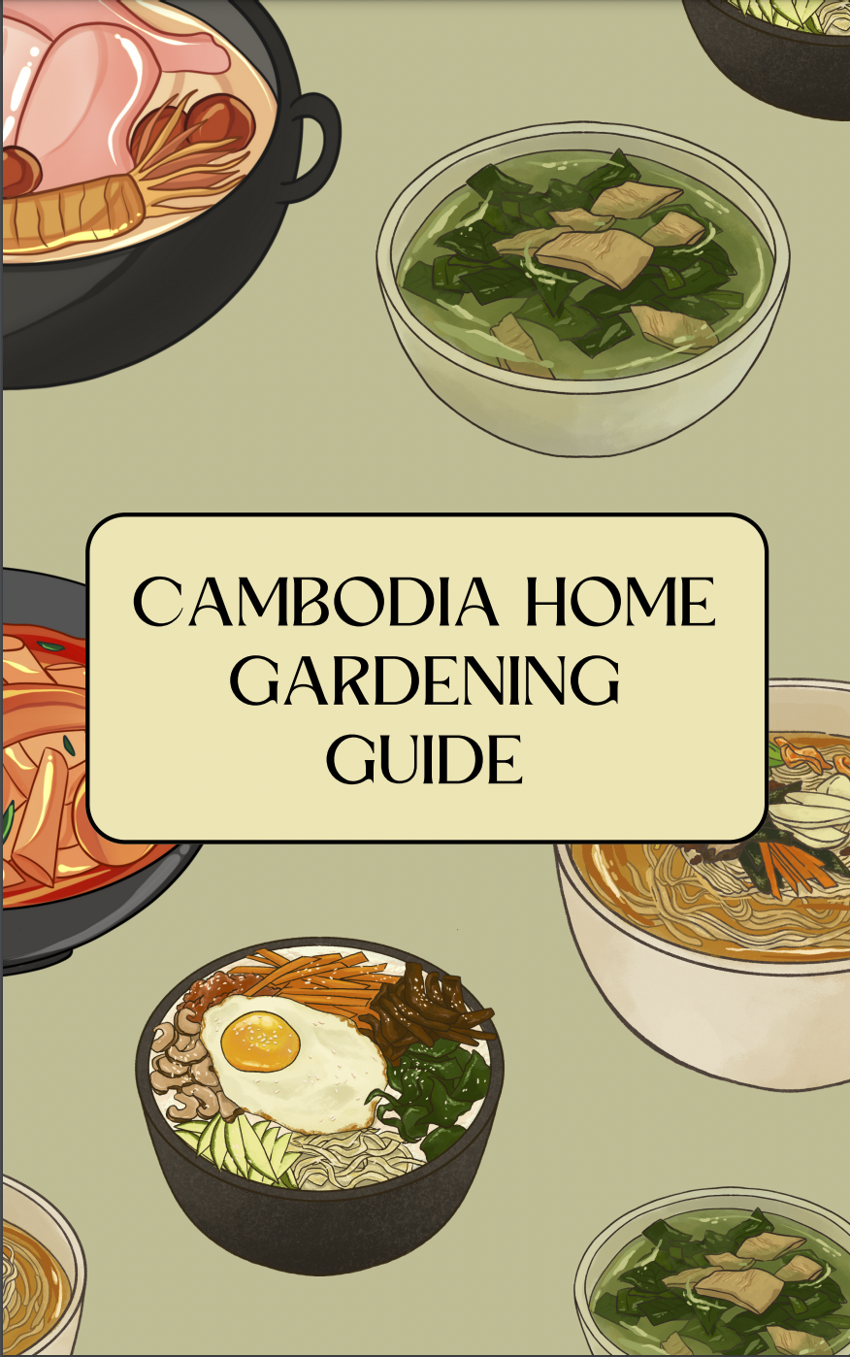
The Guide
The information was there, it was an issue of spreading the information.
We were inspired by the American-based resources that we used to help us in our research.
This Guide is catered to the Cambodian culture and resources.
The Guide has room to grow and develop in this format.
Notes:
The information was there, it was an issue of spreading the information
The JRS Staff had developed many of the assistive devices and the compost recipe that were in use while we were there, it was about figuring out how to spread this information into the particularly rural areas since members of the more rural communities were not able to come to JRS and learn from the workshops
What helped us the most with Data collection were the Books and online resources that we gathered but they were clearly in the American context.
Like Charlotte said, once we got to Cambodia, it was clear to
This is a guide that future teams can develop year after year
Alth
We went into the communities and saw the guide and we saw what was affordable and what was not affordable
The reason this is special is because this is catered to this specific Cambodian community

Slide 5
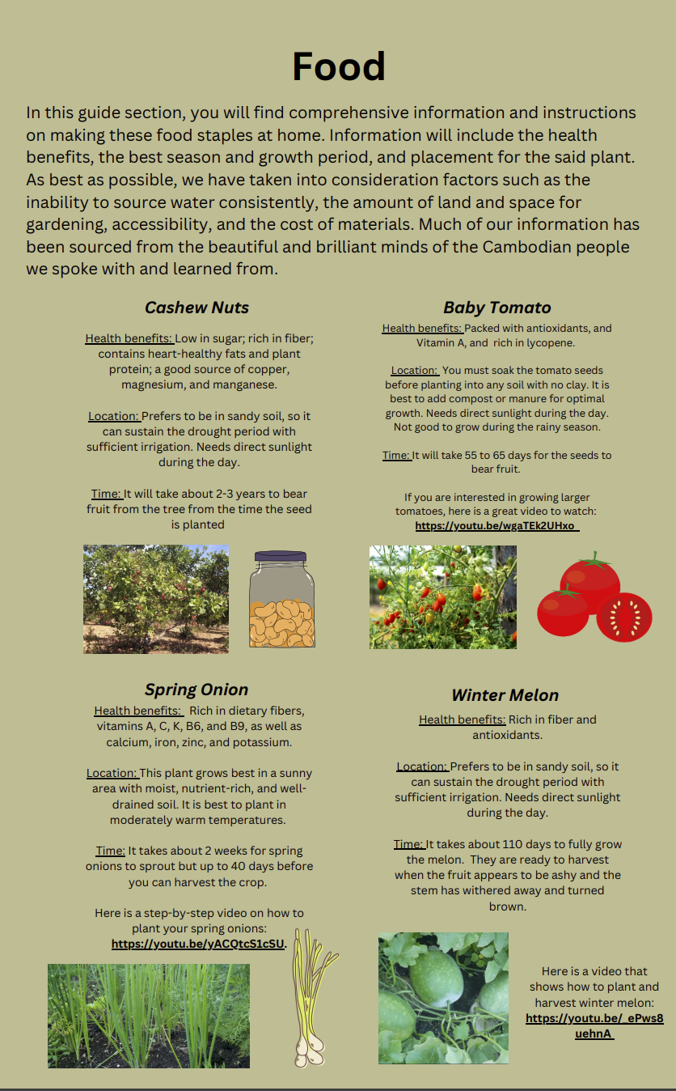
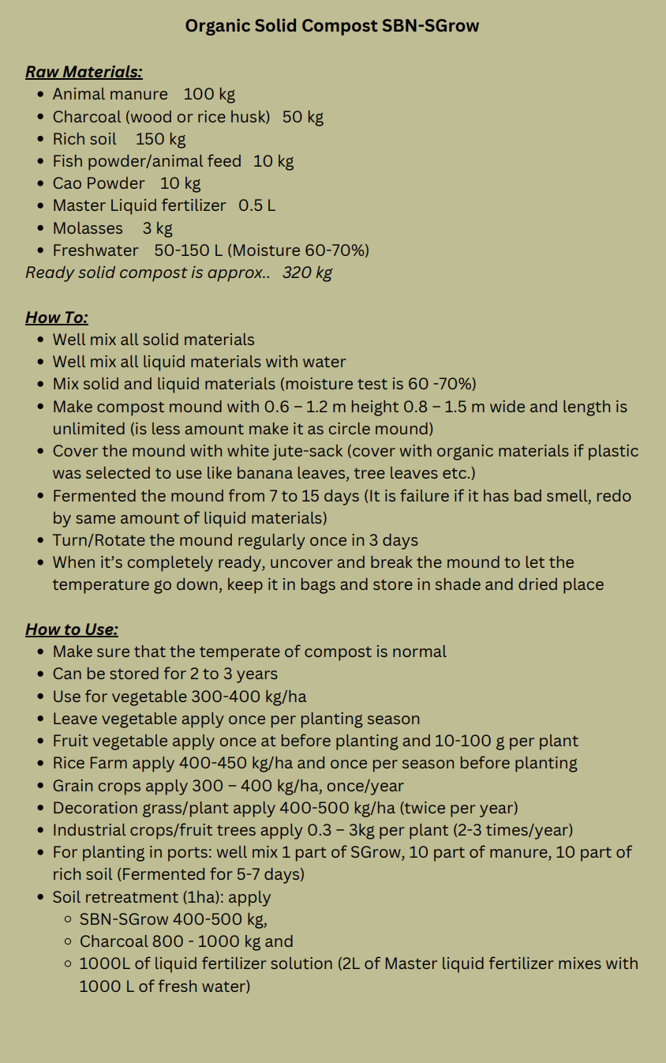
The Guide Cont.
Notes:
Our aim was to provide information that w

Slide 6
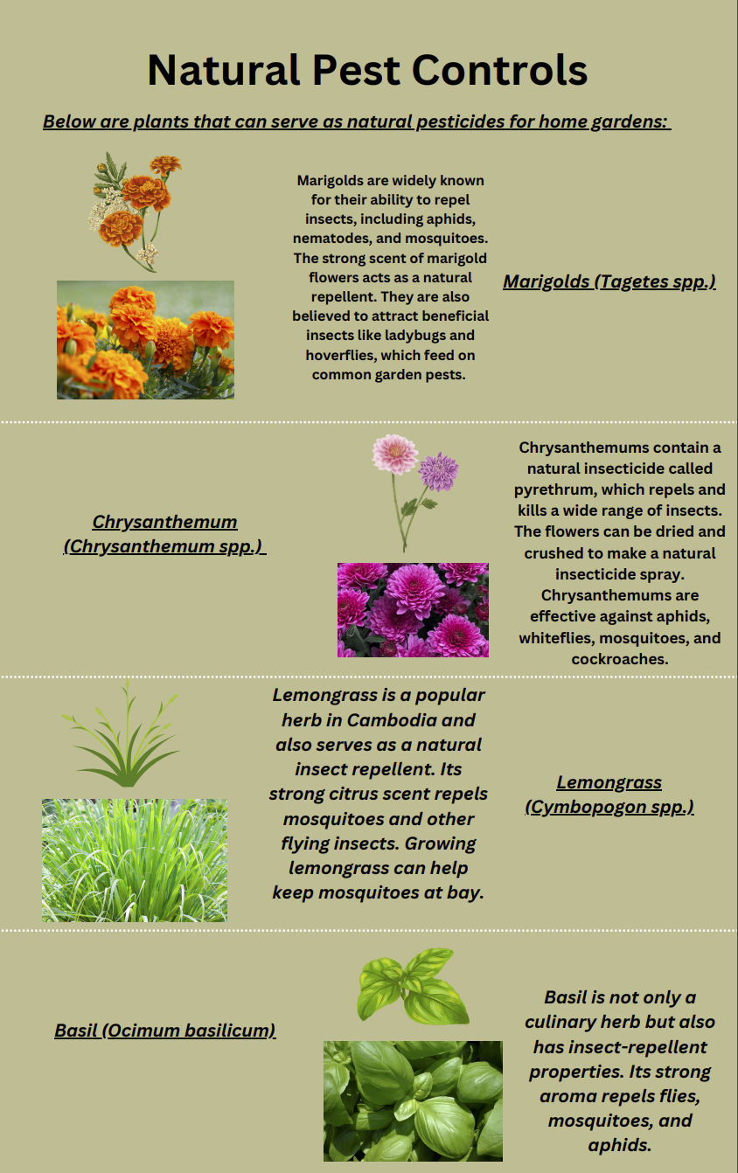
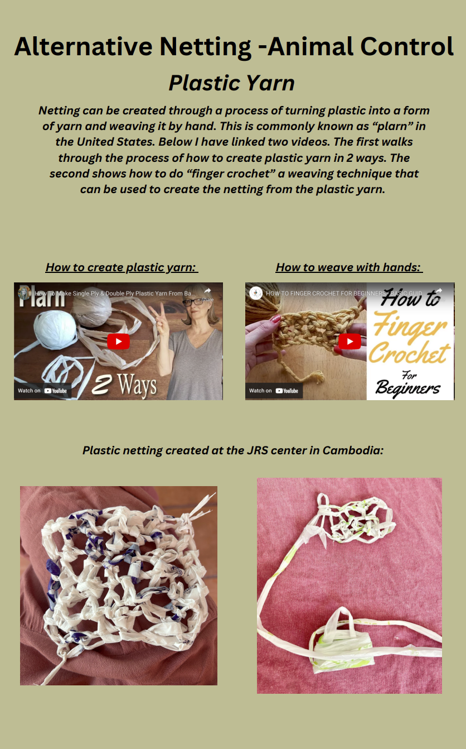
The Guide Cont.
Notes:
We wanted to be conscious of the environmental impact our suggestions would have. When in the community, many people spoke with us about the different pests that would attack their garden. With chemical pesticides being so expensive, we knew we had to provide information about natural, low-cost, “grow-it-yourself” option. In the same vain, we worked closely with the plastics group and saw how the plastic bags were being burned, discarded on the side of the road, and generally not disposed of properly. So, Kara, who knits, came up with this method of reusing these plastic bags to keep these pests away. Mesh fencing can be incredibly expensive and does not always last. This is a task that even the children of a family can do to contribute to the home gardening.

Slide 7
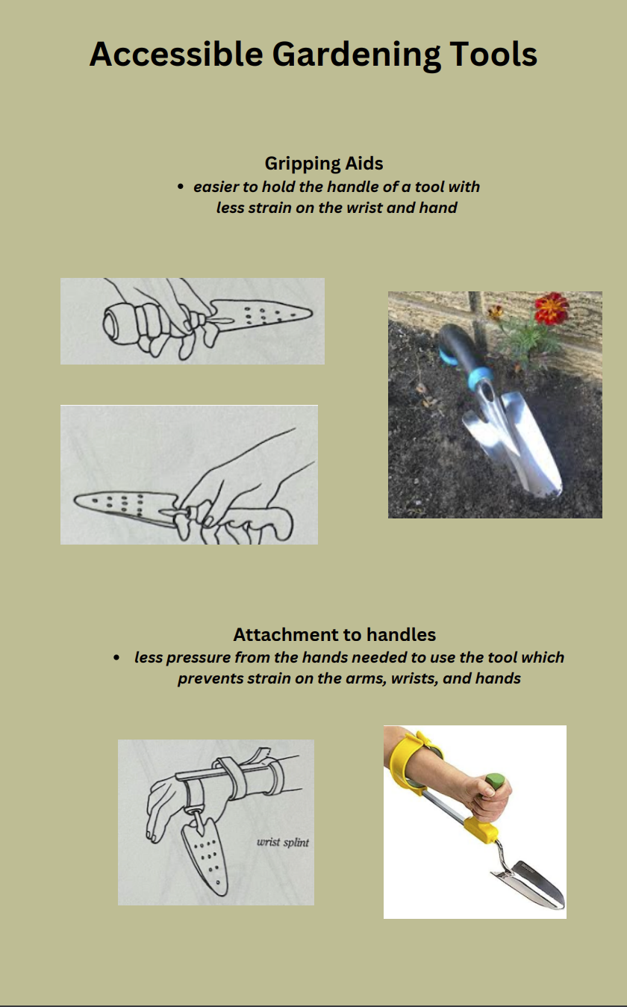
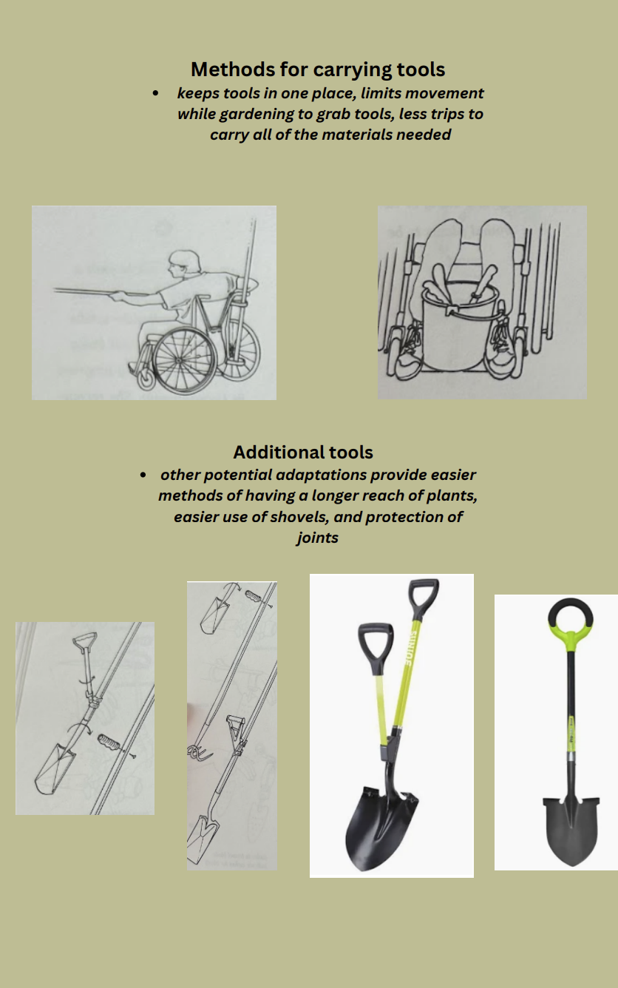
The Guide Cont.

Slide 8
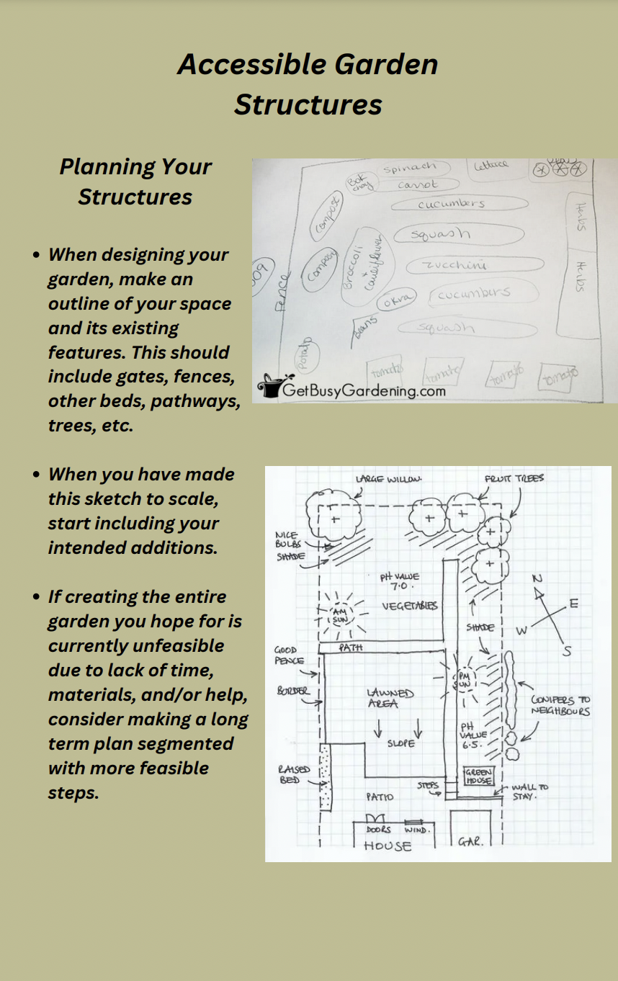
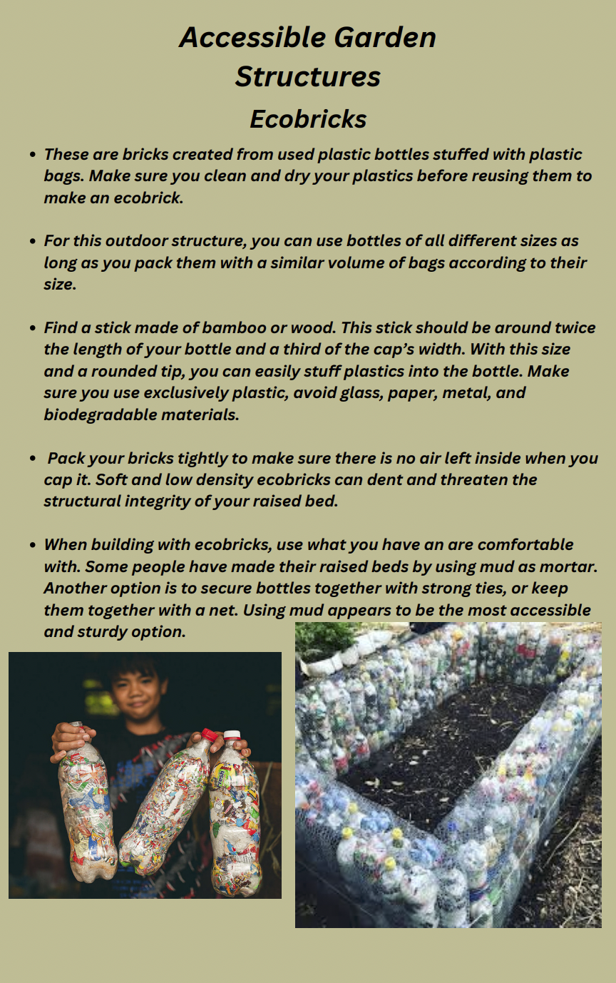
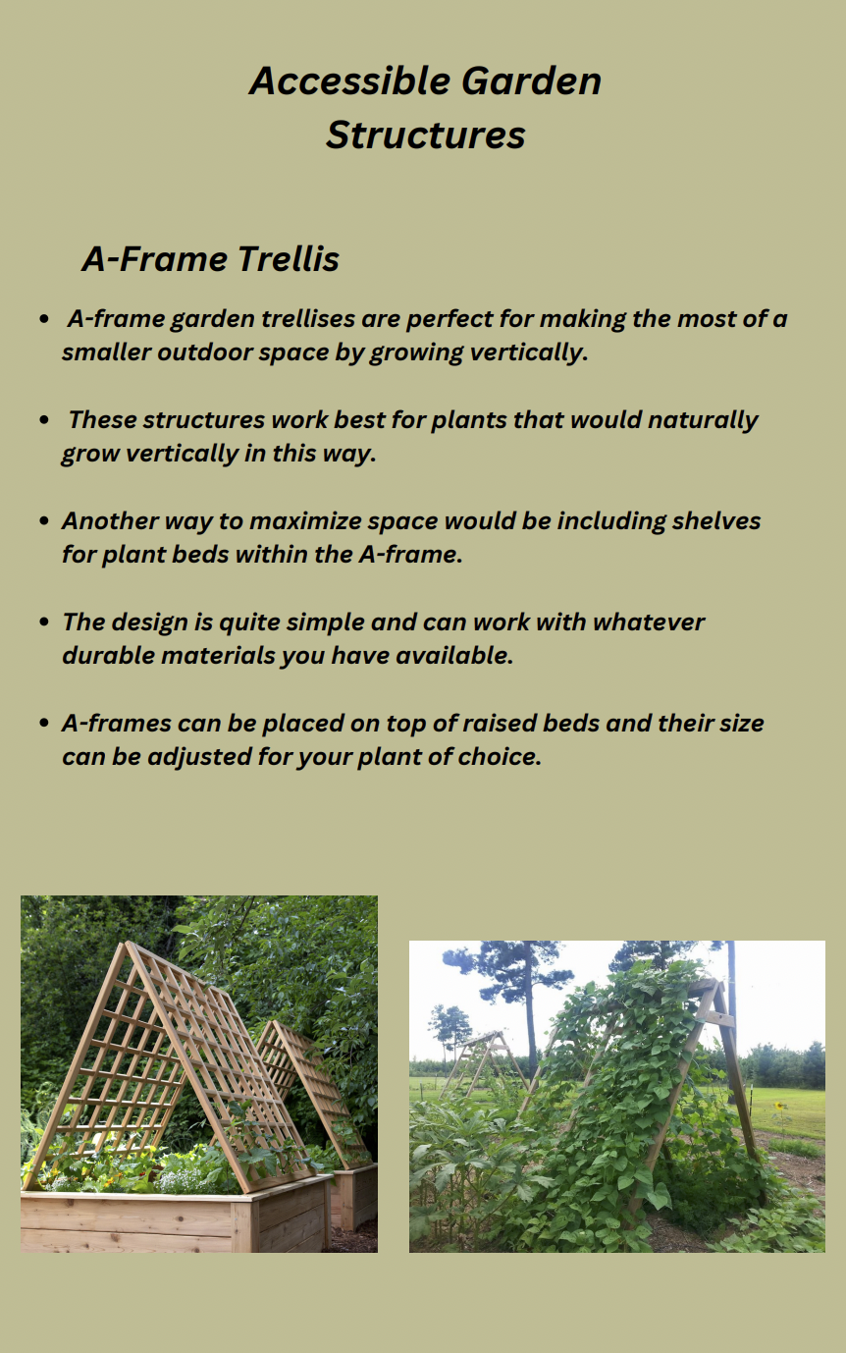
The Guide Cont.

Slide 9
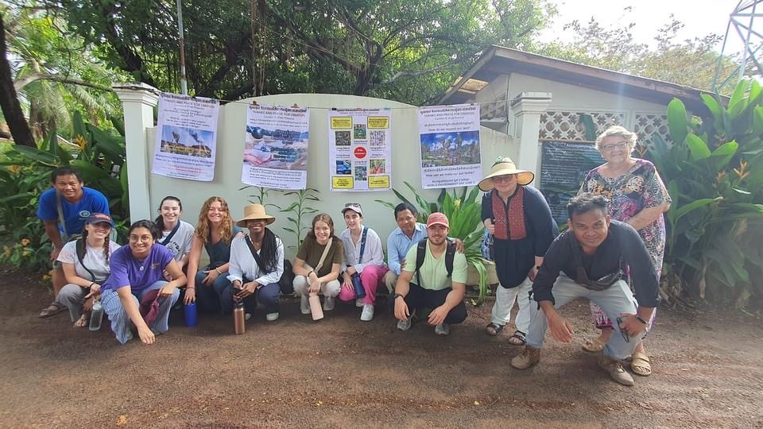
Working as a Team
Notes:
Leadership: leading within our groups and team; supporting each other; desire to learn

Slide 10
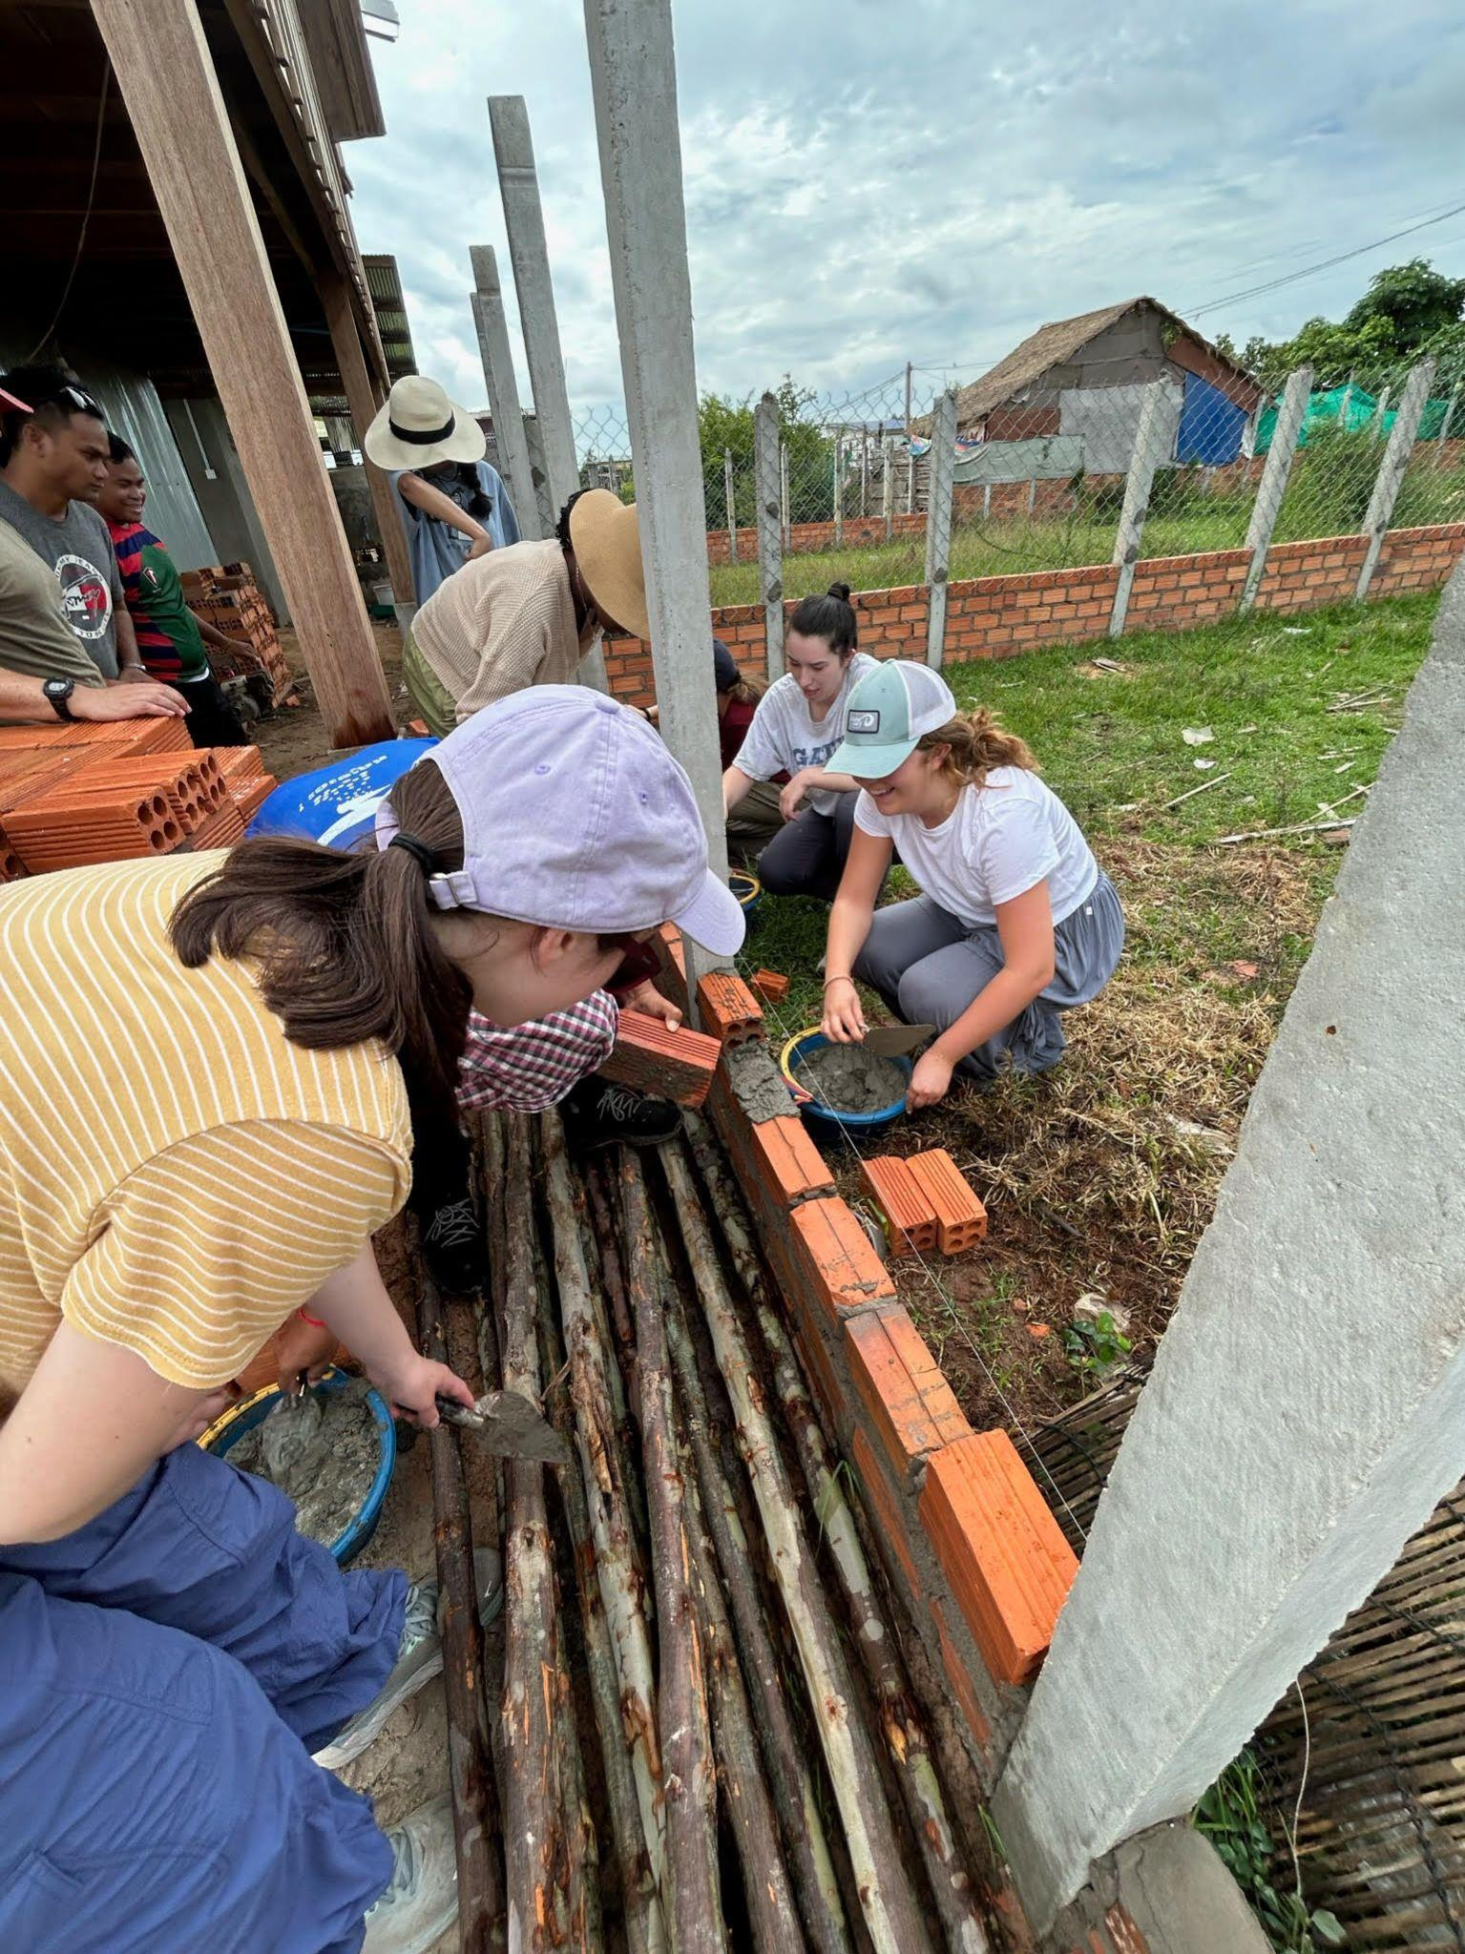
Notes:
Working at a community member’s home
Work that the JRS had started/identified that we could help with
Building a wall and making a home garden - new skills with each other

Slide 11
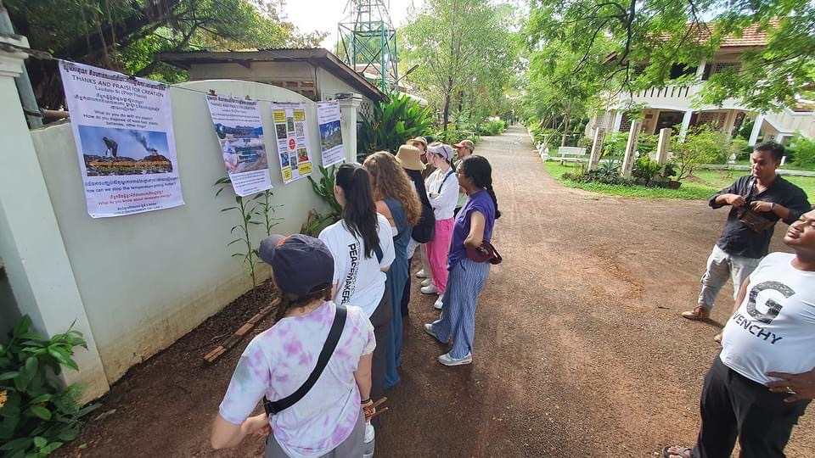
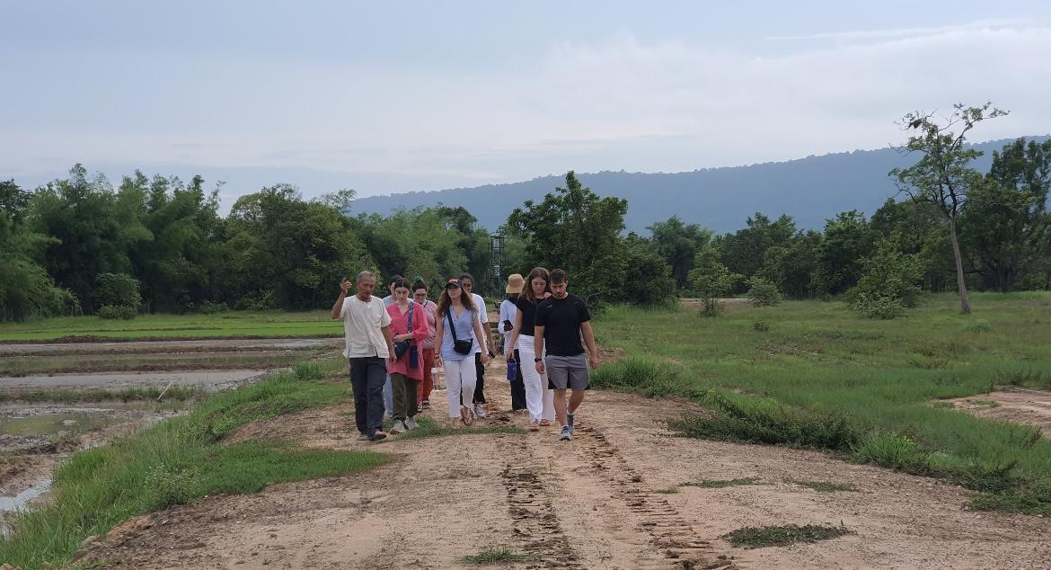
Applying Theories from the Spring
Vulnerable Communities
Project Design
Culture
Community Engagement
Notes:
Vulnerable communities: connection of various social and gov systems; social norms, etc. **
Project design: listening to community’s needs, taken culture and resources into account, long-term sustainability
Culture: learning about the culture in Cambodia, respecting it; culture informed work (food, jobs, traditions, gender roles, daily routines, kids); ex: learning that in most families that we spoke with, the women ran the home gardens - many wanting to start profiting off of them on a larger scale rather than keeping them for just the family
Community engagement: working with, rather than for; collaboration with JRS and community
Course title: Working for and With Communities: Community Engaged and Project Based Learning for the Common Good

Slide 12
Takeaways

