Slide 1
Mastering Your Job Search Understanding the Total Job Market
BOSTON COLLEGE WORLD WIDE WEBINARS::

Slide 2
Agenda
Understanding the Total Market
Formal Market
Summarizing You – 30 seconds
Search Firms
Responding to Ads, postings, search agents
Letters
Hidden Market
How to effectively network into your next job

Slide 3
30 Second Commercial
Who am I
What have I done
What am I looking to do
How you can help me
BEFORE YOU ADDRESS THE MARKET –
KNOW the PRODUCT

Slide 4
Today’s Job Market
Competition?
Cold call? Warm call?
Chances?
Negotiation?

Slide 5
What Makes Up the Formal Market?
Postings
Internet
Agencies
Search
Contingency
Temporary
Contract

Slide 6
Job Search Strategies
Search Firms/Recruiters
Responding to Ads
Cold Approach
Networking

Slide 7
Job Search Strategies Search Firms/Recruiters
Understanding the difference
Search
Contingency
Temp/Contract
Identify firms in your industry / function
Uncovers up to 10% of jobs

Slide 8
Recruiter Tips
These firms work with formal job market (posted jobs, live jobs)
Treat interviews with recruiters as job interviews (dress, presentation)
They are not your “friends”
Don’t work exclusively with one firm
Disclose salary – target “and up”

Slide 9
Job Search Strategies Responding to Ads
Uncovers 10% - 20% of jobs
Not a “prime time” activity – can apply in your pajamas!
A job board is a site where employers post jobs
A job search engine is usually an aggregator that pulls information from multiple boards or employer web sites; e.g. Simply Hired, Indeed
Job Information Sites are good for research

Slide 10
Job Search Strategies Responding to Ads
Job Board Sites | Job Search Engines | Job Information Sites
CareerBuilder.com | Beyond.com | Glassdoor.com
Dice.com | Indeed.com | Idealist.com
LinkedIN.com | LinkUp.com
Monster.com | SimplyHired.com
Snagajob.com
USAJobs.gov

Slide 11
Cover Letters
Search firm letters
Replying to postings
Follow-up to introduction

Slide 12
Cover Letters – General Format
1 page maximum, business format
Introduce yourself and connection (if possible)
Tell why you are writing
Excite reader in your credentials
Mention your resume
Refer to some follow-up

Slide 13
Job Search Strategies Cold Approach
Use networking to find way in
Research to find suitable opening in their needs

Slide 14
Thank You Letters
Personal acknowledgement
Memorable moment
Re-iteration of strength, additional information, better answer
Thank you with enthusiasm
Next steps (if known)

Slide 15
Bottom Line to Formal Market
Most people work here
You are expecting someone who doesn’t know you to pick you
High competition- lower odds
Basically a Cold Call
Use Linked In to make them Warm!

Slide 16
The Hidden Market
Represents up to 75% of the market
Jobs
Not yet open
Created
Must Network to discover
Most people do this by mistake

Slide 17
Networking Basics Its NEVER a Cold Call
A Contacts
B Contacts
C Contacts

Slide 18
Networking Basics
A Contacts People you know
B Contacts People in company or Industry you want to know more about
C Contacts Decision Makers

Slide 19
Networking Effectively
Plan and control the meeting
Set needed time ( no more than 20 minutes)
Know something you didn’t know before you went into the meeting
Have at least 3 more people to talk to…
Have a TARGET LIST

Slide 20
Networking is NOT
Something you do only when you need a job
Asking someone if they have a job for you
Just showing up physically at meeting
BEGGING

Slide 21
Building a Network
Start with people you know…
Identify links to contacts who you would most like to meet and who know the most about your profession
Don’t assume someone can’t help you!

Slide 22
Networking Approaches
Face to face meetings
Telephone conversations
Correspondence/email
Linked In
Online and “in-person” events
Networking communities
Virtual presence – what people learn about you through the Internet

Slide 23
Your Virtual Presence
Resume posting (Indeed, Monster, Dice)
Social Networks – LinkedIn, Facebook …
Associations
Blogs, discussions
Google yourself!

Slide 24
The Easy Way Out!
Now is not the time to send an email and hope someone cares…
Get to be a PERSON as often as possible…
Girl Scout Story

Slide 25
Approaching Your Network
What do they know that you need to know
Who can help you connect with others you’d like to know
What must you know before contacting them
Why do you want to connect with them
With your current network as a starting point, what will you say

Slide 26
Face to Face
Look your best
Reassure them you're not there to ask them for a job
Stick to your agenda
Ask open-ended questions
Ask questions that relate to what you want to achieve

Slide 27
Face to Face continued
State your interest in meeting as many professionals as possible
Ask if they could keep you in mind for any potential positions
Ask to stay in touch and let them know how you will follow-up
Ask if there's anything you can do for them

Slide 28
Group Meetings
BEWARE of feeling too comfortable
Bad news travels faster than good news
Artificial sense of ease to talk freely about how you REALLY feel
You never know who’s there - someone's neighbor, college roommate or former boss
Say only positive things about your organization

Slide 29
Why You Need A Network
Only 25% of available positions are posted
Recruiters are “hunting” for talent
(LinkedIn is a push and a pull if you have a great profile)
Ability to display accomplishments
Demonstrate knowledge in your field
Unsolicited References
BE on the Boat! Not on the Dock!

Slide 30
LinkedIn – The Basics
LinkedIn is all about networking. People expect to be asked for introductions
Be very clear about expectations when requesting an introduction
Remember that recruiters are searching on a daily basis

Slide 31
Networking
A necessity in finding work and in life
Circular- not linear
Network before you need someone, then its not “begging”
Develop tools to establish continuity. It helps in job search, career development….LIFE
**

Slide 32
Question & Answer

Slide 33
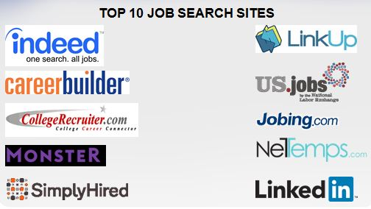
Resources

Slide 34
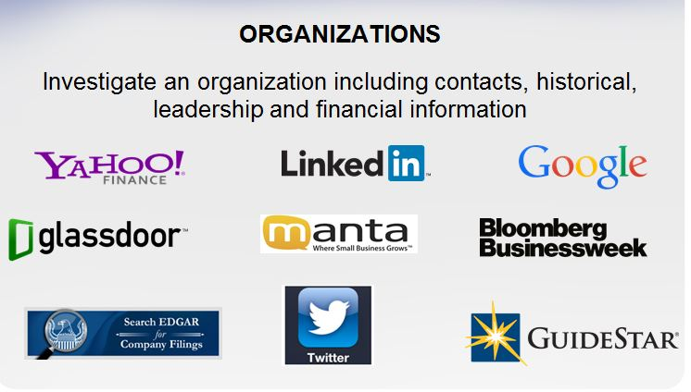
Resources cont.

Slide 35
Resources cont.

Slide 36
Resources cont.

Slide 37
Resources cont.

Slide 38
Resources cont.

Slide 39
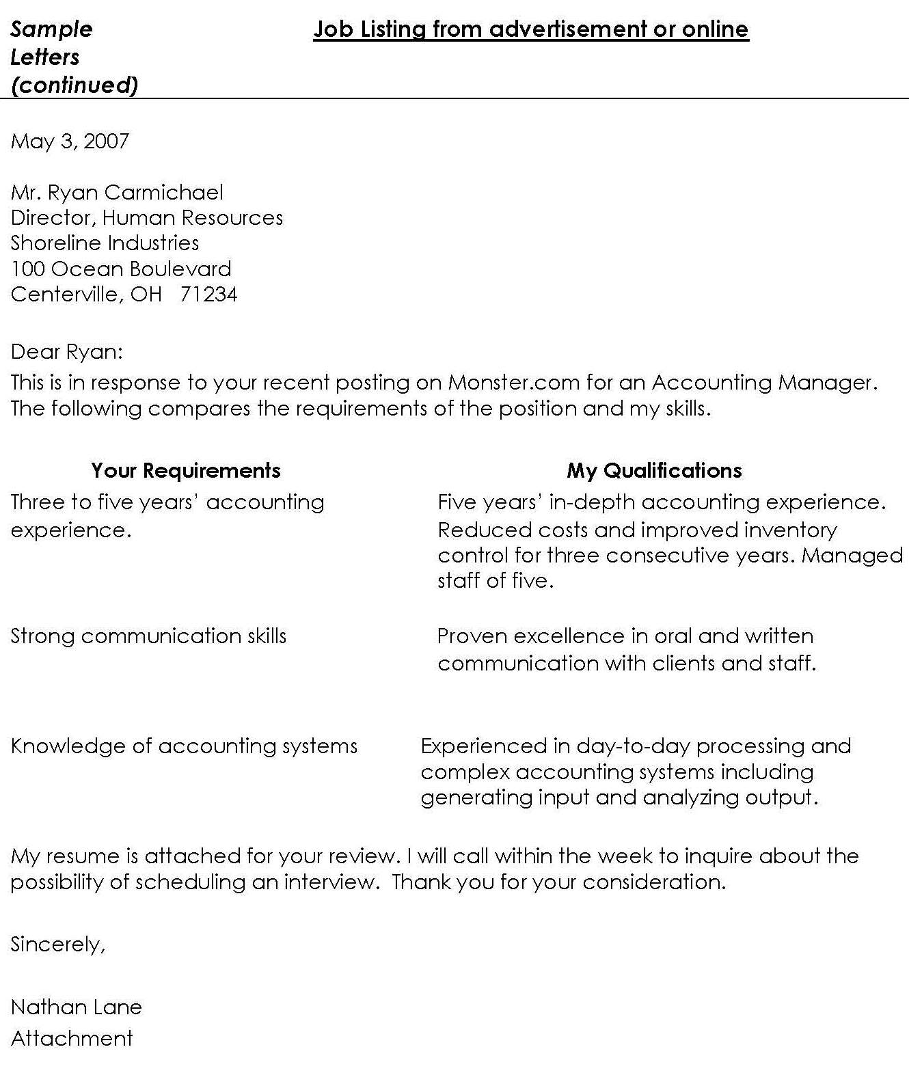
“T” Letter Sample Cover

Slide 40
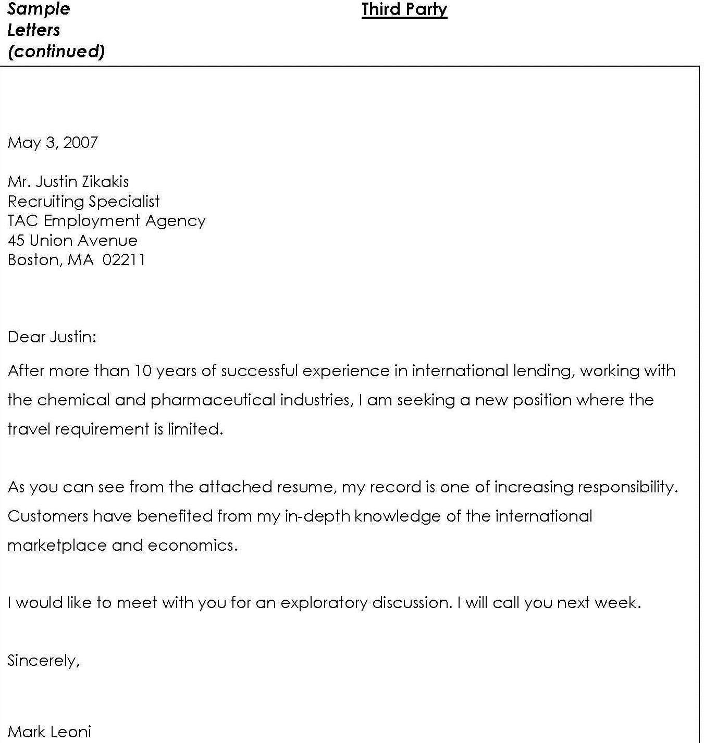
Letter to a Search Firm

Slide 41
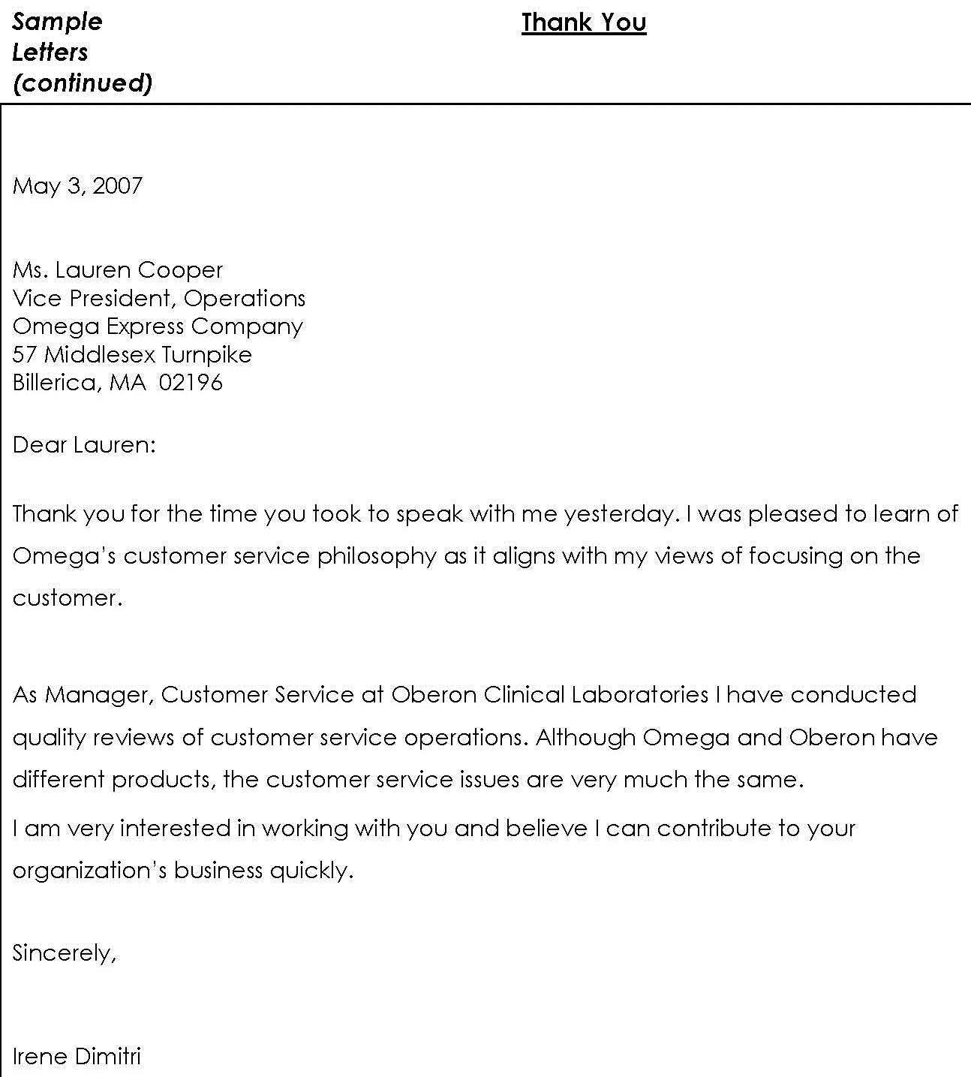
Interview “Thank You” Letter

Slide 42
Contact Information
Donna Sullivan
General Manager
Transition Solutions
dsullivan@transitionsolutions.com

