Slide 1

Are You Financially Fit? First Time Home-Buying Skills
Presented By: Liz Barletta of Ligris & Associates, Bryan Brown of Guaranteed Rate, Brett Saide of Ameriprise Financial, and Thomas Matthews of Gibson Sotheby’s

Slide 2
Meet Tom & Giselle
Young couple who met in 2010 at the Beanpot Championship game when BC beat BU in overtime. They have been dating for 4 years and are looking to buy their first home and raise a family.
Income:
  Tom- IT for 1 year: base $65k, $10k bonus
  Giselle- Teacher 2.5 years: $51k base
Assets:
  Combined $19k in savings & $40k in 401k/403B
  Gift from parents $10k
Credit/Liabilities:
  708 credit score
  $8,000 credit card debt= $400/m
  $50,000 in student loan debt = $800/m
  2 car loans- $42k= $625/m combined
Property types:
  Single family homes
  Townhouses

Slide 3

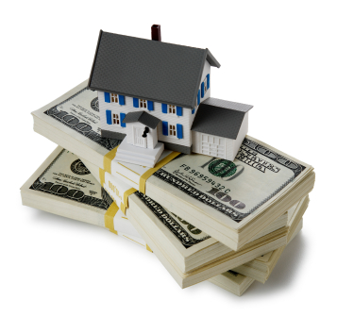
“I’m thinking of buying a home…”
How do I find my financial advisor?
How does a home purchase fit the context of my comprehensive financial plan?
Down payment options
Preparing for the changes home ownership brings
Building a home purchase team

Slide 4



Pre-approval
Pre-qual vs. Pre-app
Time and costs
Shopping Lenders
4 major factors in a pre-approval
  Property Type
  Assets/Down Payment
  Income
  Credit
You’re Pre-approved!
NOW WHAT???

Slide 5
Tom & Giselle’s Pre-Approval
Income: combined $116,000/12 = $9667/m
  $9667 x .45 = $4305 max debt load allowed
  $4305- $1825 = $2480 max mortgage payment
Assets: using $10k from savings, $10k gift and $10k from retirement funds
Property: Single family home asking $400k
  Taxes $5000/y= $416/m
  Insurance $900/y = $75/m
Want to make an offer at asking price, putting 5% (20k) down
$380,000 loan amount
- $2473 total payment (includes taxes and insurance)
- $2473 < $2480 allowance
PRE-APPROVED

Slide 6
Choosing a Realtor:
Excellent listening skills
Save Tom & Giselle time and energy
Educate them
Determine what price to offer
Show them ways to get more value
Available to take their calls
Peace of mind.
Top-of-the-line service.

Slide 7

Home Finding Services Commitment
Communicate in a timely and efficient manner. (Phone, Email, Text)
Plan a home search based on Tom & Giselle’s needs and wants.
Introduce you to properties and neighborhoods that meet Tom & Giselle’s requirements based upon their plan.
Assist Tom & Giselle in preparing an offer to purchase on the property of your choice.
Represent Tom & Giselle in the transaction with the seller. (Keeping their information confidential)
Work to protect Tom & Giselle’s interests during the completion of the transaction.

Slide 8

Deciding how much to offer:
1) Analyze the comparable sales
  Look at what’s ACT, UAG, SLD, and EXP
2) Consider Tom & Giselle’s objectives in the sale
  Do they need the terms tailored to their needs?
  Are they in a lease?
3) Know what Tom & Giselle’s maximum is
  What is the top dollar that they are willing to spend on this property?
4) Be prepared for a counter offer!
  Know how we can work with the terms or price, ahead of time.
5) Decide on a strategy!
Accepted Offer!

Slide 9
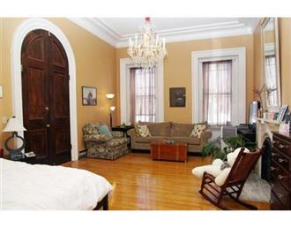
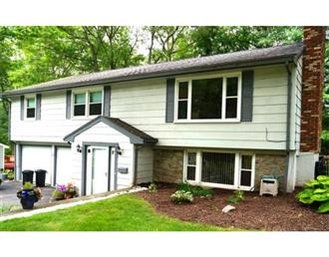
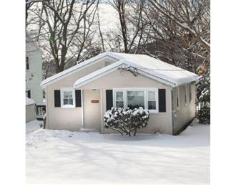
Where to find properties for sale?
MLS is Online!
www.tomandjoanneteam.com
Zillow.com
Trulia.com
Realtor.com
43 W. Newton St. Unit #1
South End, Boston
$369,000
60 Blossom St.
Waltham
$379,900
80 Angelica Dr.
Framingham
$399,900

Slide 10
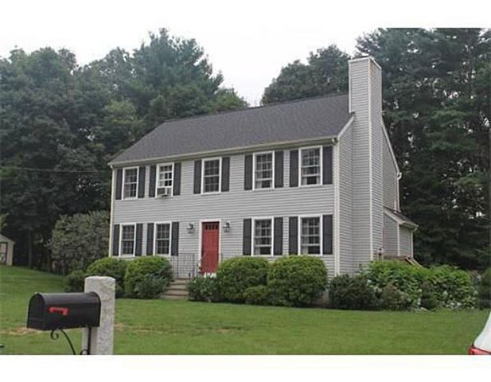

Tom & Giselle’s Home Search
Single family home for sale: $415,000
They make their offer at $385,000
Seller counter offers at $400,000
Offer accepted!

Slide 11
Home Inspections
All Massachusetts home inspectors are licensed by the state
We introduce Tom & Giselle to an inspector.
They set aside a half day for inspection.
Cost varies based upon the size and type of property.
The main objective is to assure they will be WARM, SAFE & DRY
All structural and mechanical components are reviewed.
Defects revealed during inspection may be grounds for renegotiation of the offer contract. Tom & Giselle’s inspector found several defects and they negotiated for the seller to issue a $2,000 closing cost credit.
Inspection complete!

Slide 12

Purchase and Sale
Agreement
Costs associated
Timeframe for the P&S
Bank Attorney vs. Buyers attorney
Drafting the P&S
  Parties involved
  Time necessary
  Inspection items
  Important dates
Purchase and Sales Signed- next…!?!

Slide 13
Tom and Giselle’s P&S Review
Buyers add the $2,000 closing cost credit
Sellers want to close 45 days from signing P&S with 30 days for mortgage commitment
Buyers want to work appliances into the deal
Sellers agree!
Both parties sign, next….

Slide 14
Mortgage Process
Sign Mortgage Application & send in required documents
*What documents are required?
Next, an appraisal of your new home will be ordered
*What does this cost?
Mortgage company will send the title request to the attorney
Complete loan file now sent to underwriting!

Slide 15



Your Loan is Approved!
CONGRATULATIONS!
Underwriting has approved your loan!
Now what?
Closing package is prepared
Package is sent to the attorney

Slide 16
Moving on to Closing…
What happens now
  Walk through?
How much do I owe
  Escrow, closing costs (title insurance), down payment?
What do I bring?
Who goes to closing?
Where are my keys!?!

Slide 17
Tom and Giselle’s Closing
The couple complete a final “walk through” and the property is in acceptable condition
They go to the bank and get a certified bank check for $24,500
They sign closing documents and get their keys
CLOSED
BUT THERE IS STILL ONE THING LEFT TO DO….

Slide 18
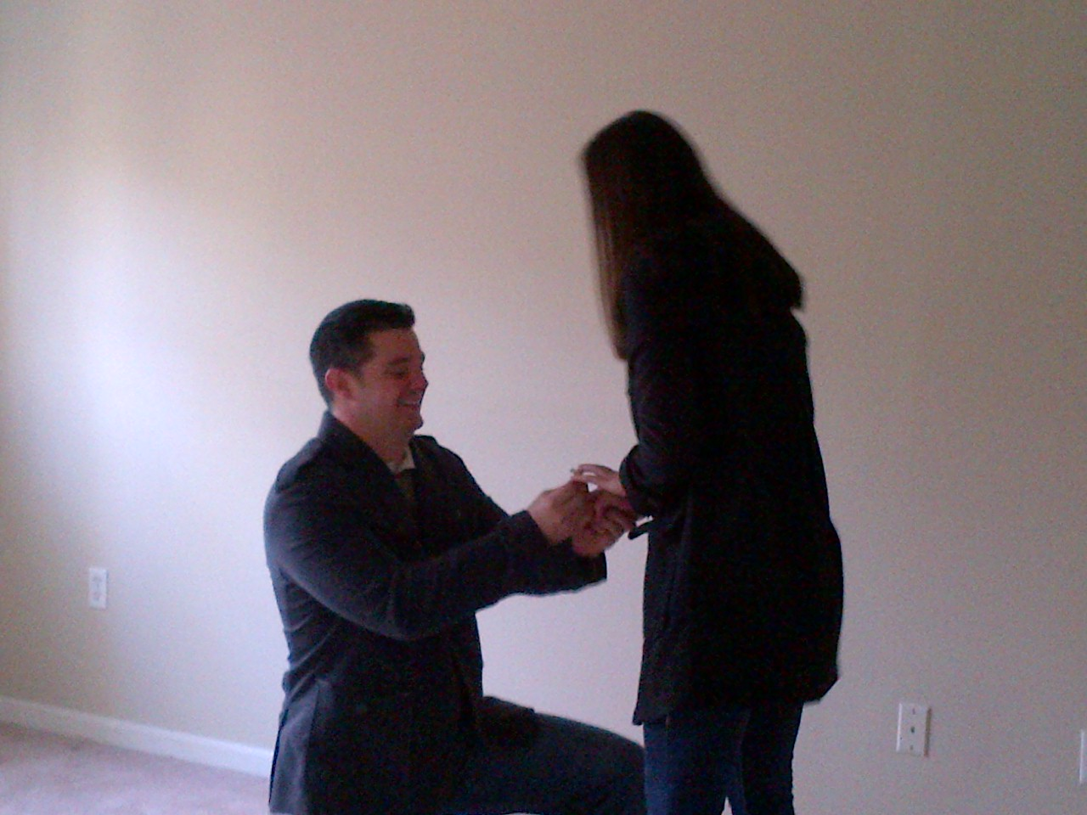
And they lived happily ever after….

