Slide 1
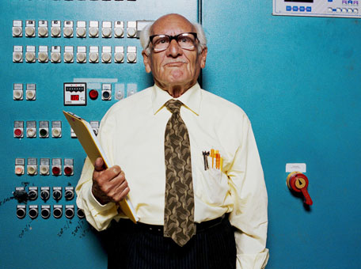
BOSTON COLLEGE WORLD-WIDE WEBINARS:
What’s Your Encore?:
Crafting a Rewarding and Engaged Second Half of Life
Christina Matz-Costa, MSW ‘03, PhD ‘11
Assistant Professor, School of Social Work
Boston College Alumni Education Webinar Series
October 14, 2015

Slide 2
What’s in store?
Introduction of “Encore”
Staying engaged in midlife and beyond
The Encore movement
Selected research findings from the Center on Aging & Work at Boston College
Stories of those who have gone through their Encore journey

Slide 3
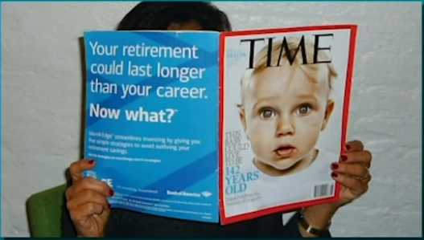
The Era of Longevity
Notes:
Time: february 2015
Baby who is living now who is likely to live to be age 142…now maybe A recent article in TIME magazine claims that babies born today may have a life expectancy of 142 years (Pekkanen, 2015). Although highly sensationalized, this article draws public attention to the very real dilemmas we are facing as a society as we grapple with a new era of longevity.

Slide 4
US Life Expectancies at Birth, At Age 65 and At Age 75
Source: http://www.cdc.gov/nchs/data/hus/2011/022.pdf

Slide 5
Paradigm shift needed?
Increased longevity = additional years of chronic disease, disability, and reduced quality of life, as well as greater costs to society
Notes:
On one hand, the traditional paradigm of aging suggests that increased longevity will inevitably lead to disengagement and increasing morbidity. It argues that while improvements in longevity might be successful in extending years of life, it would also lead to additional years of chronic disease, disability, and reduced quality of life, as well as greater costs to society (Gruenberg, 1977).

Slide 6
What is Your Retirement
Destination?
Notes:
In fact, persistent negative ideas about the “retirement” years the types of activities that older adults should or shouldn’t get involved in still exist and …. …here is crossword puzzle clue that my colleague and co-author found recently in a major newspaper…The clue is “retirement destination” and the answer is “BED”…

Slide 7
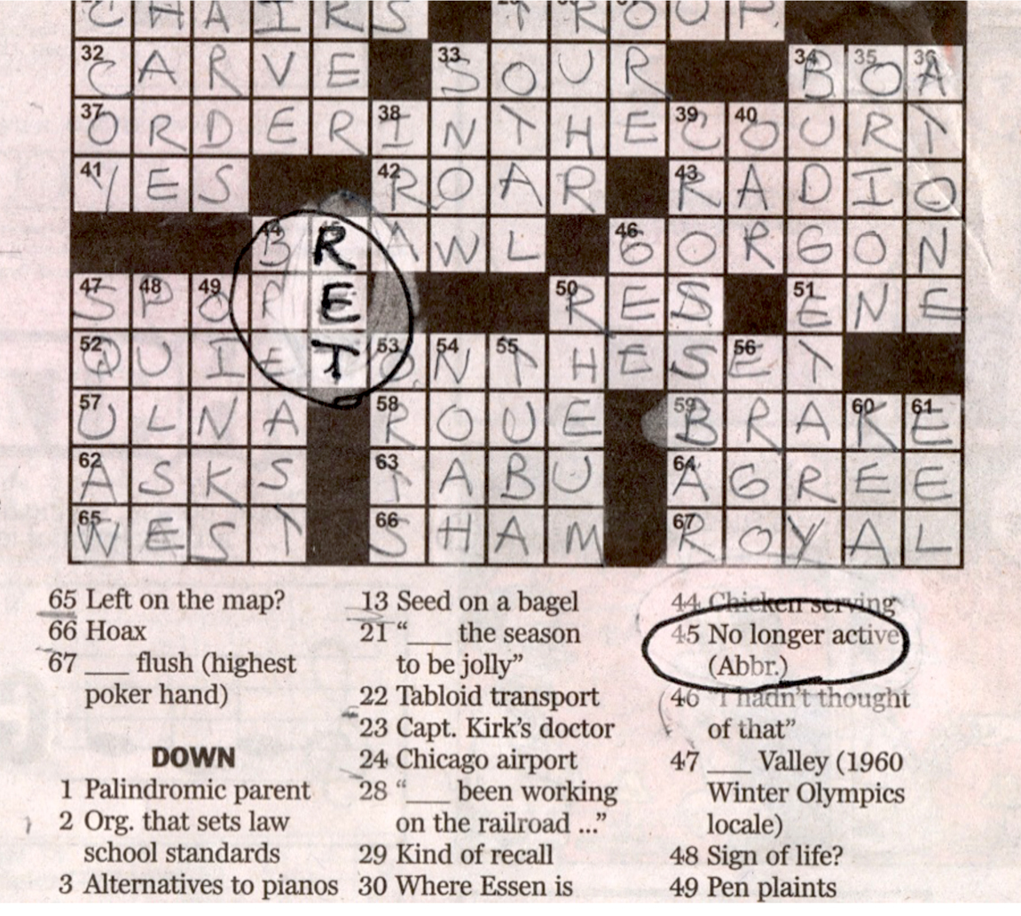
Later life as “rolelessness”?

Slide 8
What if…?
…we saw aging as an opportunity rather than a challenge?
…we recognized and celebrated the powerful source of talent, skills, experience and wisdom represented by those in middle and later life?
…we embraced the unique
opportunity presented by increased
longevity to tackle some of
society’s most urgent challenges?

Slide 9
Paradigm shift needed?
New, more positive—and arguably more actionable—paradigms: Lifestyle improvements can delay the onset of disease and disability and increase quality of life in this era of longevity, to the benefit of individuals, communities, organizations, and society.
Notes:
On the other hand, many new, more positive—and arguably more actionable—paradigms have emerged that are based upon postponing functional and cognitive decline and compressing morbidity into a shorter period later in life. These frameworks suggest that lifestyle improvements could delay the onset of disability and increase quality of life (Fries, 2005). These 15, 20, or 30 “extra” years of productive life may benefit not only individuals, but also families, organizations, communities, and society at large.

Slide 10
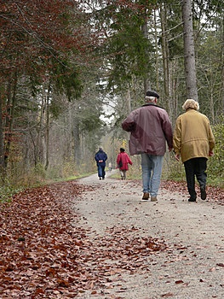
Entering New Territory
“All of us are now in uncharted territory, a stage of life not seen before in human history. And whether woman or man, whether working-class or professional, we are all wondering how we’ll live, what we’ll do, who we’ll be for the next twenty or thirty years.”
Lillian Rubin, Sixty on Up: The Truth about Aging in America, p. 54
Notes:
I really like the way she phrases this because it implies a couple things… 1) that there is no road map for this new and emerging stage of life…there are no age-related norms or structured patterns to guide activity, unlike other stages in life… and 2) it implies that that what we “do” is intimately tied to our perceptions of “who we are”…and we know that is important for health and well-being in later life.
For the first time in history, many of us have an extra 20 or 30 “bonus” years of active, healthy life, after having developed extensive skills, knowledge and life experience.

Slide 11
Continued Engagement with Life
“Healthy aging”, “successful aging” describe optimal aging—a process of aging where we are in good health and have good quality of life.
In all of these paradigms, “continued engagement with life” is a key component.
Under what conditions does engagement contribute positively or negatively to a holistic picture of healthy aging in the 21st century that seeks to ensure that increased life spans are met with increased health spans?
Notes:
Indeed, the theoretical frameworks of “healthy aging”, “successful aging”, and “active aging” describe optimal aging—a process of aging where we are in good health and have good quality of life. In all of these paradigms, “continued engagement with life” is a key component. But what constitutes “engagement”? How will older adults want or need to spend these extra years? Under what conditions does engagement contribute positively or negatively to a holistic picture of healthy aging in the 21st century that seeks to ensure that increased life spans are met with increased health spans?
How’s that for an opportunity??

Slide 12
What if… we designed policies and programs for midlife and older adults that build on purposeful living and quality ties to others rather than on decline and the increasing need for monitoring and care?
Engage
Connect
Enrich
Quality of engagement matters just as much or more than the participation itself.
We connect through relationships, but also through place and purpose.
Broadening the possibilities for accomplishment and contribution in later life is critical.

Slide 13
The Impact Could Be Profound
Slow age-related functional and cognitive decline, prevent social isolation, depression, societal exclusion.
Prevent dependence on families, communities, and society at large.
Promote the economic and social health of families, communities, organizations and society.
Promote quality of life, health, well-being, and meaning/purpose; mitigate impact of age-related role loss.

Slide 14
The Encore movement
As the “encore” movement gains momentum (e.g., encore.org), millions of people in the second half of life are wanting to apply their skills and experience to make a difference for others (whether paid or unpaid).
Defining this new stage of life and work.
Creating new pathways and to transform existing institutions in ways that will help millions make the transition from “what’s last” to “what’s next?”
Some are able to do so as unpaid volunteers or in roles in their communities or families. But for many, encore work can bring a new source of continued income.
Notes:
About people pursuing a whole new act of life…a second stage…a third stage.
Offers a new model combining elements of work, service, and social impact – an “encore” or “encore career.”
An encore career is work in the second half of life that combines continued income, greater personal meaning, and social impact. These jobs are paid positions often in public interest fields, such as education, the environment, health, the government sector, social services, and other nonprofits. Encore Fellowships, created in 2009 by the nonprofitEncore.org, are designed to transition highly experienced professionals from the corporate sector into encore careers in the social sector.
The phrase "encore career" was first made popular by Marc Freedman, the founder and CEO of Encore.org in his book Encore: Finding Work That Matters in the Second Half of Life.^{[1]}
Al Gore as a "poster child, the model for what Marc Freedman calls the 'encore career.' The head of Civic Ventures [now known as Encore.org], a think tank promoting civic engagement as the second act for boomers, Freedman says, 'Gore found himself by losing himself - literally losing - and being liberated from ambition, the idea that there's a particular ladder you have to scurry up and if you don't make it to the top it's all over. Essentially he found a different ladder.'" ^{[3]}

Slide 15
In 2009, we started the Engaged as We Age (EAWA) initiative at the Center on Aging and Work at Boston College
Question the “busy ethic” of retirement
The research projects of the EAWA initiative expand on the Center’s understanding of “work” to include both paid and unpaid forms, such as volunteering, caregiving, and informal helping.
Notes:
Observations around the “busy ethic” of retirement that we observed as an undercurrent in much of the popular press, but also in the academic literature…the idea that staying busy in and of itself was good for health and well-being in later life.

Slide 16
Overarching Question:
What is the impact of continued engagement in work, in volunteer activities, in informal helping, and in caregiving for family members and friends on health and well-being in midlife and beyond?
Notes:
I’m going to report on the findings of some of these projects today and tell you about what we have learned so far.

Slide 17
2009
Brought researchers, policy-makers, and employers together
2010
Focus groups
The Life & Times in an Aging Society Survey of over 800 individuals
2011-2012
Developed new strategies for the measurement of engagement
2013-present
Testing our conceptual model- The EngAGE Study
Developing and testing an ecological momentary intervention- The Engaged4Life Study
Notes:
2009: Brought researchers, policy-makers, and employers together to discuss the barriers and facilitators of later life engagement in these roles.
2010: Focus groups; tive activities; 2) The Life & Times in an Aging Society Study- a survey of over 800 individuals, the majority of whom were over the age of 50.
Phase III (2011-2012): The development of new strategies for the measurement of engagement, which we differentiate from “involvement,” and understand to refer to the psychological significance of an activity or role.
Phase IV (2013-present): Testing our conceptual model- The EngAGE Study, an Ecological Momentary Assessment (EMA) study funded by the Hartford Foundation aimed at gaining a better understanding of the lived experience of productive activity in later life
Developing and testing an ecological momentary intervention, funding by a pilot grant through the NIA-funded Boston Roybal Center for Active Lifestyle Interventions.
I’m going to report on the findings of some of these projects today and tell you about what we have learned so far.
A fuller, more holistic picture of the interactions between aging, work-both paid and unpaid- and health and well-being.

Slide 18
What is Quality Engagement?
Highly Engaged
Highly Quality
Engagement
Think about the experience of being highly engaged in something that you’re doing.
Think about the experience of being “somewhat” engaged.
Think about the experience of being largely unengaged.
Inspired, energized, lose track of time, enthusiastic, focused, absorbed
Bored, time passes slowly, uninterested, distracted, detached, tired
Low Quality
Engagement
Not So Engaged
Notes:
Okay, now I am going to shift gears….I want each of you to think about a time when you were really engaged in an activity you were participating in- whether it be work, a class, a volunteer activity, or a leisure activity…are you imagining something? What was this experience like? Can you describe how you felt? What was it about the experience that was so engaging?
Okay, now I want you to think about a time when you were largely unengaged…again, this could be at work or while volunteering or caregiving or at a class…what was this experience like? Can you describe how you felt? What was it about the experience that was not engaging?
Okay, now I am going to hand out three transparent pieces of paper to each of you…which is the “best fitting”? No, you’ll see in the top left hand corner of the box on the transparencies that this indicates high, medium or low engagement…Do you think that the “best fitting” transparency accurately describes your general level of engagement at your field placement?

Slide 19
Quality Engagement:
A positive, enthusiastic, and affective connection with a role that both motivates individuals to invest their valuable resources and simultaneously energizes them.
Characterized by:
Energy-- a high degree of investment of personal energies (physical, cognitive, or emotional)
Focus-- being highly focused on the role activities
Interest-- being genuinely enthusiastic and interested in the role
Not so Engaged

Slide 20
Is it Quantity, Quality or Nature that Matters?
Findings for Paid Work and Volunteering
- High quality engagement was associated with the most positive well-being outcomes.
- Those who experienced low/moderate engagement quality had lower psychological well-being than those not involved in the role at all.
Quality Matters!

Slide 21
Is it Quantity, Quality or Nature that Matters?
Findings for Caregiving
- Moderate engagement quality was associated with the most positive well-being outcomes.
- Those who were low/high in engagement quality had lower psychological well-being than those not involved in the role at all.
Quality and Nature of Role Matters!

Slide 22
Model of Engagement in Paid and Unpaid Work in Later Life
Structural factors:
- Age discrimination
- Lack of opportunities
- Lack of access to opportunities
Individual Health & Well-Being
Engagement Portfolio
Physical Activity
Quantity
Organizational Benefits
Cognitive Activity
Quality
Social Interaction
Nature
Family Benefits
Individual characteristics:
- Health status
- Social networks/ capital
- Demographics
- Spirituality
- Personality
Competing/Complementary Roles
Emotional Exchange
Community/ Societal Benefits
Notes:
Slide 22 & 23 are hard to understand and my mind will follow better if they are simpler. When I have to connect concluding thoughts back & forth I get lost in thought, a bit overwhelmed and do not listen.
Slide 26 - there is is some great information and action steps the listener can take, The link for Discovering whats next is http://www.escne.org/discovering-whats-next/
Slide 26 again less words on the total slide or build with each point. I definitely would add:
Encore Expo 2016 Nov 18 at Boston College
visit encore,org for inspiration and available resources.
Google Encore for events and resources in your community
Lastly it was helpful for me to hear your research as I hone my part. It made me feel a heck of lot better about sharing my story. Now I have a better idea how to transition back to you too.

Slide 23
Quality Engagement: What makes for an engaging encore opportunity?
Task identity and significance
Task autonomy
Task and skill variety
Feedback
Social support
Opportunities for continued learning and growth
Notes:
Task identity and significance. Sets of tasks should be separated from other sets of tasks by some clear boundary. They should be clearly defined, visible, and meaningful.
Task autonomy. Employees should be able to exercise some control over their work. Areas of discretion and decision making should be available.
Task and skill variety. An attempt must be made to provide an optimal variety of tasks within each job and the opportunity should draw on a number of skill levels.
Feedback. There should be some means for informing employees quickly when they have achieved their targets.
Social support. There should be opportunities to develop constructive relationships.
Opportunities for continued learning and growth.

Slide 24
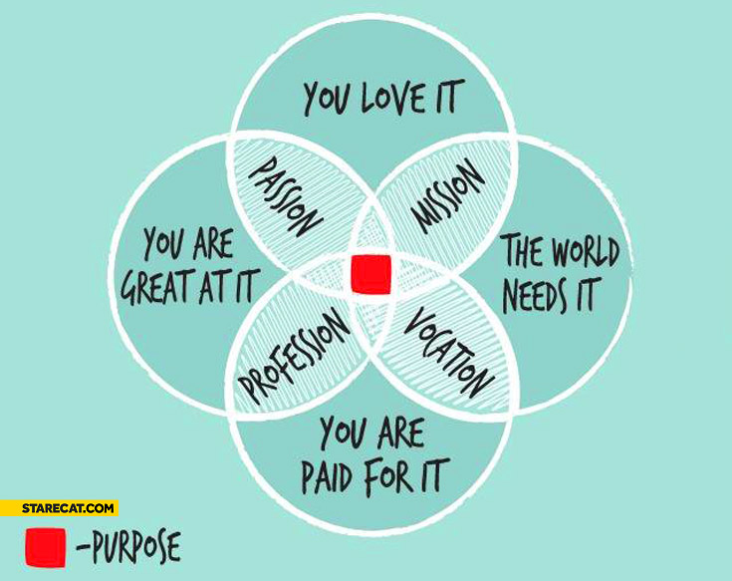
Embarking Upon an Encore is a Journey
Some examples
starting a non-profit or your own business in later life
leaving a long-time job to work in a new field that is of interest to you
volunteer work/unpaid work/care work?
stipended opportunities?
Notes:
Tap into or rediscover those interests or activities in your life that you find most meaningful, and find a way to pursue them
Just get out there and try something- may not be a linear path and you may not know where the path will lead yet

Slide 25
Alison Berglund Encore Innovation Fellow at Encore Boston Network

Slide 26
Action steps: Some recommendations for getting started!
Plan for the psychological and social aspects of retirement
Develop a strategic plan with a mission, vision and goals for your life
Job-craft
Develop your skills across the life course, become a lifelong learner, actively seek-out training and learning opportunities
Notes:
http://www.escne.org/discovering-whats-next/
Slide 26 again less words on the total slide or build with each point. I definitely would add:
Encore Expo 2016 Nov 18 at Boston College
visit encore,org for inspiration and available resources.
Google Encore for events and resources in your community
Plan for the psychological and social aspects of retirement by thinking ahead about the transition to retirement, the development of identity, finding meaningful activities, options for generativity, etc., with the same vigor dedicated to planning financially for retirement (e.g., AARP’s Life Reimagined, http://www.lifereimagined.aarp.org).
Develop a strategic plan with a mission, vision and goals for your life. Identify strengths and interests, building on those to build a strong activity portfolio. Reach out to local organizations that can help you to achieve these goals and leverage existing resources.
“Job-craft”-- advocate for yourself in the workplace, identify and follow your strengths, network.
Develop your skills across the life course, become a lifelong learner, actively seek-out training and learning opportunities
Tap into or rediscover those interests or activities in your life that you find most meaningful—that inspire you—that “light you up” and find a way to pursue them. There is an example of a car mechanic who learned to play blues guitar just prior to selling his shop to retire. He is now doing “gigs” all over New Orleans and has found a new lease on life.

Slide 27
National and Local Encore Resources
Resources from Encore.org
Upcoming Event
Encore Expo 2016
Nov 18, noon-6pm at Boston College, Corcoran Commons, free to the public!
Sponsored by the Boston College Institute on Aging, Hartford Center of Excellence in Geriatric Social Work, and AARP MA, among others.
Give your time and/or your skills
Ignatian Volunteer Corps (IVC)
Find transition support
AARP Life Reimagined
Discovering What's Next
Explore social sector jobs
Seniors Helping Seniors
Books and Readings
Notes:
Visit encore.org for inspiration and available resources.
Google Encore for events and resources in your community
Ignatian Volunteer Corps (IVC) provides men and women, most age 50 or better, opportunities to serve others and to transform lives. IVC matches the talents of experienced Volunteers with the greatest social needs of our time. IVC has a unique spiritual reflection program, which is rooted in the Jesuit tradition of Ignatian spirituality.
We're holding our first annual ENCORE EXPO on Wednesday November 18th. FREE TO THE PUBLIC! We will connect community organizations with 200+ individuals who are looking for paid or volunteer opportunities to give back. The expo will include a dynamic keynote speaker, David Campbell, founder of All Hands Volunteers, exhibitors, workshops, and networking opportunities. We are grateful to our lead sponsors Boston College Institute on Aging, Hartford Center of Excellence in Geriatric Social Work, and AARP MA for making this event possible.

Slide 28
Conclusion
Notes:
In conclusion…It is essential that we work toward mitigating barriers that may be serving to foreclose opportunities for positive role involvement in later life. And instead continually work to understand factors that open up doors to opportunity and increased choice…
Research that takes a more holistic, nuanced approach to the impact of activity involvement in later life can help us to refine and extend our understanding of an “encore” to value multiple forms and levels of giving back, not only in later life but across the lifespan

Slide 29
Resources: Research
Visit the Engaged as We Age page on the Center’s website :
http://www.bc.edu/research/agingandwork
Click on the “Research” tab
Journal articles
Matz-Costa, C., Carr, D., McNamara, T., & James, J.B. (in press). Mechanisms underlying the health-promoting effects of productive activity in later life: Physical, cognitive, and social. Research on Aging.
Gonzales, E., Matz-Costa, C., & Morrow-Howell, N. (2015). Increasing opportunities for the productive engagement of older adults: A response to population aging. The Gerontologist, 55(2), 252-261.
Matz-Costa, C., Besen, E., James, J., & Pitt-Catsouphes, M. (2014). Differential impact of multiple levels of productive activity engagement on psychological well-being in middle and later life. The Gerontologist.
Matz-Costa, C.; James, J.B.; Ludlow, L.; Brown, M.; Besen, E.; & Johnson, C. (2014). The meaning and measurement of productive engagement in later life. Social Indicators Research.
Ludlow, L., Matz-Costa, C.; Johnson, C.; Brown, M.; Besen, E.; & James, J.B. (2014). Measuring engagement in later life activities: Rasch-based scenario scales for work, caregiving, informal helping, and volunteering. Measurement and Evaluation in Counseling and Development.

Slide 30
Q & A?
Thank you!
Christina Matz-Costa, MSW ‘03, PhD ‘11
Assistant Professor, School of Social Work
matzch@bc.edu
Notes:
We are living longer…the third age has emerged…we are all wondering who we will be for the next 20 or 30 years…

